Slide 1
Introducing Oscilloscope
By Team

Slide 2

Secure Communication
A secure connection is cryptographically protected against attackers trying to read or manipulate the transferred data.

Slide 3


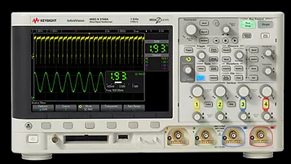
Keysight Secure Instrument Communication system consists of three main elements:
Test Station
Instrument
SIC Expert

