Slide 1
test 1
By Team

Slide 2

test 2
A secure connection is cryptographically protected against attackers trying to read or manipulate the transferred data.

Slide 3


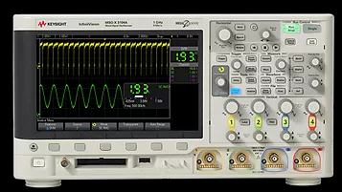
test 3:
Test Station
Instrument
SIC Expert

