Slide 1
ARCHITECTURE_TEMPELATE_1
BY TEAM

Slide 2
SLIDE1

Slide 4

SECURE COMMUNICATION
A secure connection is cryptographically protected against attackers trying to read or manipulate the transferred data.

Slide 5


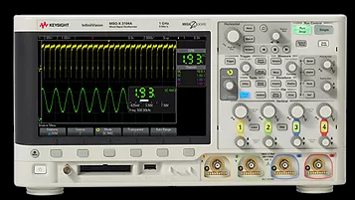
KEYSIGHT SECURE INSTRUMENT COMMUNICATION SYSTEM CONSISTS OF THREE MAIN ELEMENTS:
Test Station
Instrument
SIC Expert

