Slide 1
test 1 shubham
By Team

Slide 2

test 2 shubham
A secure connection is cryptographically protected against attackers trying to read or manipulate the transferred data.

Slide 3


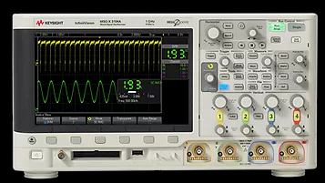
test 3 shubham:
Test Station
Instrument
SIC Expert

