Slide 1
template 1
By Team

Slide 2

template 2
A secure connection is cryptographically protected against attackers trying to read or manipulate the transferred data.

Slide 3


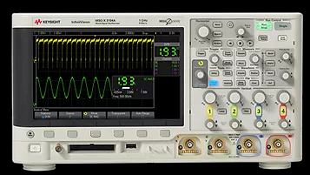
template 3:
Test Station
Instrument
SIC Expert

