Slide 1


Project presentation: Fake news detection
By,
Tarun Munjal
Sanket Tilotkar
Aman Raj
Shubham Pahuja

Slide 2
Contents
Introduction: What is Fake News?
Motivation behind the task at hand
About the Problem Statement
Milestones
Related Work

Slide 3
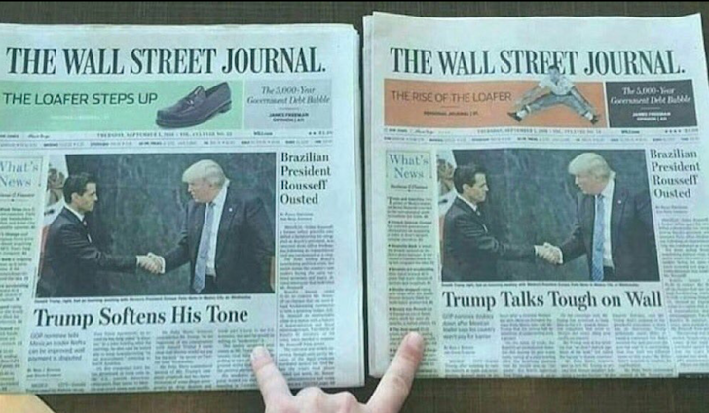

What is Fake News?
Fake news is news, stories or hoaxes created to deliberately misinform or deceive readers.
On social networks, the reach and effects of information spread occur at such a fast pace and so amplified that distorted, inaccurate or false information acquires a tremendous potential to cause real world impacts, within minutes, for millions of users.
People unaware of the consequences of fake news is another difficult problem to tackle.

Slide 4
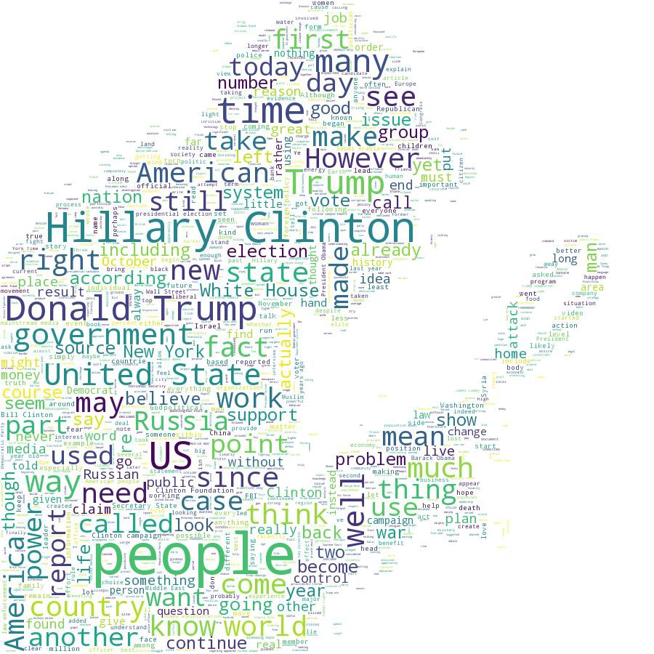
Motivation
Social media and the internet is suffering from fake accounts, fake posts, and fake news. The intention is often to mislead readers and/or manipulate them into purchasing or believing something that isn’t real.
The motivation behind this task is to allow people to take unbiased decisions based on the news they see by ensuring the relativity is pretty high.
The main motivation in a general sense would however be to make sure that devastating fake news is not propagated to ensure global well being.

Slide 5
Problem Statement
The goal of the Fake News Detection is to explore how artificial intelligence technologies, particularly natural language processing along with information security, might be leveraged to combat the fake news problem.
We believe that these AI technologies hold promise for significantly automating parts of the procedure human fact checkers use today to determine if a story is real or a hoax.
To put it in simple words, we need to automatize the task of establishing an authenticity between the news heading and news body and detect if the information provided in the news is authentic or not.
It is thus a classical Classification problem with it’s own set of classical challenges in information security.
After the successful implementation of this problem, we will modify the model for indian languages.

Slide 6
Milestones
Explore the news data and preprocess the data
Explore and analyse existing techniques
Identify suitable approaches for detecting fake news and secure authenticity of information
Implement the model for English language
Modify the model for Indian languages

Slide 7
Related Work
“Predicting information credibility in time-sensitive social media” applied the time sensitive supervised approach by relying on the tweet content to address the credibility of a tweet in different situations using LSTM.
“Convolutional neural networks for stance detection and rumor veriﬁcation” aimed at detecting the stance of tweets and determining the veracity of the given rumor with convolution neural networks.
“Any-target stance detection on twitter with autoencoders” focuses on creating a bag-of-words auto encoder, and training it over the tokenized tweets.
“Stance detection for the fake news challenge with attention and conditional encoding” experimented on four basic models on which the ﬁnal result was evaluated: Bag Of Words (BOW), basic LSTM, LSTM with attention and conditional encoding LSTM using recurrent models for fake news stance detection.

Slide 8
Related Work
“Team athene on the fake news challenge” concatenated various features vectors and passed it through an MLP model.
“A simple but tough-to-beat baseline for the fake news challenge stance detection task”, focuses on generating lexical and similarity features using (TF-IDF) representations of bag-of-words (BOW) which are then fed through a multi-layer perceptron (MLP) with one hidden layer.
“Stance detection for the fake news challenge: Identifying textual relationships with deep neural nets” divided the problem into two groups: unrelated and related. They were able to achieve 90% in detection fake information.
“Fake news headline classiﬁcation using neural networks with attention” focuses on the use of recurrent models for fake news stance detection.

Slide 9
Thank You !!

