Slide 1
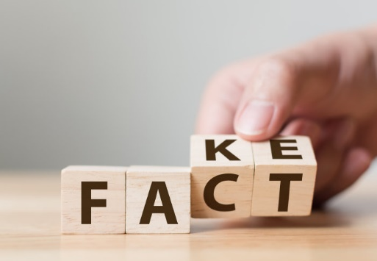

Project presentation: Fake news detection
By,
Tarun Munjal
Sanket Tilotkar
Aman Raj
Shubham Pahuja

Slide 2
Contents
Milestones
Problem Statement
Formal Definition and Dataset Details
Model Structure and Hyperparameters
Observations
Result Analysis
Comparative Analysis

Slide 3
Milestones
Explore the news data and preprocess the data
Explore and analyse existing techniques
Identify suitable approaches for detecting fake news
Implement the model for English language
Modify the model for Indian(Hindi) language

Slide 4

Problem Statement
The goal of the Fake News Challenge is to explore how artificial intelligence technologies, particularly machine learning and natural language processing, might be leveraged to combat the fake news problem.
We believe that these AI technologies hold promise for significantly automating parts of the procedure human fact checkers use today to determine if a story is real or a hoax.
To put it in simple words, we need to automatize the task of establishing an authenticity between the news heading and news body as a measure to the relative similarity between them.
It is thus a classical Classification problem with it’s own set of classical challenges.

Slide 5
Formal Definition
Input
A headline and a body text - either from the same news article or from two different articles.
Output
Classify the stance of the body text relative to the claim made in the headline into one of four categories:
1. Agrees: The body text agrees with the headline.
2. Disagrees: The body text disagrees with the headline.
3. Discusses: The body text discuss the same topic as the headline, but does not take a position
4. Unrelated: The body text discusses a different topic than the headline

Slide 6
Dataset Details
TRAINING SET
[HEADLINE, BODY TEXT, LABEL]
Pairs of headline and body text with the appropriate class label for each.
TESTING SET
[HEADLINE, BODY TEXT]
Pairs of headline and body text without class labels used to evaluate systems.
DETAILS
Data: The dataset and a brief description of the data is provided at the FNC-1 github.
Source: The data is derived from the Emergent Dataset created by Craig Silverman.

Slide 7
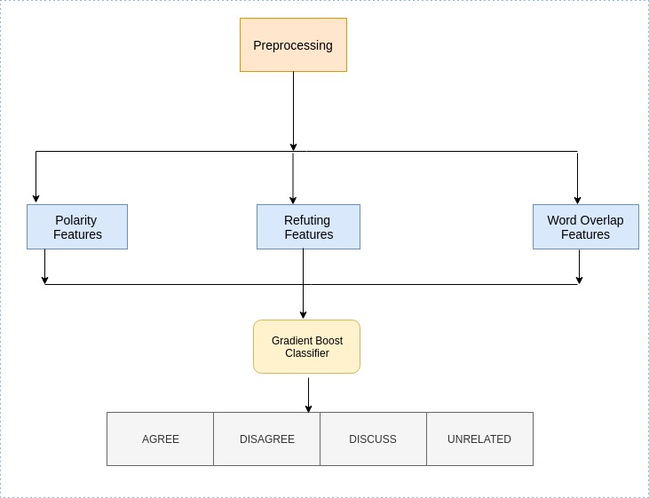
Model Architecture
(1) Baseline Architecture

Slide 8
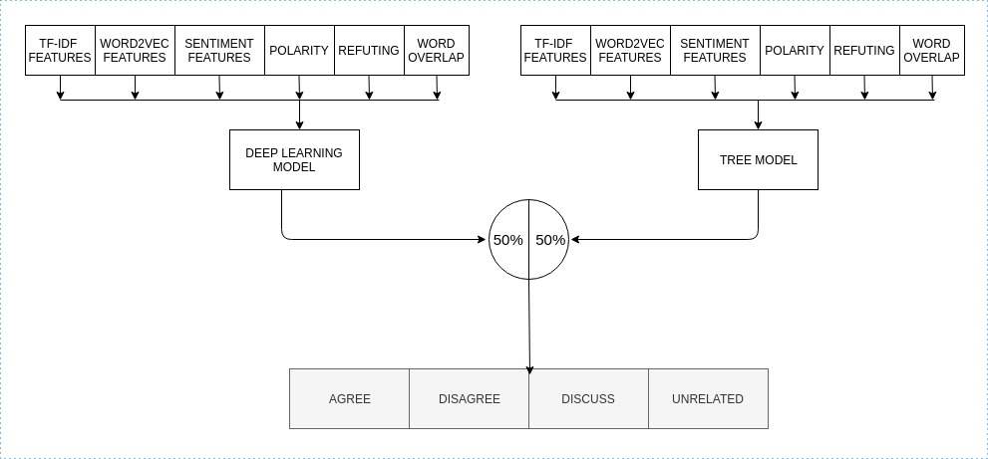
(2) Proposed Architecture : It is a combined model of tree-based model and deep learning model giving equal weightage to both.

Slide 9
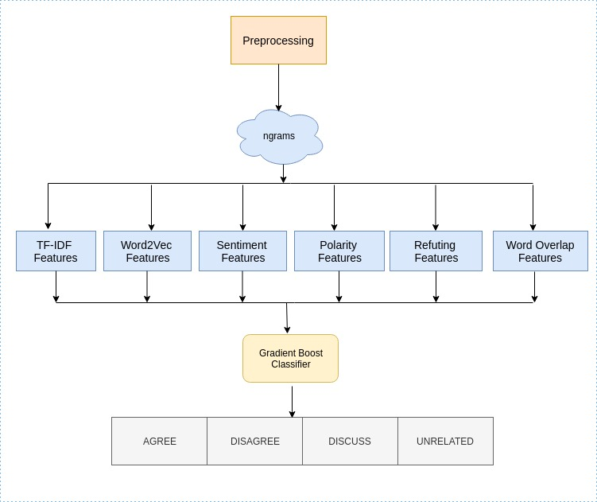
(2.a) Tree Based Model

Slide 10
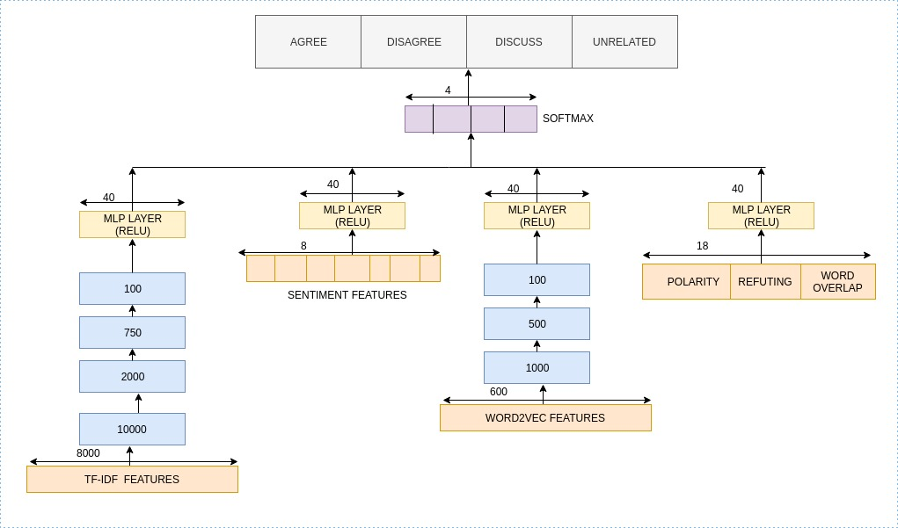
(2.b) Deep Learning Model

Slide 11
Hyperparameters
Hyperparameters | TF-IDF vectors | Sentiment Features | Word2Vec Features | Baseline Features
MLP Layers | 6 | 2 | 6 | 2
MLP Neurons | [8000, 10000, 2000, 750, 100, 40] | [8, 40] | [600, 1000, 500, 500, 100, 40] | [18, 40]
Dropout | [0.5, 0.5, 0.25, -, -, -] | [-,-] | [0.25, 0.125, 0.1, 0.1, -] | [-,-]
Activation | Re-Lu | Re-Lu | Re-Lu | Re-Lu
MLP Layers | 1
MLP Neurons | 4
Activation | Softmax
Optimizer | Adam
Learning Rate | 0.001
Batch Size | 32
Loss | Categorical Cross-Entropy

Slide 12
Observations
(1) For Tree Based Model
 | Agree | Disagree | Discuss | Unrelated | Overall
Agree | 1057 | 11 | 639 | 196 | 1903
Disagree | 261 | 20 | 237 | 179 | 697
Discuss | 1019 | 15 | 2969 | 504 | 4464
Unrelated | 84 | 3 | 292 | 17979 | 18349
Overall | 2421 | 49 | 4094 | 18849 | 25413
Accuracy: 86.46% (Test), 93.99% (Validation)
FNC Score: 77.59 (Test), 90.28 (validation)

Slide 13
Observations(2)
(2) For Baseline Model
 | Agree | Disagree | Discuss | Unrelated | Overall
Agree | 86 | 3 | 1535 | 279 | 1903
Disagree | 18 | 4 | 430 | 245 | 697
Discuss | 136 | 17 | 3708 | 603 | 4464
Unrelated | 9 | 1 | 567 | 17772 | 18349
Overall | 249 | 25 | 6240 | 18899 | 25413
Accuracy: 80.26% (Test), 83.19% (Validation)
FNC Score: 75.320 (Test), 78.799 (validation)

Slide 14
Observation(3)
(3) For Deep Learning Model
 | Agree | Disagree | Discuss | Unrelated | Overall
Agree | 799 | 6 | 816 | 282 | 1903
Disagree | 130 | 2 | 317 | 248 | 697
Discuss | 615 | 2 | 3241 | 606 | 4464
Unrelated | 60 | 0 | 328 | 17961 | 18349
Overall | 1604 | 10 | 4702 | 19097 | 25413
Accuracy: 86.58% (Test), 90.59% (Validation)
FNC Score: 77.277 (Test), 83.97 (validation)

Slide 15
Observation(4)
(4) For Proposed Model
 | Agree | Disagree | Discuss | Unrelated | Overall
Agree | 951 | 3 | 713 | 236 | 1903
Disagree | 190 | 9 | 276 | 222 | 697
Discuss | 731 | 4 | 3199 | 530 | 4464
Unrelated | 52 | 2 | 296 | 17999 | 18349
Overall | 1924 | 18 | 4484 | 18987 | 25413
Accuracy: 87.19% (test)
FNC Score: 78.42 (Test)
Precision: 0.86
Recall: 0.87
F1 Score: 0.85

Slide 16

Analysis of Results
Standalone Run of Tree Model and Deep Learning Model give us FNC score of 77.59 and 77.277. In contrast, when we use our proposed architecture, which is a combination of both these, we get an FNC score of 78.42. Better!
In contrast to the baseline model, the FNC score obtained is 75.320 and for our proposed model, the FNC score obtained is 78.42. Again, Better!

Slide 17
Comparative Analysis
Performance of diﬀerent models on FNC-1 Test Dataset. The ﬁrst row of the table shows the baselines, followed by the diﬀerent architectures used in our work. Column 2-5 shows the class-wise accuracy in % while the last column shows the overall accuracy
Method | Score_{FNC} | Agree | Disagree | Discuss | Unrelated | Overall
FNC-1 Baseline | 75.20 | 9.09 | 1.00 | 79.65 | 97.97 | 85.44
Tree Model | 77.59 | 55.4 | 2.8 | 66.50 | 97.98 | 86.46
Deep Learning Model | 77.277 | 41.98 | 2.8 | 13.57 | 97.88 | 86.58
Proposed Model | 78.42 | 49.9 | 1.29 | 71.66 | 98.08 | 87.19

Slide 18
Results on Small Data Set
Predicted/True | Agree | Disagree | Discuss | Unrelated | Total
Agree | 645 | 8 | 371 | 879 | 1903
Disagree | 92 | 9 | 98 | 498 | 697
Discuss | 562 | 19 | 2014 | 1869 | 4464
Unrelated | 25 | 28 | 280 | 18016 | 18349
Total | 1324 | 64 | 2763 | 21262 | 25413
Accuracy: 81.39% (Test)
FNC Score: 64.02

Slide 19
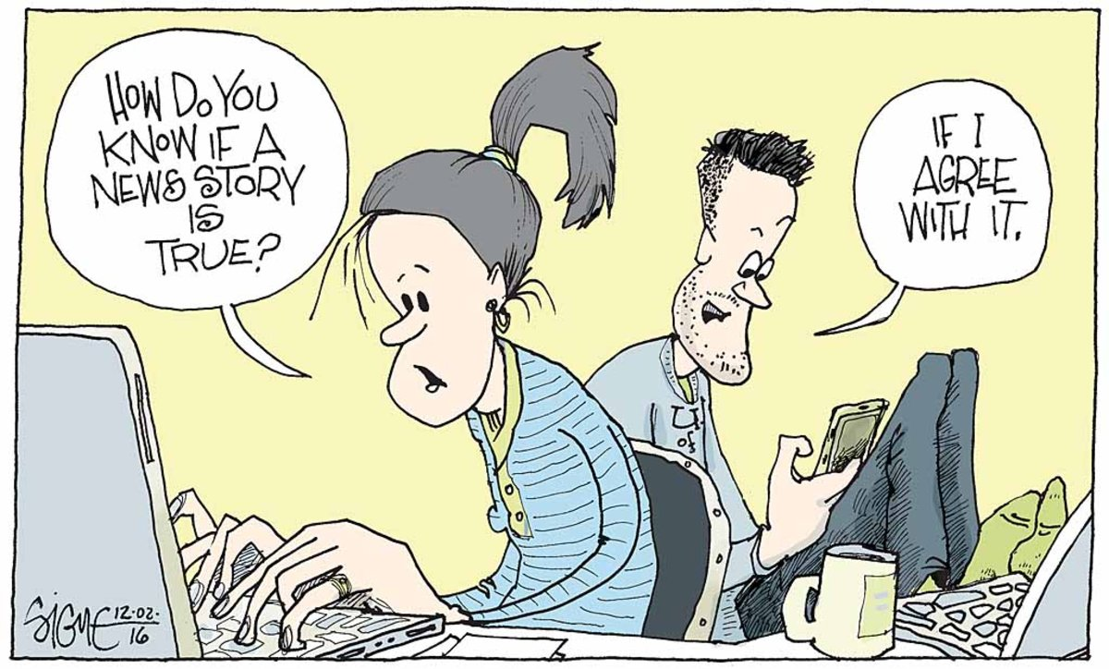

THANK YOU
(And Beware of Fake News!)

