Slide 1
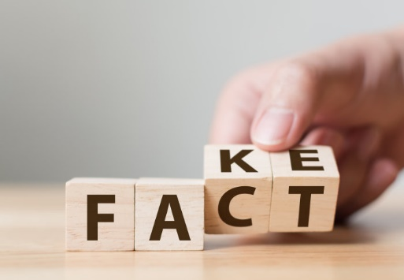

Project presentation: Fake news detection
By,
Tarun Munjal
Sanket Tilotkar
Aman Raj
Shubham Pahuja

Slide 2
Contents
Introduction: What is Fake News?
About the Problem Statement
Motivation behind the task at hand
Model Structure and Hyperparameters
Observations
Result Analysis
Comparative Analysis
Challenges
Conclusion

Slide 3
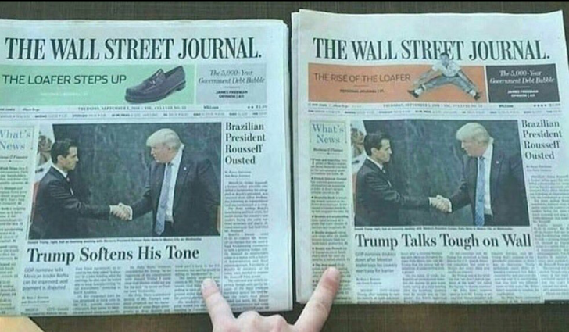
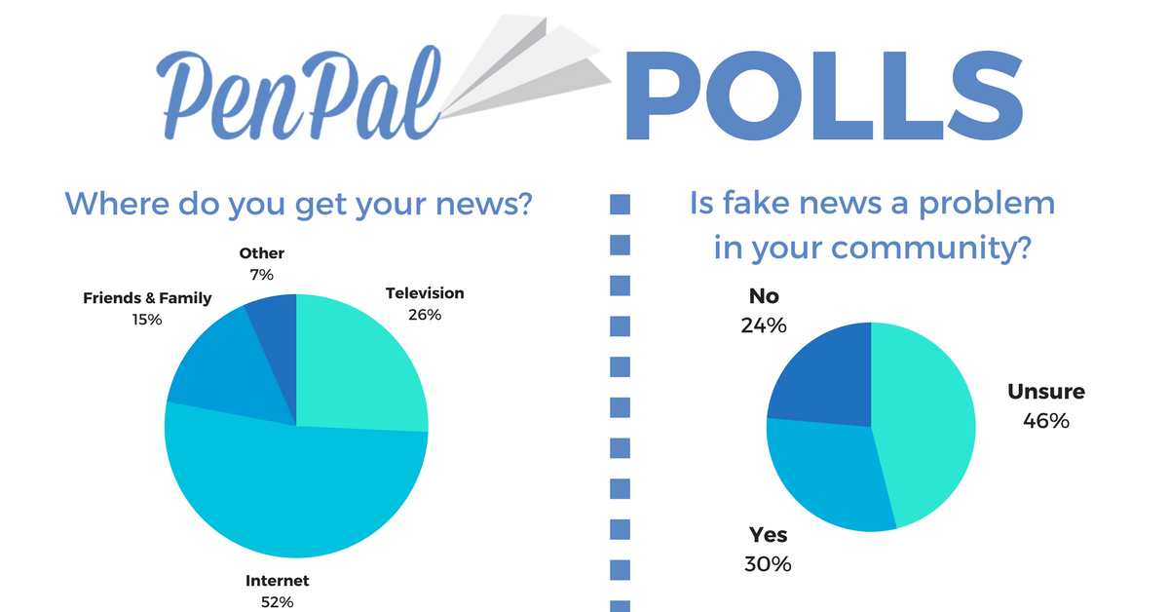
What is Fake News?
Fake news is news, stories or hoaxes created to deliberately misinform or deceive readers.
On social networks, the reach and effects of information spread occur at such a fast pace and so amplified that distorted, inaccurate or false information acquires a tremendous potential to cause real world impacts, within minutes, for millions of users.
People unaware of the consequences of fake news is another difficult problem to tackle.

Slide 4
Milestones
Explore the news data and preprocess the data
Explore and analyse existing techniques
Identify suitable approaches for detecting fake news
Implement the model for English language
Modify the model for Indian languages

Slide 5

Problem Statement
The goal of the Fake News Challenge is to explore how artificial intelligence technologies, particularly machine learning and natural language processing, might be leveraged to combat the fake news problem.
We believe that these AI technologies hold promise for significantly automating parts of the procedure human fact checkers use today to determine if a story is real or a hoax.
To put it in simple words, we need to automatize the task of establishing an authenticity between the news heading and news body as a measure to the relative similarity between them.
It is thus a classical Classification problem with it’s own set of classical challenges.

Slide 6
Formal Definition
Input
A headline and a body text - either from the same news article or from two different articles.
Output
Classify the stance of the body text relative to the claim made in the headline into one of four categories:
1. Agrees: The body text agrees with the headline.
2. Disagrees: The body text disagrees with the headline.
3. Discusses: The body text discuss the same topic as the headline, but does not take a position
4. Unrelated: The body text discusses a different topic than the headline

Slide 7
Data
TRAINING SET
[HEADLINE, BODY TEXT, LABEL]
Pairs of headline and body text with the appropriate class label for each.
TESTING SET
[HEADLINE, BODY TEXT]
Pairs of headline and body text without class labels used to evaluate systems.
DETAILS
Data: The dataset and a brief description of the data is provided at the FNC-1 github.
Source: The data is derived from the Emergent Dataset created by Craig Silverman.

Slide 8
Fnc-Score
FNC-1 dataset shows a heavy bias towards unrelated headline-body pairs. Recognizing this data bias and the simpler nature of the related/unrelated classiﬁcation problems, the organizers of FNC-1 introduced the following weighted accuracy score as their ﬁnal evaluation metric.
Score1 =Accuracy _{Related, Unrelated}
Score2 = Accuracy _{Agree, Disagree, Discuss}
ScoreFNC = 0.25∗Score₁ + 0.75∗Score₂

Slide 9
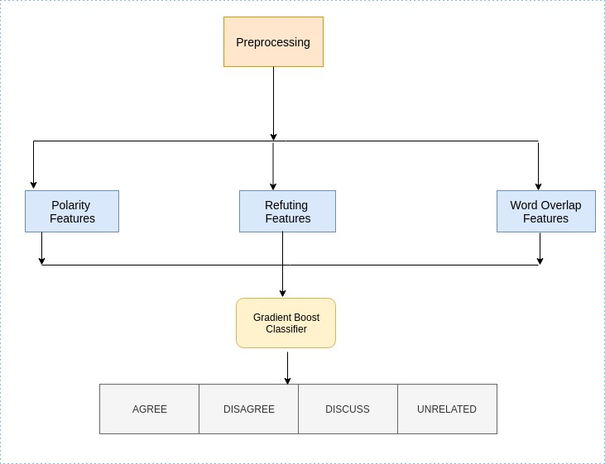
Model Architecture
(1) Baseline Architecture

Slide 10
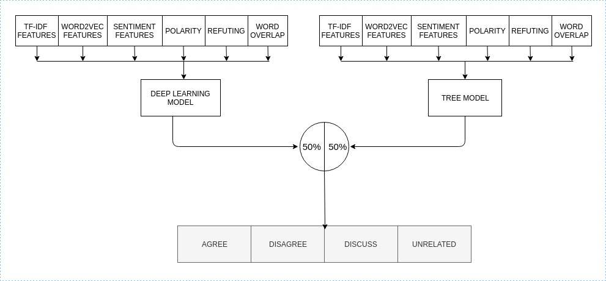
(2) Proposed Architecture : It is a combined model of tree-based model and deep learning model giving equal weightage to both.

Slide 11
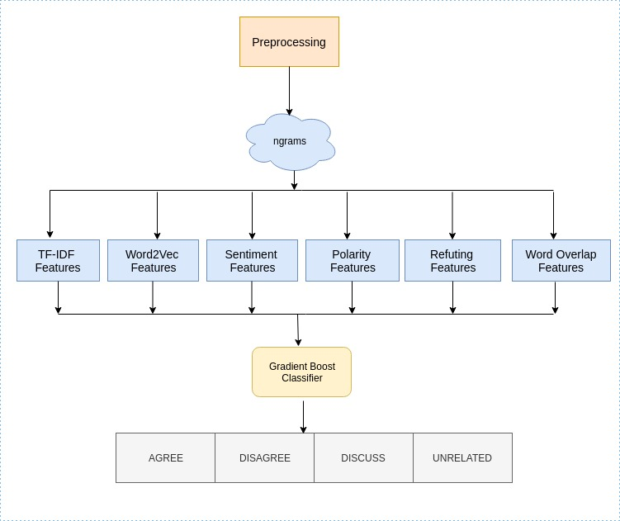
(2.a) Tree Based Model

Slide 12
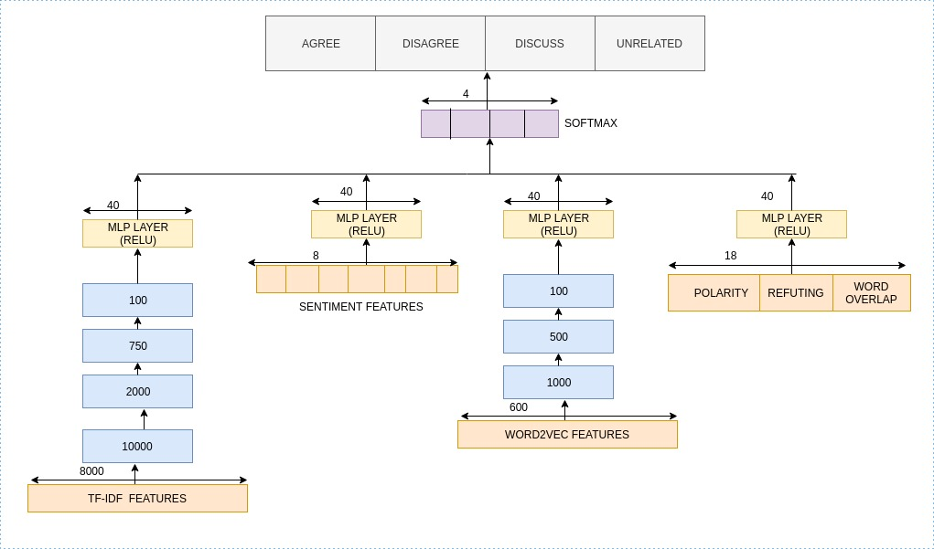
(2.b) Deep Learning Model

Slide 13
Hyperparameters
Hyperparameters | TF-IDF vectors | Sentiment Features | Word2Vec Features | Baseline Features
MLP Layers | 6 | 2 | 6 | 2
MLP Neurons | [8000, 10000, 2000, 750, 100, 40] | [8, 40] | [600, 1000, 500, 500, 100, 40] | [18, 40]
Dropout | [0.5, 0.5, 0.25, -, -, -] | [-,-] | [0.25, 0.125, 0.1, 0.1, -] | [-,-]
Activation | Re-Lu | Re-Lu | Re-Lu | Re-Lu
MLP Layers | 1
Dropout | -
Activation | Softmax
Optimizer | Adam
Learning Rate | 0.001
Batch Size | 32
Loss | Categorical Cross-Entropy

Slide 14
Observations
(1) For Tree Based Model
 | Agree | Disagree | Discuss | Unrelated | Overall
Agree | 1057 | 11 | 639 | 196 | 1903
Disagree | 261 | 20 | 237 | 179 | 697
Discuss | 1019 | 15 | 2969 | 504 | 4464
Unrelated | 84 | 3 | 292 | 17979 | 18349
Overall | 2421 | 49 | 4094 | 18849 | 25413
Accuracy: 86.46% (Test), 93.99% (Validation)
FNC Score: 77.59 (Test), 90.28 (validation)

Slide 15
Observations(2)
(2) For Baseline Model
 | Agree | Disagree | Discuss | Unrelated | Overall
Agree | 86 | 3 | 1535 | 279 | 1903
Disagree | 18 | 4 | 430 | 245 | 697
Discuss | 136 | 17 | 3708 | 603 | 4464
Unrelated | 9 | 1 | 567 | 17772 | 18349
Overall | 249 | 25 | 6240 | 18899 | 25413
Accuracy: 80.26% (Test), 83.19% (Validation)
FNC Score: 75.320 (Test), 78.799 (validation)

Slide 16
Observation(3)
(3) For Deep Learning Model
 | Agree | Disagree | Discuss | Unrelated | Overall
Agree | 799 | 6 | 816 | 282 | 1903
Disagree | 130 | 2 | 317 | 248 | 697
Discuss | 615 | 2 | 3241 | 606 | 4464
Unrelated | 60 | 0 | 328 | 17961 | 18349
Overall | 1604 | 10 | 4702 | 19097 | 25413
Accuracy: 86.58% (Test), 90.59% (Validation)
FNC Score: 77.277 (Test), 83.97 (validation)

Slide 17
Observation(4)
(4) For Proposed Model
 | Agree | Disagree | Discuss | Unrelated | Overall
Agree | 951 | 3 | 713 | 236 | 1903
Disagree | 190 | 9 | 276 | 222 | 697
Discuss | 731 | 4 | 3199 | 530 | 4464
Unrelated | 52 | 2 | 296 | 17999 | 18349
Overall | 1924 | 18 | 4484 | 18987 | 25413
Accuracy: 88.19% (test)
FNC Score: 79.82 (Test)
Precision: 0.86
Recall: 0.87
F1 Score: 0.85

Slide 18

Analysis of Results
Standalone Run of Tree Model and Deep Learning Model give us FNC score of 77.59 and 77.277. In contrast, when we use our proposed architecture, which is a combination of both these, we get an FNC score of 79.82. Better!
In contrast to the baseline model, the FNC score obtained is 75.320 and for our proposed model, the FNC score obtained is 79.82. Again, Better!

Slide 19
Performance of diﬀerent models on FNC-1 Test Dataset. The ﬁrst half of the table shows the baselines, followed by the top-4 submissions, and diﬀerent architectures used in our work. Column 2-5 shows the class-wise accuracy in % while the last column shows the overall accuracy
Comparative Analysis
Method | Score_{FNC} | Agree | Disagree | Discuss | Unrelated | Overall
FNC-1 Baseline | 75.20 | 9.09 | 1.00 | 79.65 | 97.97 | 85.44
WOrd2Vec | 75.78 | 50.70 | 9.61 | 53.38 | 96.05 | 82.79
TF-IDF Features | 78.72 | 44.04 | 6.60 | 81.38 | 97.90 | 88.46
SOLAT in SWEN | 79.05 | 58.50 | 1.86 | 76.18 | 98.70 | 89.08
Athene | 77.76 | 44.72 | 9.47 | 80.89 | 99.25 | 89.50
UCL M/C Reading | 79.72 | 44.04 | 6.60 | 81.38 | 97.90 | 88.46
Tree Model | 77.59 | 55.4 | 2.8 | 66.50 | 97.98 | 86.46
Deep Learning Model | 77.277 | 41.98 | 2.8 | 13.57 | 97.88 | 86.58
Proposed Model | 79.82 | 49.9 | 1.29 | 71.66 | 98.08 | 88.19

Slide 20
Results on Small Data Set
Predicted/True | Agree | Disagree | Discuss | Unrelated | Total
Agree | 645 | 8 | 371 | 879 | 1903
Disagree | 92 | 9 | 98 | 498 | 697
Discuss | 562 | 19 | 2014 | 1869 | 4464
Unrelated | 25 | 28 | 280 | 18016 | 18349
Total | 1324 | 64 | 2763 | 21262 | 25413
Accuracy: 81.39% (Test)
FNC Score: 64.02

Slide 21
Challenges
Implementation Challenges:
The major challenge faced while implementing our model was the computation lack-off due to which the process became tedious than normal
Other Challenges:
News characteristics such as timeliness and oddity indicate that the detection of fake news does not follow that of other fake information, e.g., fake statements and fake reviews, and thus brings about new challenges.
However the challenge much more bigger than fake news is civic reasoning in a social media environment which any AI algorithm can’t seem to monitor.

Slide 22
Conclusion and Future Scope
Since the challenge’s metric is highly affected by the imbalanced class distribution of the test data, the FNC score used for measuring performance can be considered as a weak metric. However, use of F1 score can provide a levelled evaluation.
More sophisticated machine learning techniques are needed, which have a deeper semantic understanding, and are able to determine the stance on the basis of propositional content instead of relying on lexical features.
We can incorporate more detailed datasets and also include news articles with images in them to expand the deliverables.

Slide 23
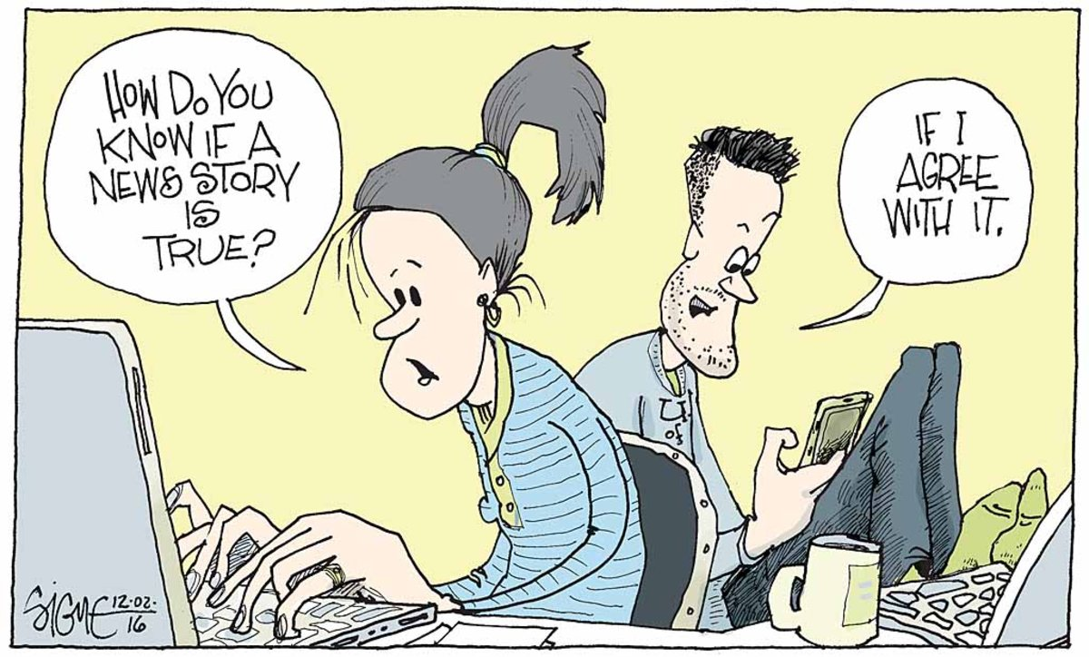

THANK YOU
(And Beware of Fake News!)

Slide 24
FND for Indian Languages
Aim : Modify the code to classify the News in Indian languages
Challenges :
    Unavailability of Data
    Discrepancy in Label Format
Procedure :
1.Create Training Data using translator(Enlish -> Hindi -> English)
2.Try Different combinations for training(Discussed in next slide)
3.Test on Indian Languages(Hindi)
4.Select the model with maximum accuracy

Slide 25
FND for Hindi : Training Data Combinations
We train our model on different combnations of training data and tested on hindi news(obtained from translator).
1. 100% data generated from translator (Acc : 54%)
2. 20% original data and 80% data generated from translator (Acc : 56%)
2. 50% original data and 50% data generated from translator (Acc : 60%)
3. 80% original data and 20% data generated from translator (Acc : 61%)
4.100% original data [Demo Notebook on Git] (Acc : 64%)
Observations:
- Weakness of translator
e.g. Text : Sanket is good boy.
Translator : संकेत अच्छा लडका है। -> Hint is a good boy.
Conclusion : Results are not satisfactory and We need to explore new procedure.

