Slide 1

Introduction to Machine Learning
Rohit Kate
Assignment 4: Using CNNs in Keras

Slide 2
CNNs in Keras
It is fairly easy to implement CNNs in Keras
We will build a CNN for an image classification task
Several image datasets are publicly available, for example: https://www.kaggle.com/datasets?search=image+classification&tags=12107-Computer+Science
Keras also has a few toy datasets (small images): https://keras.io/api/datasets/

Slide 3
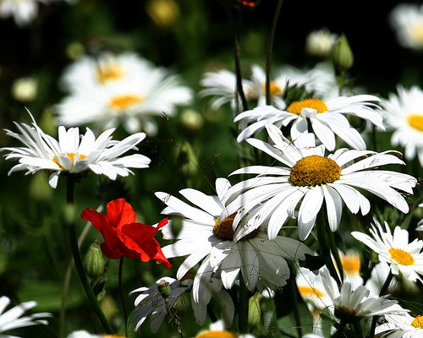
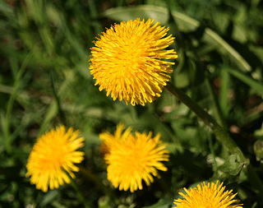
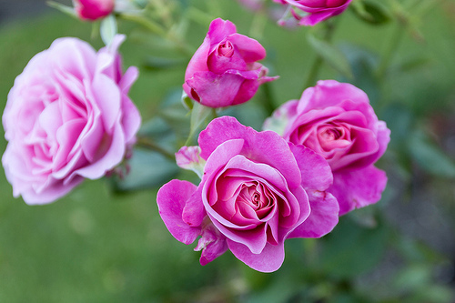
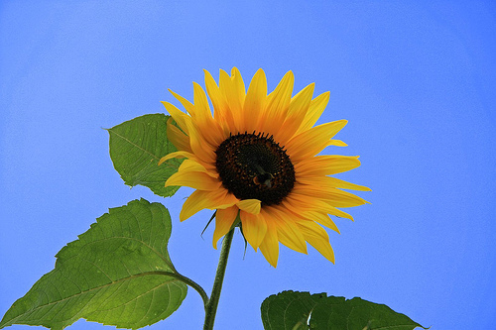
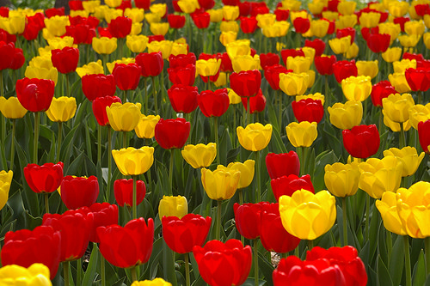
Dataset
We will use the Flower Recognition dataset from Kaggle: https://www.kaggle.com/datasets/alxmamaev/flowers-recognition
It has:
4242 images of flowers, different sizes
236 MB
Five classes:
daisy dandelion rose sunflower tulip
Sample images from the dataset

Slide 4
Download Dataset
Download the dataset
Requires signing-in from an email
Unzip it and keep it as a folder “flowers” inside your Python folder
Images of each class will be in a separate folder inside the flowers folder
General structure for many classification datasets
Program would easily work with any other such dataset

Slide 5
Loading Dataset
Keras provides a handy preprocessing function to load an image dataset from the folder structure: image_dataset_from_directory
https://keras.io/api/preprocessing/image/
>>> from tensorflow.keras import preprocessing
>>> training_set = preprocessing.image_dataset_from_directory(“flowers",
validation_split=0.2,
subset="training",
label_mode="categorical",
seed=0,
image_size=(100,100))

Slide 6
Loading Dataset
Arguments:
“flowers”: name of the folder
validation_split=0.2: use 80% part for training set (randomly selected)
subset="training": create the training set
label_mode="categorical": give labels corresponding to categorical labels, will automatically do one-hot encoding
seed=0: seed for random number (use the same seed to generate the other 20% part)
image_size=(100,100): resize all images to 100x100

Slide 7
Loading Dataset
Function image_dataset_from_directory returns a tensorflow Dataset object: https://www.tensorflow.org/api_docs/python/tf/data/Dataset
It includes labels, and can be directly fed to Keras fit or evaluate functions
If you iterate through the Dataset, you will see it consists of tuples of numpy arrays corresponding to the images (100x100x3) and their labels (one-hot encoded), in batches (default 32)
>>> for e in training_set :
print(e)
a = input() # to pause
Indexing or slicing does not work on it

Slide 8
Loading Dataset
You can look at some of the loaded images and their labels:
>>> import matplotlib.pyplot as plt
>>> for e in training_set :
print(e[1][0])
plt.imshow(e[0][0]/255)
plt.show()
Close an image to see the next; <control>-c to exit
Label
Image (numpy array)

Slide 9
Loading Dataset
We create a test set with the rest of the data (important: use the same seed)
>>> test_set = preprocessing.image_dataset_from_directory("flowers",
validation_split=0.2,
subset="validation",
label_mode="categorical",
seed=0,
image_size=(100,100))

Slide 10
Building CNN
Now we are ready to build a CNN
>>> from tensorflow.keras.models import Sequential
>>> from tensorflow.keras.layers import Rescaling, Conv2D, Dense, Flatten, MaxPooling2D, Dropout
We will need the above types of layers (details later)
>>> m = Sequential()
m is the variable name of our model
We add a rescaling layer so that the input numbers are between 0 and 1 (currently the colors are between 0 and 255):
>>> m.add(Rescaling(1/255))

Slide 11
Building CNN
We add the first convolutional layer:
>>> m.add(Conv2D(32, kernel_size=(3, 3),
activation='relu',
input_shape=(100,100,3)))
Filter size 3x3
Number of filters
ReLU activation
function
Input shape: 100x100 size images
with 3 channels (red, green & blue)
https://keras.io/api/layers/convolution_layers/convolution2d/
Defaults: stride=(1,1) and padding=valid

Slide 12
Building CNN
We add a pooling layer using max function :
>>> m.add(MaxPooling2D(pool_size=(2, 2)))
See other types of pooling layers: https://keras.io/layers/pooling/
Pooling using max
Pooling window size 2x2

Slide 13
Building CNN
We add the next convolutional layer:
>>> m.add(Conv2D(64, (3, 3), activation='relu'))
There is no need to specify the input_shape, it figures out from the previous layer
Convolutional layers and their documentation: https://keras.io/layers/convolutional/

Slide 14
Building CNN
We add a few more convolution layers:
>>> m.add(MaxPooling2D(pool_size=(2, 2)))
>>> m.add(Conv2D(128, kernel_size=(3, 3), activation='relu'))
>>> m.add(MaxPooling2D(pool_size=(2, 2)))
>>> m.add(Conv2D(256, kernel_size=(3, 3), activation='relu'))
>>> m.add(MaxPooling2D(pool_size=(2, 2)))

Slide 15
Building CNN
Before we get to the final dense layers, we need to combine the outputs (of the last layer) and then flatten the structure

Slide 16
Building CNN
From here we will build a regular full-connected (dense) neural network that will lead to output, to do that first we need to change the nodes of a 2D layer to 1D layer:
>>> m.add(Flatten())
See other reshaping layers:
https://keras.io/api/layers/reshaping_layers/flatten/
See all other layers:
https://keras.io/api/layers/

Slide 17
Building CNN
We add a traditional neural network Dense layer:
>>> m.add(Dense(128, activation='relu’))
A dense hidden layer with 128 units and ReLU activation function.

Slide 18
Building CNN
We add a “dropout” layer: It randomly sets the specified fraction of inputs to 0 to avoid overfitting (adding this layer and deciding the fraction is a design decision)
>>> m.add(Dropout(0.5))
See other regularization layers:
https://keras.io/api/layers/regularization_layers/

Slide 19
Building CNN
Finally we add the output layer with 5 nodes and softmax activation (because it is classification task)
>>> m.add(Dense(5, activation='softmax'))
Size of output
Because it is classification

Slide 20
Setting CNN
We are done building the CNN, now we need to “compile” it to specify its settings
>>> m.compile(loss="categorical_crossentropy",
optimizer="Adadelta",
metrics=["accuracy"])
Other losses: https://keras.io/api/losses/
Other optimizers: https://keras.io/api/optimizers/
Other metrics: https://keras.io/api/metrics/
For classification
Evaluation metric

Slide 21
Training CNN
We train the CNN using the fit function
>>>history = m.fit(training_set,
batch_size=32, epochs=25,verbose=0)
The history variable will store information regarding each epoch
Set verbose to 0 if you do not want
it to print messages while training.

Slide 22
Training CNN
It took me around 8 minutes to train on a desktop computer (1 CPU)
Note you can measure clock time by:
>>> import time
>>> start = time.time(); m.fit(….); end = time.time()
>>> print(end-start, "seconds")

Slide 23
Training CNN
You can see accuracy after each epoch using:
>>> print(history.history["accuracy"])
You can see the summary of the model:
>>> m.summary()
You can see the names of the classes (same order as in the one-hot encoding
>>> print(training_set.class_names)

Slide 24
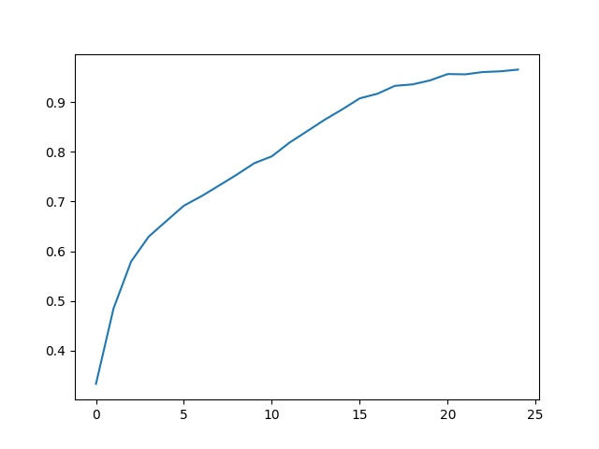
Training CNN
You can plot the training accuracies over the epochs:
>>> plt.plot(history.history["accuracy"])
>>> plt.show()
Accuracy
Epoch

Slide 25
Testing CNN
We can test the model’s accuracy on the test data
>>> score = m.evaluate(test_set, verbose=0)
>>> print(“Test accuracy:”, score[1])
Test accuracy: 0.7566627860069275
(You may not get the same value due to randomness.)
One could design and evaluate different CNN architectures

Slide 26
Predicting Using CNN
Note: Please first install the Python imaging library pillow (pip install pillow) and then restart the Python shell (save the trained model in a file first, if needed).
One can also make predictions on individual images:
>>> image_file = “flowers/rose/12240303_80d87f77a3_n.jpg”
>>> img = preprocessing.image.load_img(image_file,target_size=(100,100))
The above loads the image in an internal format, we need to change it to numpy array:
>>> img_arr = preprocessing.image.img_to_array(img)
>>> img_arr.shape
(100, 100, 3)
See the image:
>>> plt.imshow(img_arr.astype("uint8"))
(or plt.imshow(img_arr/255))
>>> plt.show()

Slide 27
Predicting Using CNN
The predict function takes a bunch of examples to test, we have only one example, hence we need to increase its dimension
>>> img_cl = img_arr.reshape(1,100,100,3)
>>> score = m.predict(img_cl)
>>> print(score)
[[0.33894712 0.00582944 0.6132814 0.01129632 0.03064577]]
61.3% confident that it is rose

Slide 28
Saving and Loading Models
It is possible to save models in Keras so that one does not need to train every time
One can train them once and load them any time for testing
>>> m.save("my_model.h5")
It will be saved in Python’s installation folder by default.
And load it later:
>>> from tensorflow.keras.models import load_model
>>> old_model = load_model("my_model.h5")
See Models API: https://keras.io/api/models/
See FAQ: https://keras.io/getting_started/faq/

