Slide 1


ShareSpace
Presented by
PRASAD TAWARE (233186)
SHUBHAM SABANE (233213)
Mrs. Rupali Thorat Project Guide

Slide 2
Point to be Discuss through out the Presentation
Introduction
Motivation
Objective
UML Diagrams
Screenshots
Technology
Software Requirement
Hardware Requirement
Advantages
Disadvantages
Conclusion
Future Enhancement
References

Slide 3
Introduction
ShareSpace is a convenient platform for connecting accommodation seekers and home owners without any middlemen like brokers and listing agents.
The main aim of this platform to provide hassle free experience for users to find suitable places to live and home owners (listers) to list their properties for possible candidates.
ShareSpace has some functions where users can register, search properties, shortlist properties and match with listers.
System administrator responsible for managing bookings, listings, adding and removing users / listers.

Slide 4

As a person in a new city, it is very difficult to find good and affordable places.
Even if you find one, there mind be additional costs associated with it such as brokerage and agent’s premium.
From home-owner’s perspective, it is often very difficult to find good tenants and find them quuickly.

Slide 5
Objective
In the existing system, you need to contact a broker who will show you the desired places and then he will charge his premium as well.
This trouble also extends to home owners as well.
ShareSpace platform serves to eliminate these hurdles and provide a hassle free experience for both seekers and home owners.
Users just need to register as seekers / listers then they can search properties / list properties, shortlist properties / accept short-listings, confirm matches and confirm booking.

Slide 6
Unified Modeling language (UML Diagram)

Slide 7
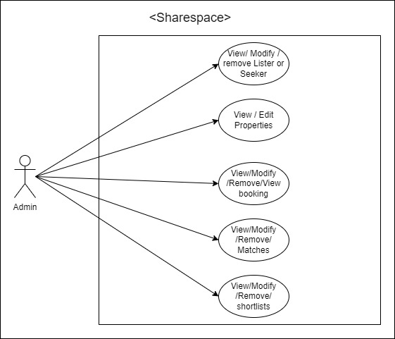
Use-case Diagram

Slide 8
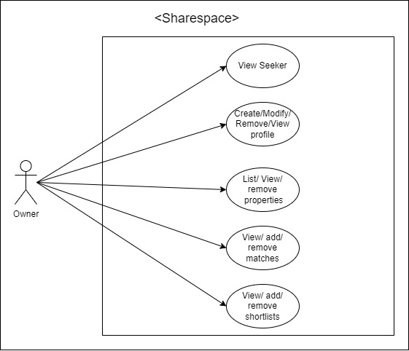

Slide 9
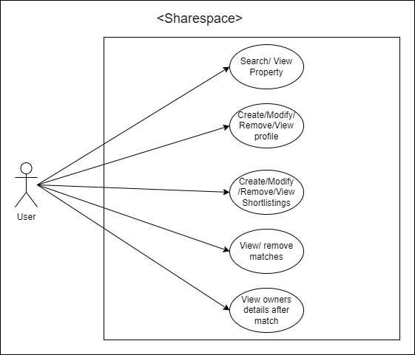

Slide 10
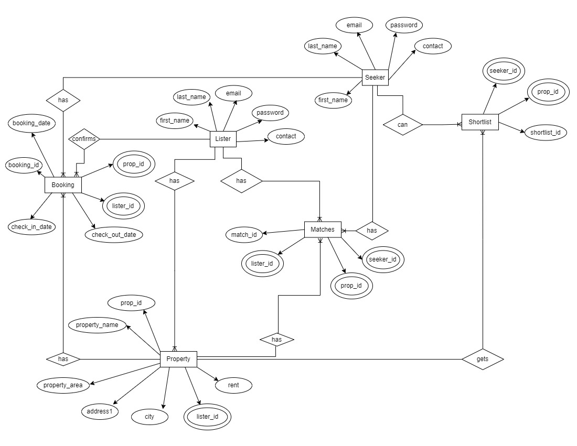
Entity Relationship Diagram

Slide 11
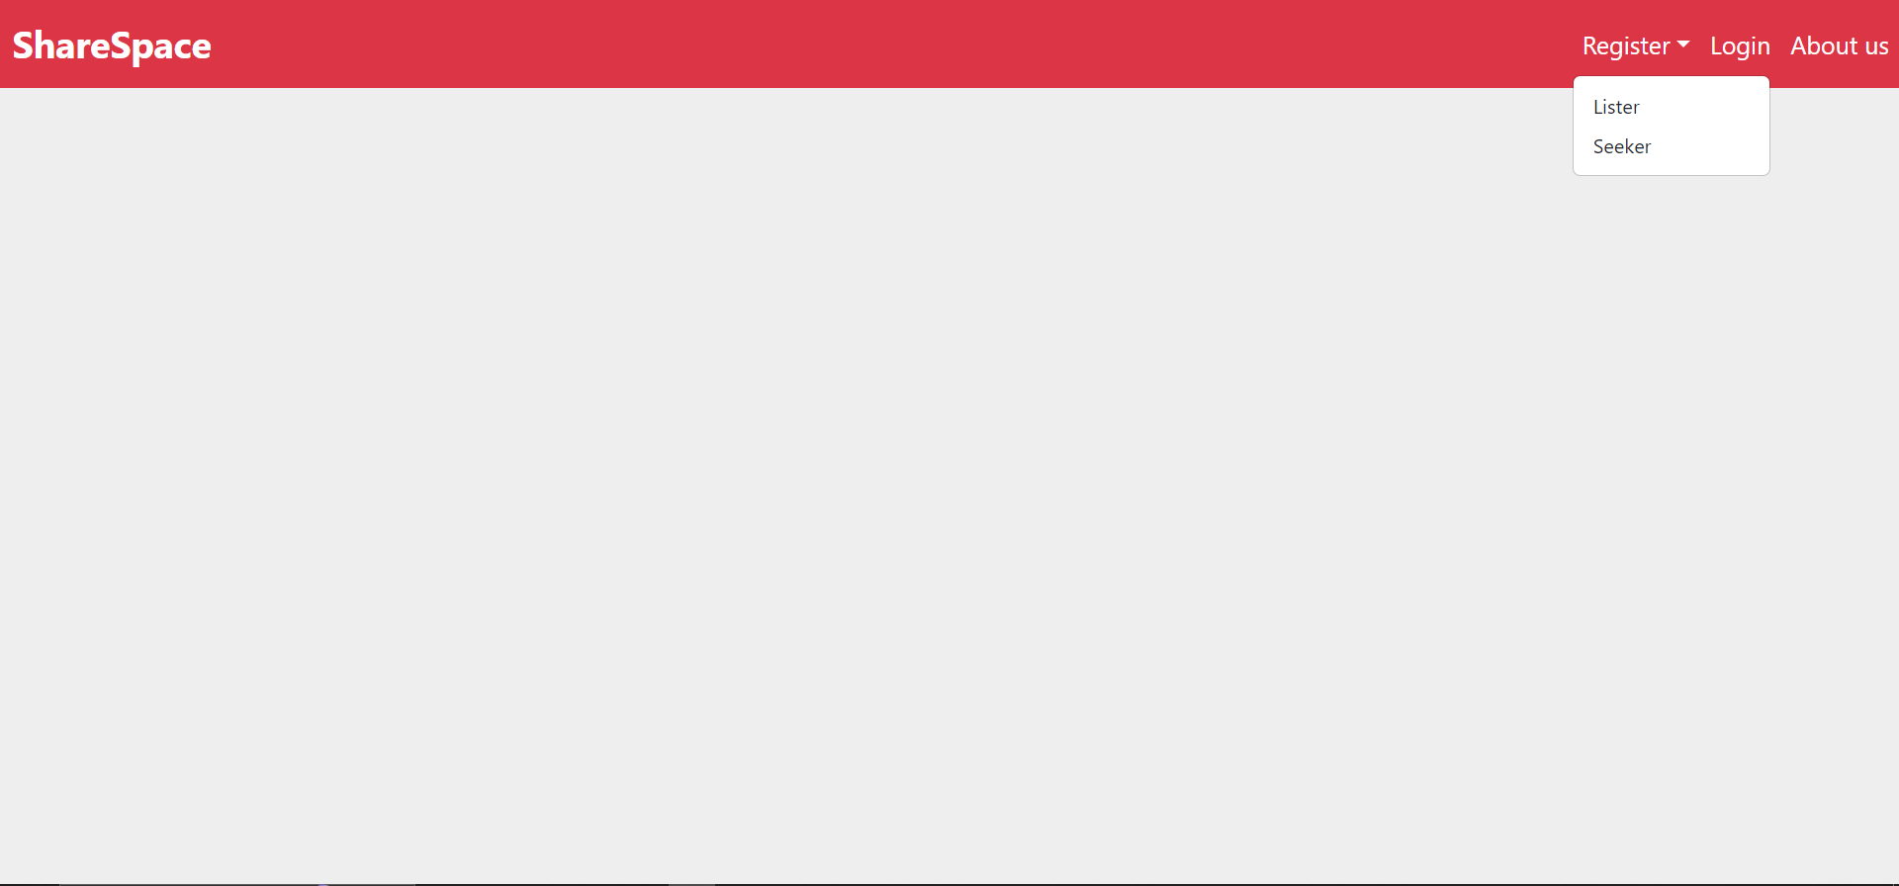
Screenshots

Slide 12
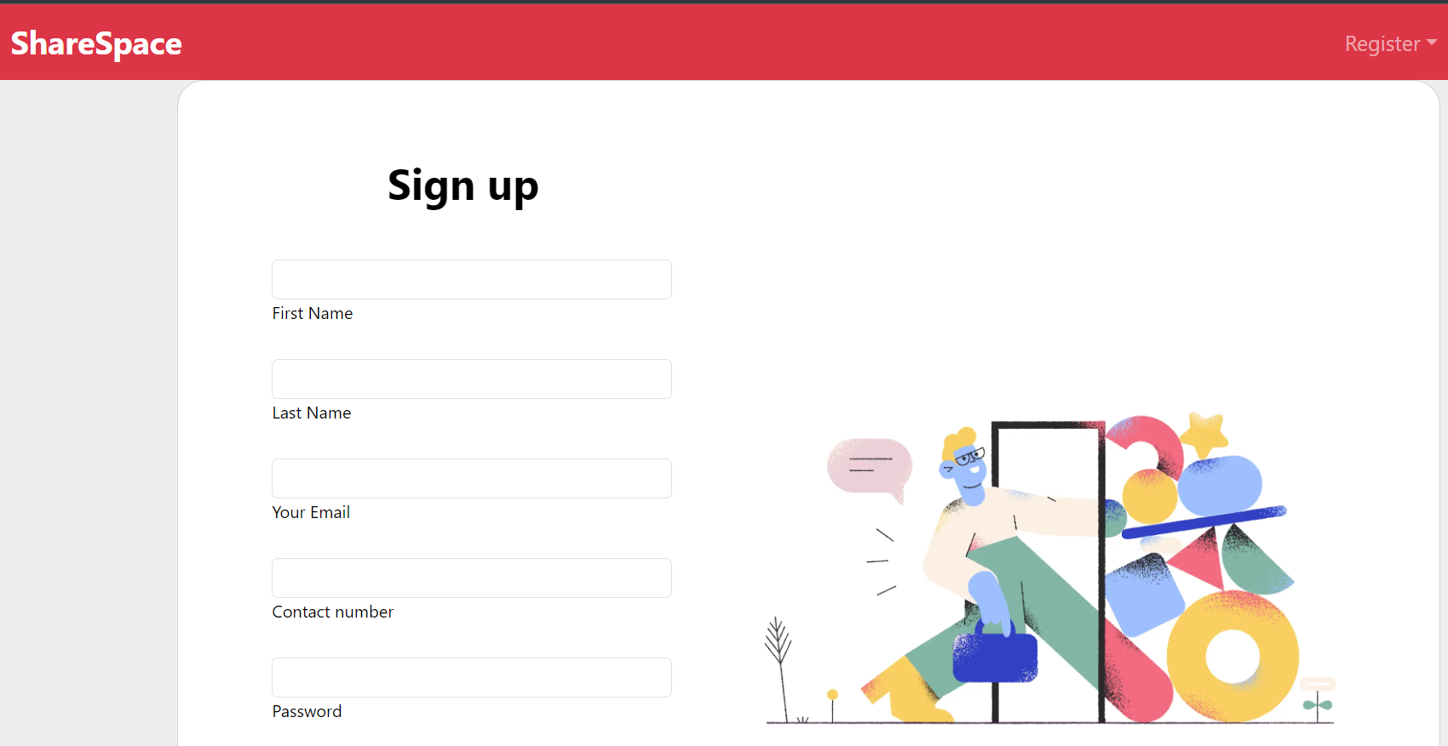

Slide 13
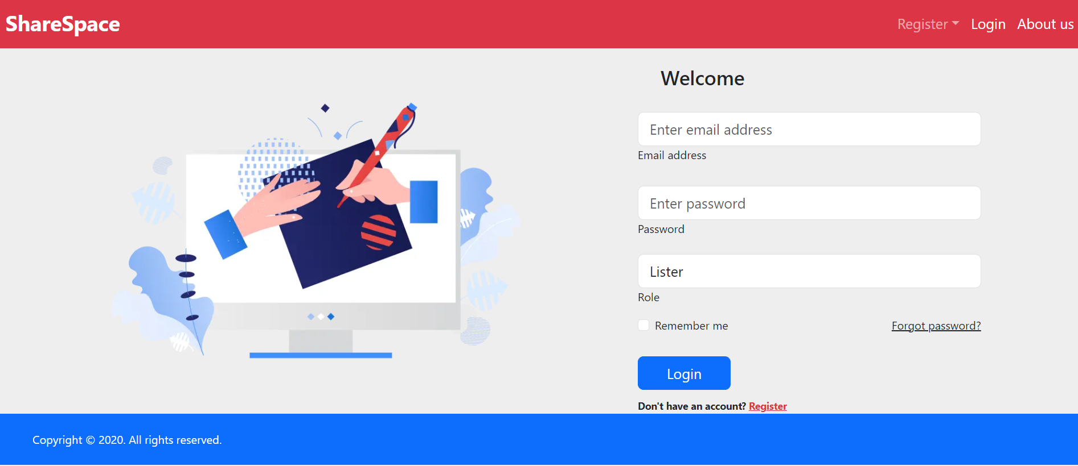

Slide 14
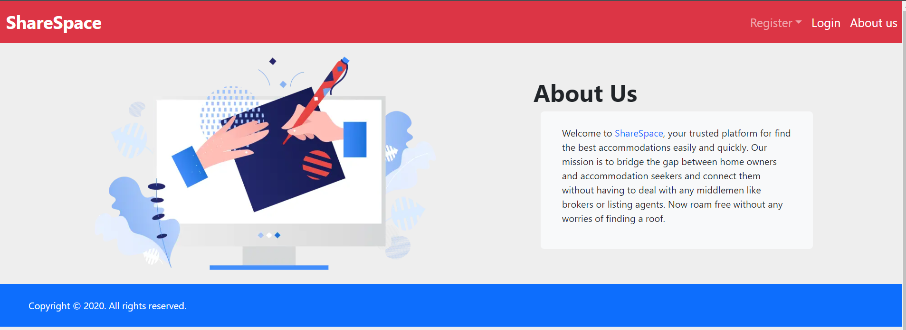

Slide 15
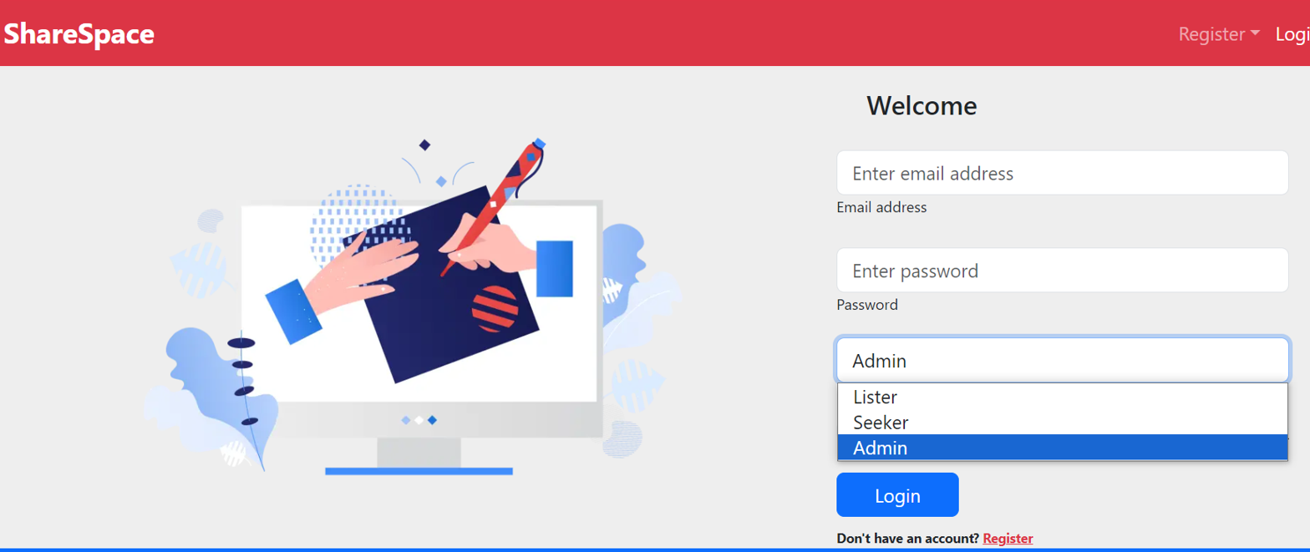

Slide 16
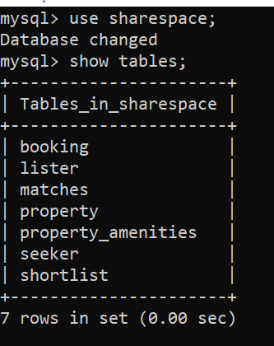
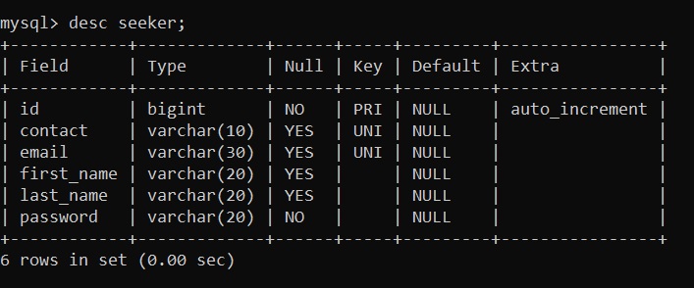
Database Design

Slide 17
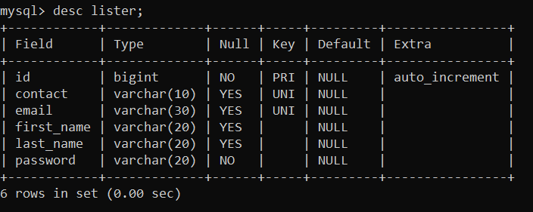
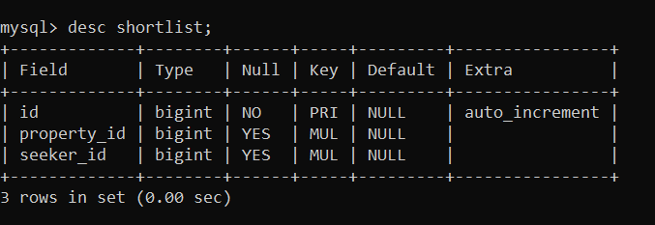

Slide 18
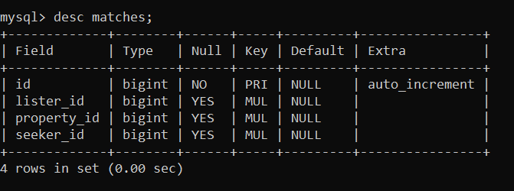
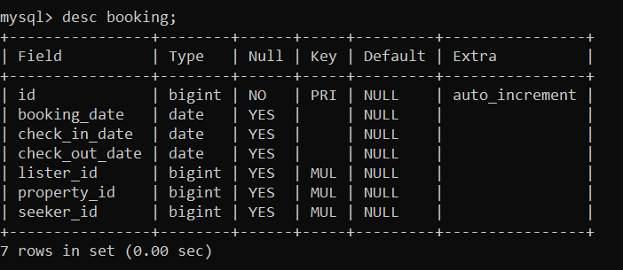

Slide 19
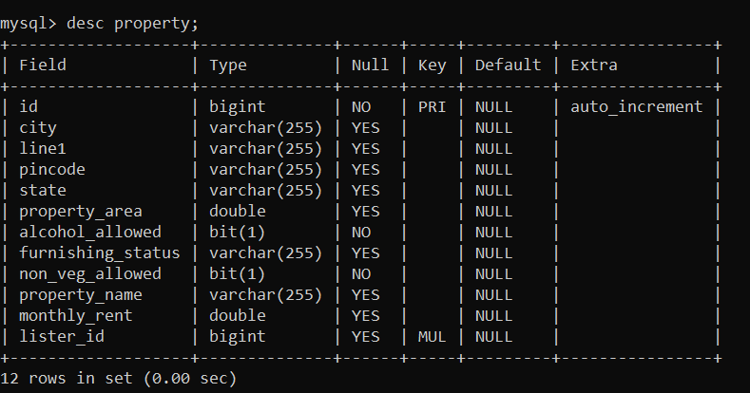

Slide 20
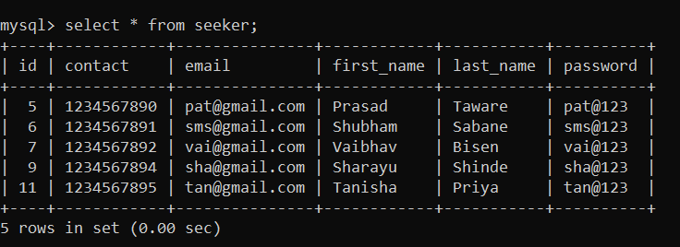
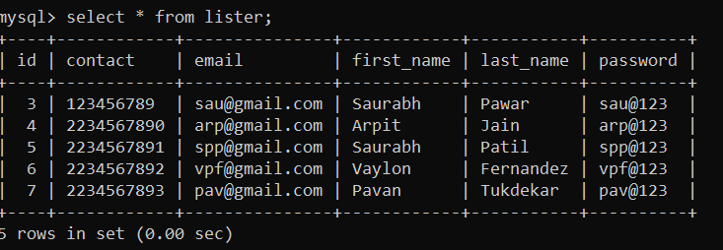
Database Records

Slide 21
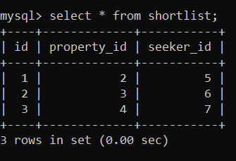
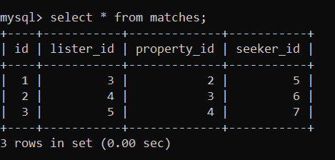

Slide 22
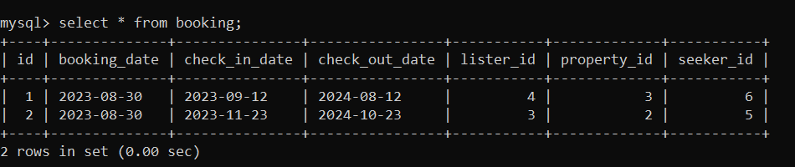
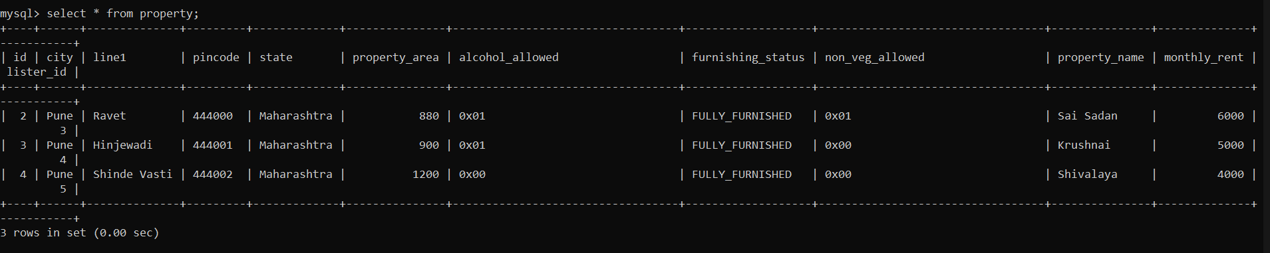

Slide 23
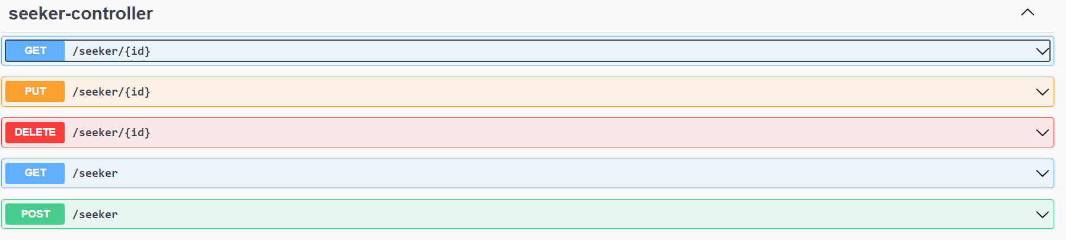
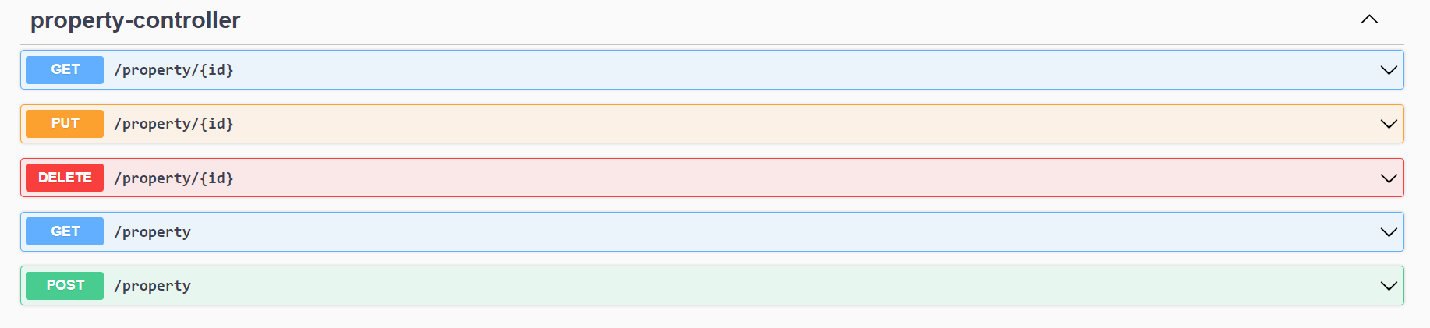
RestAPI End Points

Slide 24
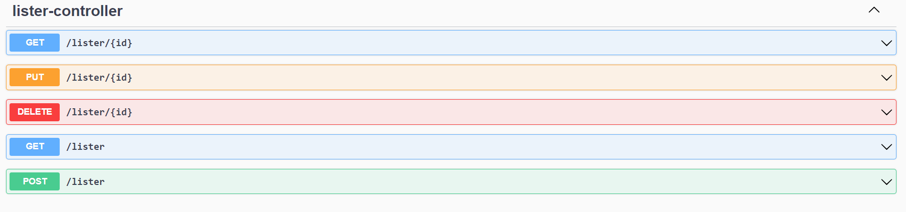
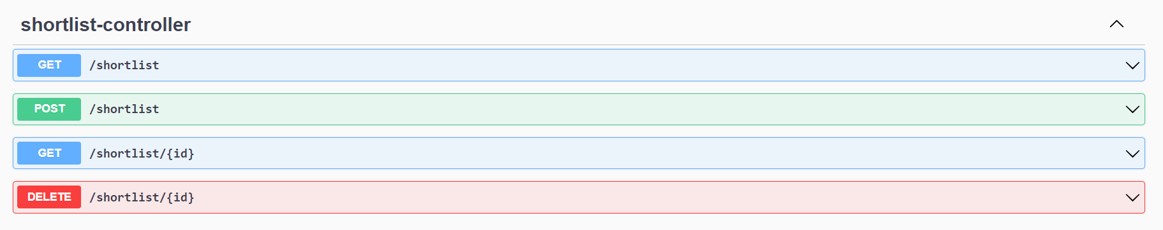

Slide 25
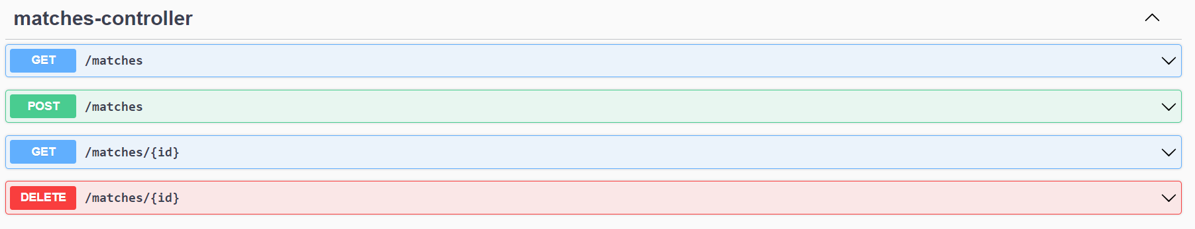
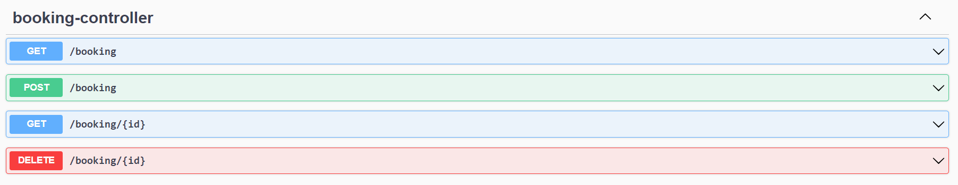

Slide 26
Technologies
Front-End: ReactJS, HTML, CSS, Bootstrap
Back-End: Spring Boot RestAPI
Database: MySQL

Slide 27
Software And Hardware Requirement
Server Side:
Processor: Intel® Xeon® processor 3500 series
HDD: Minimum 500GB Disk Space
RAM: Minimum 8GB
OS: Windows 10, Linux 6
Database: MySQL
Client Side (thin client):
Processor: Intel Dual Core
HDD: Minimum 80GB Disk Space
RAM: Minimum 4GB
OS: Windows 7, Linux

Slide 28
Advantages
Client can access the platform from anywhere with just a browser and an internet connection.
Searching accommodations in a new city becomes very easy.
Finding the right tenants is now as easy as it gets.
No middle-men like brokers or listing agents.
Access to large pool of seekers as well as home owners.

Slide 29
Disadvantages
Usability of the platform depends on the number of users. More the better.
Contract negotiations between home-owners and accommodations is currently not a part of ShareSpace.
Platform currently is not enabled with e-wallet or any third party payment services.
Currently ShareSpace is very limited region-wise.
ShareSpace currently does not support location based searching or maps.

Slide 30
Conclusion
Having your online presence is a must in this world.
ShareSpace allows users and home-owners alike to find their right accommodation/ tenants without any middlemen like brokers or listing agents.
User friendly experience: ShareSpace is very easy to access (with just a browser and an internet connection) and offers effortless way to find accommodations / tenants.

Slide 31
Future Scope
Developmental changes in the pipeline:
1. Payment and E-wallet services.
2. Searching and Map functionalities using geo-location.
3. Contract negotiations and other documentation services.

Slide 32
References
https://bootstrapmade.com/mentor-free-education-bootstrap-theme/
https://www.javatpoint.com/java-mail-api-tutorial
https://www.w3schools.com/
https://reactjs.org/docs/getting-started.html
https://javaee.github.io/javaee-spec/javadocs/

Slide 33
Thank you
Any Question

