Slide 1

Credit risk minimizing model in Peer to Peer (P2P) lending business.
Guided By:
Ms. Trupti Joshi
Mr. Milind Kapase
Submitted By:
Krishna Pawar (220943025014)
Pratik Chavan (220943025027)
Atharva Shinde (220943025036)
Shubham Sarade (220943025043)
11/03/2023
1

Slide 2
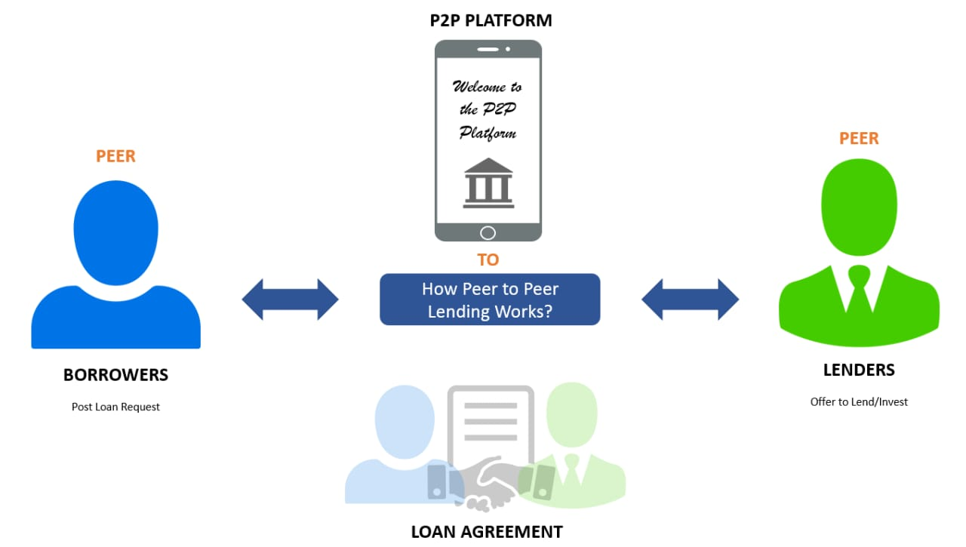
Introduction
Lending club is Peer-to-Peer lending platform that connect borrowers and lenders through an online marketplace, providing a platform for borrowers to obtain loans from investors who are willing to lend them money.

Slide 3
Used Lending Club’s data.
Available on data.world.
Dataset period from 2007 to 2011.
There are more than 42000 observations and 115 variables.
Data size is 30MB.
Contain - complete loan data for all loans issued through the time period stated, including the current loan status (Current, Late, Fully Paid, etc.) and latest payment information

Slide 4
Problem Statement
To Predict a borrower's probability of defaulting on a loan based on a variety of variables like their FICO score, income, loan size, loan term, etc.
To reduce the risk by predicting the potential customer being a defaulter or not.

Slide 5
Raw data in Local file system
System Architecture
Pre-Processing using PySpark
(Clean missing values,
Selecting important features.)
Machine Learning
(Logistic Regression, Decision Tree, Gradient Boosting, SVM, Random Forest.)
Model Training & Testing
Run Model
Visualization..

Slide 6
Data Pre-Processing :-
1) Cleaning the columns according to requirement
2) Converting target columns into binary values
3) Dropping missing values
4) Encoding of Categorical Columns
5) Data Balancing and Scaling
6) Vector Assembling
6

Slide 7
Machine Learning Algorithms
Logistic Regression-
It is simple and fast algorithm that can handle large dataset with many input variables.
In this, logistic function is used to build relationship between dependent variable and one or more independent variable.
2) Decision Trees –
In this the data divided into two groups until it predicts outcome correctly.
It can be pruned to reduce overfitting and improve accuracy.
3) Random Forests –
It is a combination of multiple decision tree.
It predicts outcomes based on combined results of all the decision trees.

Slide 8
4) Gradient Boosting –
It combines multiple weak learners to make accurate decision.
It works on stage-wise fashion, where each model tries to improve upon the errors of the previous model.
5) Support Vector Machines (SVM) -
It tries to find hyperplane that separates the data points into two classes with maximum margin.
Sensitive to outliers.

Slide 9
Accuracy Comparison Between Machine Learning Algorithms
Machine Learning Model | Training_Dataset_Accurcy | Test_Dataset_Accurcy
Logistic Regression | 68% | 68%
Decision Tree | 63% | 62%
Random Forest | 69% | 67%
Gradient Boosting | 72% | 69%
Support Vector Machine | 66% | 67%

Slide 10
Data Visualization & Representation

Slide 11
Data Analysis
The most risky loan purpose among all is small business type borrower’s.
Borrower’s with higher interest rate and low FICO score have higher chance of being defaulter.
There is no significant impact of loan amount on loan status.
The verification process can be improved based on the number of not verified and verified borrower’s.
Grading system of company providing good results by correctly segregating Fully Paid and Charged Off borrower’s into different categories for easy processing.

Slide 12
CONCLUSION AND FUTURE SCOPE
After analyzing and modeling the Lending Club dataset, we can conclude that machine learning can be effectively used in building a credit risk minimizing model for P2P lending businesses.
The logistic regression model achieved an accuracy of around 68%, while the gradient boosting model achieved an accuracy of around 72%. Moreover, we have used evaluation metrics such as ROC AUC to determine the performance of our models.
Overall, we can conclude that using machine learning algorithms can help lenders make informed decisions by predicting the credit risk of potential borrowers. This can lead to a reduction in default rates and an increase in profitability for P2P lending businesses.
For future scope, the model's prediction can be made more interpretable to help the stakeholders understand the factors contributing to the borrower's credit risk.

Slide 13
Thank you for Your Attention!!!
Questions.?
13

