Slide 1

Authsync Authentication and User management
Presented By-
Shubham Singh (02131135)
Roshni Pal (02137180)

Slide 2

Introduction
This project aims to automate the management of client-server environments using Ansible while enhancing security with Two-Factor Authentication (2FA). The implementation focuses on efficient automation, secure authentication, and scalability, reducing manual interventions and mitigating security risks.
Scope:
Automating software installations, configurations, and updates.
Securing servers with authentication mechanisms.
Mitigating risks of malicious activities.

Slide 3
Background
In large-scale IT infrastructures, managing multiple servers manually is inefficient and prone to errors. Tools like Ansible enable centralized management, allowing automation of software installations, configurations, and updates. Security is critical, so advanced authentication mechanisms like 2FA are integrated to ensure server access is secure.

Slide 4
Motivation
Simplify server management by automating routine tasks.
Enhance security to prevent unauthorized access and mitigate malicious activities.
Provide a scalable, reliable solution for growing IT infrastructures.
Reduce human errors and improve efficiency in server management.

Slide 5
Scope
Automate repetitive tasks like software installations and updates.
Ensure secure authentication using passwordless SSH and 2FA.
Centralize server management using Ansible's configuration management capabilities.
Identify and address integration challenges, ensuring reliability.
Plan for scalability and future enhancements.

Slide 6
Tools & technology
Ansible:
Open-source automation tool for configuration management, application deployment, and task orchestration.
Used for managing and automating tasks across multiple servers without requiring agents.
SSH (Secure Shell):
Provides a secure communication channel between the master and client servers.
Ensures passwordless authentication using key pairs for secure and seamless connections.
Google Authenticator:
Enables Two-Factor Authentication (2FA) by generating one-time passwords (OTPs).
Used to enhance server authentication security.
Ubuntu:
Operating system used for both master and client servers.
Provides a robust platform for running Ansible and other tools.

Slide 7
Tools & Technology (contd.)
NGINX:
NGINX is a powerful and versatile open-source software often used as a web server, but its functionality extends far beyond that.
It is one of the most widely used tools in the IT and web development industries.
Python:
Required for Ansible execution on the client servers.
Ensures compatibility with Ansible modules.
Firewall (UFW - Uncomplicated Firewall):
Configured to block unauthorized traffic and restrict access to specific ports.
Ensures secure network communication.
PAM (Pluggable Authentication Module):
Configured to integrate Google Authenticator for Two-Factor Authentication.
Handles authentication for SSH sessions securely.
AWS Cloud:
Hosted the master and client servers for deployment.
Provided a scalable environment for testing and implementation.

Slide 8
Tools & Technology (contd.)
Ansible:
Ansible is an open-source automation tool used for IT tasks such as configuration management, application deployment, and orchestration.
It simplifies complex IT workflows and enables automation at scale.
In Ansible, a playbook is a structured package used to define and execute configurations, tasks, or orchestration on managed nodes (servers). Playbooks are the cornerstone of Ansible's automation capabilities, allowing users to describe the desired state of a system or execute specific commands systematically.
NGINX:
Web Server
Reverse Proxy
Load Balancer
Content Caching
HTTP/HTTPS server
API Gateway
Streaming Media
WebSocket Proxy

Slide 9
Architecture
Master Server: Configured with Ansible for orchestrating tasks across client servers.
Client Servers: Managed nodes that execute tasks received from the master server.
Secure Communication: Enabled using SSH for passwordless authentication.
2FA Integration: Adds an additional layer of security for user authentication.

Slide 10
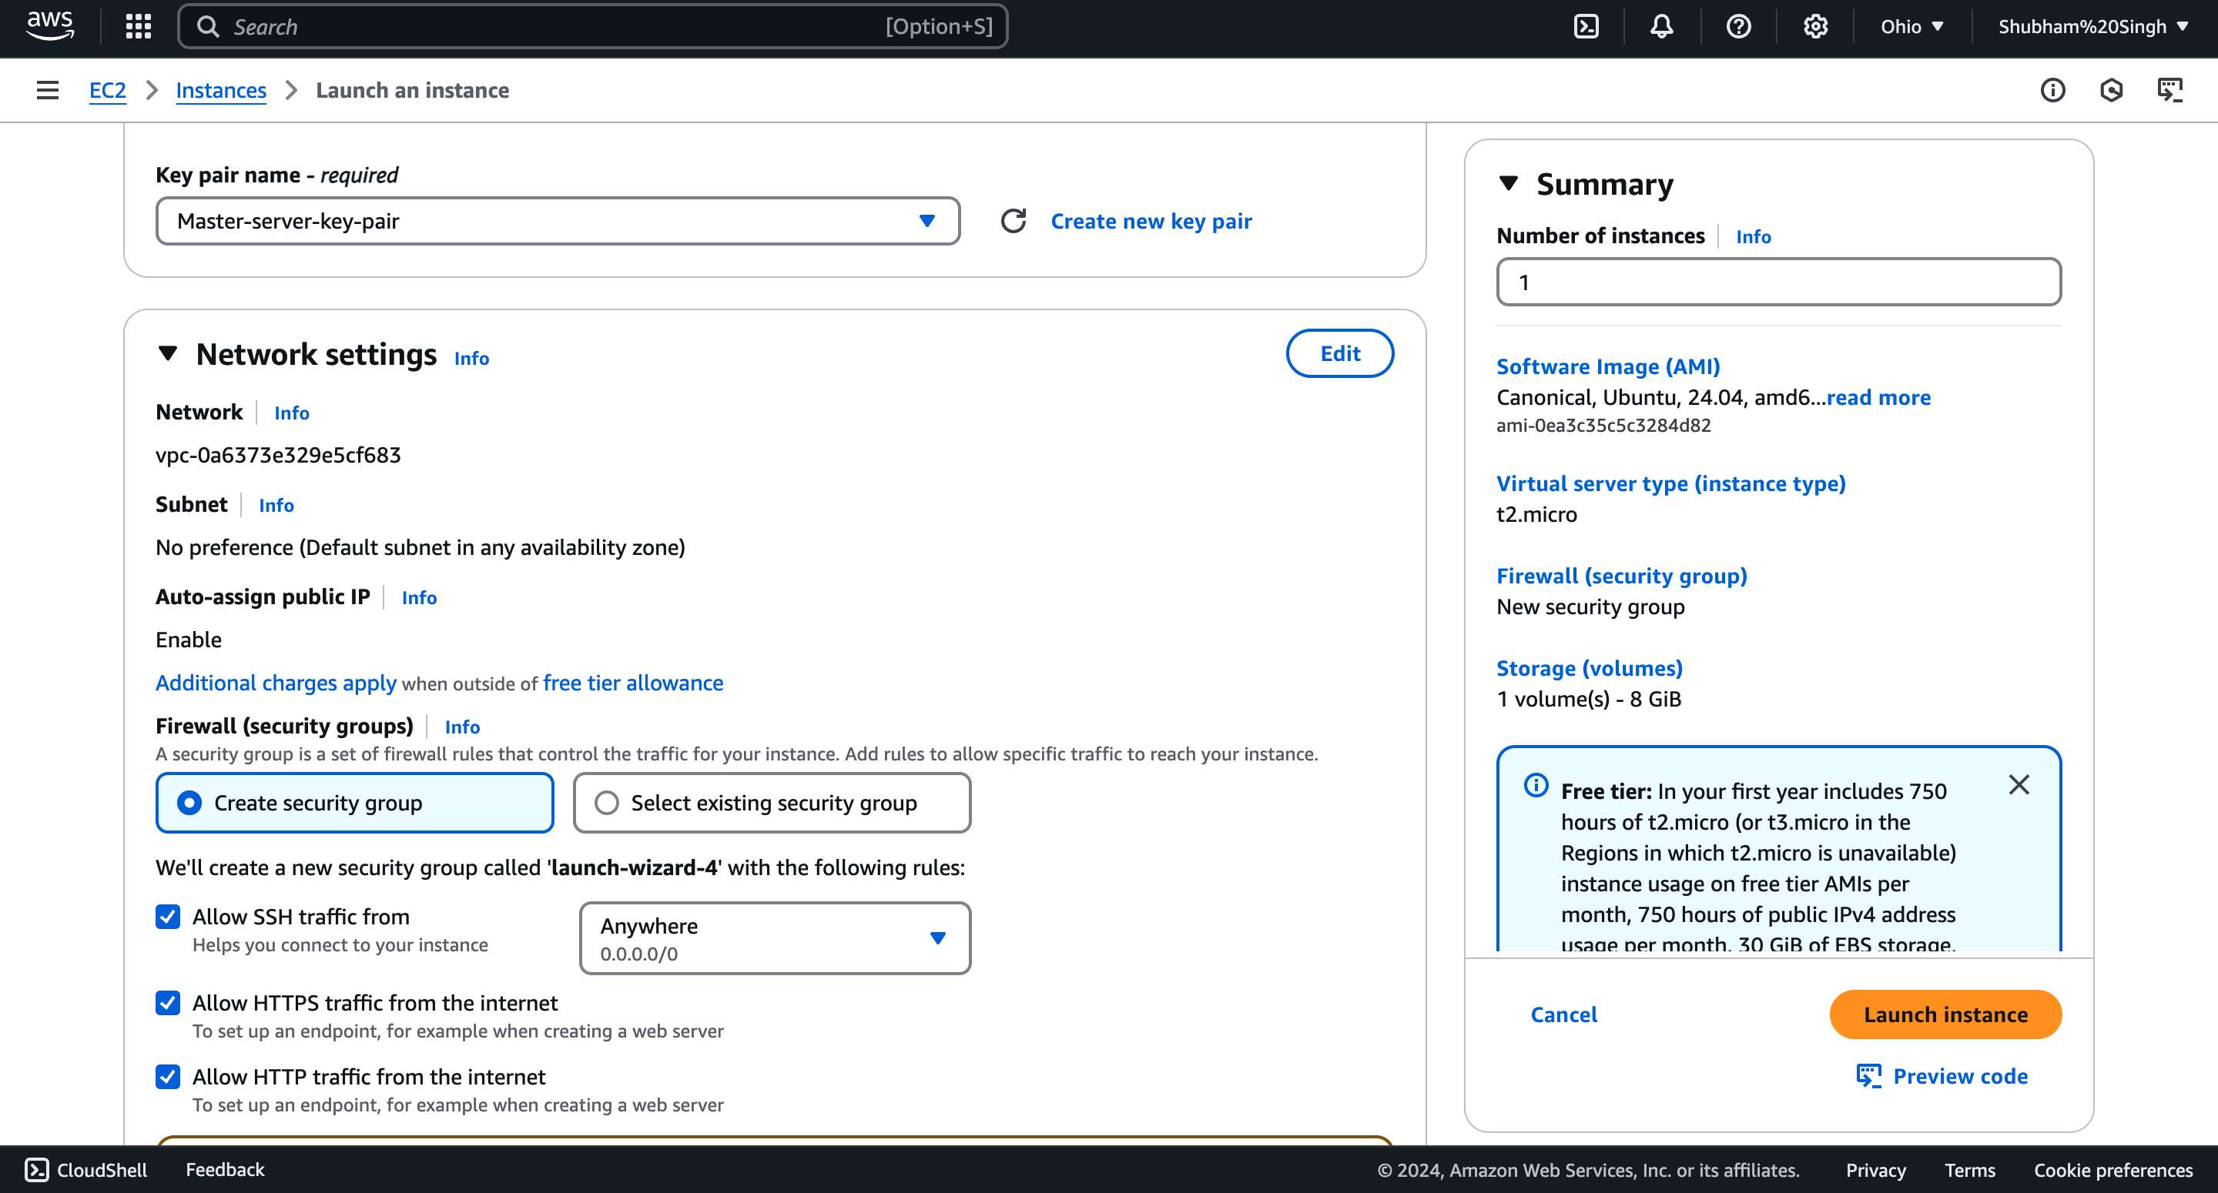
Server configurations

Slide 11
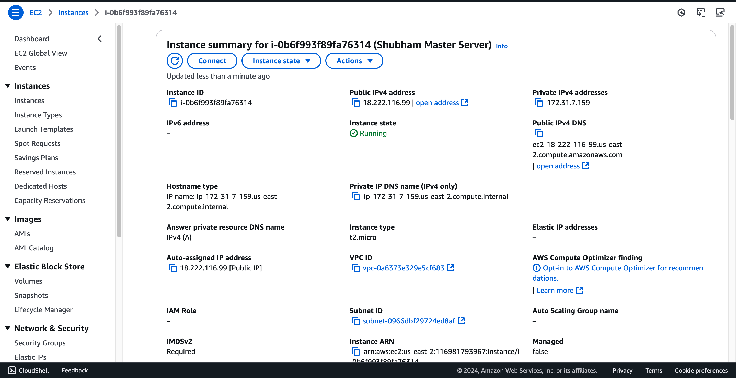
Creating Master Server

Slide 12
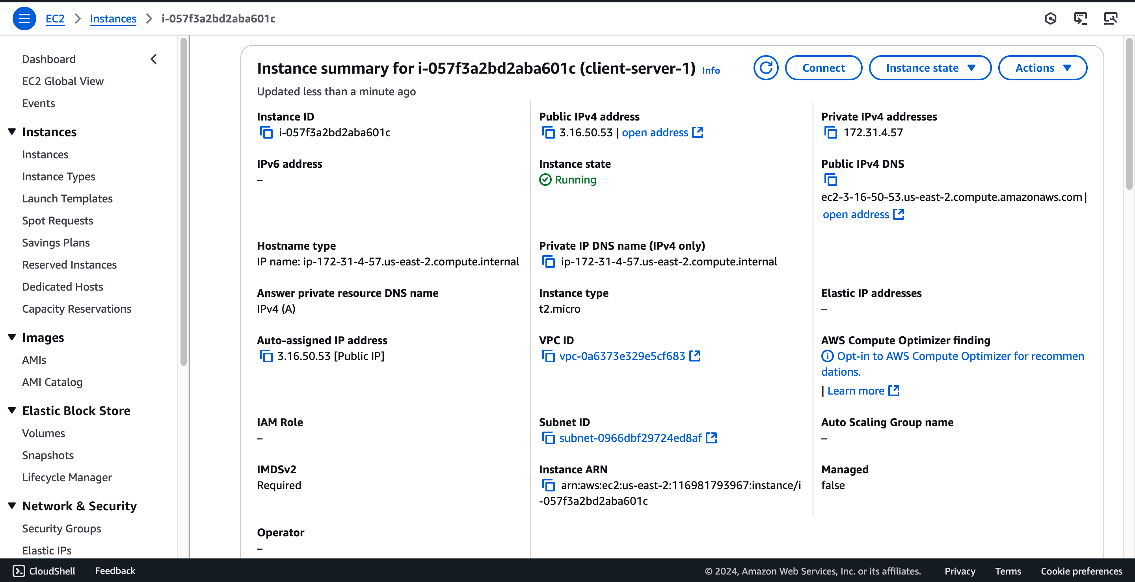
Creating Client server 1

Slide 13
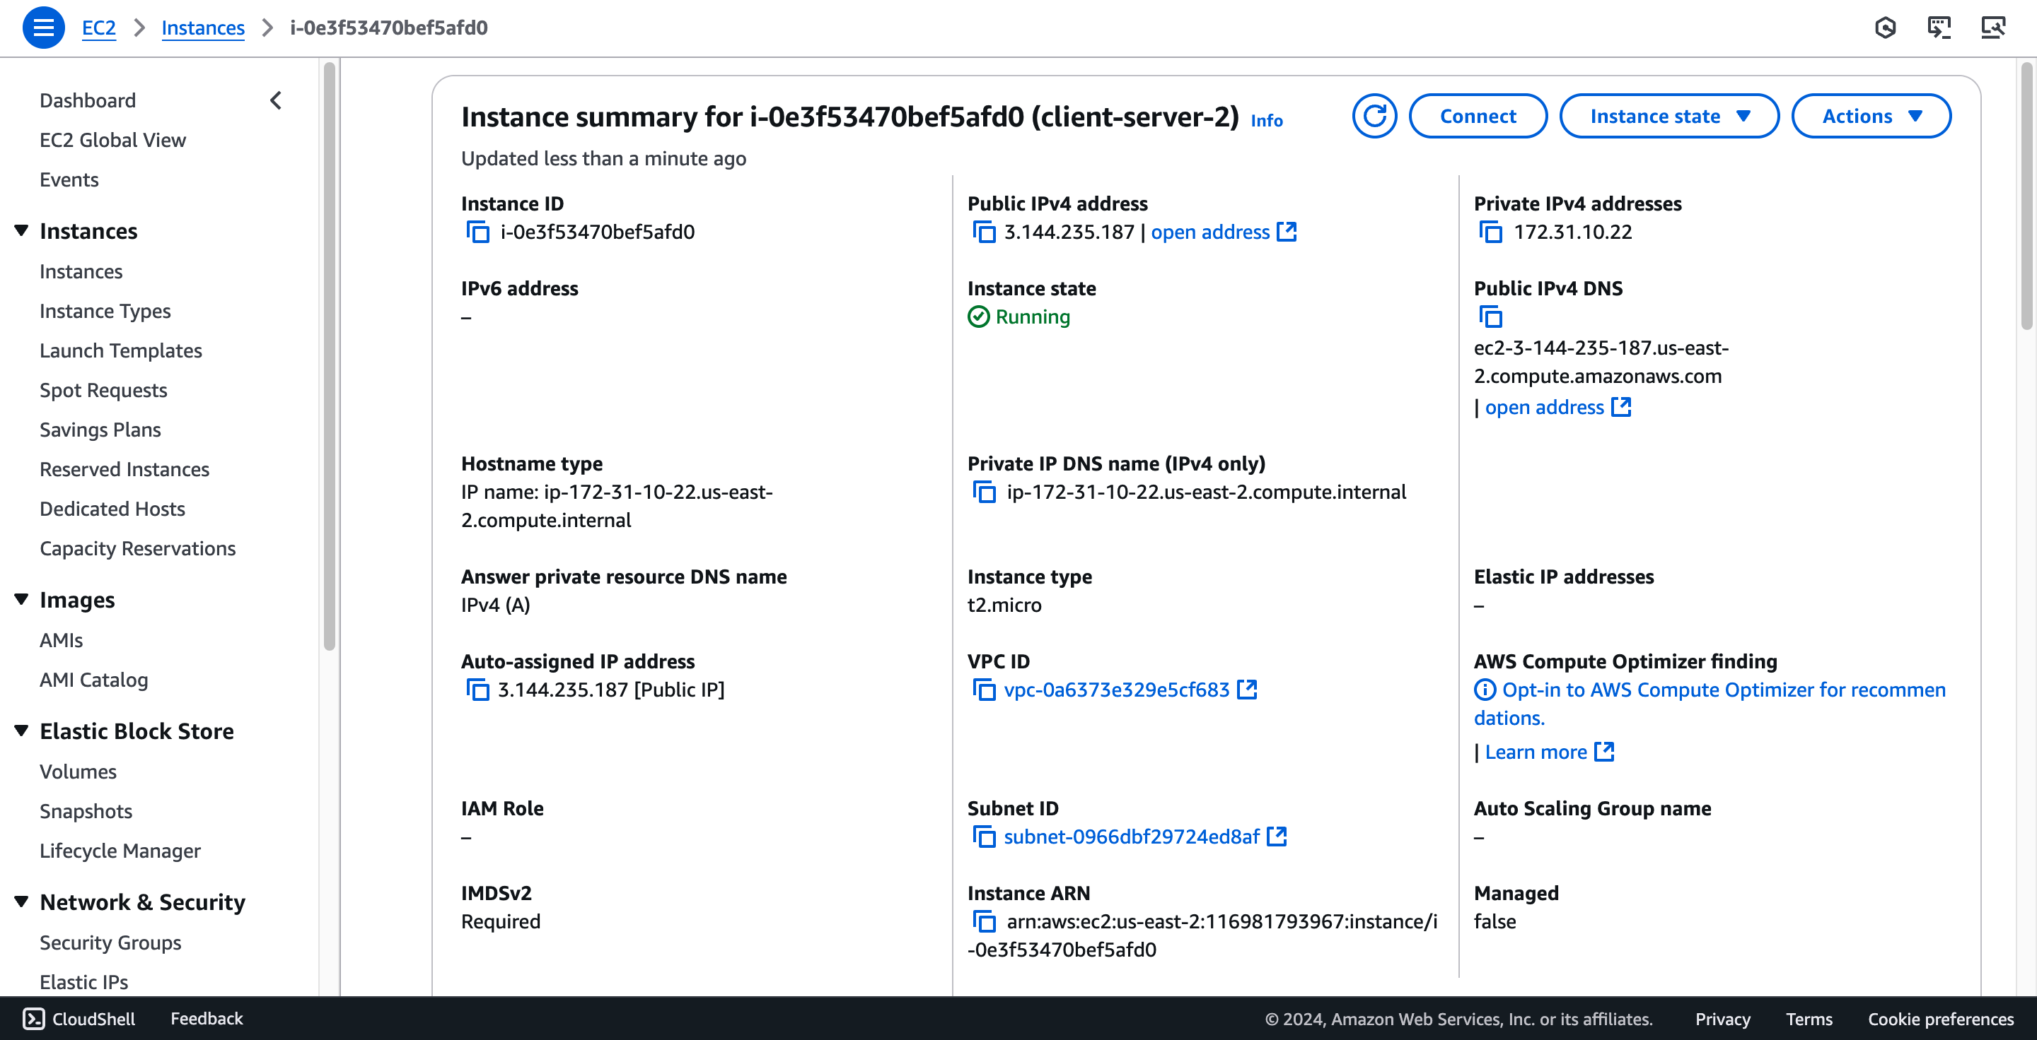
Creating client server 2

Slide 14
configurations
Master Server Setup:
Install Ansible and configure inventory files to define client servers.
Generate SSH keys for secure communication.
Client Server Setup:
Prepare the servers by installing necessary dependencies.
Configure .ssh/authorized keys to access SSH.
2FA Configuration:
Install Google Authenticator on client servers.
Configure PAM and SSH to require both SSH keys and OTPs.

Slide 15
implementations
Ansible Playbooks:
Automate tasks like installing software, updating packages, and configuring services.
Secure Communication:
Establish secure SSH connections between master and client servers.
2FA Implementation:
Install and configure Google Authenticator on client servers.
Enable SSH to require OTPs in addition to SSH keys.
Note: Authentication is implemented and ready to integrate with application. It will allow users to authenticate their profile once the application is deployed and work in a medium with Google Authenticator App.

Slide 16
workflow
Task Initiation:
Master server sends instructions to client servers via Ansible.
Execution:
Client servers execute the tasks and return results to the master server.
Authentication:
Secure communication using SSH ensures only authorized users can access servers.
Users authenticate using both SSH keys and OTPs via 2FA.
Automation:
Routine tasks like software updates, configurations, and maintenance are automated using playbooks.

Slide 17
Security measures
Passwordless SSH:
Ensures secure communication by eliminating password vulnerabilities.
Two-Factor Authentication:
Protects servers from unauthorized access by requiring an OTP in addition to SSH keys.
Firewall Configuration:
Blocks unauthorized traffic and restricts access to specific IP ranges.
Regular Updates:
Automates updates to ensure servers remain protected against vulnerabilities.

Slide 18
scalability
Dynamic Inventory:
Supports dynamic environments where servers are added or removed frequently.
Ansible Roles:
Modular configurations allow easier management of large-scale infrastructures.
Cloud Integration:
Easily extendable to manage cloud-based servers on AWS, Azure, or Google Cloud.
Future Enhancements:
Integration of monitoring tools like ELK stack for centralized logging and monitoring.

Slide 19
issues
SSH Connectivity Issues:
Faced difficulties with Permission denied (publickey) due to incorrect SSH key setups.
Service Restart Failures:
Errors in the SSH configuration caused sshd service failures.
Firewall Restrictions:
Initial firewall settings blocked port 22, preventing SSH access.
2FA Integration:
Misconfigurations in PAM led to authentication errors during testing.

Slide 20
Challenges
VMware Setup:
In my local, despite of several attempts, it’s hard to create servers for master and client.
Configuration Management:
Ensuring consistent configurations across multiple servers was challenging.
Debugging Failures:
Identifying and resolving issues like misconfigured SSH or PAM settings.
2FA Rollout:
Implementing 2FA across all client servers required careful testing to prevent lockouts.
Time Synchronization:
Ensuring accurate time synchronization between servers and 2FA apps to prevent OTP mismatches.

Slide 21
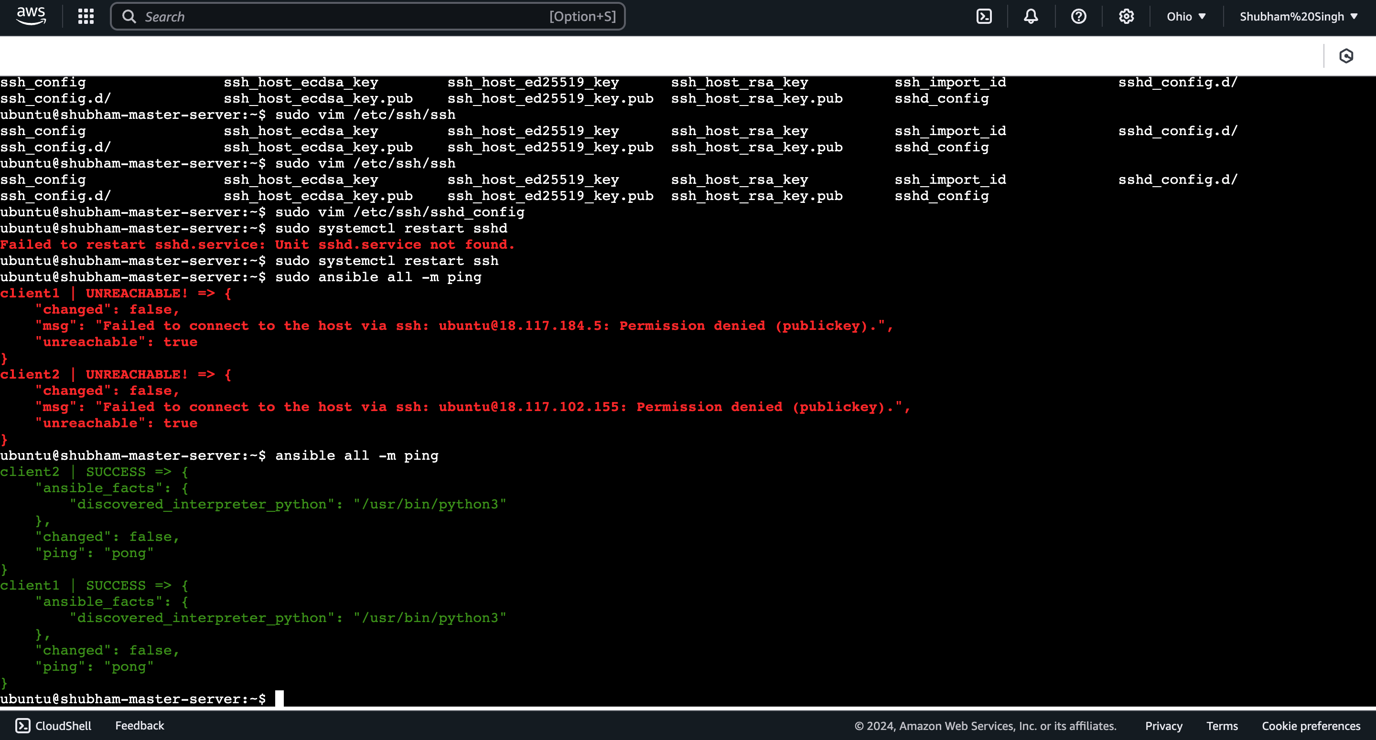
Pinging the ansible

Slide 22
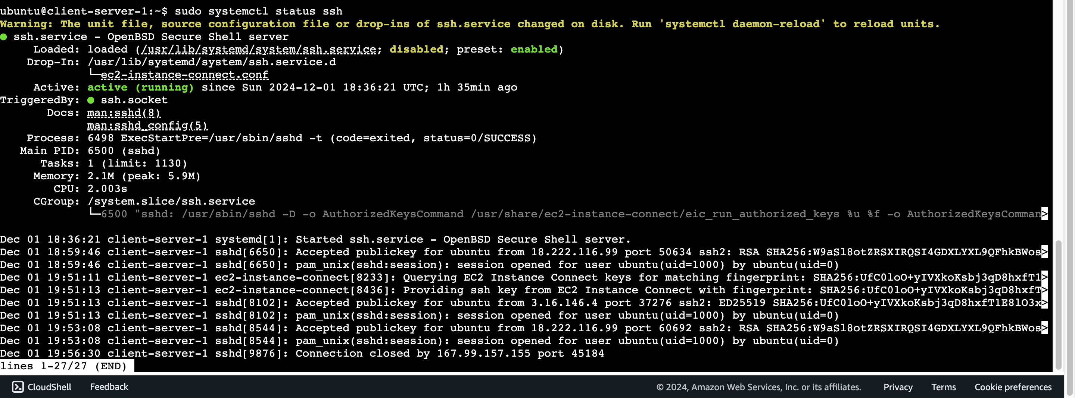
Accessing client server 1

Slide 23
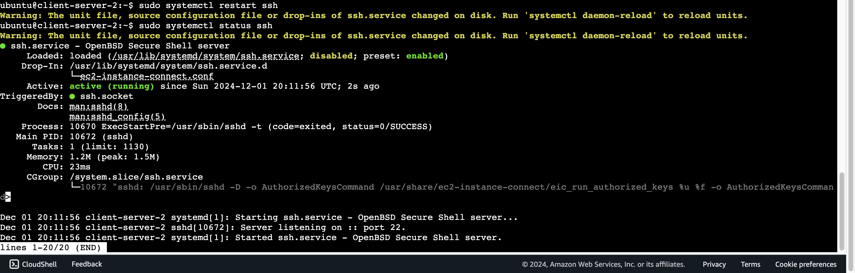
Accessing client server 2

Slide 24
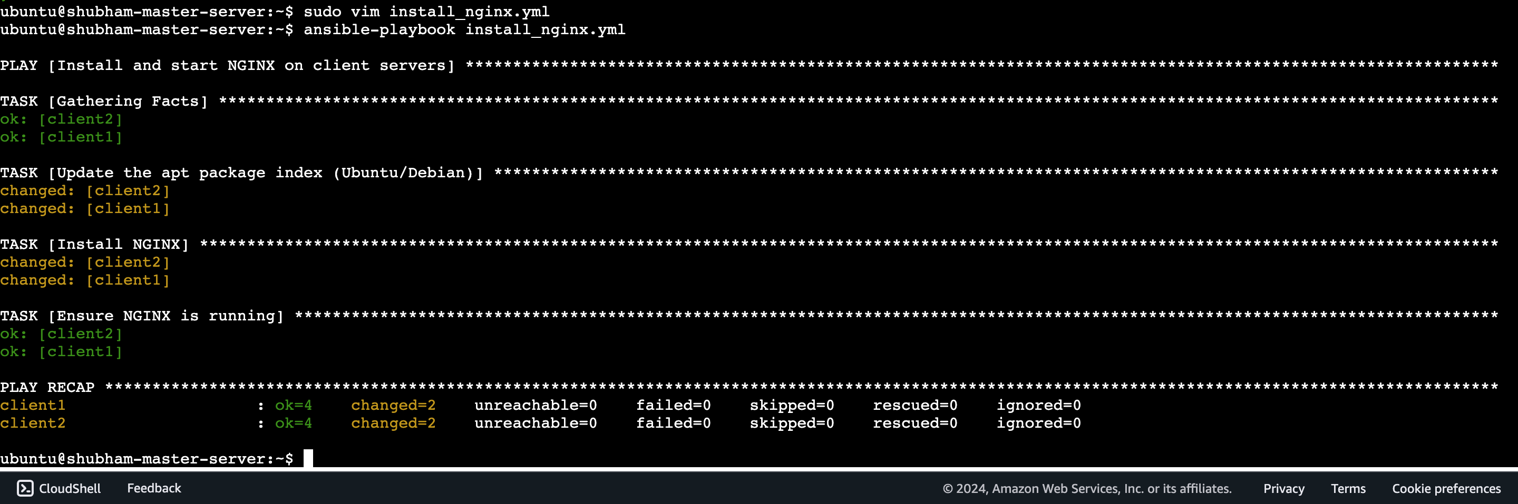
Final Output: Running Playbook

Slide 25
Advantages of Playbook
CRUD operations
Log Management
Automation
User Management
Ecosystem Compatibility
Configuration Management
Monitoring & Alerts
Ease of use and Maintenance

Slide 26
summary
This project automated master and client-server management using Ansible and enhanced security with Two-Factor Authentication. It streamlined routine server tasks, reduced manual errors, and ensured secure authentication mechanisms. Integration challenges were resolved, and the solution was designed to be scalable for future growth.
CONTRIBUTIONS
Shubham:
Automation and Configuration
Set up the master server, configure Ansible, create inventory files, and write playbooks for automating tasks like software installation and updates.
Debug and resolve issues (e.g., SSH errors, service failures) while ensuring dynamic inventory and scalability.
Roshni:
Security and 2FA Integration
Prepare client servers, configure SSH for the admin, and implement Two-Factor Authentication (Google Authenticator with PAM and SSH).
Enhance security with firewall rules, test 2FA, and troubleshoot synchronization and authentication issues.

Slide 27
conclusion
Achievements:
Successfully automated server management and implemented 2FA.
Addressed integration challenges and ensured secure communication.
Future Scope:
Centralized logging and monitoring using tools like ELK Stack.
Advanced authentication mechanisms such as hardware tokens.
Further automation for dynamic cloud environments.
Takeaways:
Automation improves efficiency and reduces human error.
Robust security mechanisms are essential to protect critical infrastructure.

Slide 28
References
[1] Michael DeHaan. (Nov 20, 2024). “Ansible Community Documentation”. Ansible.
DOI - https://docs.ansible.com/ansible/latest/collections/ansible/builtin/setup_module.html
[2] Charles Adebayo and Suhail Fouzan. (Oct 08, 2024). “Centralized monitoring and alerting for AWS Systems Manager Agent status on managed nodes across AWS Organization”. AWS.
DOI - https://aws.amazon.com/blogs/mt/centralized-monitoring-and-alerting-for-aws-systems-manager-agent-status-on-managed-nodes-across-aws-organization/
[3] Google Author. (Updated). “Server-side passkey authentication”. Google.
DOI - https://developers.google.com/identity/passkeys/developer-guides/server-authentication
[4] NGINX Author. (Updated). “nginx documentation”. NGINX.
DOI - https://nginx.org/en/docs/
[5] Ansible project contributors. (Nov 20, 2024). “Ansible playbooks”. Ansible.
DOI - https://docs.ansible.com/ansible/latest/playbook_guide/playbooks_intro.html

