Slide 1
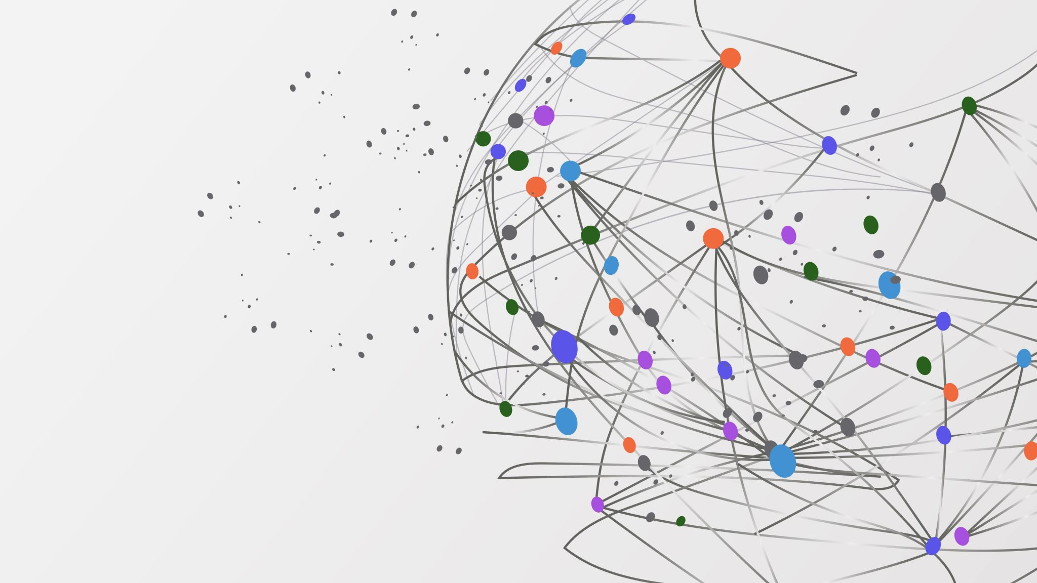
EQUITY INSIGHT TRENDS EXPLORER
GROUP NO – 18
Rahul Gamara (12)
Saurav Kumar (25)
Shubham Singh (53)

Slide 2
INTRODUCTION
In this analysis, we examine a diverse range of global stock exchanges to understand their performance, trends, and correlations. The selected stock exchanges represent various geographical regions and market sectors, providing a comprehensive view of international financial markets. The stock exchanges analysed are HSI (Hang Seng Index), NYA (NYSE Composite Index), IXIC (NASDAQ Composite Index), 000001.SS (Shanghai Composite Index), N225 (Nikkei 225), N100 (Euronext 100 Index), 399001.SZ (Shenzhen Component Index), GSPTSE (S&P/TSX Composite Index), NSEI (Nifty 50), GDAXI (DAX Index), SSMI (Swiss Market Index), TWII (Taiwan Weighted Index), and J203.JO (Johannesburg Stock Exchange Top 40 Index)
Creating a Data pipeline to analyze the real-time equity dataset.
Analyze the trend of the market over time.
Used AWS infrastructure to store the data and analyze it.
Achieved the continuous integration to manage big data.

Slide 3
SERVICES
AWS S3
AWS Glue
AWS CloudWatch
AWS Lambda Function
AWS Athena
AWS SageMaker

Slide 4
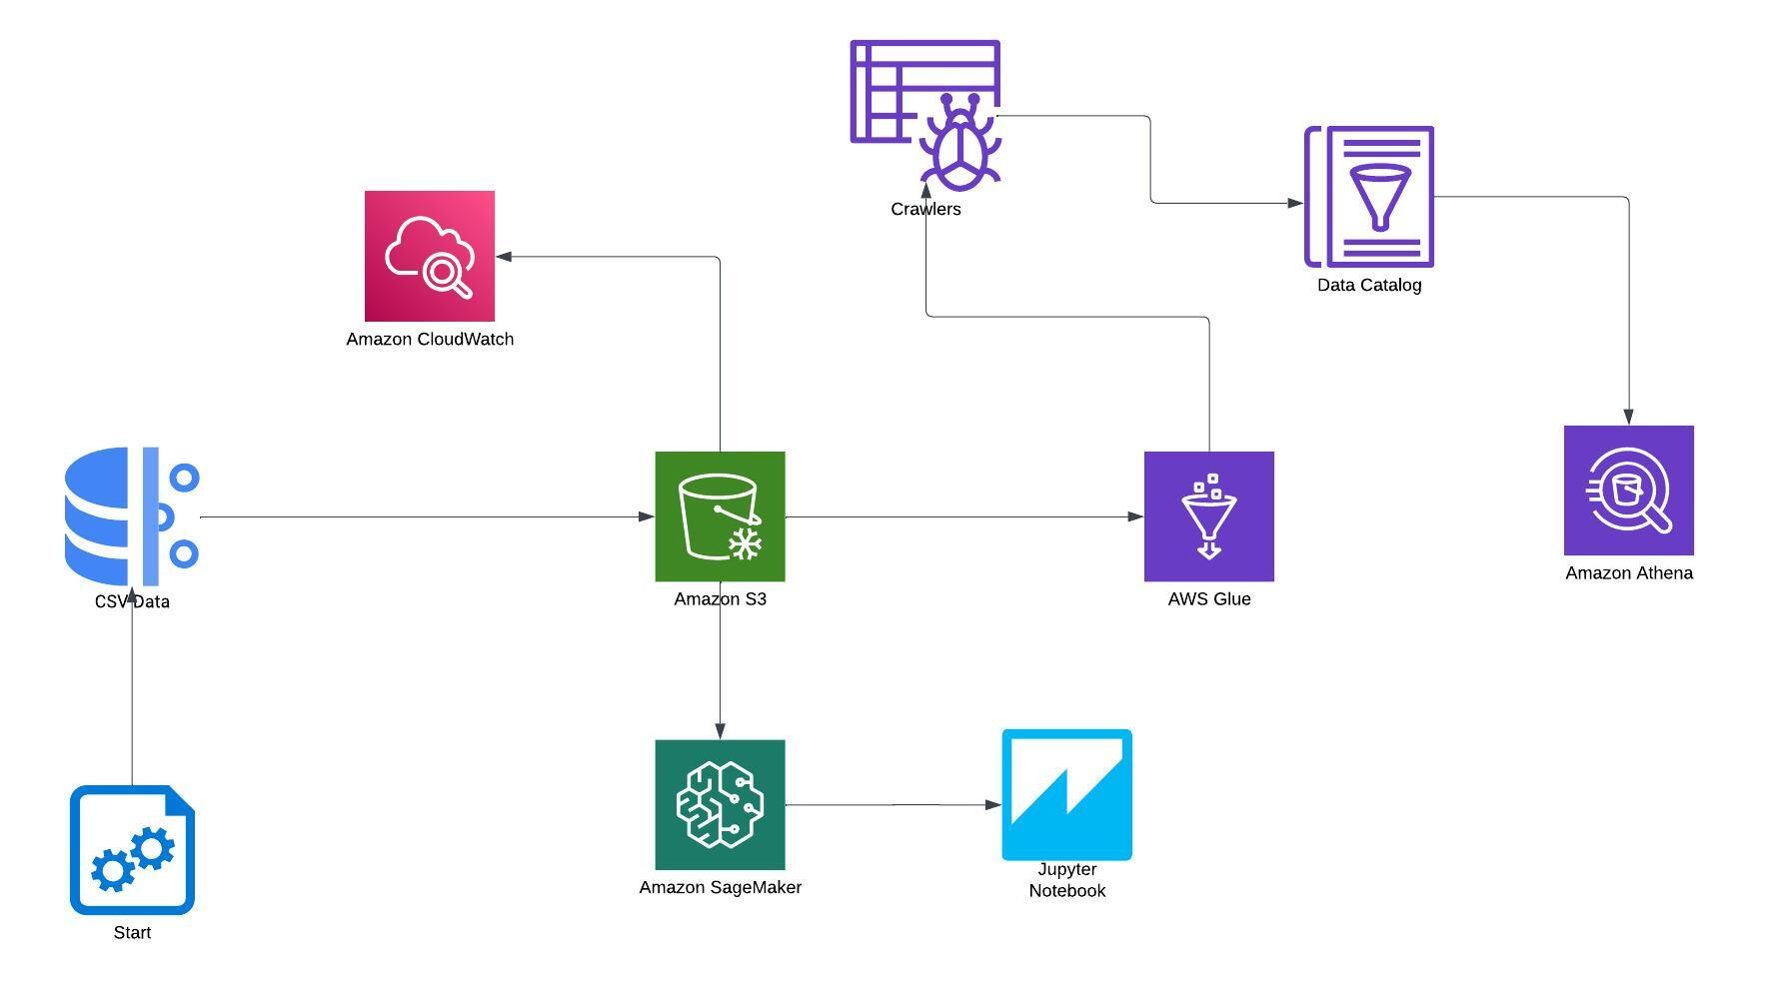
Architecture

Slide 5
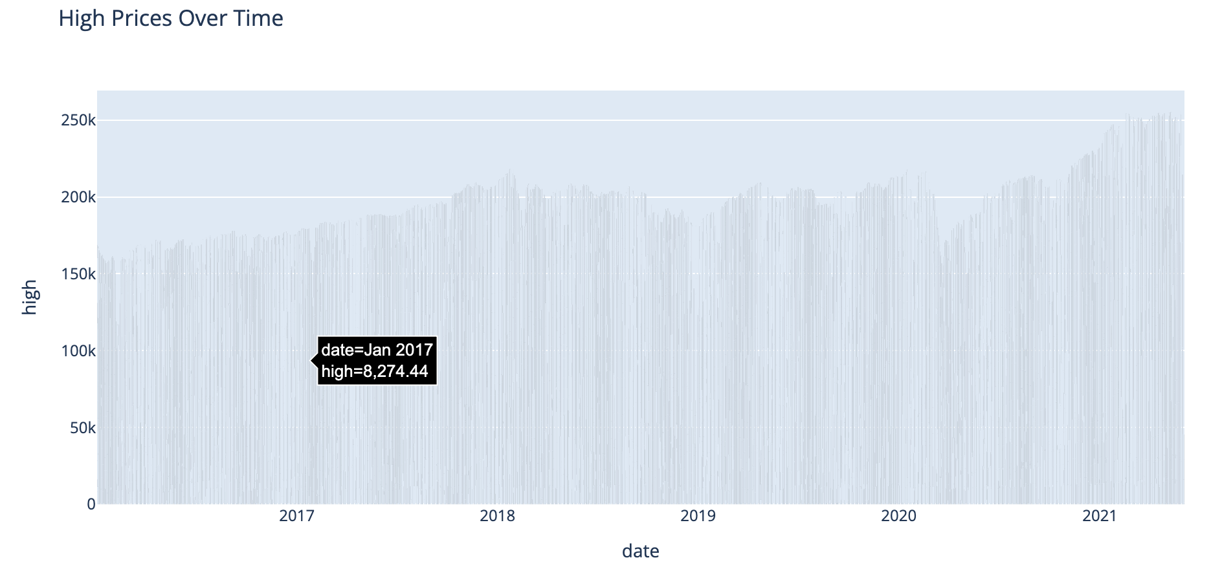
RESULTS

Slide 6
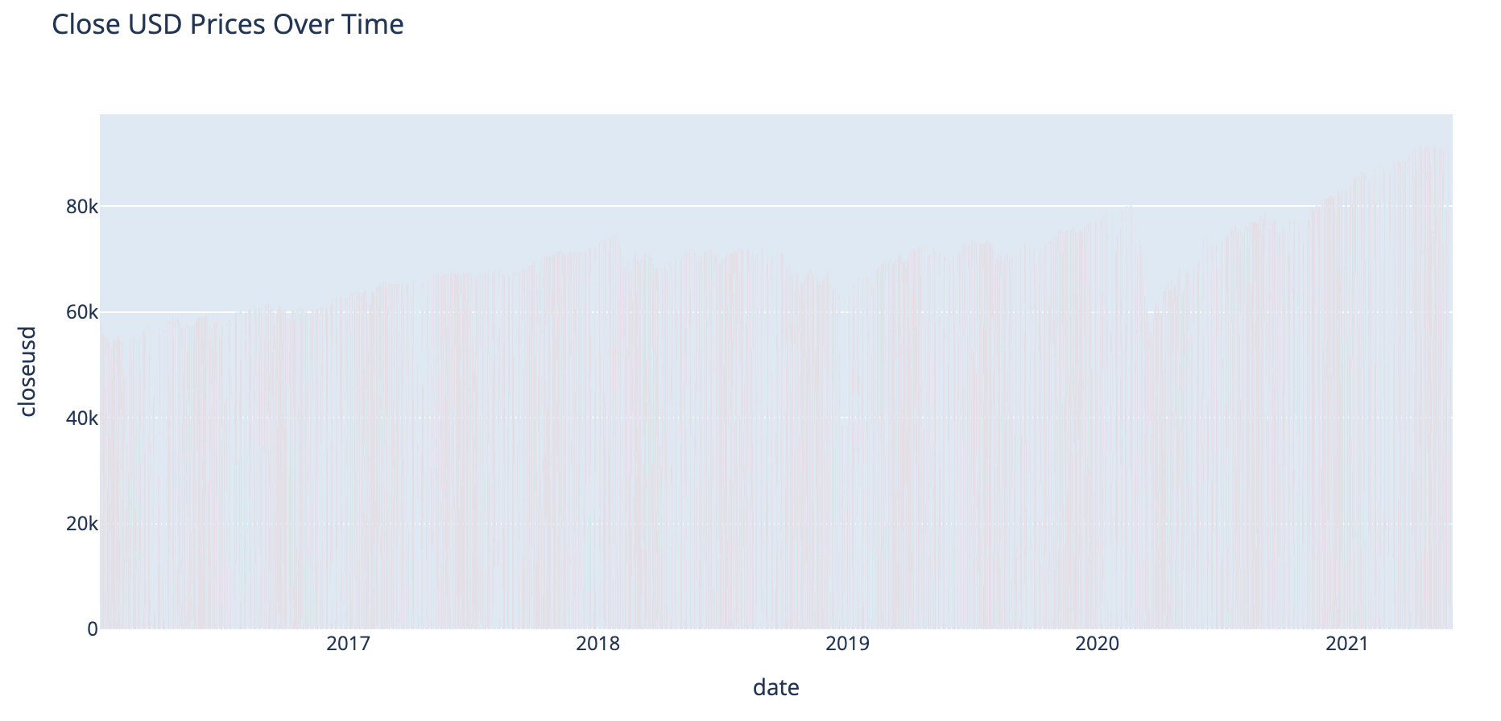
RESULTS

Slide 7
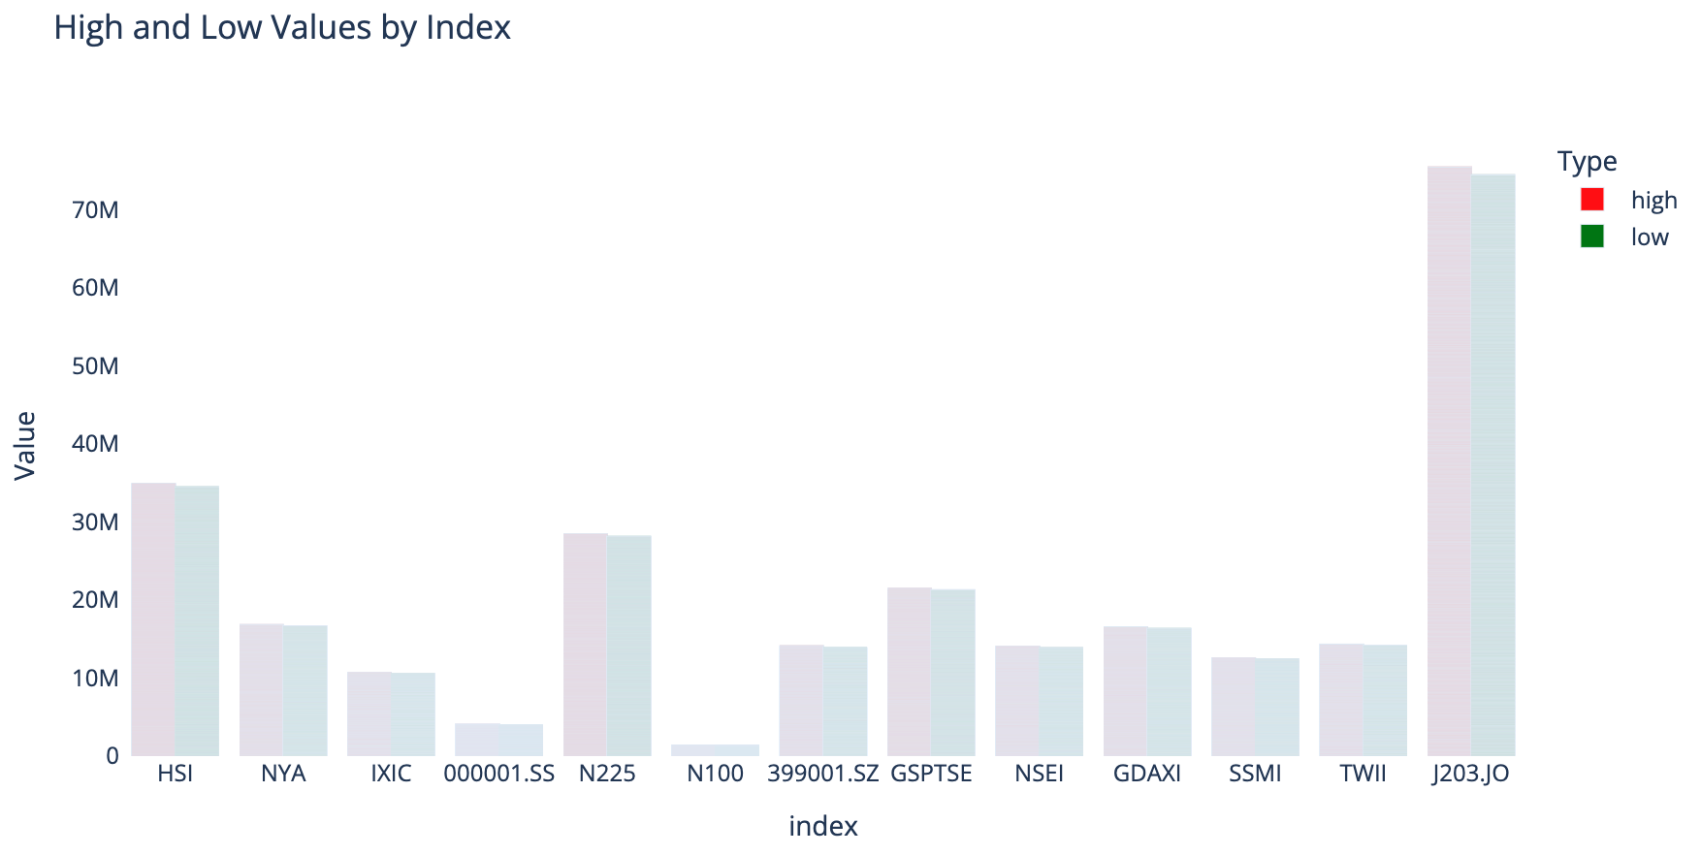

RESULTS

Slide 8




DEMONSTRATION

Slide 9

QUESTIONS

