Slide 1
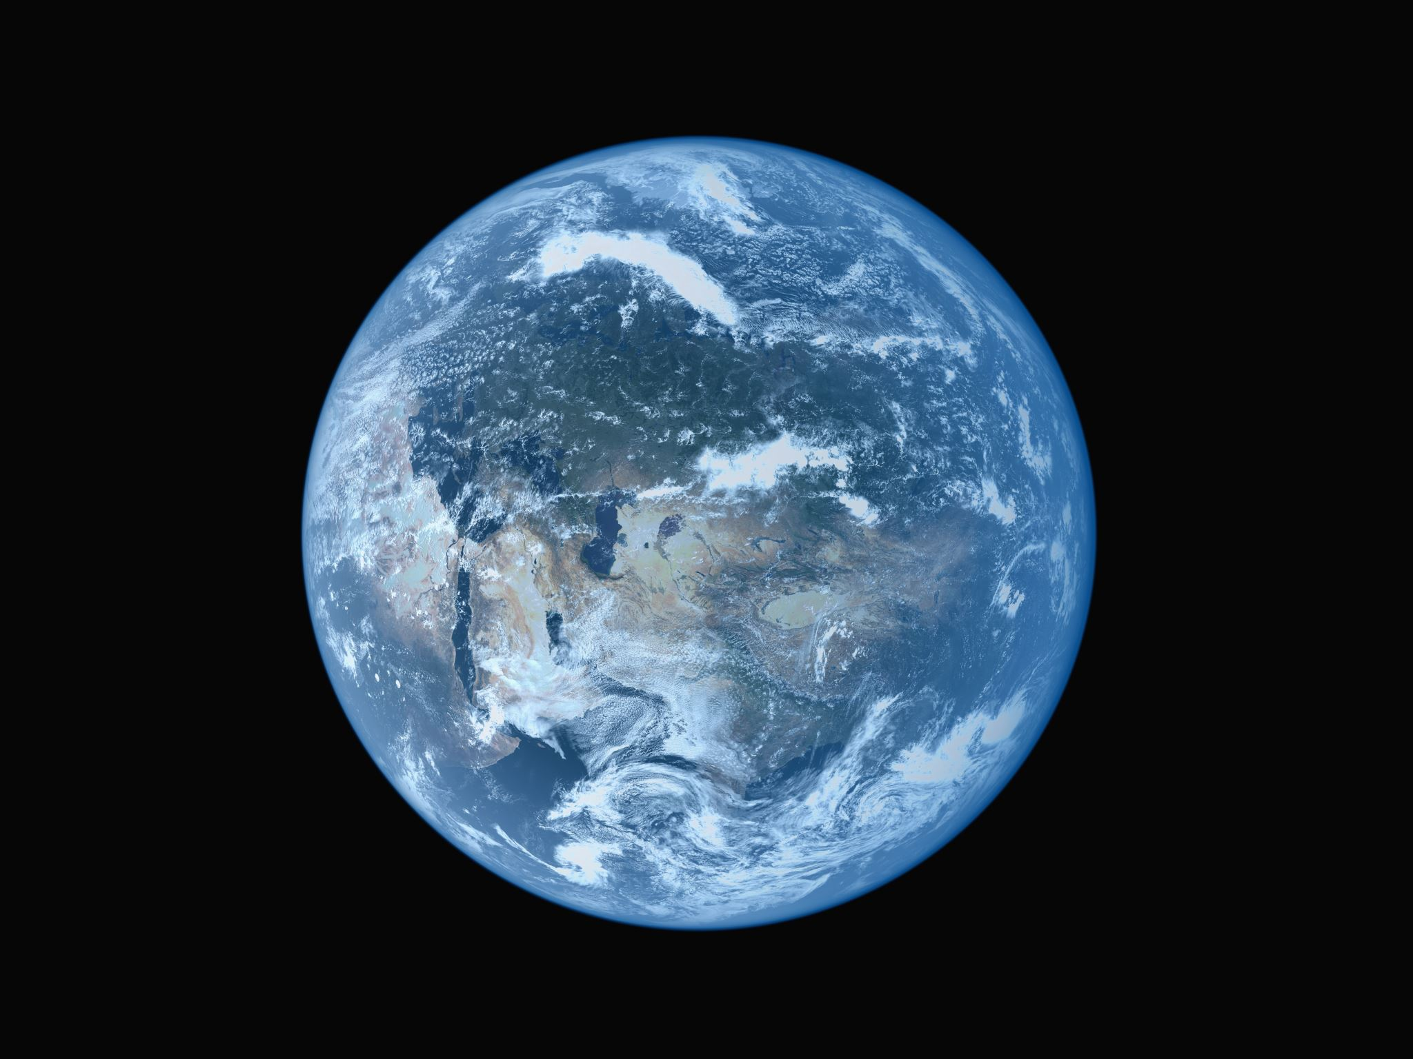
Global temperature anomaly & Country-level Climate visualizer
Presented By-
Shubham Singh (02131135)
Visit Link

Slide 2

Why and How
Why:
Provide insights into global temperature changes over the past 120 years (1901–2020).
Help users explore temperature anomalies and long-term trends, highlighting seasonal and regional variations.
Facilitate a better understanding of climate patterns to support research and awareness.
How:
Data-Ink Maximization: Focused on meaningful visual elements by using a clean map with color-coded temperature ranges and minimal distractions.
Clear Comparison: Side-by-side views of spatial and temporal trends enable quick comparison between regions and time-frames.
Layering and Separation: Multiple views (map, radial plot, line chart) clearly distinguish dimensions of the data (spatial, temporal, and anomaly-based trends).
Faceting: Monthly and yearly breakdowns to explore seasonal trends.
Multiview: Combined map, radial, and line charts offer different perspectives of the same dataset.
Filtering: Selectable options for country, year, and month empower users to filter data relevant to their needs.

Slide 3
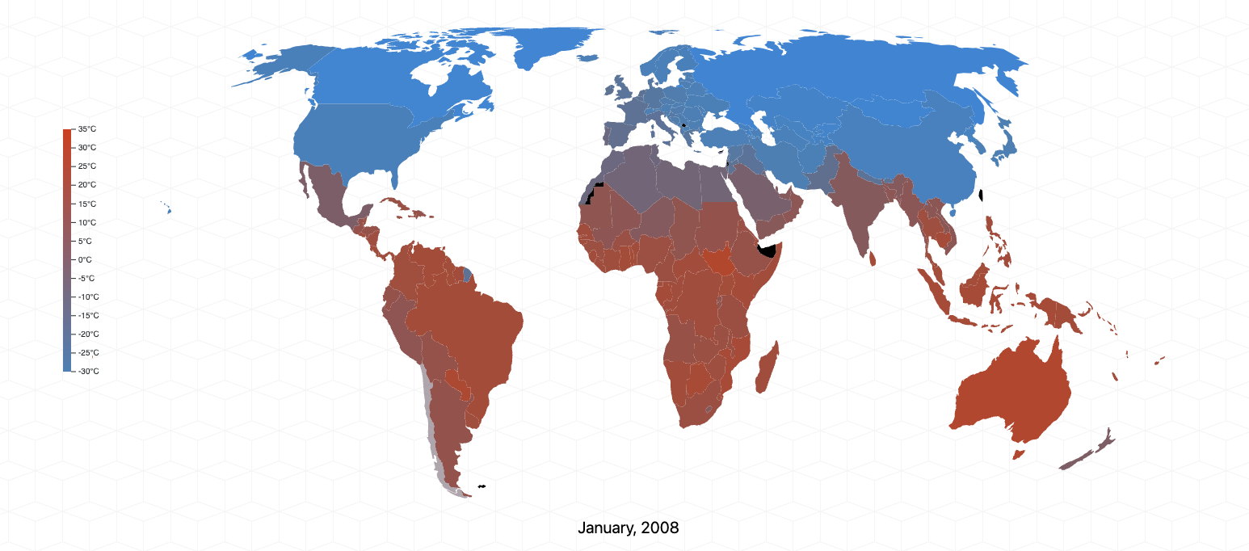
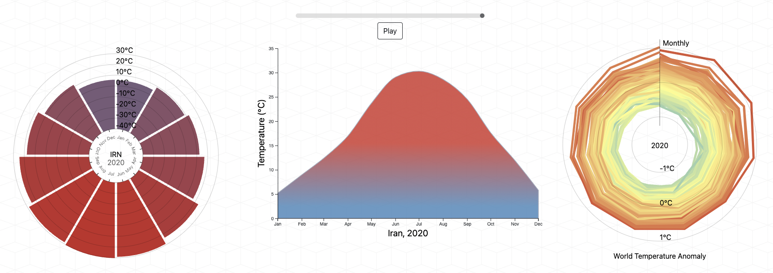
Regions (polygons representing countries) are the primary marks. Each region is filled with a color corresponding to its average temperature.
Color Encoding:
Warmer colors (reds) represent higher temperatures.
Cooler colors (blues) represent lower temperatures.
Encodes the geographic location of each region on the map.
Scale Representation:
Range: The scale spans from -30°C (deep blue) to +30°C (deep red).
Gradient: The gradient bar transitions smoothly from blue (cold regions) to red (warm regions), with intermediate shades for moderate temperatures.
Temperature Over Time: This area chart displays monthly temperature trends for countries over the years, highlighting seasonal variations.
Monthly Temperature Trends:
X-Axis: Months of the year (January to December).
Y-Axis: Average temperature in degrees Celsius (°C).
Temperature Anomaly:
Radial Axis: Represents months of the year, arranged in a circular format.
Concentric Circles: Represent the anomaly scale in degrees Celsius (e.g., -1°C, 0°C, +1°C).

Slide 4
DISCUSSIONS
Goals Achieved:
Progression from Phase 1B to Phase 2:
In Phase 1B, we focused on creating basic visualizations, including an area chart, line chart, and radial anomaly plot, to analyze and represent global temperature trends effectively.
Phase 2 strengthened these visualizations, ensuring clear communication of temperature patterns over time.
Advancements in Phase 3:
Choropleth Map Addition:
Introduced a choropleth map to visualize temperature zones across the world dynamically.
Added hover functionality to display average temperatures for specific countries, months, and years dynamically over the 120-year period.
Interactive Filters:
Implemented multiple tabs to filter data by country, year, and month, enhancing user exploration and understanding.
Dynamic Playback:
Added a "Play/Pause" button to animate the temporal data.
This allows users to analyze changes over time and observe temperature trends for specific regions dynamically.
Enhanced User Experience:
The new features (interactive map, filtering options, and animation) empower users to better explore and interpret the data, making the visualization more engaging and actionable.

Slide 5
OBSTACLES
Limitations:
Data Collection Challenges: The data for the 120 years (1901–2020) had to be sourced from two separate datasets—one for the first 100 years and another for the remaining 20 years.
Data Resolutions: For some countries, the temperature data lacks fine granularity, making it challenging to represent subregional variations accurately.
Dynamic Scaling Issues: Countries with diverse climates (e.g., large nations with varying regional temperatures) posed difficulties in dynamically adjusting the color scale for better representation.
Future Scope:
Integrating Air Pollution and AQI Data: Extend the visualization to include air pollution and Air Quality Index (AQI) metrics for respective regions.
Enhanced Filtering and Regional Granularity: Allow finer filtering options to explore subnational data (e.g., cities or provinces) for large countries.
Real-Time Data Updates: Incorporate real-time or near-real-time data for temperature, pollution, and AQI, providing users with up-to-date insights.
Predictive Analysis: Use machine learning models to predict future temperature trends and correlate them with projected AQI changes to inform policymaking.

