Slide 1

Heterogeneity-Aware Operator Placement for Stream Processing Systems at the Edge
Optimizing Edge Resources
Team 4

Slide 2
Project Overview
Rapid growth of edge computing applications.
RPi – edge computing device to connect to sensors.
Streaming app ingests data streams from RPis
To server over internet.
Limited bandwidth – high latency.
Heterogeneity aware system for operator placement.
Utilize edge computing cluster and efficiently use edge resources.
Adapt Flink
Heterogeneous hardware resources.
Adaptive/custom operator placement.

Slide 3
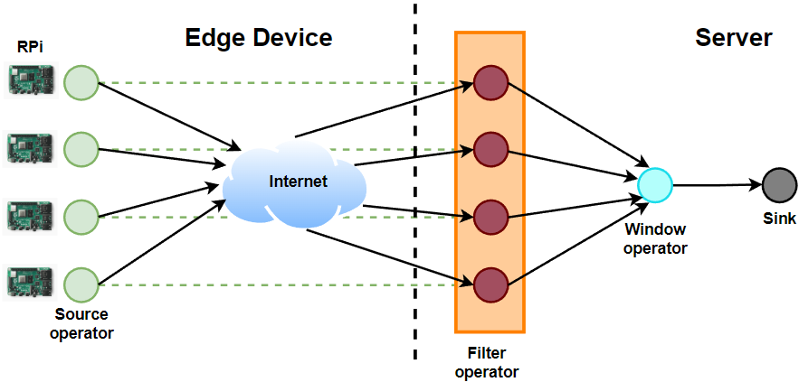
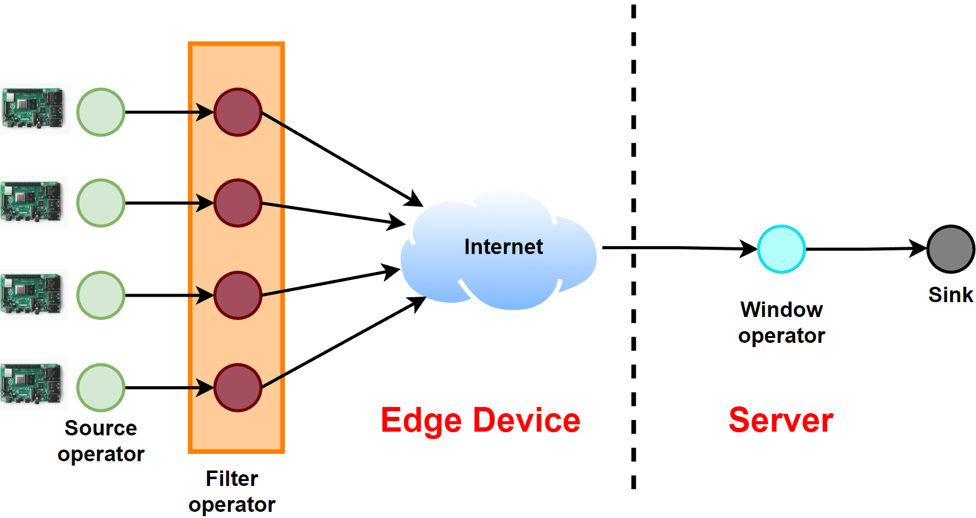
Project Overview

Slide 4
Proposed Solution
Filter operator
Selectivity
Complexity.
Preprocessing at edge
High selectivity – Reduced data traffic and low latency.
High complexity – More processing time.
Trade off based on selectivity and complexity.
Develop cost model
Algorithm to decide which operators to offload.
Implement a scheduler for offloading operator to RPis.
Improve latency and throughput.

Slide 5
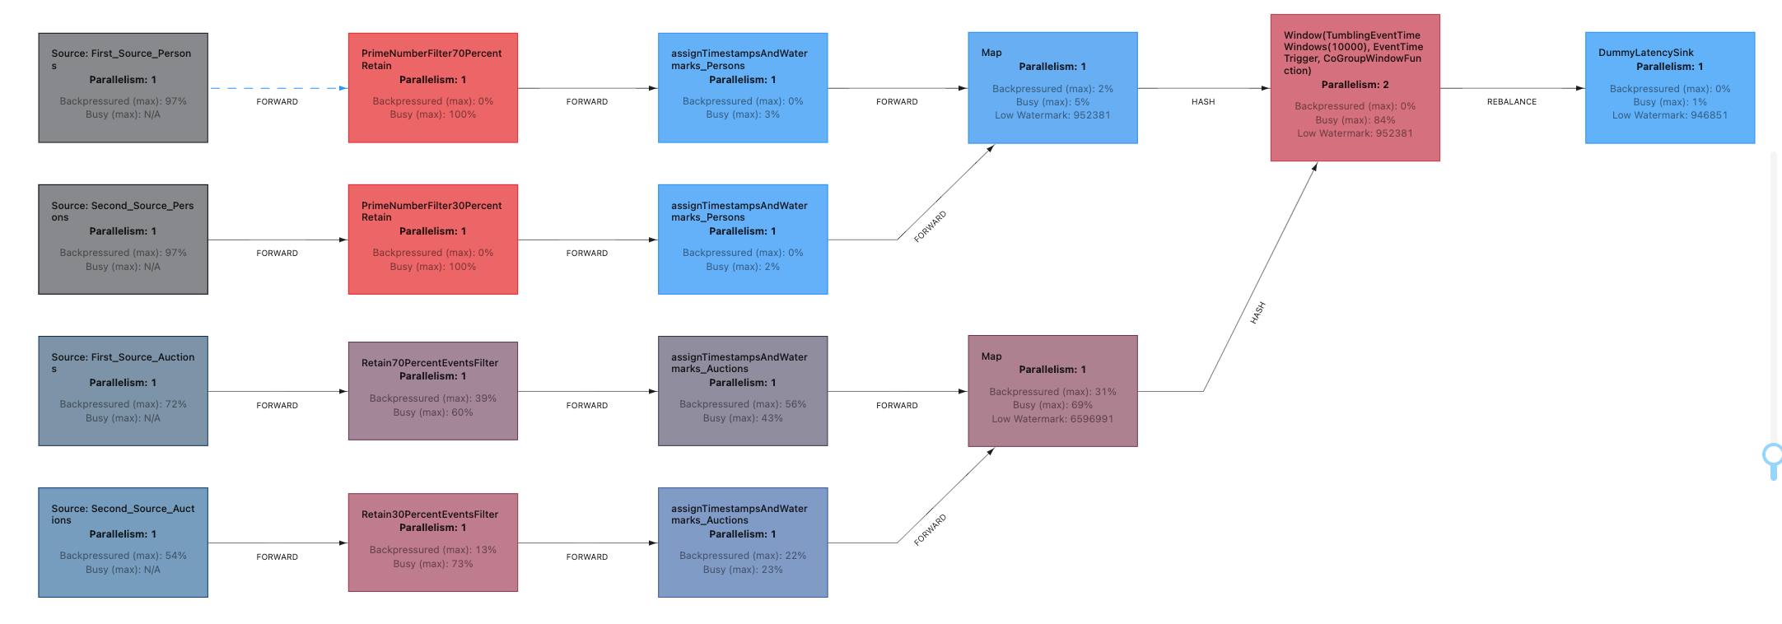
Cost Model
Identify parameters which impact the decision
Complexity, selectivity, bandwidth & RTT and data rate.
Metric used to identify suitable operators for offloading
Provide insight into operator efficiency.
Runs on server and from time to time collect metric for every operator.

Slide 6
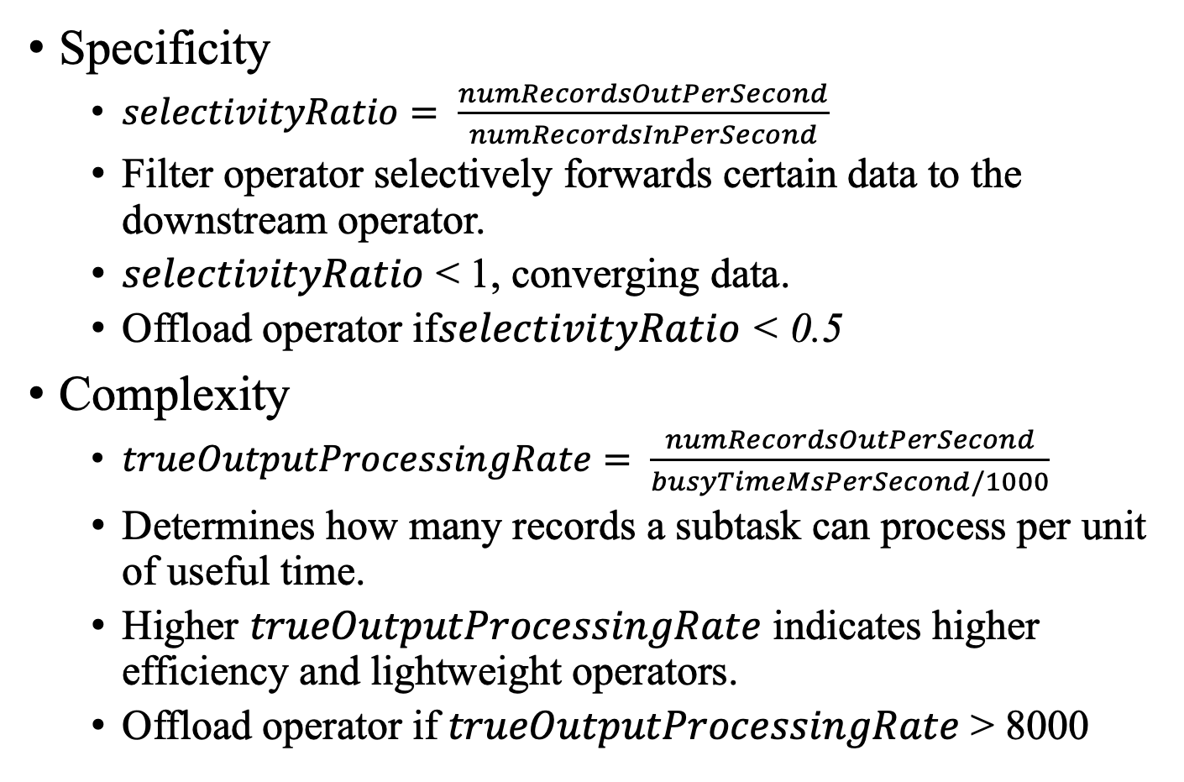
Complexity & Selectivity
Specificity
$selectivityRatio= \frac{numRecordsOutPerSecond}{numRecordsInPerSecond}$
Filter operator selectively forwards certain data to the downstream operator.
$selectivityRatio$ < 1, converging data.
Offload operator if$selectivityRatio$ < 0.5
Complexity
$trueOutputProcessingRate= \frac{numRecordsOutPerSecond}{busyTimeMsPerSecond/1000}$
Determines how many records a subtask can process per unit of useful time.
Higher $trueOutputProcessingRate$ indicates higher efficiency and lightweight operators.
$\text{Offload} \text{operator} \text{if} trueOutputProcessingRate$ > 8000

Slide 7
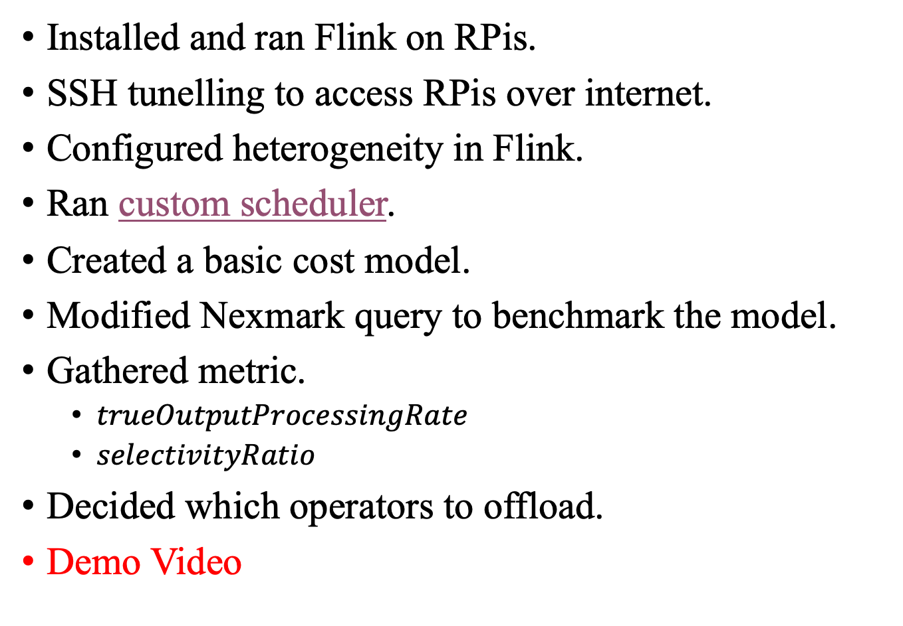
Progress
Installed and ran Flink on RPis.
SSH tunelling to access RPis over internet.
Configured heterogeneity in Flink.
Ran custom scheduler.
Created a basic cost model.
Modified Nexmark query to benchmark the model.
Gathered metric.
$trueOutputProcessingRate$
$selectivityRatio$
Decided which operators to offload.
Demo Video

Slide 8
Challenges
Collecting metrics inside Flink environment
No documentation.
REST APIs based metrics collection,
Directly access MetricFetcher modifying the Flink source code.
Configuring heterogeneity
Not straightforward
Deploy scripts and custom Flink build to work on RPis.
Debugging custom scheduler to pickup correct config.
Modifying Nexmark queries to benchmark our mode.

Slide 9
Future Work
Offload operator to edge/server adaptively based on metric.
Decisions to be made
Other metric parameters to consider.
When to run cost model
Interval of 5 seconds after initial 60 seconds.
When to offload operator
Checkpoint every 30 second
Modify schedulercfg if required and restart job from last checkpoint.
Conduct experiments.
Vary bandwidth.
Vary data rate.
Vary Round Trip Time.
New queries from Nexmark benchmark.

Slide 10
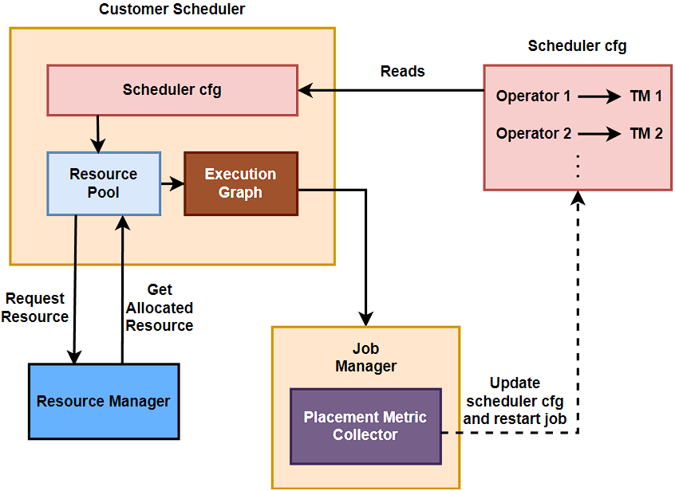
Custom Scheduler

Slide 11
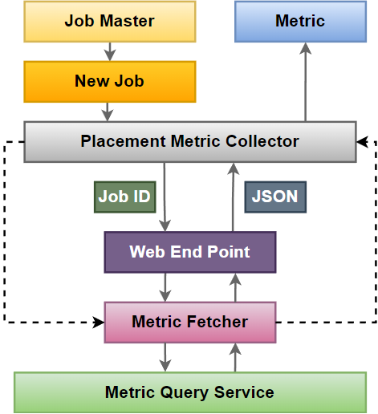
Collecting Metric
Job ID
Java Object

Slide 12
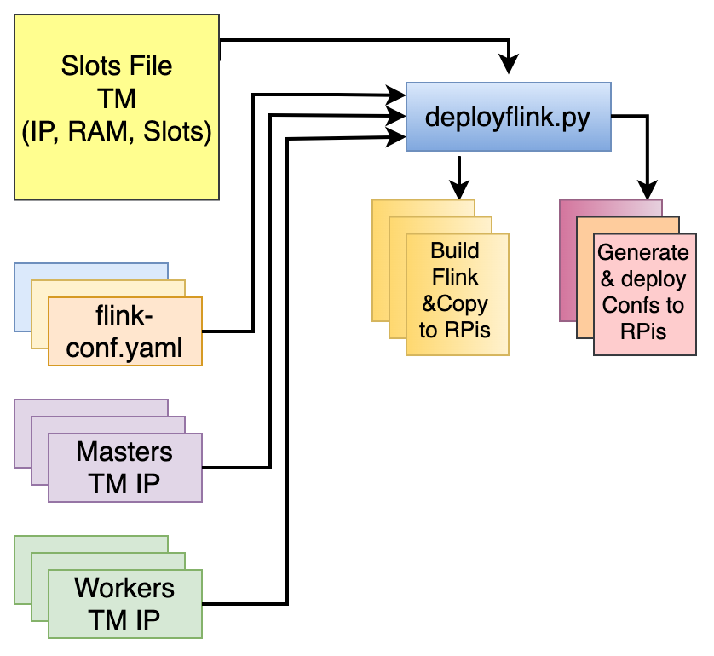
Deploy Flink on RPis

Slide 13
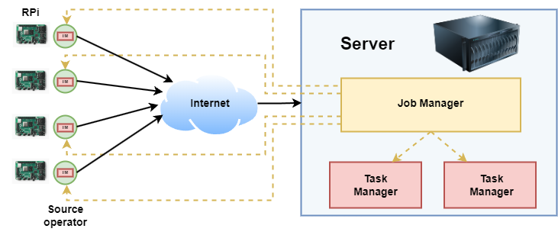
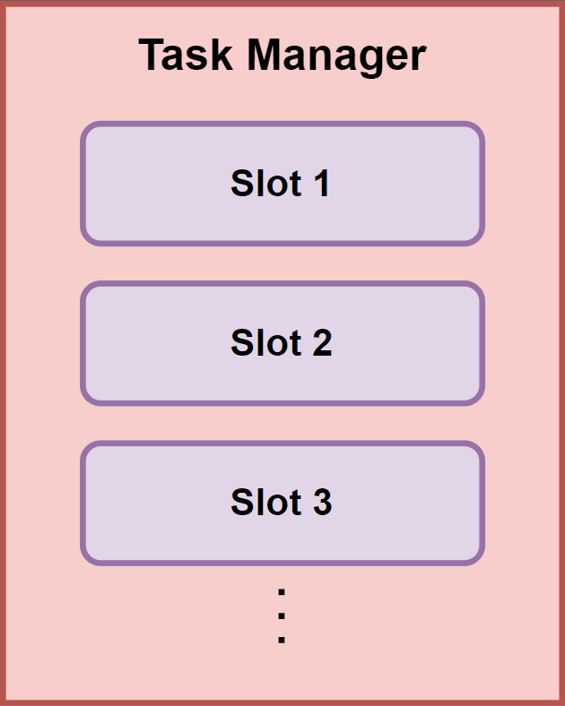
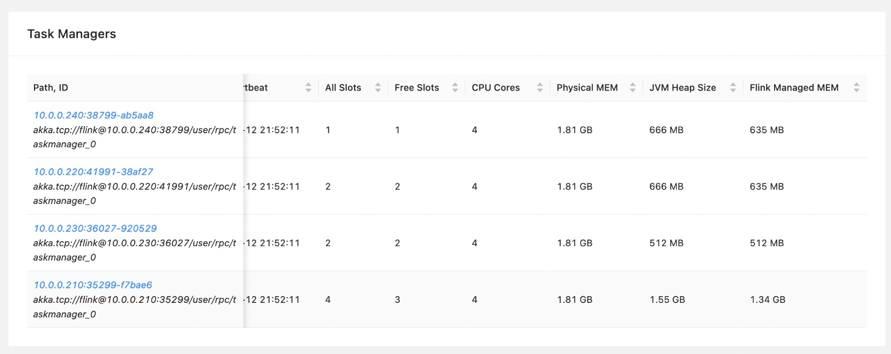
Heterogeneity Awareness

Slide 14


