Slide 1

#LifeKoKaroLift
Foundations of Programming Program

Slide 2


Course : Foundations of Programming Program
Lecture On : Functions
Instructor : Shubham Sharma

Slide 3



Poll 1
for(;i<15;i++);
The value of i after this line will be(Assuming i was declared before as i=0) :
12
17
15
0
Practice in teams of 4 students
Industry expert mentoring to learn better
Get personalised feedback for improvements
06/09/19
11

Slide 4
Poll 1
for(;i<15;i++);
The value of i after this line will be(Assuming i was declared before as i=0) :
12
17
15
0
Practice in teams of 4 students
Industry expert mentoring to learn better
Get personalised feedback for improvements
06/09/19
11

Slide 5
Poll 1 (Multiple Choice)
int i=12;
while(______) :
{ System.out.println(“Hey”);
i--;
}
The line(s) that can make the code print “Hey” 17 times is/are :
i>=0
i<27
i>=-4
i>-5
Practice in teams of 4 students
Industry expert mentoring to learn better
Get personalised feedback for improvements
06/09/19
11

Slide 6
Poll 1 (Multiple Choice)
int i=12;
while(______) :
{ System.out.println(“Hey”);
i--;
}
The line(s) that can make the code print “Hey” 17 times is/are :
i>=0
i<27
i>=-4
i>-5
Practice in teams of 4 students
Industry expert mentoring to learn better
Get personalised feedback for improvements
06/09/19
11

Slide 7
Today’s Agenda
1
Strings and Arrays
2
Functions in Java
3
User Input - The Scanner Class
4
Exceptions
5
Inbuilt Functions and Basic File I/O

Slide 8
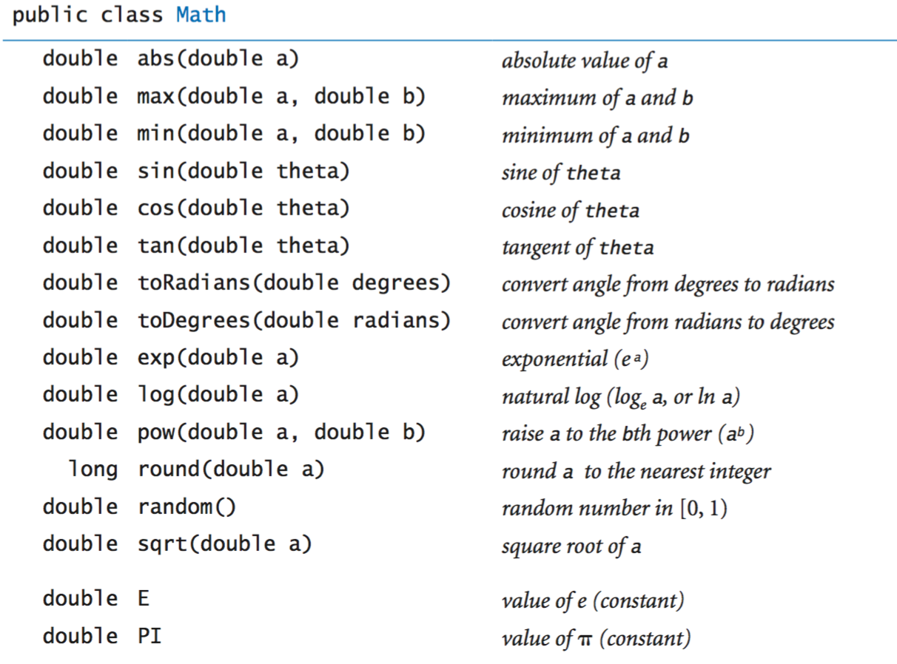
Math methods in Java

Slide 9
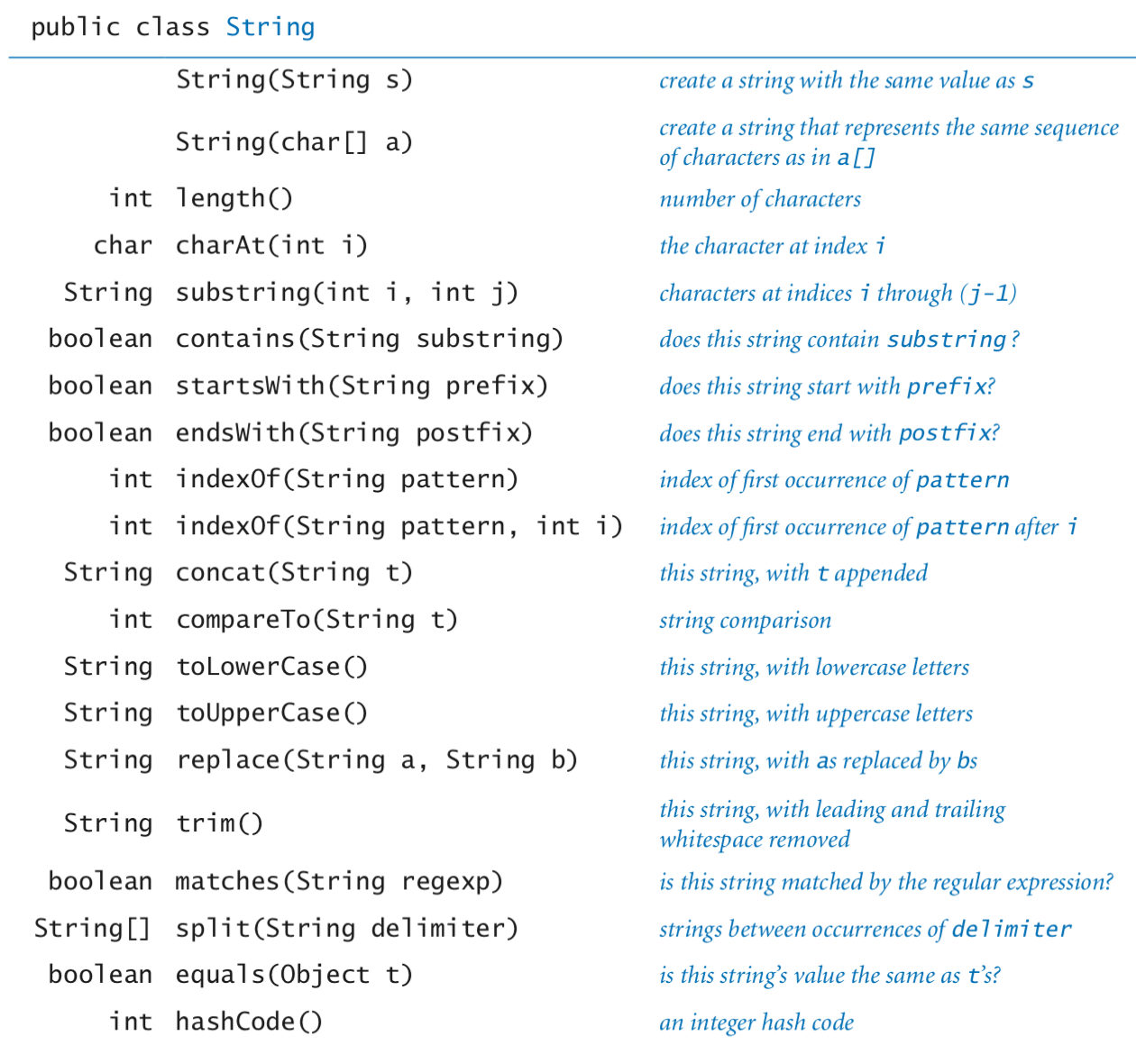
String methods in Java

Slide 10
Poll 2
Which of the following will throw a compilation error :
byte b=1;byte c=2;byte d=b+c;
Int x=1000_000;
byte b=1, c=2,d=2;
byte b=1;byte c=2;byte d=b+c;
Practice in teams of 4 students
Industry expert mentoring to learn better
Get personalised feedback for improvements
06/09/19
11

Slide 11
Poll 2
Which of the following will throw a compilation error :
byte b=1;byte c=2;byte d=b+c;
Int x=1000_000;
byte b=1, c=2,d=2;
byte b=1;byte c=2;byte d=b+c;
Practice in teams of 4 students
Industry expert mentoring to learn better
Get personalised feedback for improvements
06/09/19
11

Slide 12
Poll 2
Assuming byte b=64, what will be the output of following operation :
byte c=(byte)((b|5)+((byte)3&(byte)4));
80
69
70
64
Practice in teams of 4 students
Industry expert mentoring to learn better
Get personalised feedback for improvements
06/09/19
11

Slide 13
Poll 2
Assuming byte b=64, what will be the output of following operation :
byte c=(byte)((b|5)+((byte)3&(byte)4));
80
69
70
64
Practice in teams of 4 students
Industry expert mentoring to learn better
Get personalised feedback for improvements
06/09/19
11

Slide 14
Key Takeaway
1
Functions, Passing Parameters
2
Inbuilt methods
3
Basic File I/O

Slide 15
Next Class
1
Object oriented programming

Slide 16
#LifeKoKaroLift
Thank You!

