Slide 1
AI Invoice Processing Agent
AI-powered business process automation using
n8n, Google Gemini & Google Workspace
Presented by Shubham Vishwakarma

Slide 2
Business Problem
Invoice processing is repetitive, manual and error-prone
Manual steps
Key challenges
Receive invoices via email
Open and read documents
Extract data manually
Validate amounts and fields
Check against Purchase Orders
Detect duplicates
Approve / review / reject
Maintain records and notify
Manual data-entry effort
Extraction and validation errors
Duplicate invoice processing
PO and invoice mismatches
Delayed exception handling
No centralized processing records

Slide 3
Project Objective
Build an agentic AI invoice workflow that receives invoice PDFs via Gmail, extracts structured data with an LLM, validates it, detects duplicates, matches POs, applies deterministic business rules, logs results and escalates exceptions to a human.
Automate invoice intake
Extract structured data
Validate invoice data
Detect duplicates
Match with POs
Apply business rules
Maintain processing log
Notify users
Human-in-the-loop escalation

Slide 4
Existing Manual Process
Invoice Received
→
Open Email
→
Download PDF
→
Read Invoice
→
Manually Extract Data
→
Validate Invoice
Check PO
→
Check Duplicate
→
Approve / Reject / Review
→
Update Records
→
Notify Stakeholder
Limitations
Multiple manual steps and repetitive work
Higher possibility of human error; time-consuming validation
Manual exception identification
Inconsistent processing records

Slide 5
Proposed Automated Solution
Gmail Invoice
→
Retrieve Invoice
→
Extract Text
→
AI Data Extraction
→
Data Validation
Duplicate Detection
→
PO & Vendor Validation
→
Decision Engine
→
Log Result
→
Notify / Human Review
Approved / normal → Processing notification | Exception → Human review alert
Core principle: AI handles unstructured extraction; deterministic business rules handle validation, matching and the final decision.

Slide 6
Technology Stack
Workflow automation + LLM + business rules + human-in-the-loop
Technology | Purpose
n8n Cloud | Workflow orchestration and automation
Gmail | Invoice email trigger and notifications
Google Drive | Storage of original invoice PDFs
Google Gemini | AI-based invoice information extraction
Structured Output Parser | Converts AI output into structured JSON
JavaScript (n8n Code) | Validation, duplicate detection, decision logic
Google Sheets | PO Master and Invoice Log
Human-in-the-Loop | Handles exceptions needing manual review

Slide 7
System Architecture
Gmail Invoice Email
→
n8n Workflow Engine
→
PDF Text Extraction
→
Google Gemini
Validation & Business Rules
→
Decision Engine
→
Google Sheets PO / Log
→
Gmail Notification
Google Drive keeps the original invoice PDF
Google Sheets holds the PO Master and Invoice_Log
Exceptions go to a human reviewer instead of auto-approval

Slide 8
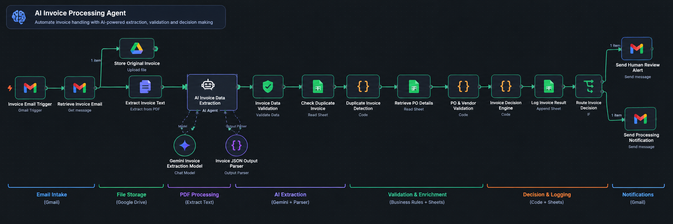
Final Implemented n8n Workflow
Fig. Final workflow with supporting Google Drive, Gemini and Output Parser components
Trigger → retrieve → extract text → Gemini → validate → duplicate check → PO check → decision → log → route

Slide 9
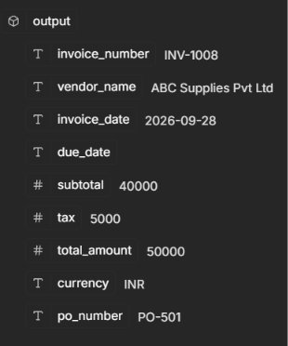
AI-Powered Invoice Extraction
Gemini converts unstructured invoice text into structured JSON
Extracted fields
Invoice number, vendor name
Invoice date, due date
PO number
Subtotal, tax, total amount
Currency
{
"invoice_number": "INV-1008",
"vendor_name": "ABC Supplies Pvt Ltd",
"invoice_date": "2026-09-28",
"subtotal": 40000, "tax": 5000,
"total_amount": 50000,
"currency": "INR",
"po_number": "PO-501"
}
Gemini structured output
The LLM extracts information; it does not make the approval decision.

Slide 10
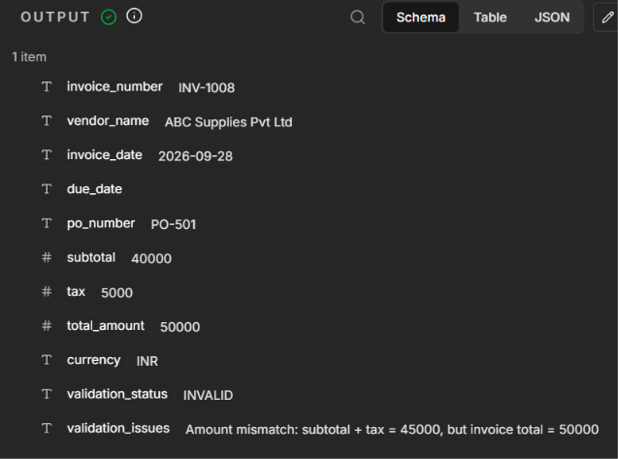
Invoice Data Validation
Deterministic rules run after AI extraction
Invoice number, vendor, invoice date exist
PO number exists
Subtotal, tax, total exist
Subtotal + Tax = Total Amount
Example: 40,000 + 5,000 = 45,000, but invoice total = 50,000 → INVALID → HUMAN REVIEW
Validation output (INV-1008)

Slide 11
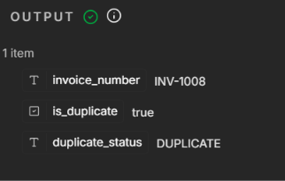
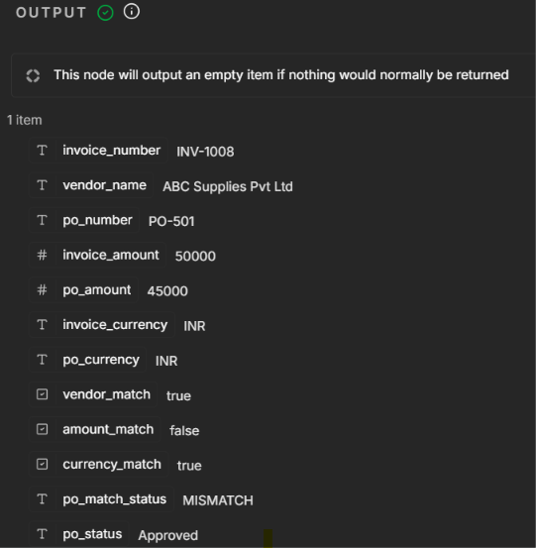
Duplicate Detection & PO Matching
Duplicate detection
PO & vendor validation
Invoice number searched in Invoice_Log
Already exists → DUPLICATE → REJECTED
Matches PO number, vendor, amount, currency, PO status
Any mismatch → HUMAN REVIEW
Duplicate detection output
PO validation output (amount mismatch)

Slide 12
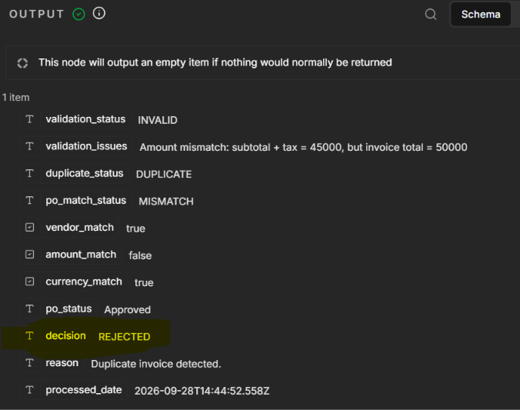
Invoice Decision Engine
Final decision comes from deterministic business rules
Rule | Decision
Duplicate invoice | REJECTED
Validation failed | HUMAN REVIEW
PO / vendor / amount / currency mismatch | HUMAN REVIEW
PO not approved | HUMAN REVIEW
All checks pass | APPROVED
The decision reason is stored for traceability.
Decision engine output (duplicate → REJECTED)

Slide 13
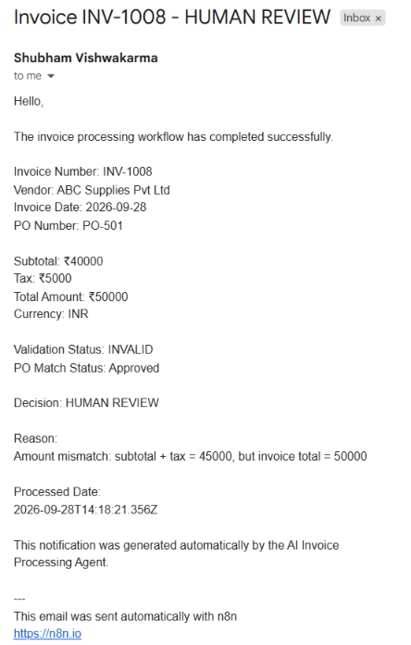
Human-in-the-Loop
Uncertain cases are reviewed, not auto-approved
A review alert is sent when
Validation fails
Amount, vendor or currency mismatches PO
PO is not approved
Other business-rule exceptions
Exception → HUMAN REVIEW → logged → email alert
Human review Gmail alert

Slide 14
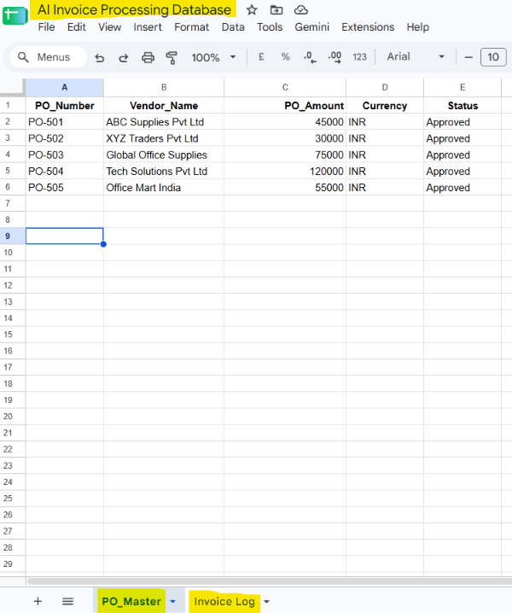
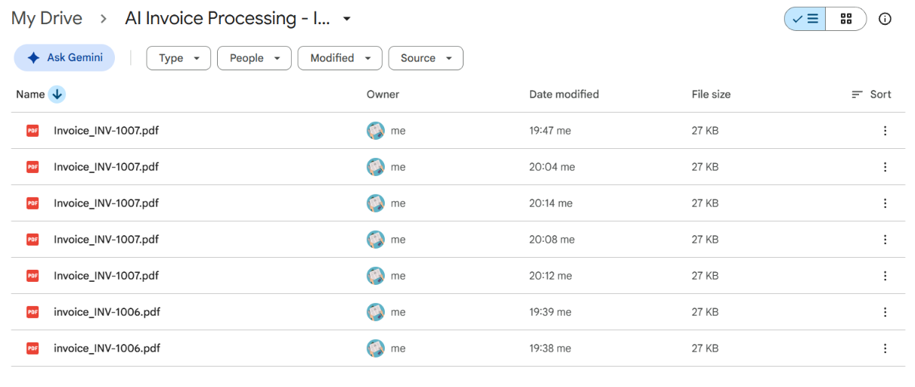
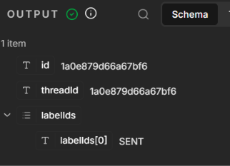
Logging, Storage & Notifications
Traceability from original invoice to final outcome
Invoice_Log stores invoice data, validation, PO match, decision, reason and date
Original PDFs stored in Google Drive
Human review alert or processing notification sent
Original PDFs in Google Drive
PO_Master / Invoice_Log
Processing notification sent

Slide 15
Testing & Results
ID | Scenario | Expected result
TC-01 | Valid invoice + matching PO | APPROVED
TC-02 | Invoice amount ≠ PO amount | HUMAN REVIEW
TC-03 | Duplicate invoice number | REJECTED
TC-04 | Invoice arithmetic mismatch | HUMAN REVIEW
Verified: extraction, validation, duplicate detection, PO matching, decision logic, routing, notifications, logging
Result: intake → AI extraction → validation → PO matching → decision → logging → notification works end to end.

Slide 16
Key Controls & Design Principles
Structured AI output
Parser constrains Gemini to a JSON schema
Deterministic validation
Financial checks use explicit rules
Duplicate detection
Invoice numbers checked against the log
PO matching
Vendor, amount, currency, status verified
Human-in-the-loop
Exceptions routed to manual review
Auditability
Results and reasons stored in Invoice_Log
AI extracts information; deterministic business rules control the decision.

Slide 17
Business Benefits
Less repetitive manual invoice work
Standardized validation
Duplicate invoices detected
PO mismatches identified
Better exception handling
Centralized processing records and traceability
Automated processing notifications
Manual processing
↓
AI + automation + business rules
↓
Structured, controlled processing

Slide 18
Future Scope
ERP and Vendor Master integration
OCR for scanned / image invoices
Advanced approval thresholds
Accounts-payable system integration
Multi-currency processing
Invoice analytics dashboard
Human approval interface
Fraud / anomaly detection
Automated payment workflow

Slide 19
Conclusion
Agentic AI + workflow automation for a real business process
Receives invoices automatically and extracts data with Gemini
Validates data, detects duplicates, matches POs
Applies deterministic rules and logs every result
Sends notifications and routes exceptions to reviewers
Architecture: Gmail + n8n + Gemini + Google Drive + Google Sheets + Gmail + Human-in-the-Loop

Slide 20
Thank You

