Slide 1
PRP PROJECT
E-Commerce Digital Analytics
Final Deliverable Presentation
SQL Server • Python & Machine Learning • Power BI
End-to-end analytics on website sessions, orders, products & refunds
Prepared by Shubham Vishwakarma

Slide 2
AGENDA
What We'll Cover
Business Understanding
Technology Stack & Data Architecture
01
02
Context, problem statement & objectives
Tools used and how the data is modelled
Data Quality & KPI Framework
Descriptive Analysis
03
04
Audit approach and how KPIs are defined
Revenue, marketing, product & refund performance
Diagnostic Analysis
Predictive Analysis
05
06
Where and why performance varies
Session conversion model & key drivers
Power BI Dashboards
Findings, Recommendations & Conclusion
07
08
Executive-ready visual reporting
What we learned and what to do next
PRP E-COMMERCE DIGITAL ANALYTICS
2

Slide 3
BUSINESS UNDERSTANDING
Business Context & Problem Statement
Context
What Success Looks Like
An e-commerce company operates an online store selling a small catalogue of gift and novelty products (e.g. “The Original Mr. Fuzzy”). The business tracks every website session, order, product line item and refund, but this data has never been consolidated into a single source of truth or turned into a decision-ready reporting layer.
One clean SQL Server model behind every number
Self-serve Power BI dashboards for execs & marketing
A documented, repeatable EDA + diagnostic process
A predictive model that flags conversion likelihood
Clear, prioritised business recommendations
Problem Statement
Leadership cannot see revenue, margin and refund performance in one place.
It is unclear which marketing channels and devices actually convert profitably.
Refunds and margin erosion by product are not systematically investigated.
There is no data-driven way to flag sessions likely (or unlikely) to convert.
PRP E-COMMERCE DIGITAL ANALYTICS
3

Slide 4
OBJECTIVES & TECH STACK
Project Objectives & Technology Stack
Objectives
Technology Stack
1
Build a validated, single source of truth in SQL Server
1
SQL Server
Data warehouse, cleaning views, KPI & diagnostic queries
2
Deliver descriptive & diagnostic analysis of sales, marketing, product and refund performance
2
Python (pandas, scikit-learn)
EDA, visualisation & logistic regression modelling
3
Design and build Power BI dashboards for ongoing self-serve reporting
3
Jupyter Notebook
Reproducible, documented analysis workflow
4
Develop a predictive (logistic regression) model for session conversion
4
Power BI Desktop
Executive, marketing, product & refund dashboards
5
Translate analysis into prioritised, actionable business recommendations
5
Project Documentation
Structured documentation of SQL, Python & Power BI analysis
Every objective above is delivered through this exact stack – SQL Server for the source of truth (connected via pyodbc), Python for analysis and modelling, Power BI for the reporting layer, and GitHub to keep it all versioned.
PRP E-COMMERCE DIGITAL ANALYTICS
4

Slide 5
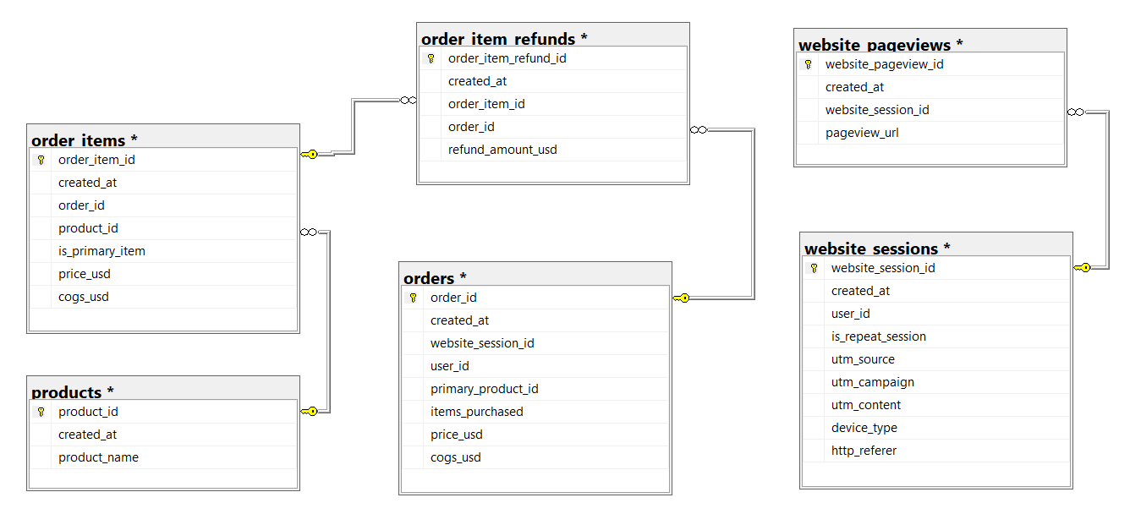
DATA ARCHITECTURE
Data Model & ER Diagram
6 core tables covering sessions, pageviews, orders, order items, products & refunds
Core Tables
website_sessions – traffic source, device, repeat flag
website_pageviews – page-level browsing path
products – product catalogue
orders – order-level revenue & COGS
order_items – line-item detail per order
order_item_refunds – refund amount & timing
Source: PRP_Ecommerce_Analytics – dbo schema (raw) → analytics schema (clean views)
PRP E-COMMERCE DIGITAL ANALYTICS
5

Slide 6
DATA QUALITY
Data Audit & Cleaning Approach
10 SQL scripts, executed in order, transform raw tables into trusted analytics views
1
Audit Revalidation
4
EDA (Sales, Marketing, Product, Customer)
Row counts, primary-key duplicate checks and meaningful-NULL review on all 6 source tables.
Four dedicated scripts profiling each business area independently.
2
Cleaning & Transformation
5
Diagnostic Analysis
Standardised types, trimmed text fields and built analytics.vw_* clean views without altering raw tables.
Comparative & decomposition queries – device, channel, product and calendar cuts.
3
KPI Definitions
6
Final Reconciliation & KPI Snapshot
Reusable queries for revenue, margin, AOV, refunds, sessions & conversion rate.
Single validated result set used as the source of truth for this presentation.
Principle
Raw source tables are never modified. Every transformation lives in versioned SQL views (analytics schema), so results are always reproducible and auditable back to source.
PRP E-COMMERCE DIGITAL ANALYTICS
6

Slide 7
KPI FRAMEWORK
How Our KPIs Are Defined
Definitions used consistently across SQL, Python and Power BI
KPI | Definition | Layer
Gross Revenue | SUM(price_usd) across all order line items | SQL
Gross Margin % | (Revenue − COGS) / Revenue × 100 | SQL
Average Order Value (AOV) | AVG(price_usd) per order | SQL
Net Revenue | Gross Revenue − Total Refund Amount | SQL
Conversion Rate | Converted Sessions / Total Sessions × 100 | SQL / Python
Revenue per Session | Gross Revenue / Total Sessions | SQL / Power BI
Refund Rate | Refund Amount / Revenue × 100 | SQL / Power BI
PRP E-COMMERCE DIGITAL ANALYTICS
7

Slide 8
DESCRIPTIVE ANALYSIS
Executive KPI Snapshot
SQL final KPI snapshot – Dec 2012 to Apr 2015, validated against Power BI
$1.94M
32,313
472,871
6.83%
Gross Revenue
Total Orders
Website Sessions
Conversion Rate
$59.99
62.74%
$1.22M
$85.3K
Avg. Order Value
Gross Margin
Gross Profit
Total Refunds (4.40% of rev.)
Net Revenue: $1.85M • Total COGS: $722.4K • Revenue per Session: $4.10
PRP E-COMMERCE DIGITAL ANALYTICS
8

Slide 9
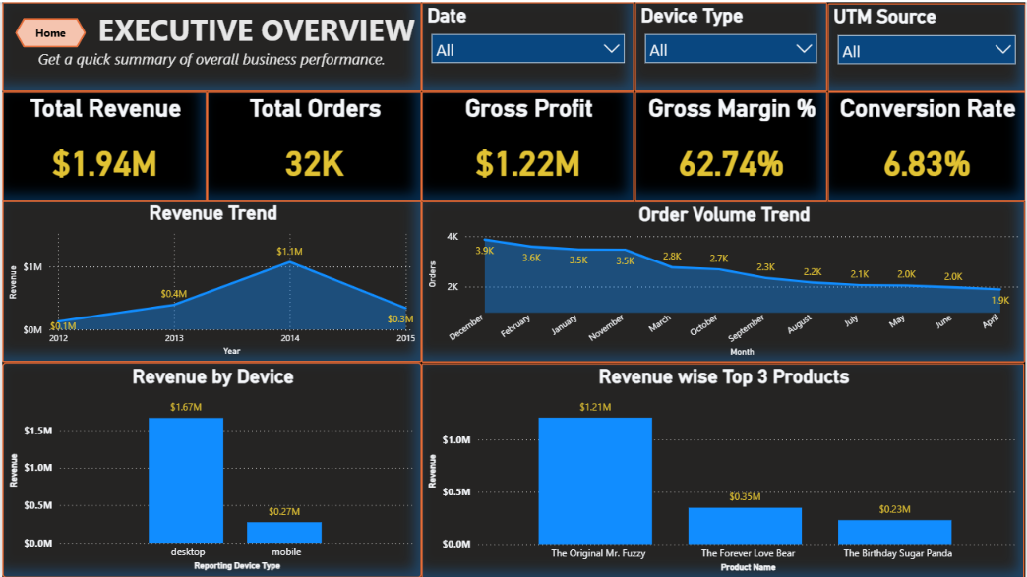
DESCRIPTIVE ANALYSIS
Executive Overview Dashboard
Dynamic, filterable by date, device type & UTM source – published to Power BI Service
PRP E-COMMERCE DIGITAL ANALYTICS
17

Slide 10
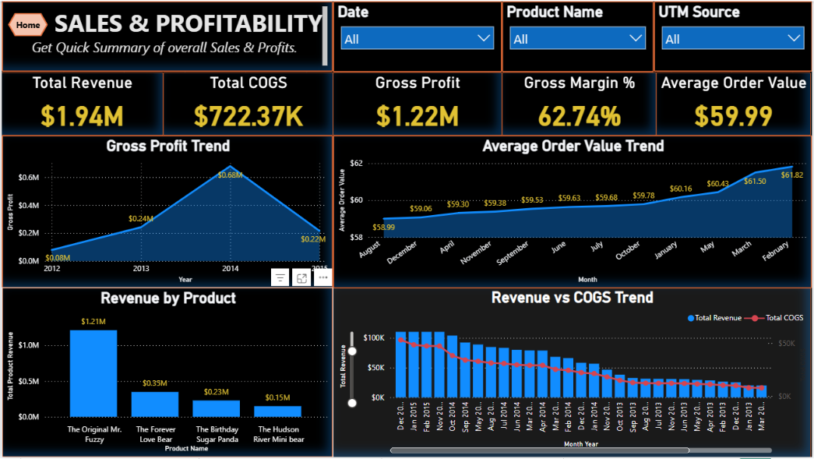
DESCRIPTIVE ANALYSIS
Revenue & Profitability Trends
Power BI – Sales & Profitability dashboard, connected live to SQL Server
Reading the Trend
Revenue & gross profit peak in 2014, then taper into early 2015
AOV climbs steadily from $58.99 to $61.82 over the window
COGS tracks revenue closely, keeping margin stable near 62–63%
Order volume declines faster than revenue – fewer, higher-value orders
PRP E-COMMERCE DIGITAL ANALYTICS
9

Slide 11
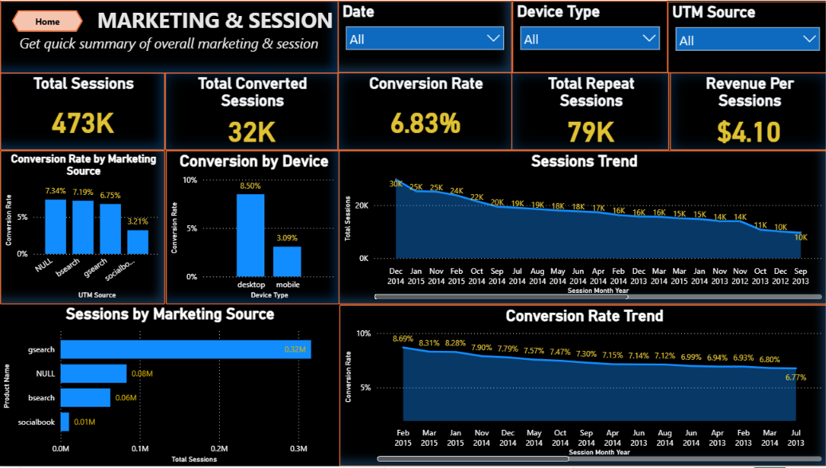
DESCRIPTIVE ANALYSIS
Marketing & Session Performance
Power BI – Marketing & Sessions dashboard
Reading the Trend
Google Search drives 67% of all sessions (316K of 473K)
Desktop converts nearly 3x better than mobile (8.50% vs 3.09%)
Repeat sessions are only 17% of traffic but convert better (7.83% vs 6.64%)
Overall conversion rate has drifted down from ~8.7% to ~6.8%
PRP E-COMMERCE DIGITAL ANALYTICS
10

Slide 12
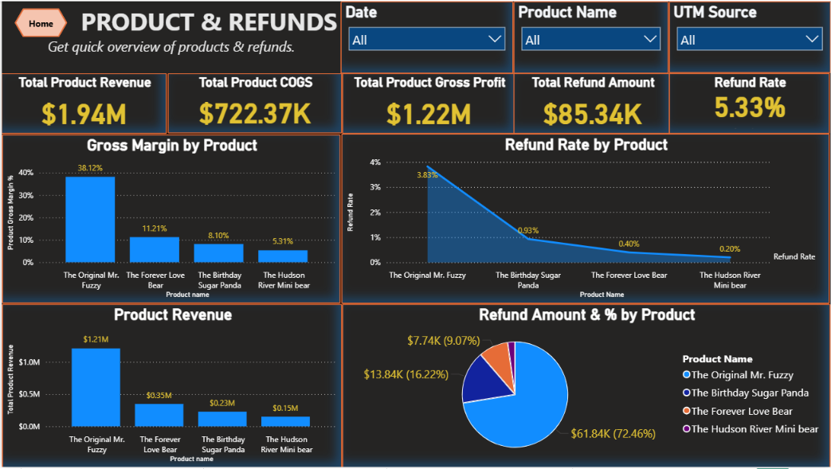
DESCRIPTIVE ANALYSIS
Product Performance & Refunds
Power BI – Product & Refunds dashboard
Reading the Trend
Mr. Fuzzy drives 62% of revenue but has the thinnest margin (61.0%)
Birthday Sugar Panda has the best margin (68.5%) and highest refund rate (6.04%)
Hudson River Mini Bear is the safest line: strong margin, lowest refunds (1.28%)
72% of all refund dollars come from Mr. Fuzzy alone ($61.8K)
PRP E-COMMERCE DIGITAL ANALYTICS
11

Slide 13
DIAGNOSTIC ANALYSIS
Where Does Conversion Fall Short?
Conversion rate by device — the single biggest performance gap in the funnel
Diagnostic Read-outs
Device gap
Mobile converts at 3.09% vs desktop 8.50% – a 5.4 point gap despite mobile carrying 31% of all sessions (145.8K).
Session type
Repeat sessions convert better than new (7.83% vs 6.64%), but make up only 17% of traffic – upside in remarketing.
Revenue at risk
At desktop's conversion rate, mobile's 145.8K sessions would generate roughly $740K – about $470K more than today.
PRP E-COMMERCE DIGITAL ANALYTICS
12

Slide 14
DIAGNOSTIC ANALYSIS
Channel Quality & Product Risk
Volume is not the same as value — looking beyond session/unit counts
Marketing Channel Quality Matrix
Channel | Sessions | Conv. Rate | Rev / Session
Direct / Organic (NULL) | 83,328 | 7.34% | $4.46
bsearch | 62,823 | 7.19% | $4.28
gsearch | 316,035 | 6.75% | $4.04
socialbook | 10,685 | 3.21% | $2.08
So What?
Rebalance channel spend
socialbook converts at less than half the average rate and returns the lowest revenue per session — review targeting and creative before increasing spend.
Best-margin product carries the most refund risk
gsearch drives the most sessions and revenue, but direct/organic and bsearch traffic actually convert more efficiently per session.
Birthday Sugar Panda pairs the highest margin (68.5%) with the highest refund rate (6.04%) – a quality or expectation-setting review would protect that margin.
Product Margin vs. Refund Risk
Product | Margin % | Refund %
The Original Mr. Fuzzy | 61.0% | 5.11%
The Forever Love Bear | 62.5% | 2.23%
The Birthday Sugar Panda | 68.5% | 6.04%
The Hudson River Mini Bear | 68.4% | 1.28%
Flagship product needs a refund review
Mr. Fuzzy is 62% of revenue and 72% of refund dollars – even a small improvement here has an outsized profit impact.
PRP E-COMMERCE DIGITAL ANALYTICS
13

Slide 15
PREDICTIVE ANALYSIS
Predicting Session Conversion
Approach, feature engineering & model selection
Modelling Approach
Why Logistic Regression Fits Here
Objective
Target is binary (converted vs not converted) – a natural fit for logistic, not linear, regression
Coefficients translate directly into “which session traits raise or lower conversion odds” – useful for marketing conversations
Fast to train and re-train as new session data lands, keeping the model easy to refresh
Serves as an interpretable baseline before considering tree-based models for further lift
Predict whether a website session converts into an order (binary classification).
Target
converted_session (1 = converted, 0 = not converted)
Algorithm
Logistic Regression – chosen for a binary target and for interpretable, business-explainable coefficients.
Leakage control
order_count and session_revenue intentionally excluded – they reveal the outcome directly.
Pipeline
SQL Server → Python extraction → validation → train/test split → preprocessing (encode + scale) → Logistic Regression → evaluation → model saved for reuse
Features used
Device type, UTM source/campaign/content, referrer, repeat-session flag, session hour, day of week, month & year.
PRP E-COMMERCE DIGITAL ANALYTICS
14

Slide 16
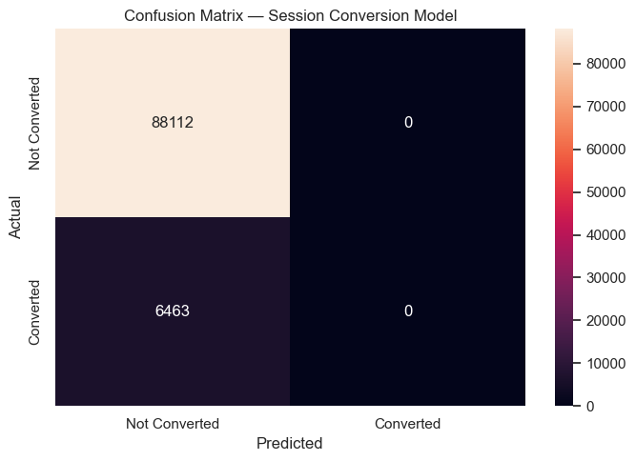
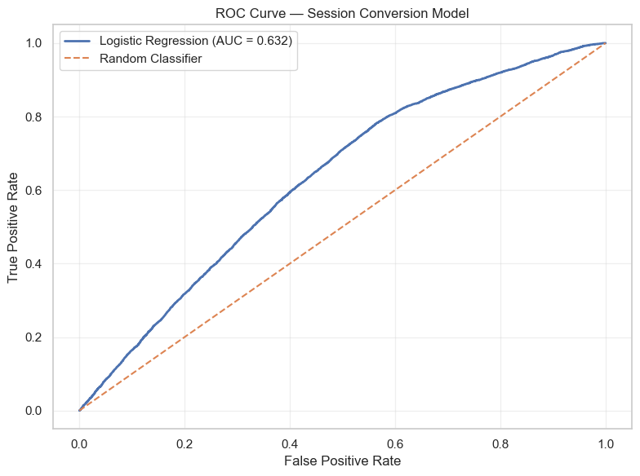
PREDICTIVE ANALYSIS
Model Results & Key Drivers
Held-out test set of 94,575 sessions
93.17%
0.632
0.00
Accuracy
ROC-AUC
Precision (class 1)
Honest Read of Model Quality
What Drives Conversion Odds
The dataset is imbalanced – only about 7% of sessions convert. The model reaches 93% accuracy simply by leaning toward the majority “not converted” class, so precision/recall on actual conversions are effectively zero at the default threshold. ROC-AUC of 0.63 shows the model has real, moderate signal – useful for ranking session quality – but it is not yet reliable as a stand-alone converter/non-converter classifier. Next step: address class imbalance (class weighting / resampling) and tune the decision threshold before deployment.
Raises odds:
Later years/months in the dataset • Repeat session • Time-of-day / weekday effects (small)
Lowers odds:
Mobile device (strongest negative driver) • Social (socialbook) traffic • Paid non-brand / pilot campaigns • bsearch source
Confirms the diagnostic finding: mobile and social traffic are the clearest places to improve conversion.
PRP E-COMMERCE DIGITAL ANALYTICS
15

Slide 17
FINDINGS
Key Business Findings
Synthesised from SQL, Python and Power BI analysis
Revenue is concentrated
Mobile is under-converting
The Original Mr. Fuzzy alone drives 62% of revenue and 61% of gross profit – the business is highly dependent on one SKU.
Mobile sessions convert at 3.09% vs 8.50% on desktop — the single largest, most fixable performance gap identified.
Paid search scales volume, not efficiency
Margin and refund risk can co-exist
gsearch brings the most sessions and revenue, but direct/organic and bsearch traffic convert more efficiently per session.
The Birthday Sugar Panda has the best margin (68.5%) and the highest refund rate (6.04%) – worth a quality/expectations review.
Repeat visitors are more valuable
The conversion model shows moderate, usable signal
Repeat sessions convert at 7.83% vs 6.64% for new sessions and generate $0.77 more revenue per session.
ROC-AUC of 0.63 confirms device and channel are real predictors, but class imbalance limits it as a stand-alone classifier today.
PRP E-COMMERCE DIGITAL ANALYTICS
18

Slide 18
RECOMMENDATIONS
Business Recommendations
Prioritised, actionable next steps for the business
1
2
3
Fix the mobile experience
Rebalance marketing spend on efficiency, not volume
Protect the flagship product's margin & quality
Run a UX/checkout audit on mobile; closing even half the gap to desktop could add roughly $200–250K in annual revenue.
Shift incremental budget toward channels with strong revenue-per-session (direct/organic, bsearch) and re-evaluate socialbook creative/targeting.
Investigate root causes of Mr. Fuzzy's refund volume (72% of all refund dollars) – quality control, sizing/description accuracy, or packaging.
4
5
6
Review high-margin, high-refund products
Invest in retention & remarketing
Mature the predictive model before deployment
Audit Birthday Sugar Panda for expectation-setting or quality issues before scaling marketing spend behind its strong margin.
Repeat sessions convert better and are still a small share of traffic – email/remarketing to past visitors is a high-ROI lever.
Address class imbalance and tune the decision threshold; use it first as a session-scoring / prioritisation tool, not a hard gate.
PRP E-COMMERCE DIGITAL ANALYTICS
19

Slide 19
CONCLUSION
Conclusion & Learnings
What This Project Delivered
Learnings & Next Steps
An end-to-end pipeline: SQL Server → Python → Power BI, built on validated, reproducible clean views
Descriptive & diagnostic analysis covering sales, marketing, device, product and refund performance
A working, interpretable logistic regression model for session conversion, with honest evaluation
Prioritised, data-backed recommendations leadership can act on immediately
Clean, well-documented SQL views made every downstream tool (Python, Power BI) trustworthy and fast to build on
Descriptive dashboards surfaced the mobile conversion gap before any modelling was needed – diagnostics matter as much as ML
Class imbalance is a real constraint on this dataset; the next iteration should test class weighting, resampling and alternative models
Next steps: monitor conversion performance, improve model evaluation, and re-run this analysis on newer data periodically
PRP E-COMMERCE DIGITAL ANALYTICS
20

Slide 20
PRP PROJECT
Thank You
Prepared by Shubham Vishwakarma | PRP Project | 2026 |

