Slide 1
INSURANCE CLAIMS ANALYTICS
Claims Operations | End-to-End Data Analytics Project
Excel
SQL / Snowflake
Python / Databricks
Power BI
Streamlit
Machine Learning
Presented by
Shubham Vishwakarma
Notes:
Good afternoon everyone. Today I'll be presenting my end-to-end Insurance Claims Analytics project, covering the full pipeline from raw data profiling in Excel through Snowflake, Python, Power BI, Streamlit and machine learning.

Slide 2
Executive Summary
Scope
This project analyzes insurance claims data to understand claim volume, financial exposure, customer characteristics, risk segments, incident severity and operational reporting patterns.
Approach
An end-to-end analytics workflow: data profiling and quality assessment, SQL-based cleaning and transformation, Python analysis, business intelligence reporting and predictive modeling.
Delivery
The final solution was delivered through Power BI and Streamlit to provide interactive, business-friendly analytical insights.
10,000
₹165.64M
6
1,200
3
Insurance Claims
Total Claim Amount
Insurance Types
Agents
Risk Segments
01
Notes:
The project covers 10,000 claims worth 165.64 million rupees across six insurance types, 1,200 agents and three risk segments.

Slide 3
Business Problem
Insurance companies generate large volumes of claims data containing customer, policy, incident, financial and operational information.
PROBLEM STATEMENT
How can insurance claims data be transformed into actionable insights for understanding claim exposure, risk, severity, operations and claim amount prediction?
Without systematic analysis, it is difficult to:
Understand overall claim volume and financial exposure.
Identify patterns across insurance types and risk segments.
Understand incident severity and claim-value distribution.
Monitor reporting delays and operational patterns.
Compare claim activity across agents and vendors.
Use historical claim characteristics to estimate future claim amounts.
Objective
Transform raw insurance claims data into a structured analytical solution that supports reporting, pattern identification and predictive analysis.
Raw Claims Data
Structured Analysis
Business Decisions
02
Notes:
The business problem is not that I had a dataset — it is that claims data sits raw and unusable. Companies cannot see exposure, risk patterns, reporting behaviour or estimate future claim amounts without a structured analytical layer.

Slide 4
Business Objectives
Six analytical objectives drive the scope of this project
01
02
03
Claims & Financial Analysis
Risk & Severity Analysis
Customer & Demographic Analysis
Measure claim volume, total claim exposure, average and median claim amount and premium patterns.
Understand the distribution of risk segments and incident severity across insurance claims.
Analyze customer age, marital status, employment status and other demographic attributes.
04
05
06
Operational Analysis
Diagnostic Analysis
Predictive Analysis
Analyze reporting delays and examine claim activity across agents and vendors.
Identify relationships between risk, severity, insurance type, injury, police reports and claim amounts.
Build regression models to estimate claim amounts using historical claim and customer characteristics.
03
Notes:
Objectives move deliberately from descriptive, to diagnostic, to predictive.

Slide 5
Dataset Overview
Three related datasets form the analytical foundation
Dataset | Rows | Columns | Purpose
Insurance | 10,000 | 38 | Main claims-level dataset
Employee | 1,200 | 10 | Agent reference information
Vendor | 600 | 7 | Vendor reference information
Main Analytical Path
Insurance Data
SQL Cleaning & Transformation
Total Records Across Datasets
11,800
CLAIMS_ANALYTICS_VW
Transaction Period
June 2020 – June 2021 · 13 months of claims activity
Python · Power BI · Streamlit
04
Notes:
The insurance table is the fact table; employee and vendor are reference dimensions.

Slide 6
Data Dictionary — Insurance Claims
Key analytical fields used throughout the project
Column | Description
TRANSACTION_ID | Unique identifier for each claim transaction
CUSTOMER_ID | Unique customer identifier
POLICY_NUMBER | Insurance policy identifier
TXN_DATE_TIME | Transaction date and time
POLICY_EFF_DT | Policy effective date
LOSS_DT | Date of loss / incident
REPORT_DT | Date the incident was reported
INSURANCE_TYPE | Type of insurance
CLAIM_AMOUNT | Monetary claim amount
PREMIUM | Insurance premium amount
AGE | Customer age
TENURE | Customer / policy tenure
Column | Description
RISK_SEGMENTATION | Risk segment of the claim / customer
INCIDENT_SEVERITY | Severity classification of the incident
ANY_INJURY | Whether injury was reported
POLICE_REPORT_AVAILABLE | Availability of police report
AGENT_ID | Agent associated with the claim
VENDOR_ID | Vendor associated with the claim
MARITAL_STATUS | Customer marital status
EMPLOYMENT_STATUS | Customer employment status
HOUSE_TYPE | Customer house type
SOCIAL_CLASS | Customer social classification
CUSTOMER_EDUCATION_LEVEL | Customer education level
The complete field-level dictionary is provided in Appendix A.
05

Slide 7
Data Model — Entity Relationship Diagram
EMPLOYEE_DATA
INSURANCE_DATA
Model Notes
PK AGENT_ID
Agent name
Agent region
Employee details
AGENT_ID 1 : N
PK TRANSACTION_ID
CUSTOMER_ID
POLICY_NUMBER
FK AGENT_ID
FK VENDOR_ID
INSURANCE_TYPE
CLAIM_AMOUNT
PREMIUM
RISK_SEGMENTATION
INCIDENT_SEVERITY
Customer attributes
Incident attributes
Reporting attributes
Insurance is the central claims-level fact table.
Employee and Vendor provide reference information.
Joins on AGENT_ID and VENDOR_ID.
VENDOR_ID is nullable — 32.45% of claims have no vendor.
VENDOR_DATA
PK VENDOR_ID
Vendor name
Vendor location
Vendor details
VENDOR_ID 1 : N
06
Notes:
This is effectively a star schema: one fact table with two dimension tables.

Slide 8
Technology Stack
DATA PROFILING
DATA WAREHOUSE
DATA ANALYSIS
Microsoft Excel
SQL / Snowflake
Python / Databricks
Data profiling
Missing-value analysis
Duplicate checks
Data quality assessment
Data storage
SQL cleaning
Data transformation
Analytical views
Pandas · NumPy
Matplotlib · Seaborn
Exploratory analysis
Diagnostic analysis
BUSINESS INTELLIGENCE
APPLICATION
MACHINE LEARNING
Power BI
Streamlit
Scikit-learn
KPI reporting
Interactive dashboards
Slicers
Business visualizations
Interactive Python app
Filters & dynamic KPIs
Analytics pages
ML prediction interface
Linear Regression
Random Forest
MAE · RMSE · R²
Model evaluation
07

Slide 9
End-to-End Project Architecture
RAW CSV FILES
EXCEL PROFILING
SNOWFLAKE
SQL CLEANING
SQL TRANSFORMATION
Raw tables
CLAIMS_ANALYTICS_VW
PYTHON / DATABRICKS
POWER BI
STREAMLIT
EDA
Diagnostic analysis
Machine learning
Overview
Risk & Severity
Operations
Overview · Descriptive
Diagnostic · Predictive
ML prediction
The analytical view acts as the common analytical layer for Python, Power BI and Streamlit — eliminating duplication of cleaning logic across tools.
08
Notes:
One cleaning layer, three consumers — that is the key architectural decision.

Slide 10
Data Quality Assessment
0
0
0
0
Duplicate Rows
Invalid Agent References
Invalid Vendor References
Negative Claim / Premium
Major Missing-Value Findings
Validation Checks Passed
ADDRESS_LINE2
8,505 (85.05%)
✓
No full-row duplicates identified.
VENDOR_ID
3,245 (32.45%)
✓
No invalid Agent_ID references identified.
AUTHORITY_CONTACTED
1,945 (19.45%)
✓
No invalid non-null Vendor_ID references identified.
CUSTOMER_EDUCATION_LEVEL
529 (5.29%)
✓
Reporting delay remained between 0 and 5 days.
CITY
54 (0.54%)
✓
No policy effective date occurred after the loss date.
INCIDENT_CITY
46 (0.46%)
✓
No report date occurred before the loss date.
09

Slide 11
SQL Data Cleaning & Transformation
Raw Data
Derived Fields Created
Data Security
Data Type Validation
REPORTING_DELAY_DAYS
Sensitive fields such as SSN, account number and routing number were excluded from the downstream analytical dataset.
CLAIM_TO_PREMIUM_RATIO
NULL / Blank Handling
AGE_GROUP
Duplicate Validation
TENURE_GROUP
CLAIM_AMOUNT_BUCKET
Foreign-Key Validation
REPORTING_CATEGORY
Why a View?
Date Validation
CLAIM_VALUE_CATEGORY
All cleaning and derivation logic lives once in SQL, so Python, Power BI and Streamlit consume identical, consistent data.
LOSS_YEAR
Derived Columns
LOSS_MONTH
Cleaned Tables
LOSS_MONTH_NAME
CLAIMS_ANALYTICS_VW
10

Slide 12
Descriptive Analysis
10,000
₹165.64M
₹16,563.83
₹7,000
₹88.51
3.21 days
Total Claims
Total Claim Amount
Average Claim
Median Claim
Average Premium
Avg Reporting Delay
Claims by Insurance Type
Claims by Risk Segment
Claims by Incident Severity
11
Notes:
Average claim is 16,563 but median is 7,000 — the distribution is right-skewed, driven by a small number of very high-value claims.

Slide 13
Diagnostic Analysis
Examining relationships between claim attributes
QUESTION
VERDICT
EVIDENCE
WHAT IT MEANS
Does risk vary across incident severity?
Low 4,395 · Medium 4,150 · High 1,455
Shows how risk categories are distributed across severity levels.
1
PATTERN OBSERVED
Does risk profile differ by insurance type?
6 insurance types · 10,000 claims
Helps compare risk composition across insurance products.
2
PATTERN OBSERVED
Does claim amount vary by severity?
Average ₹16,563.83 · Median ₹7,000
Helps understand financial exposure across severity levels.
3
PATTERN OBSERVED
Does reporting delay relate to claim amount?
Delay 0–5 days · Average 3.21 days
Helps compare claim exposure across reporting timelines.
4
PATTERN OBSERVED
Do agents and vendors have different claim exposure?
Agent & vendor claim volume and exposure analyzed
Shows how claims are distributed across operational entities.
5
PATTERN OBSERVED
KEY TAKEAWAY Diagnostic analysis identifies relationships and patterns in claim data. It does not establish causation.
12
Notes:
Every relationship here is a pattern, not a cause. I checked risk against severity, risk against insurance type, claim amount against severity, reporting delay against claim amount, and exposure across agents and vendors. The takeaway line is the one I would stress in a review: diagnostic analysis shows what moves together, not what drives what.

Slide 14
Predictive Analysis — Claim Amount Prediction
Objective
Feature Set
Predict CLAIM_AMOUNT using historical customer, claim, risk, incident and reporting attributes.
Insurance Type
Age
Tenure
Risk Segmentation
TARGET VARIABLE
CLAIM_AMOUNT
Incident Severity
Marital Status
Employment Status
House Type
Models & Evaluation
Social Class
Education Level
1 · Linear Regression
2 · Random Forest
Any Injury
Police Report Available
MAE
RMSE
R²
Incident Hour
Reporting Delay
Mean Absolute Error
Root Mean Squared Error
Coefficient of Determination
13

Slide 15
Predictive Model Performance
Model | MAE | RMSE | R²
Linear Regression | 6,935.15 | 11,976.84 | 0.7066
Random Forest | 6,903.99 | 12,250.86 | 0.6930
FINAL MODEL
Linear Regression
R² = 0.7066
≈ 71% of the variation in claim amount is explained by the selected features.
Model Selection
Linear Regression was selected as the final model based on combined test performance.
Random Forest achieved a slightly lower MAE, but Linear Regression achieved a lower RMSE and a higher R². Linear Regression therefore provided the stronger overall performance for this dataset based on the selected evaluation metrics.
Interpretation Note
Predictions represent estimates of claim amount and should not be interpreted as guaranteed claim settlements.
14

Slide 16
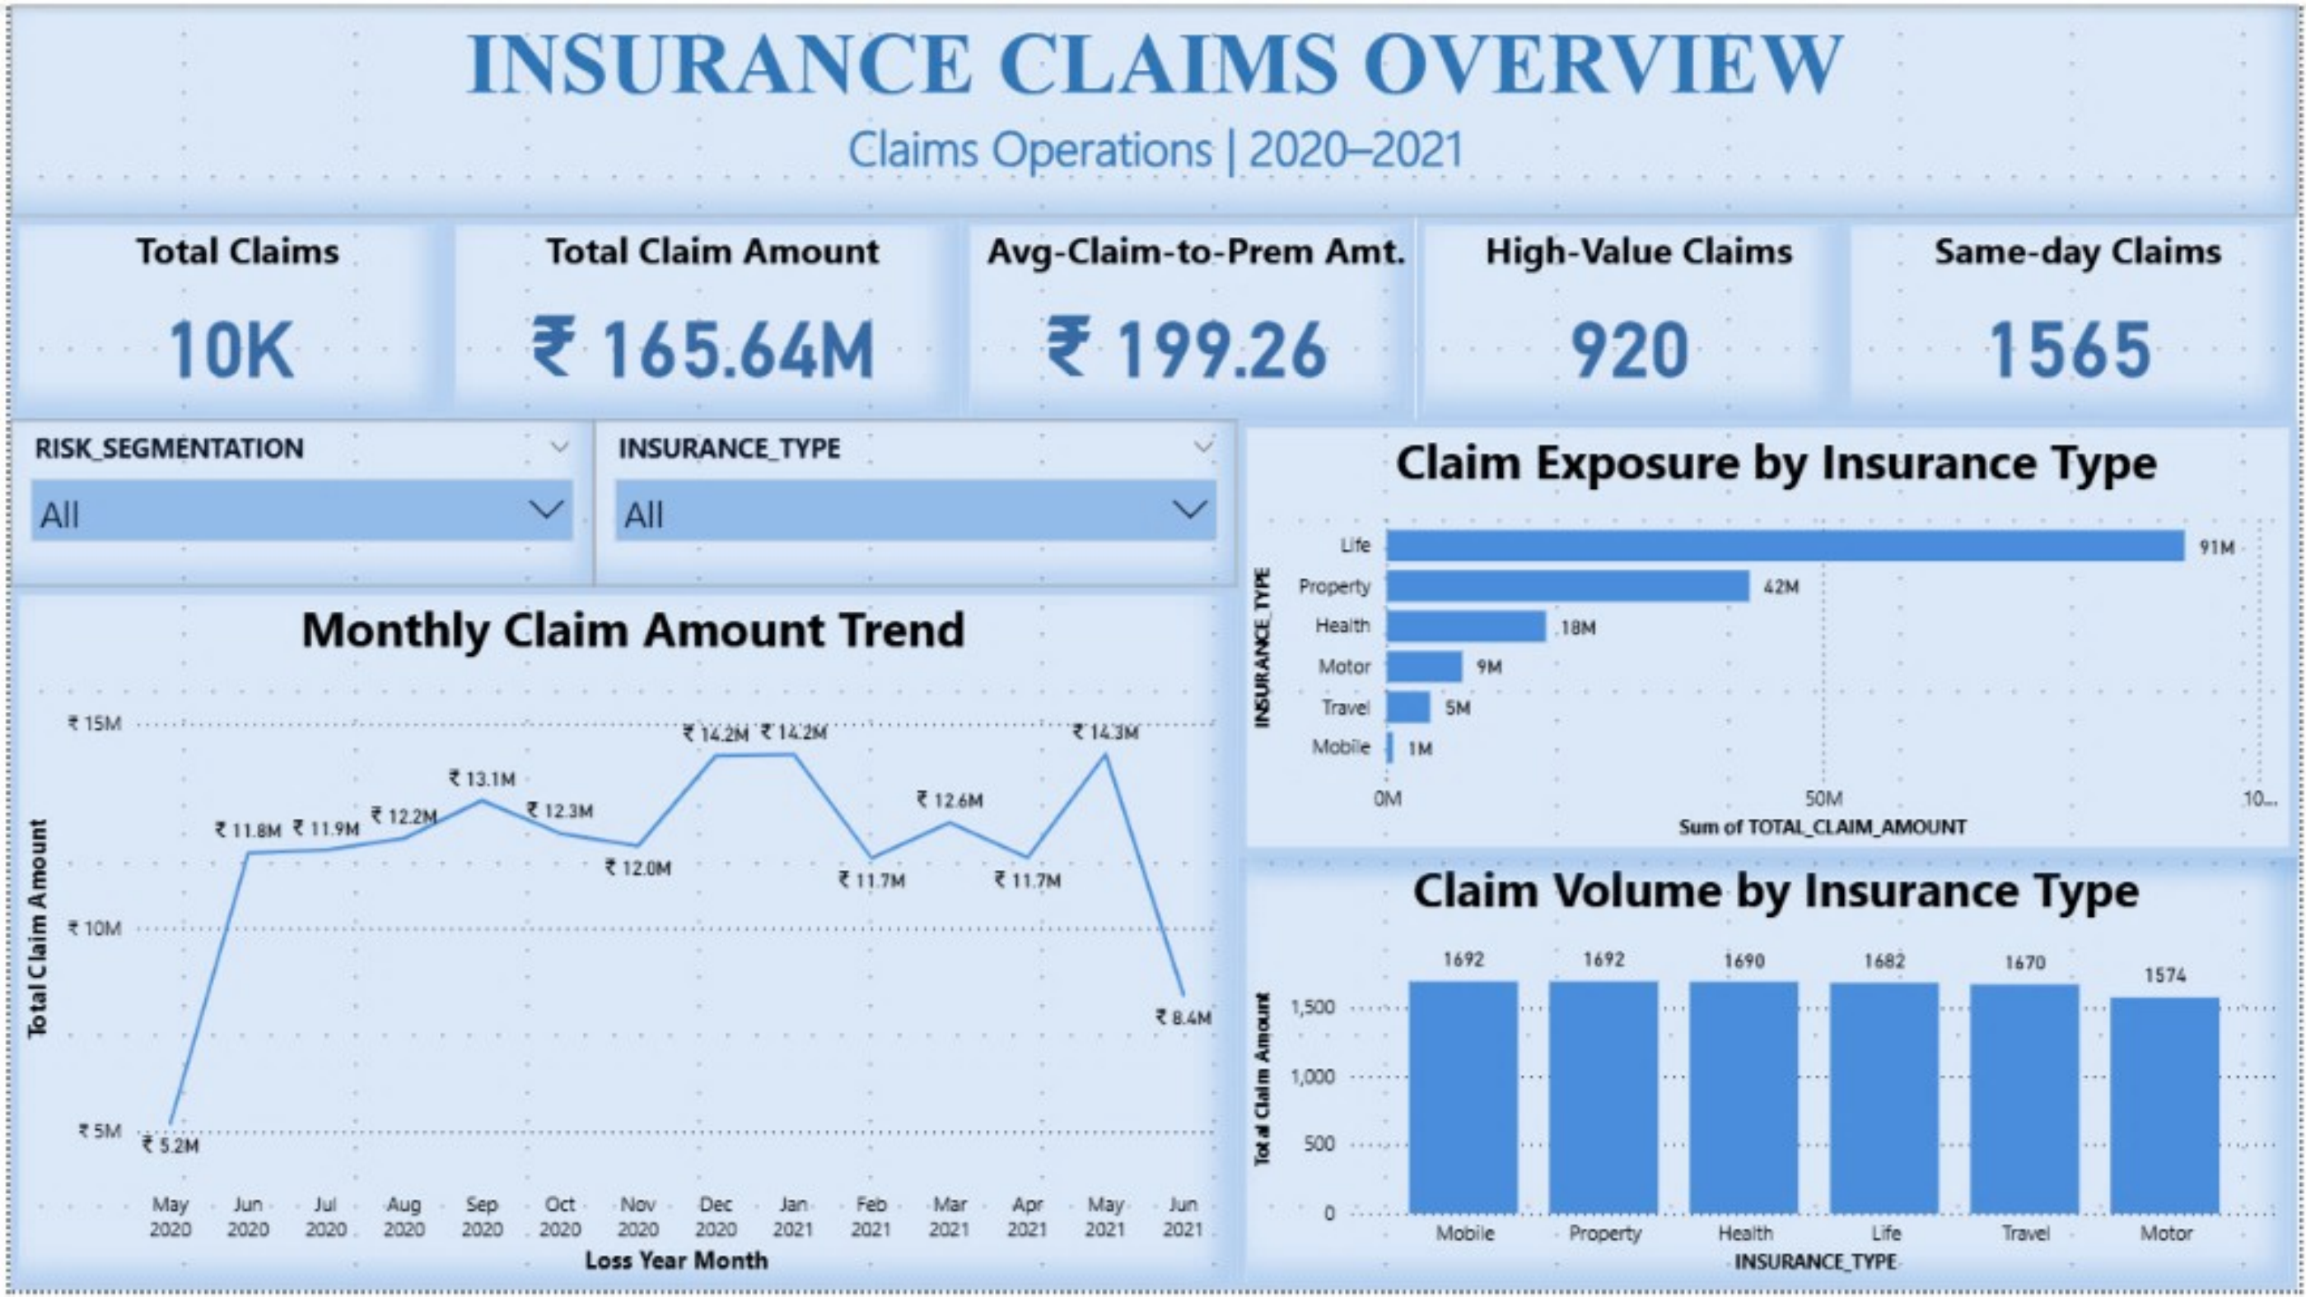
Power BI Dashboard 01 — Insurance Claims Overview
Purpose
Provide a high-level view of claim volume, financial exposure, insurance type distribution and monthly claim trends.
Key Components
Total Claims
Total Claim Amount
Average Claim-to-Premium
High-Value Claims
Same-Day Claims
Monthly Claim Amount Trend
Claim Exposure by Insurance Type
Claim Volume by Insurance Type
Risk & Insurance Type slicers
This page provides the overall business-level view of insurance claim activity and financial exposure.
15
Notes:
Life insurance alone accounts for 91M of the 165M total exposure — over half — while claim volume is almost evenly split across all six types. High value, not high volume.

Slide 17
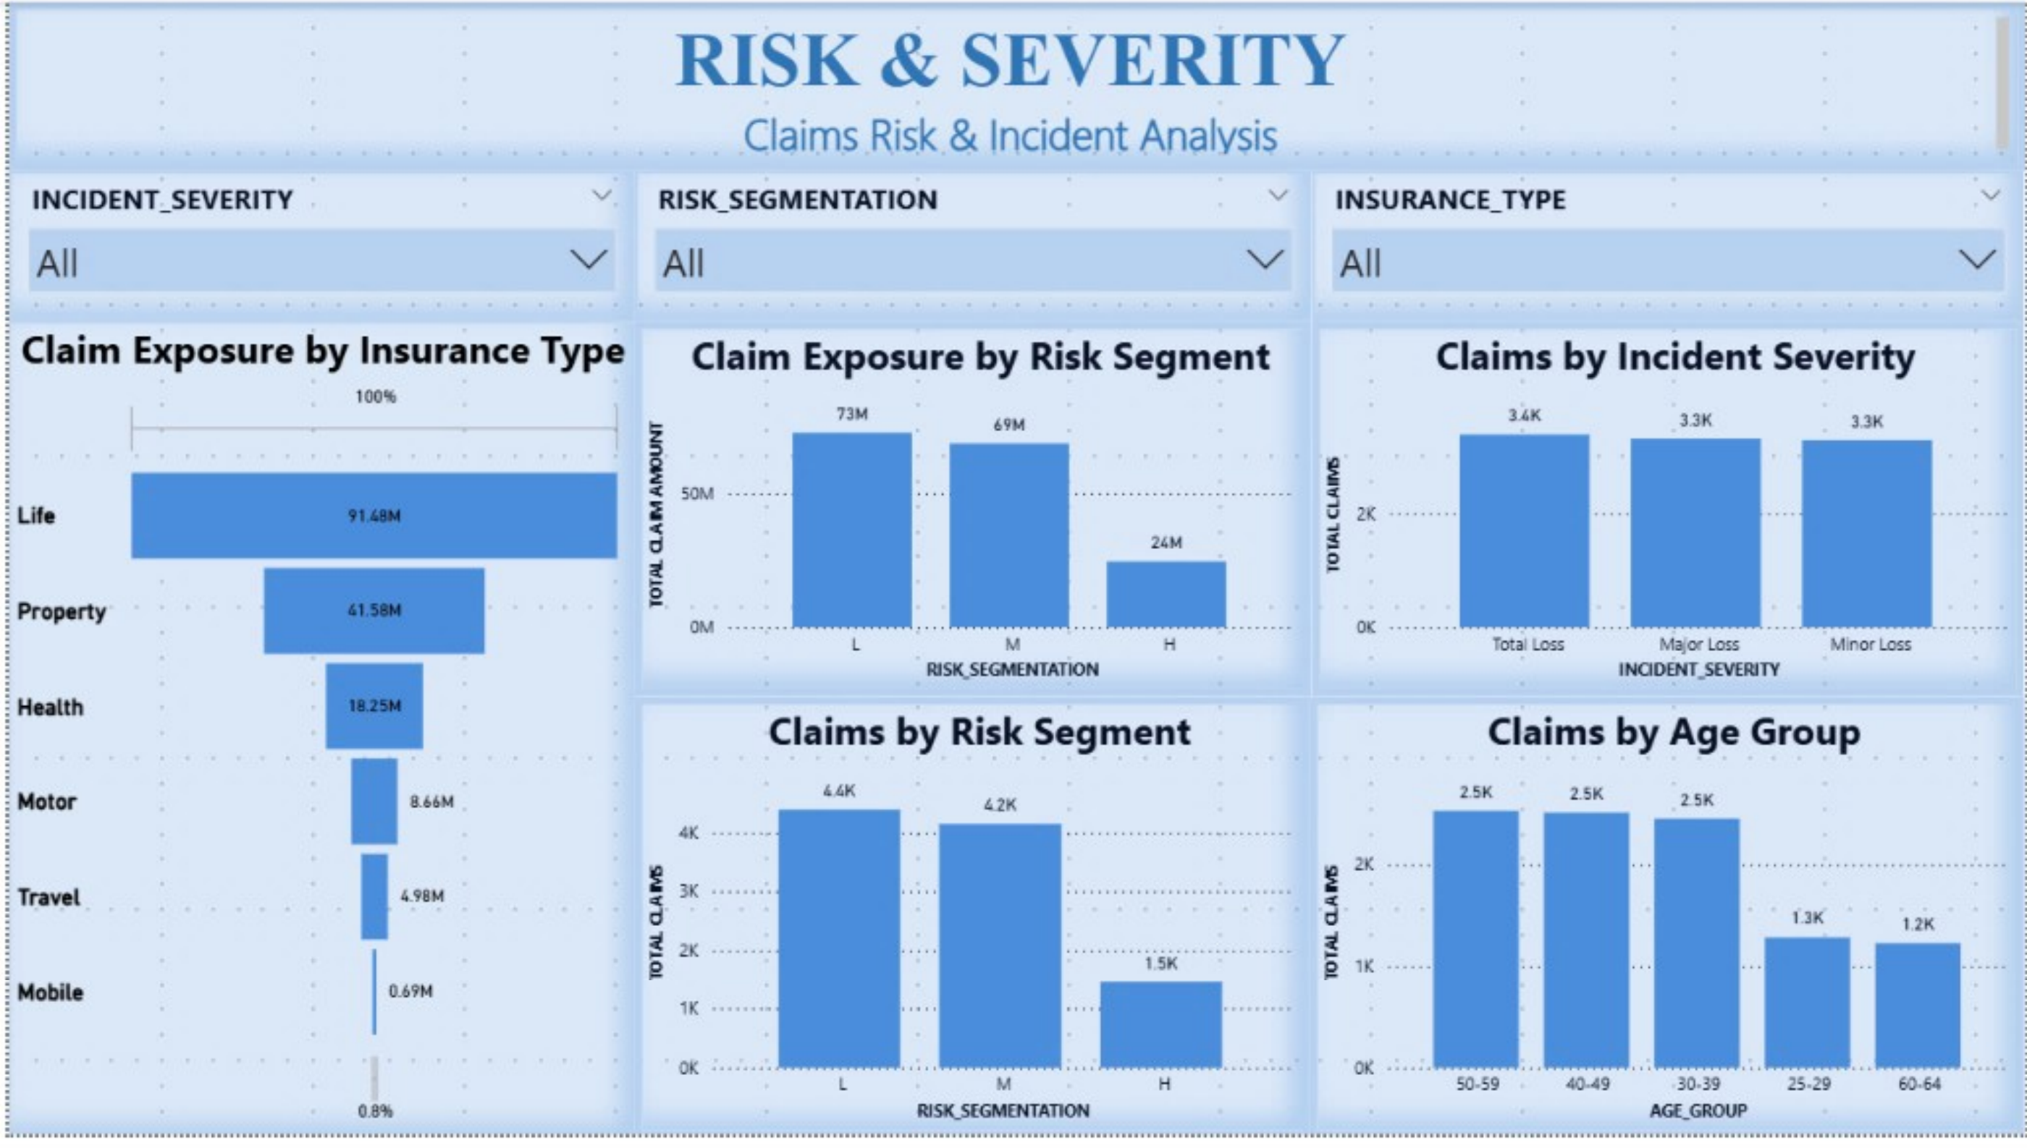
Power BI Dashboard 02 — Risk & Severity
Purpose
Understand the distribution of risk segments, incident severity, claim exposure and customer age groups.
Key Components
Claims by Risk Segment
Claims by Incident Severity
Claim Exposure by Risk Segment
Claims by Age Group
Risk × Incident Severity matrix
Insurance Type slicer
Risk Segment slicer
Incident Severity slicer
Low and Medium risk segments account for most claims, while High risk represents 14.55% of total claims.
16
Notes:
Severity is almost perfectly even across the three classes, so severity alone does not segment the book — it has to be combined with risk.

Slide 18
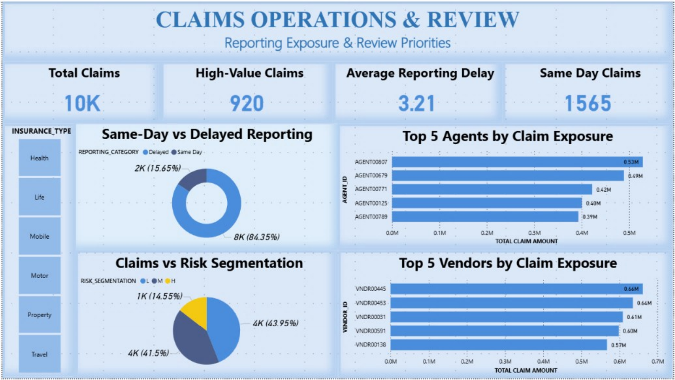
Power BI Dashboard 03 — Claims Operations & Review
Purpose
Analyze reporting behavior and operational claim exposure across agents and vendors.
Key Components
Total Claims
High-Value Claims
Average Reporting Delay
Same-Day Claims
Same-Day vs Delayed Reporting
Top Agents by Claim Exposure
Claims by Risk Segmentation
Top Vendors by Claim Exposure
84.35% of claims are reported after the loss date, with an average reporting delay of 3.21 days.
17
Notes:
Note the wording — Top Agents by Claim Exposure, not best agents. Exposure reflects workload and claim value, not performance quality.

Slide 19
Streamlit Analytics Application
The Streamlit application provides an interactive Python-based analytics interface connected directly to the Snowflake analytical view.
Application Navigation
Overview
Application Features
Descriptive Analysis
Snowflake data connection
Secure credentials via Streamlit secrets
Cached data loading
Interactive filters
Diagnostic Analysis
Dynamic KPIs
Descriptive analysis
Predictive Analysis
Diagnostic analysis
Predictive analysis
About Project
ML prediction interface
Screenshot of the running application is included in the project repository.
18

Slide 20
Key Business Insights
1
Financial Exposure
2
Risk Distribution
3
Incident Severity
10,000 claims with total exposure of ₹165.64M. Average claim is ₹16,563.83 while the median is ₹7,000 — a right-skewed distribution.
Low-risk claims account for 4,395, Medium-risk for 4,150 and High-risk for 1,455 (14.55% of the book).
Total Loss represents 3,390 claims, Major Loss 3,317 and Minor Loss 3,293 — an almost even split.
4
Reporting Behaviour
5
Data Quality
6
Predictive Modeling
Average reporting delay is 3.21 days. 1,565 claims were reported on the same day as the loss date.
No full-row duplicates and no invalid agent or vendor relationships were identified during validation.
Linear Regression achieved an R² of 0.7066 on the test set, explaining a substantial share of claim-amount variation.
19

Slide 21
Business Recommendations
01
Monitor Claim Exposure
Track high-value claims and claim exposure by insurance type to support financial planning and operational monitoring.
02
Risk-Based Monitoring
Use risk segmentation together with incident severity to identify claim groups requiring closer operational review.
03
Reporting Monitoring
Monitor reporting delays and same-day reporting patterns to understand operational reporting behaviour.
04
Agent & Vendor Monitoring
Use claim volume and financial exposure metrics to monitor operational workload across agents and vendors.
05
Predictive Analytics
Use claim amount prediction as a supporting analytical tool for estimation and planning, with continuous validation against future outcomes.
20

Slide 22
Project Deliverables
All assignment components completed end to end
Excel Data Profiling
Completed
Excel Data Quality Analysis
Completed
✓
✓
Snowflake Setup
Completed
SQL Data Cleaning
Completed
✓
✓
SQL Transformation
Completed
SQL EDA
Completed
✓
✓
Analytical Views
Completed
Python Analysis
Completed
✓
✓
Databricks Analysis
Completed
Machine Learning
Completed
✓
✓
Power BI Dashboards
Completed
Streamlit Application
Completed
✓
✓
Project Presentation
Completed
GitHub Repository
Completed
✓
✓
21

Slide 23
Conclusion
This project demonstrates an end-to-end insurance claims analytics workflow, from raw data profiling and quality assessment through SQL-based data preparation, Python analysis, business intelligence and machine learning.
Raw claims data was transformed into a structured analytical dataset and delivered through Power BI and Streamlit.
The analysis provides visibility into claim exposure, insurance types, risk segments, incident severity, customer characteristics, reporting behaviour, agent and vendor activity, and claim amount prediction.
The final solution demonstrates how multiple data analytics tools work together to support a complete business analytics workflow.
Raw Data
Clean Data
Analysis
Insights
Business Decisions
22

Slide 24
THANK YOU

Slide 25
Appendix A — Insurance Data Dictionary
Key insurance fields with business meaning and data type
Field | Business Meaning | Type
TRANSACTION_ID | Unique claim transaction identifier | Identifier
CUSTOMER_ID | Customer identifier | Identifier
POLICY_NUMBER | Policy identifier | Identifier
TXN_DATE_TIME | Transaction timestamp | Date/Time
POLICY_EFF_DT | Policy effective date | Date
LOSS_DT | Date of loss | Date
REPORT_DT | Date of reporting | Date
INSURANCE_TYPE | Insurance category | Categorical
CLAIM_AMOUNT | Claim amount | Numeric
PREMIUM | Premium amount | Numeric
AGE | Customer age | Numeric
TENURE | Customer / policy tenure | Numeric
Field | Business Meaning | Type
RISK_SEGMENTATION | Risk category | Categorical
INCIDENT_SEVERITY | Incident severity category | Categorical
ANY_INJURY | Injury indicator | Categorical
POLICE_REPORT_AVAILABLE | Police report indicator | Categorical
AGENT_ID | Agent identifier | Identifier
VENDOR_ID | Vendor identifier | Identifier
MARITAL_STATUS | Marital status | Categorical
EMPLOYMENT_STATUS | Employment status | Categorical
HOUSE_TYPE | House type | Categorical
SOCIAL_CLASS | Social class | Categorical
CUSTOMER_EDUCATION_LEVEL | Education level | Categorical
23

Slide 26
Appendix B — Derived Analytical Fields
Fields engineered during SQL transformation
1
REPORTING_DELAY_DAYS
2
CLAIM_TO_PREMIUM_RATIO
Days between loss date and report date
Claim amount relative to premium
3
AGE_GROUP
4
TENURE_GROUP
Customer age grouping
Tenure grouping
5
CLAIM_AMOUNT_BUCKET
6
REPORTING_CATEGORY
Claim amount range category
Reporting delay category
7
CLAIM_VALUE_CATEGORY
8
LOSS_YEAR
Claim value category
Year extracted from loss date
9
LOSS_MONTH
10
LOSS_MONTH_NAME
Month extracted from loss date
Month name extracted from loss date
24

Slide 27
Appendix C — SQL Processing Pipeline
Execution Order
Final Analytical Views
01_Database_Setup.sql
CLAIMS_ANALYTICS_VW
02_Raw_Data_Validation.sql
CLAIMS_SUMMARY_VW
INSURANCE_TYPE_VW
03_Data_Cleaning.sql
RISK_SEGMENT_VW
04_Cleaned_Data_Validation.sql
INCIDENT_SEVERITY_VW
AGENT_PERFORMANCE_VW
05_Data_Transformation.sql
VENDOR_PERFORMANCE_VW
06_EDA_Business_Analysis.sql
MONTHLY_CLAIMS_TREND_VW
STATE_CLAIMS_VW
07_Final_Views.sql
CLAIM_INVESTIGATION_PRIORITY_VW
25

Slide 28
Appendix D — Key Power BI Measures
DAX measures built on CLAIMS_ANALYTICS_VW
Volume Measures
Financial Measures
Ratio & Operational
Total Claims
Total Claim Amount
Average Claim-to-Premium Ratio
Total Customers
Average Claim Amount
Average Reporting Delay
Total Agents
Median Claim Amount
Same-Day Claims
Total Vendors
Total Premium
Same-Day Reporting %
High-Value Claims
Average Premium
High-Value Claim %
26

