Slide 1
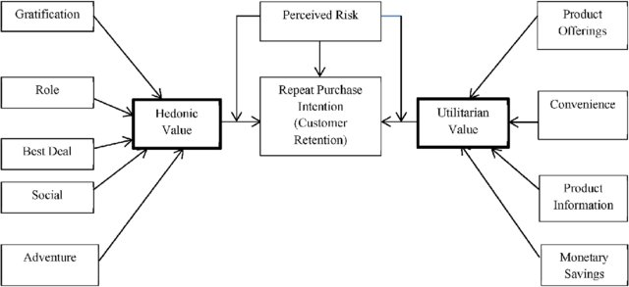
Customer Satisfaction and Retention

Slide 2
Problem statement
Customer satisfaction has emerged as one of the most important factors that guarantee the success of online store; it has been posited as a key stimulant of purchase, repurchase intentions and customer loyalty. A comprehensive review of the literature, theories and models have been carried out to propose the models for customer activation and customer retention. Five major factors that contributed to the success of an e-commerce store have been identified as: service quality, system quality, information quality, trust and net benefit. The research furthermore investigated the factors that influence the online customers repeat purchase intention. The combination of both utilitarian value and hedonistic values are needed to affect the repeat purchase intention (loyalty) positively. The data is collected from the Indian online shoppers. Results indicate the e-retail success factors, which are very much critical for customer satisfaction.
Data Scientists have to apply their analytical skills to give findings and conclusions in detailed data analysis

Slide 3
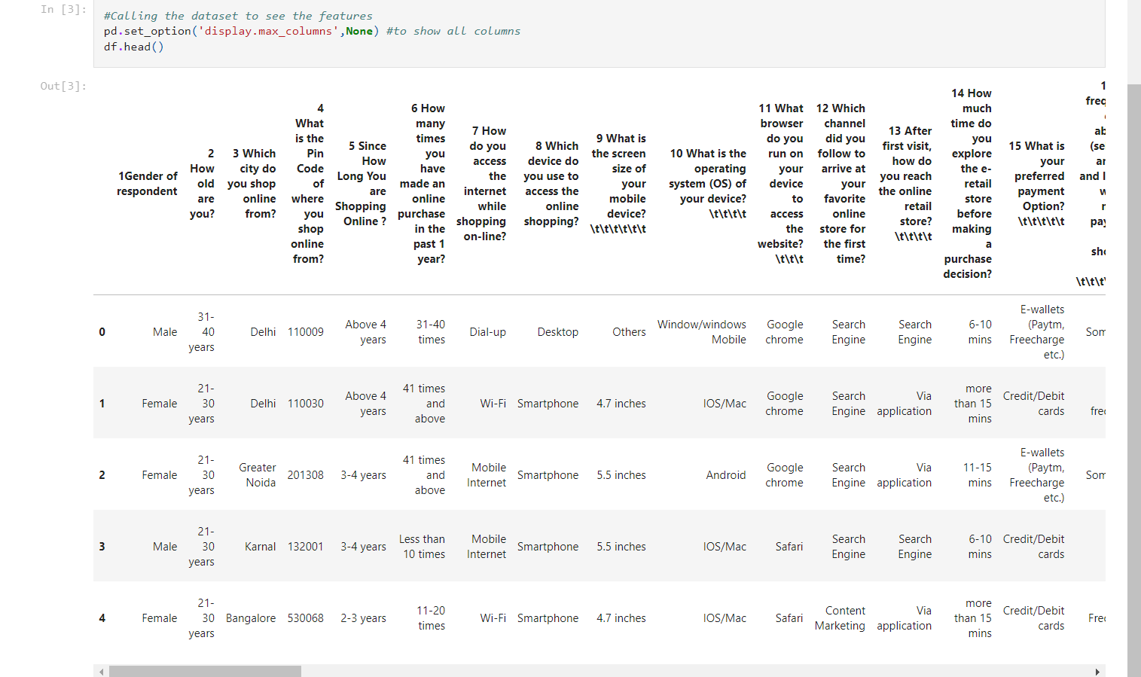
Understanding
Step 1: After importing the data, first we do is check the shape of the datset followed by the data while checking for any null values.

Slide 4
Step 2: The next step we take is look into the columns of the data visually one at a time to understand the distribution of data

Slide 5
Few details that we can make out through the visualization of the data are:
Female does more shopping through online retailers compared to men.
Most application users are from metro city such as Delhi, Noida, Banglore
Most of the purchases that happen online are from people who spend more time on the application (more than 6 min on average)
Various other factors that influence are the monetory savings, more detail of the products and the retailers
Whereas comparitively less influence is by the webpage visualization and ease of use of the application
Finally, targeted advertisement requirement as most people use the search engine to get the required destination
Therefore, technically there are two factors that influence the customer retention:
Hedonic Value
Utilitarian Value

Slide 6
EDA
Now, that we have seen the data more closely, the analysis basis for this report is the classification among male and female.
We classify each column with respect to male and female to understand how the both genders react to each factor of the websites.

Slide 7
Now we check for hedonic values distributed among gender.

Slide 8
Next, we check for utilitarian values distributed among gender

Slide 9
Conclusion

Slide 10
Thank You

