Slide 1
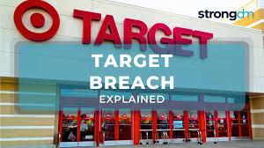
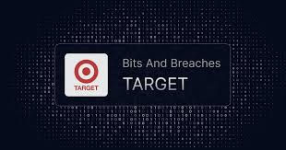
Target Corporation Data Breach (2013): Phishing Attack via Third-Party Vendor
A Case Study for Security Risk Management Principles
Submitted by:
Shubham Jha RA2311030010230
Hardik Jindal RA2311030010221
Ananya Dahiya RA2311030010236
SRM Institute of Science and Technology

Slide 2
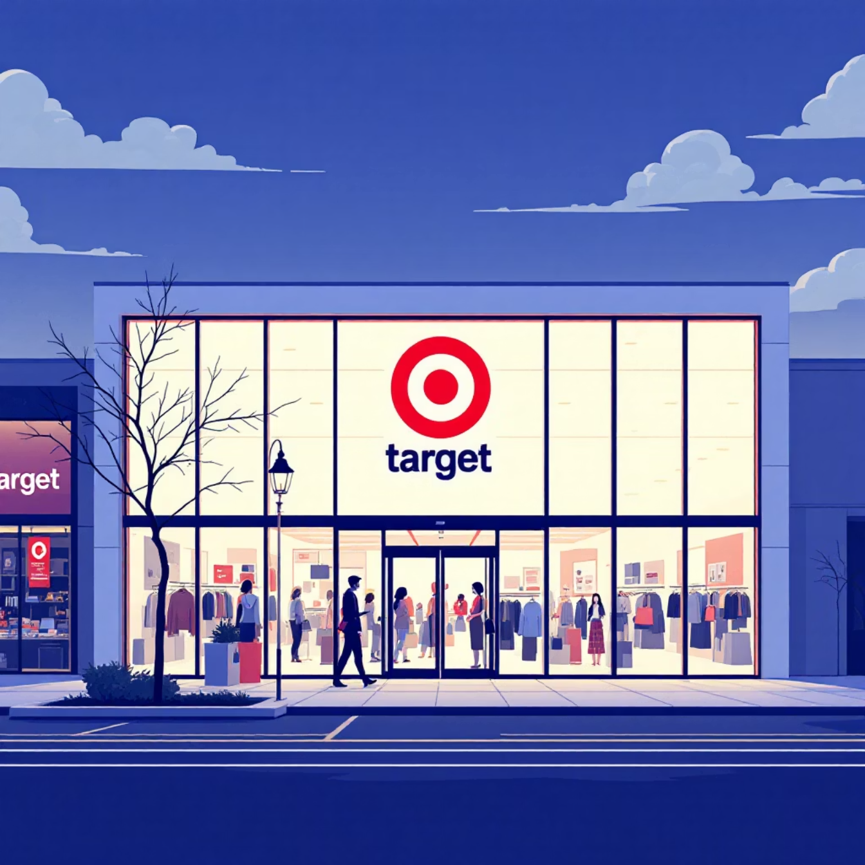


Introduction to the Target Breach Case Study
Target Corporation Overview
Target Corporation is one of the largest general merchandise retailers in the United States, operating a vast network of physical stores and e-commerce platforms. Its expansive operations involve significant volumes of sensitive customer and operational data.
Data Sensitivity and Scope
Handled millions of customer transactions daily across multiple points-of-sale (POS).
Maintained a large network requiring secure access for numerous third-party vendors.
The 2013 breach exposed critical flaws in third-party access management and network security.
The purpose of this report is to analyse the causes, impact, and post-incident risk control measures related to the 2013 Target data breach.

Slide 3
What is Phishing Attack ?
Phishing is a type of cyberattack where attackers try to trick you into giving sensitive information like passwords, credit card
numbers, or personal details. They often do this by pretending to be a trusted entity, such as a bank, social media site,
or a colleague, usually via emails, messages, or fake websites.
Key points about phishing:
Deceptive emails or messages: They look real and urgent, e.g., "Your account will be locked unless you verify it now."
Fake websites: Sites that look like legitimate ones to steal login credentials.
Malicious links or attachments: Clicking them can download malware or lead to credential theft.
Goal: Steal personal data, money, or gain unauthorized access to accounts.

Slide 4
The 2013 Incident: Breach Overview and Timeline
Initial Access (Early 2013)
Attackers used a phishing attack to steal network credentials from Fazio Mechanical Services, Target's HVAC (Heating, Ventilation, and Air Conditioning) vendor.
Lateral Movement & Malware (Nov. 2013)
Attackers exploited the vendor's compromised credentials to access Target’s internal network and deploy custom malware on POS systems.
Data Exfiltration (Late Nov. - Early Dec. 2013)
Data was collected from compromised POS terminals and exfiltrated to external servers before detection.
Public Disclosure (Dec. 2013)
The breach was publicly announced, confirming 40 million payment card details and later, 70 million customer records (names, addresses, phone numbers) were stolen.

Slide 5


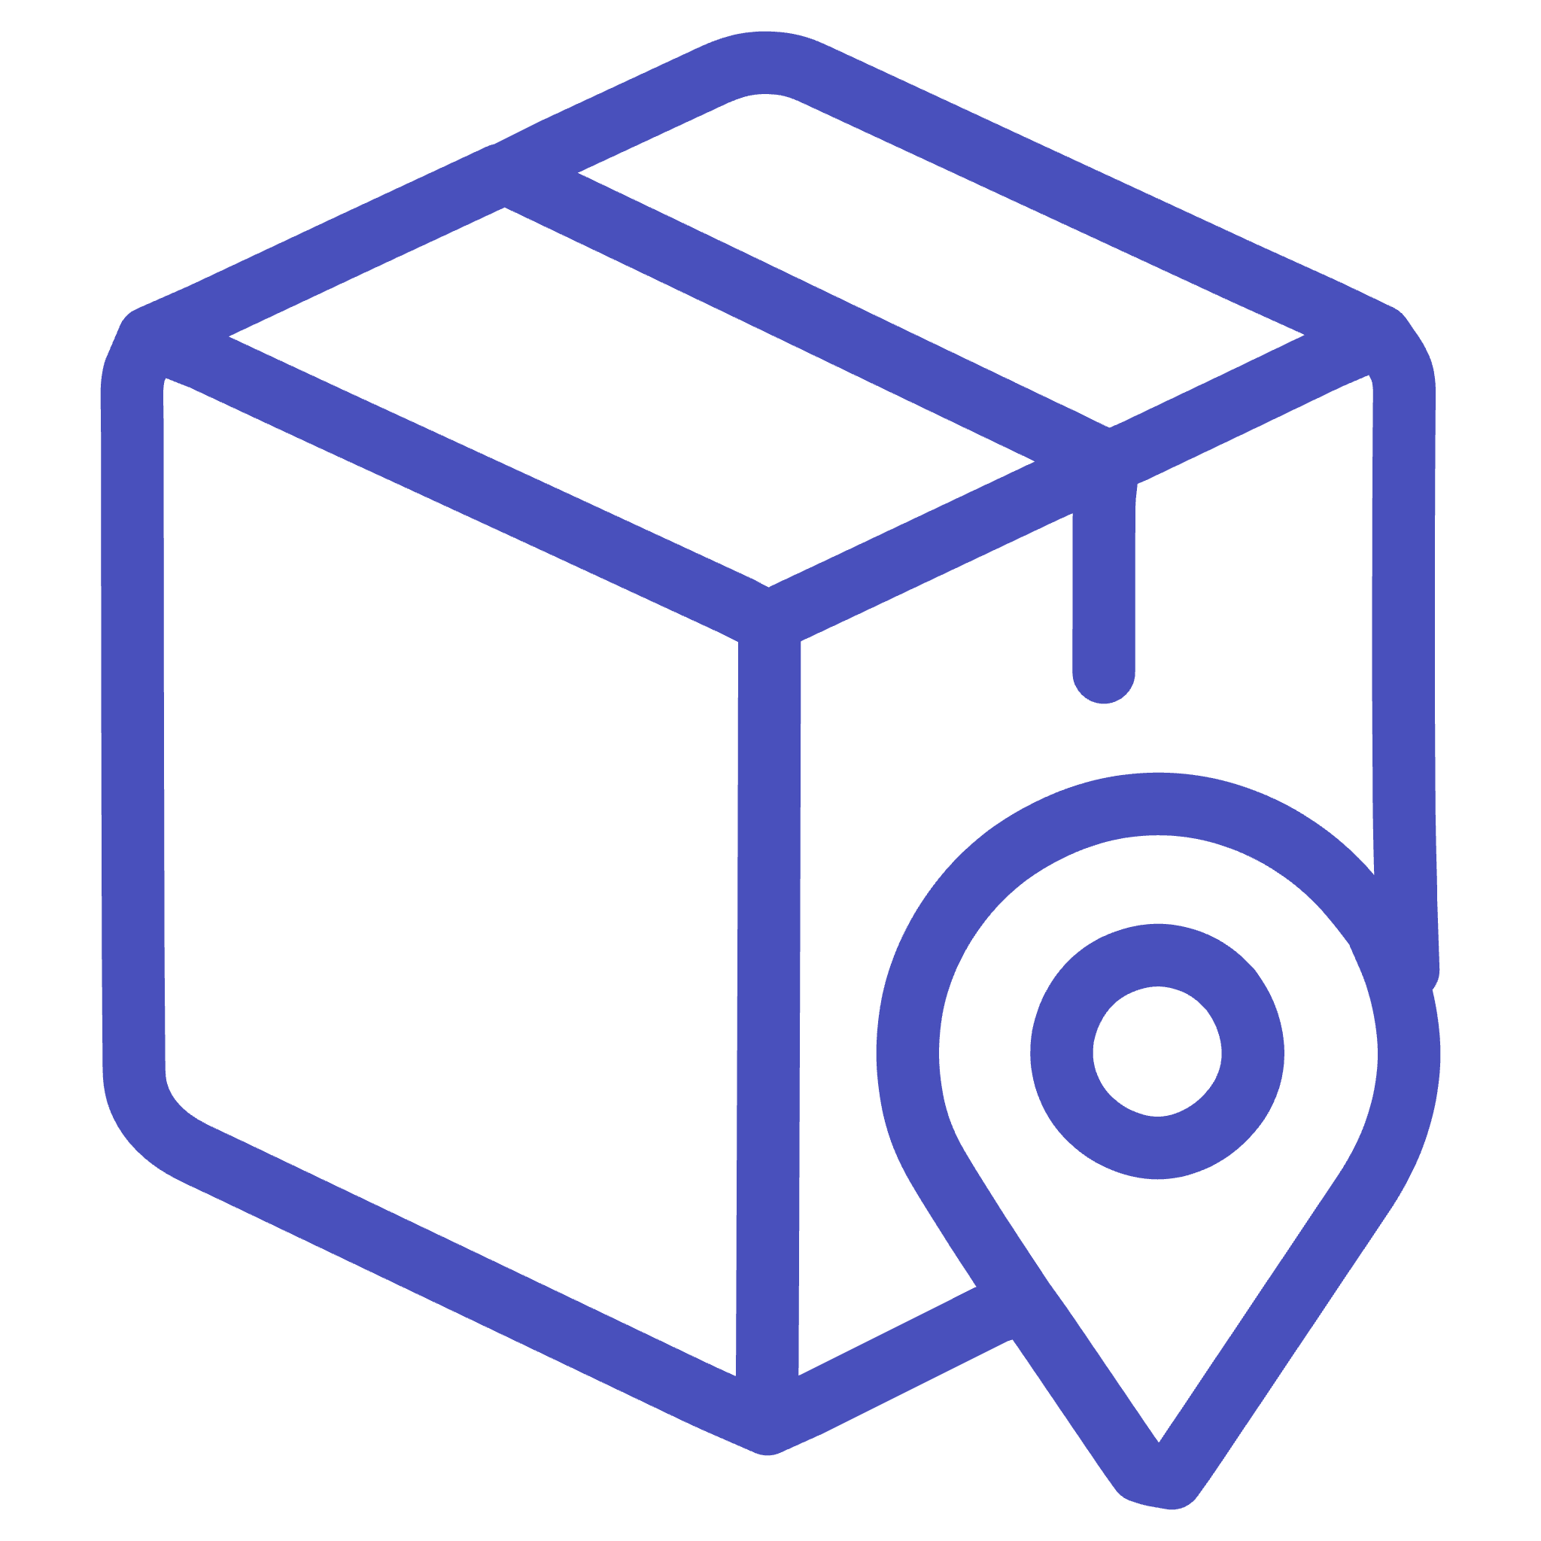

Identification of Critical Assets
Protecting these five key assets should have been the highest priority, as their compromise led directly to catastrophic data loss and financial damage.
Customer Card Data
Point-of-Sale (POS) Systems
Primary target of the attack; included magnetic stripe data, PINs, and account numbers. High sensitivity.
Entry point for data collection; systems lacked sufficient anti-malware and monitoring controls.
Vendor Credentials
Internal Network
The initial compromise vector; these access credentials were not segmented or restricted adequately.
Allowed for lateral movement due to flat structure and insufficient network segmentation.

Slide 6
Risk Identification: Threats and Vulnerabilities Exploited
1
2
Phishing Threat
Specialised Malware
Exploited Vulnerability: Weak employee/vendor security awareness and insufficient email filtering.
Exploited Vulnerability: Lack of advanced endpoint detection and response (EDR) on POS systems.
3
4
Lateral Movement
Data Exfiltration
Exploited Vulnerability: Poor network segmentation, allowing vendor access to critical POS infrastructure.
Exploited Vulnerability: Inadequate monitoring and alerting systems that failed to flag large outbound data transfers.
These intertwined weaknesses provided the attackers with the necessary window and permissions to execute the entire attack chain successfully.

Slide 7

Threat–Vulnerability Mapping: The Attack Chain
The entire incident was a result of successful chain reactions, starting with a social engineering failure and ending with poor network controls.
Phishing
Stolen Credentials
Malware Deployment
Data Theft

Slide 8




Risk Analysis: Determining Severity
Using a standard Risk Rating Matrix (Likelihood × Impact), the following risks scored the highest due to the enormous financial and reputational consequences.
1
R1: Regulatory Penalties
2
R2: Loss of Customer Trust
3
R3: Financial Loss (Direct & Indirect)
4
R4: Large-Scale Data Breach
Impact: Catastrophic (Financial losses exceeding $200 million, CEO resignation, major reputation damage).
Likelihood: High (Vulnerabilities were known industry risks, but controls were insufficient).

Slide 9






Essential Risk Control Measures Implemented
Post-breach remediation focused on strengthening security across three key defense layers: Prevention, Detection, and Correction.
Corrective
Revised and tested Incident Response Plan (IRP) for faster containment.
Preventive
Forensics and external audit of all compromised systems.
Mandatory Multi-Factor Authentication (MFA) for all third-party access.
Detective
Strict network segmentation between vendor access and POS network.
Deployment of Security Information and Event Management (SIEM).
Enhanced phishing simulation and awareness training.
Implementation of advanced Intrusion Detection/Prevention Systems (IDS/IPS).
Installation of EDR solutions across all endpoints.

Slide 10
Risk Control Implementation Summary
R4
Network Segmentation & Tokenization
Preventive
Network Security & DevSecOps
High
R3
Mandatory MFA for Vendors
Preventive
Identity & Access Management (IAM)
High
R2
24/7 SIEM Monitoring
Detective
Security Operations Center (SOC)
Medium-High
R1
Annual Phishing Simulations
Preventive
HR & Training Department
Medium
These controls are designed to mitigate the likelihood and impact of similar third-party compromise scenarios.

Slide 11




Residual Risk Evaluation: Post-Control Environment
Implementing robust controls significantly reduced the exposure across key attack vectors, shifting the risk profile from "Extreme" to "Moderate" or "Acceptable" in most categories.
Initial Risk Likelihood
Post-Control Likelihood
Phishing success and network traversal were High due to insufficient controls and a flat network structure.
MFA, segmentation, and better security awareness reduce the likelihood of a successful breach to Low-Medium.
Initial Risk Impact
Residual Risk Impact
Massive scale data exfiltration had an Extreme impact, leading to long-term financial and legal repercussions.
Tokenization and segmentation ensure that if a breach occurs, the volume and sensitivity of stolen data is Significantly Reduced.

Slide 12
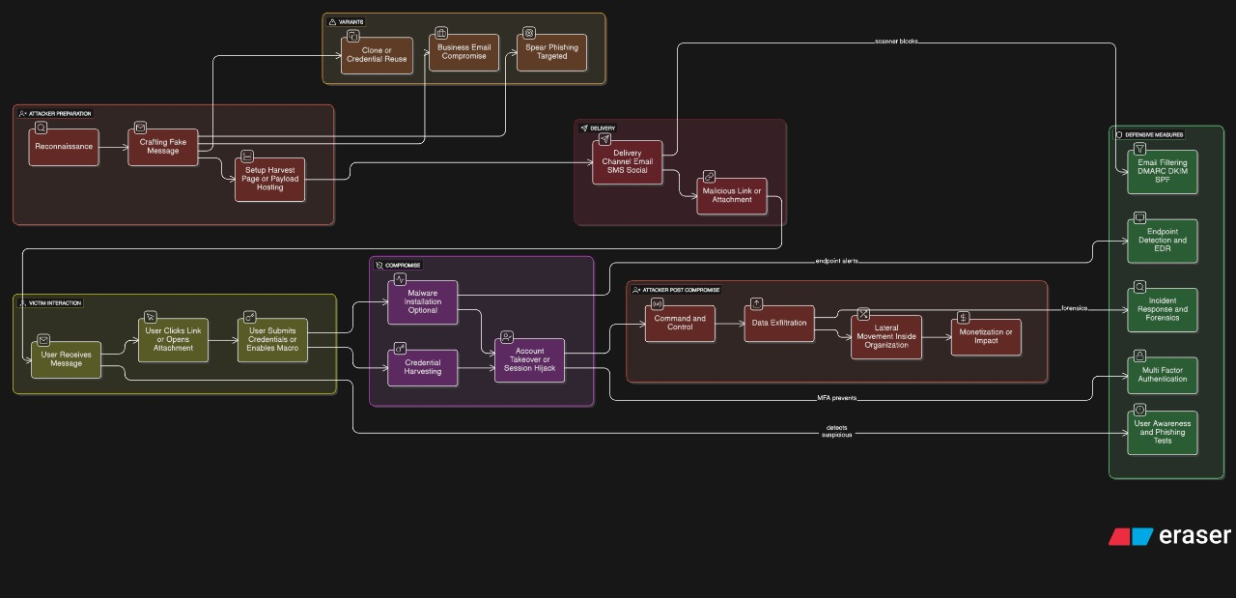
Architecture Design Of Phishing Attacks

Slide 13
Current Situation
Organisations are facing increasing cyber-threat complexity, including AI-driven attacks, supply-chain vulnerabilities,
and an expanding attack surface (cloud, IoT, machine identities). INE+3securityexceptions.com+3gartner.com+3
There is a strong shift towards frameworks like Zero Trust Architecture (ZTA), continuous monitoring and identity-first security,
replacing traditional perimeter-only defences. Centraleyes+2ansecurity.com+2
Third-party/vendor risk and supply‐chain security are major concerns, with many incidents traced to vendor access
and software dependencies. Vanta+1
AI and machine learning are playing dual roles: they’re enhancing defence capabilities, but are also being used by
threat actors to automate and personalise attacks. INE
Governance, risk management and compliance (GRC) functions are under pressure: organisations need to
adopt continuous risk assessment, live risk dashboards, and integrate SRMP into business strategy rather than just IT.

Slide 14
How it is related to SRMP
The SRMP course focuses on identifying, analyzing, evaluating, and mitigating security risks within information systems.
The Target breach is a real-world application of these very principles.
Risk Identification (SRMP Principle)
You identify what went wrong — the phishing attack on the third-party vendor.
This corresponds to the “Identify” phase of SRMP, where assets, threats, and vulnerabilities are documented.
In the case:
→ Assets: POS systems, customer data, vendor credentials
→ Threats: Phishing, malware, data exfiltration
→ Vulnerabilities: Lack of MFA, weak segmentation
2. Risk Analysis and Evaluation
You used a Risk Matrix to rate risks by likelihood and impact.
This shows how SRMP emphasizes quantifying risk (e.g., R1–R4 High Risk).
In the case:
→ R1: Phishing (High risk)
→ R2: Lateral movement (High)
→ Evaluation leads to prioritizing controls.

Slide 15
3. Risk Control / Treatment
You proposed Preventive, Detective, and Corrective Controls — exactly as SRMP teaches for risk mitigation.
In the case:
→ Preventive: MFA, segmentation
→ Detective: EDR, SIEM
→ Corrective: Incident Response plan
4. Continuous Monitoring (Residual Risk Evaluation)
Even after controls, SRMP stresses residual risk monitoring.
You included this in your case — regular audits and SOC monitoring ensure risks remain acceptable.
5. Framework Alignment
SRMP promotes aligning with standards like NIST SP 800-30 and ISO/IEC 27005 — both explicitly used in your report.
These frameworks are central to professional security risk management practice.

Slide 16
The 2013 Target data breach shows how a phishing attack on a third-party vendor can lead to a large-scale corporate
compromise.
It exposed weaknesses in vendor management, network segmentation, and employee awareness.
By applying strong controls such as:
Multi-Factor Authentication (MFA)
Vendor risk assessment
Continuous security training
Real-time monitoring and incident response
organizations can greatly reduce their exposure.
Aligning with standards like NIST SP 800-30 and ISO/IEC 27005 helps establish a robust risk management culture.
Conclusion

Slide 17
NIST SP 800-30: Guide for Conducting Risk Assessments
ISO/IEC 27005: Information Security Risk Management
ENISA Threat Landscape Report 2023
Krebs on Security (2014): Email Attack on Vendor Set Up Breach at Target
U.S. Senate Committee on Commerce (2014): A “Kill Chain” Analysis of the 2013 Target Data Breach
Target Corporation (2014): Press Release – Update on Data Breach and Financial Performance
References

