Slide 1
T H E C O M P L E T E W O R L D
0 F E D U C AT ION
Recognised under the section 2 of the UGC Act 1956
ing the Youth; Empowering the Nation

Slide 2


AI-Based-Smart-Eco-Air-Pollution-Control-System
Pre-Final Year Project Synopsis
Submitted by
ROLL | NAME
2301730100 | Shubham
2301730126 | Suryansh
2301730099 | Kartik
2301730134 | Brijesh
Faculty Mentor: Mr. Anurag Singh

Slide 3


Project Overview
Air pollution is a major environmental and health issue, especially in urban and semi-urban areas.
A large amount of pollution is generated from point sources like industrial chimneys, workshops, and enclosed spaces.
Existing air purification systems are costly, indoor-focused, and depend on non-biodegradable filters.
Conventional systems act after pollution spreads and lack real-time monitoring and intelligent response.
There is a need for a smart, eco-friendly, and low-cost system to control pollution at the source level.

Slide 4
Problem Statement
Air pollution is a major environmental and health issue, especially in urban and semi-urban areas.
Most pollution originates from point sources like industrial chimneys, workshops, and enclosed spaces.
Existing air purification systems are expensive, inefficient, and mainly designed for indoor use.
There is a lack of real-time monitoring and intelligent control to reduce pollution at the source level.

Slide 5
Specific Objectives
To develop a smart system for controlling air pollution at the source using real-time monitoring.
To use eco-friendly materials like bamboo and charcoal for sustainable air filtration.
To monitor air quality using sensors and automatically activate the system based on pollution levels.
To implement intelligent control logic and ensure a low-cost, scalable solution for indoor and outdoor use.

Slide 6

Key Features
Source-level pollution control
Real-time IoT monitoring
AI-driven automation
Eco-friendly filtration
Low-cost and scalable
Automatic Threshold – based Automation
Indoor and Outdoor Deployment support
Energy efficient Operations

Slide 7
Project Usecases
Industrial Areas & Chimneys
Can be installed near industrial chimneys and emission points to reduce pollution at the source.
Workshops and Manufacturing Units
Controls dust, smoke, and harmful gases generated during manufacturing processes.
Commercial and Public Spaces
Suitable for malls, parking areas, markets, and other high-footfall zones with poor ventilation.
Educational Institutions
Can be deployed in classrooms, laboratories, and corridors to improve indoor air quality.
Semi-Urban and Rural Locations
Effective in areas lacking access to expensive air purification infrastructure.
Indoor Enclosed Spaces
Helps maintain healthier air in rooms, basements, and storage areas.

Slide 8
Project Scope
Focuses on source-level air pollution control instead of general ambient air purification.
Supports real-time air quality monitoring using IoT-based sensors.
Implements intelligent and automatic operation using threshold-based and AI-driven decision logic.
Designed as a low-cost, eco-friendly, and scalable system with future scope for cloud integration and mobile applications.

Slide 9

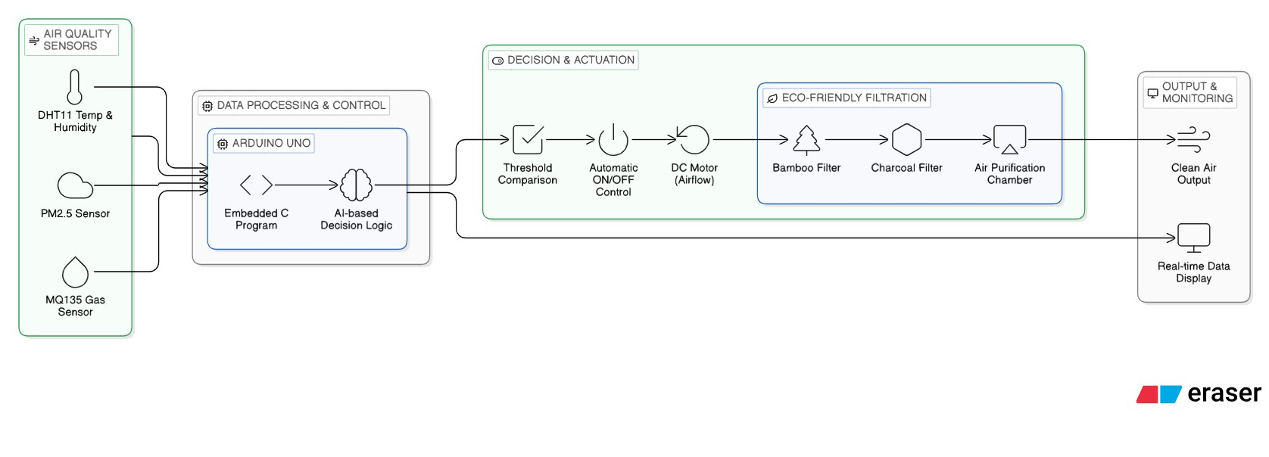
Prototype/Project Flow diagram/Architecture

Slide 10
METHODOLOGY
Step 1: Data Collection – PM2.5, MQ135 & DHT11 sensors capture real-time air quality data
Step 2: Data Processing – Arduino UNO reads sensor values and processes them in real time
Step 3: Decision Logic – AI/rule-based threshold check; if AQI exceeds limit, system activates
Step 4: Filtration Activation – DC motor drives eco-friendly bamboo/charcoal filter unit
Step 5: Output & Display – Clean air released; AQI readings shown on I2C LCD in real time

Slide 11
PROTOTYPE/IMPLEMENTATION
Working prototype built using Arduino UNO as the central microcontroller unit
PM2.5, MQ135 (CO2/smoke) & DHT11 (temp/humidity) sensors integrated with Arduino
Real-time AQI values displayed on 16x2 I2C LCD module for continuous monitoring
Automatic DC motor-driven filtration activated when pollution crosses threshold value
Eco-friendly bamboo & activated charcoal filter used as sustainable filtration medium

Slide 12
PROJECT PROGRESS
All Phases Successfully Completed
Phase 1 – Problem Identification & Literature Review
Phase 2 – System Design & Architecture Planning
Phase 3 – Hardware Setup & Sensor Integration
Phase 4 – Embedded Programming & AI Logic Implementation
Phase 5 – Filtration System Development
Phase 6 – Testing, Evaluation & Optimization
Phase 7 – Documentation & Final Presentation
Overall Status: Project successfully completed within planned timeline. Prototype is fully functional and validated.

Slide 13
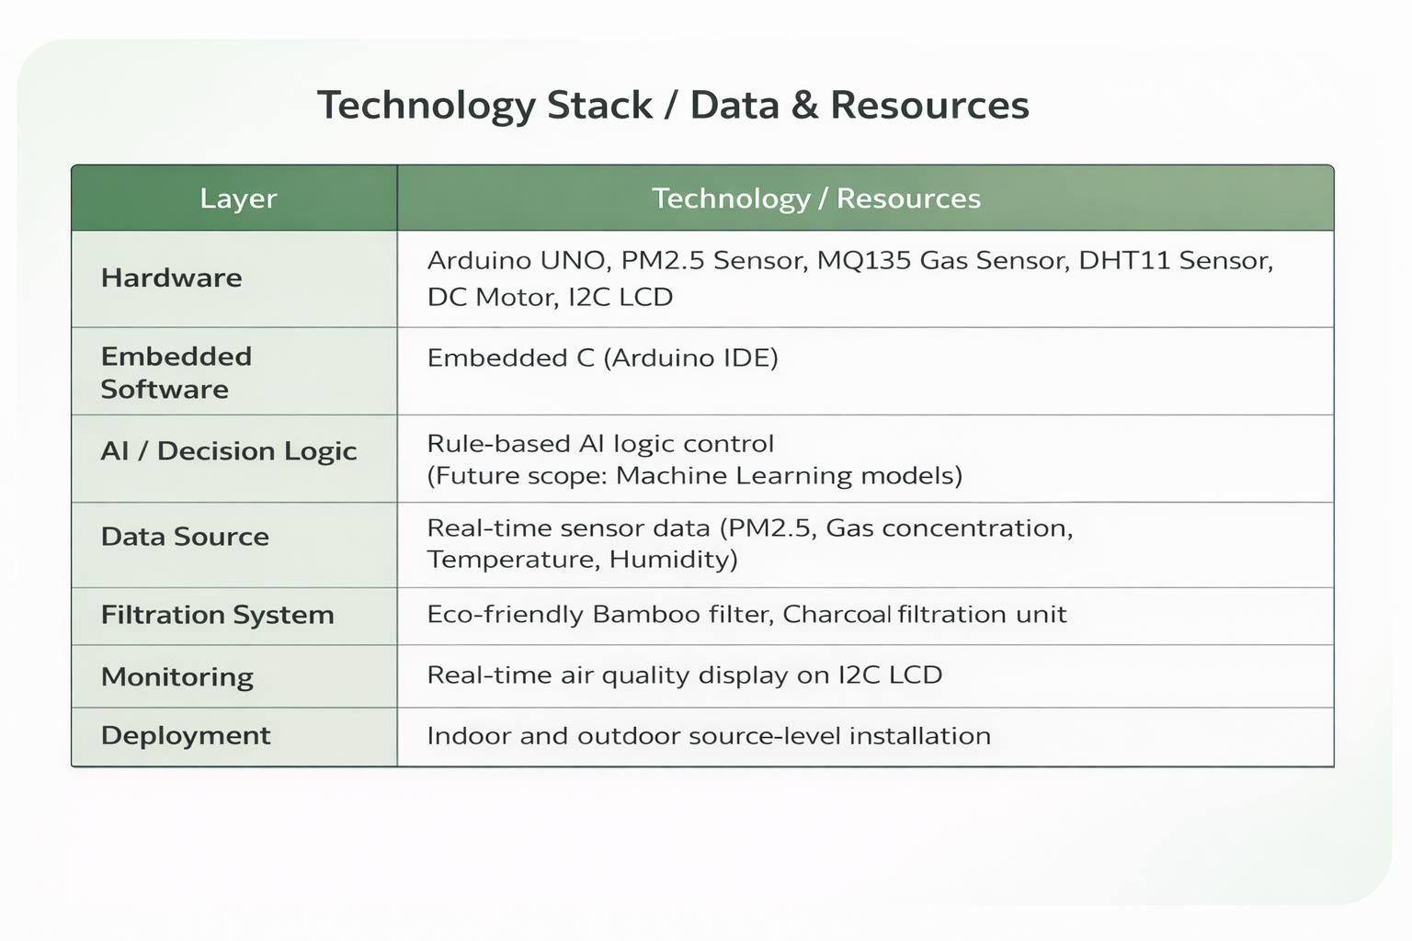
Data & Resources

Slide 14
Expected Results & Impact
Reduction in air pollution at source locations
Improvement in local air quality
Real-time monitoring of pollution levels
Automatic and efficient system operation
Eco-friendly alternative to synthetic filters
Low-cost solution suitable for wide deployment

Slide 15
FUTURE SCOPE
Cloud Integration & Remote Monitoring
Connect system to AWS / Google Cloud IoT for real-time remote data access and automated alerts via a mobile app.
AI-Powered Predictive Pollution Control
Replace rule-based logic with ML models (LSTM / Random Forest) to predict AQI spikes before they occur.
Solar-Powered & Energy-Autonomous Operation
Integrate solar panels and battery backup for fully self-sustaining operation in rural and off-grid locations.
Multi-Pollutant Detection & Expanded Sensor Suite
Add VOC, CO, NO2 and ozone sensors to enable industrial-grade multi-pollutant air quality analysis.
Smart City & Government-Level Deployment
Scale as networked Smart City AQI nodes, collaborating with municipal bodies for large-scale urban pollution management.

Slide 16
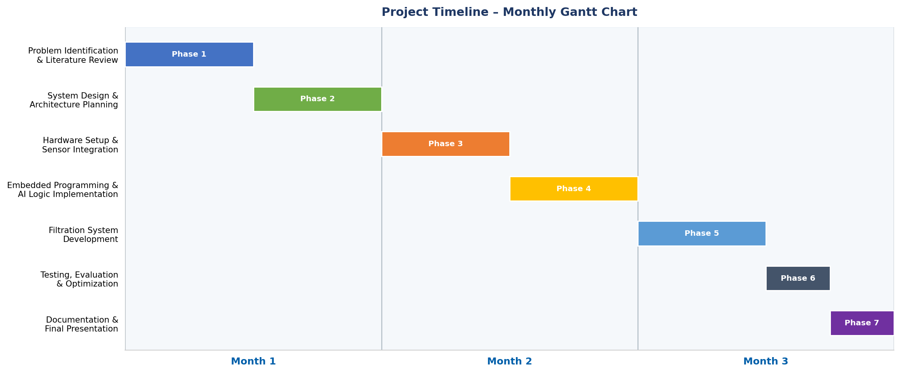
Project Timeline

Slide 17
Conclusion
The project successfully demonstrates a smart system for controlling air pollution at the source level.
It provides real-time monitoring and automatic activation, improving efficiency and response time.
The use of eco-friendly materials makes the system sustainable and cost-effective.
Overall, the system is scalable, practical, and has strong potential for real-world applications.

Slide 18

THANK YOU

