Slide 1
MAJOR PROJECT PRESENTATION
AI-Based Smart Eco
Air Pollution Control System
🌿
K.R. MANGALAM
UNIVERSITY
An IoT + AI + ML Integrated Source-Level Purification System
Using Eco-Friendly Bamboo & Charcoal Filtration
Dept. of CSE
SoET
B.Tech CSE
AI & ML — 2023–27
Team DeepThink | Projexa ID: 26E3261 Shubham (2301730100) • Suryansh (2301730126) Brijesh (2301730134) • Kartik Yadav (2301730099) Supervisor: Mr. Anurag Singh | CSE-AI&ML (Sec-B) | May 2026
Presented for: Final Major Project Evaluation | GitHub: shubham055555/AI-Based-Smart-Eco-Air-Pollution-Control-System

Slide 2
Presentation Agenda
01
Problem Statement & Motivation
06
Hardware Build & Methodology
02
Literature Review & Gap Analysis
07
ML Model Design & Training
03
Objectives
08
Experimental Results
04
System Architecture & Design
09
Comparative Advantages & Cost
05
Technology Stack & Tools
10
Conclusion & Future Work
DeepThink — K.R. Mangalam University | Major Project 2025–26

Slide 3
Problem Statement
Air pollution kills ~7 million people annually (WHO, 2022). Yet most solutions are reactive, expensive, and unsustainable.
⚠️ Reactive Systems
💸 High Cost
🗑️ Non-Biodegradable
Act AFTER pollutants spread — too late for source-level control
HEPA-based purifiers cost ₹8,000–₹25,000; inaccessible for small industries
Synthetic HEPA filters create secondary environmental waste
🔧 No Automation
📊 No Prediction
📍 No Source Control
Manual activation — no real-time adaptive intelligence
No ML-based forecasting; systems only react to current readings
No solution targets localized point sources like chimneys, workshops
DeepThink — K.R. Mangalam University | Major Project 2025–26

Slide 4
Motivation
Delhi & Gurugram PM2.5 frequently exceeds 300 µg/m³ — 12× the WHO safe limit of 25 µg/m³
7M
300+
₹25K
0
Premature deaths/year due to PM2.5 + toxic gases (WHO 2022)
µg/m³ PM2.5 in cities like Delhi — 12× WHO limit
Cost of conventional HEPA purifiers — inaccessible for most
Existing systems with unified IoT + ML + eco-filtration (gap in literature)
This project is motivated by the urgent need for a low-cost, eco-friendly, AI-driven system that controls
pollution at its source — before it spreads — using sustainable bamboo & charcoal filtration.
DeepThink — K.R. Mangalam University | Major Project 2025–26

Slide 5
Literature Review & Gap Analysis
Study / Author | Contribution | Limitation
Saha et al. (2017) — IoT Monitoring | Real-time IoT-based AQ sensing framework | No active remediation
Ayele & Mehta (2018) — ML Prediction | ML-based pollution trend prediction | No hardware filtration
Munera et al. — Smart City Review | 47 IoT deployments analyzed | No unified predict+control system
Bharath Kumar Sai et al. | 87–92% accuracy with MQ135+ML | No eco-filtration, no source control
Li et al. (2019) — Bamboo Carbon | Bamboo activated carbon — effective adsorption | Not integrated with IoT/AI
🎯 Research Gap Addressed: No prior work combines real-time IoT monitoring + ML prediction + eco-friendly filtration
in a single deployable prototype. This project directly bridges this gap.
DeepThink — K.R. Mangalam University | Major Project 2025–26

Slide 6
Project Objectives
01
Design & implement source-level IoT air pollution control using eco-friendly filtration
05
Validate Logistic Regression and Decision Tree models; compare classification accuracy
02
Collect real sensor data (PM2.5, MQ135, DHT11) and train ML models for AQI classification
06
Develop an affordable solution (target: < ₹2,000) for schools, workshops & small industries
03
Evaluate filtration efficiency through 10 controlled experimental trials
07
Minimize environmental impact by replacing synthetic HEPA with bamboo & charcoal filters
04
Achieve system actuation response time < 3 seconds from threshold exceedance
08
Enable both indoor and outdoor deployment in pollution-intensive environments
DeepThink — K.R. Mangalam University | Major Project 2025–26

Slide 7
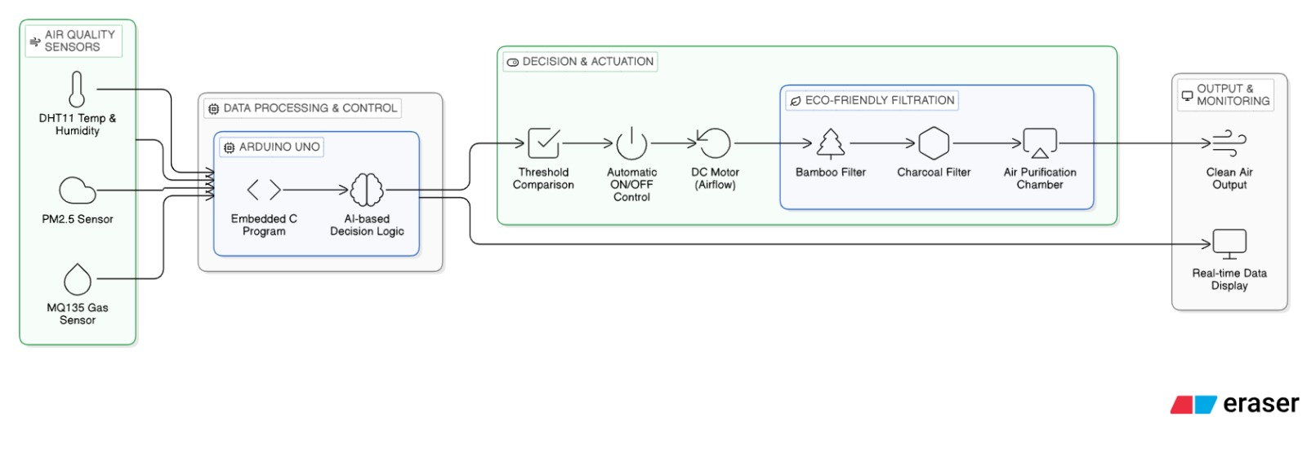
System Architecture
DeepThink — K.R. Mangalam University | Major Project 2025–26

Slide 8
System Architecture — Description
Layer 1 — Air Quality Sensors
DHT11 (Temp & Humidity), PM2.5 (GP2Y1010AU0F, 0–500 µg/m³), MQ135 Gas Sensor (10–1000 ppm). Sensors sample at 1-second intervals via Arduino's 10-bit ADC.
Layer 2 — Data Processing & Control (Arduino UNO)
Embedded C firmware processes raw ADC values into calibrated readings. Compares against CPCB thresholds: PM2.5 > 100 µg/m³ or MQ135 > 200 ppm triggers actuation.
Layer 3 — Decision & Actuation
Rule-based AI: Low power mode below threshold. Fan at base speed when threshold exceeded. Fan at full speed when PM2.5 > 200 µg/m³ (critical level). ±10 µg/m³ hysteresis prevents motor cycling.
Layer 4 — Eco-Friendly Filtration
Polluted air passes through: (1) Pre-filter mesh — coarse PM. (2) Bamboo fiber layer — fine particulate. (3) Activated charcoal — gases, VOCs, odors. 73.8% PM2.5 reduction achieved.
Layer 5 — Output & Monitoring
Clean air released. I2C LCD shows real-time PM2.5, MQ135, AQI class. Serial output to ML inference pipeline. Response time: 2.4 seconds average.
DeepThink — K.R. Mangalam University | Major Project 2025–26

Slide 9
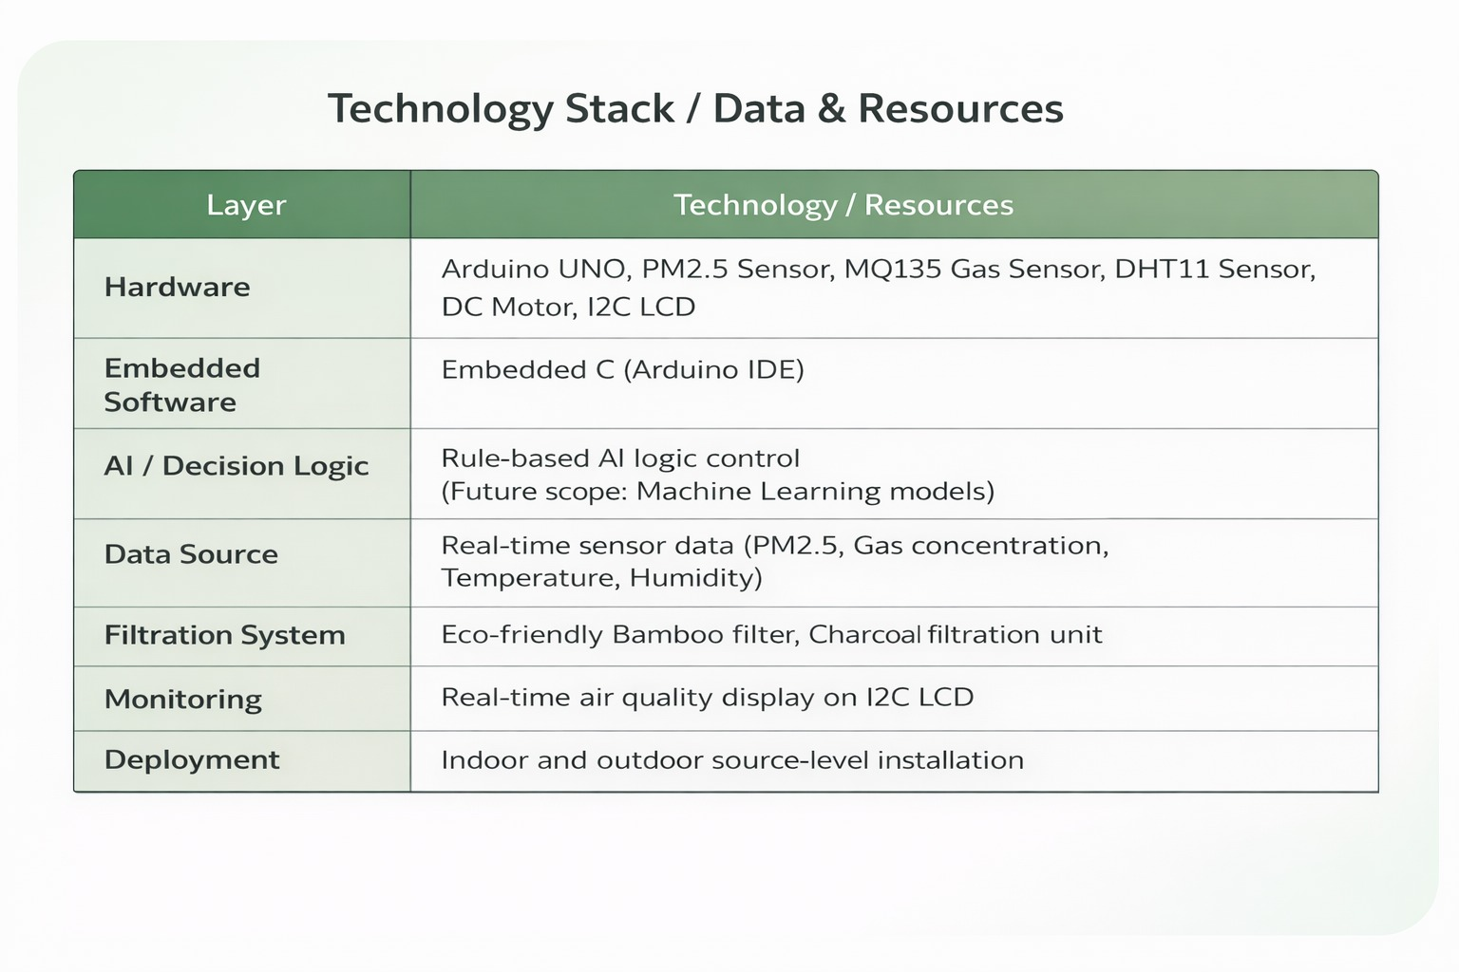
Technology Stack / Data & Resources
Hardware
Arduino UNO · PM2.5 Sensor (GP2Y1010AU0F)
MQ135 · DHT11 · DC Motor+Fan · I2C LCD
Embedded SW
Embedded C / Arduino IDE
Hysteresis control · Serial data output
AI / ML
Logistic Regression (91.3%) · Decision Tree (88.7%)
Python 3.10 · scikit-learn 1.3 · SMOTE
Filtration
Bamboo fiber pre-filter
Activated charcoal adsorption layer
Monitoring
I2C LCD real-time AQI display
Serial logging → CSV for ML pipeline
DeepThink — K.R. Mangalam University | Major Project 2025–26

Slide 10
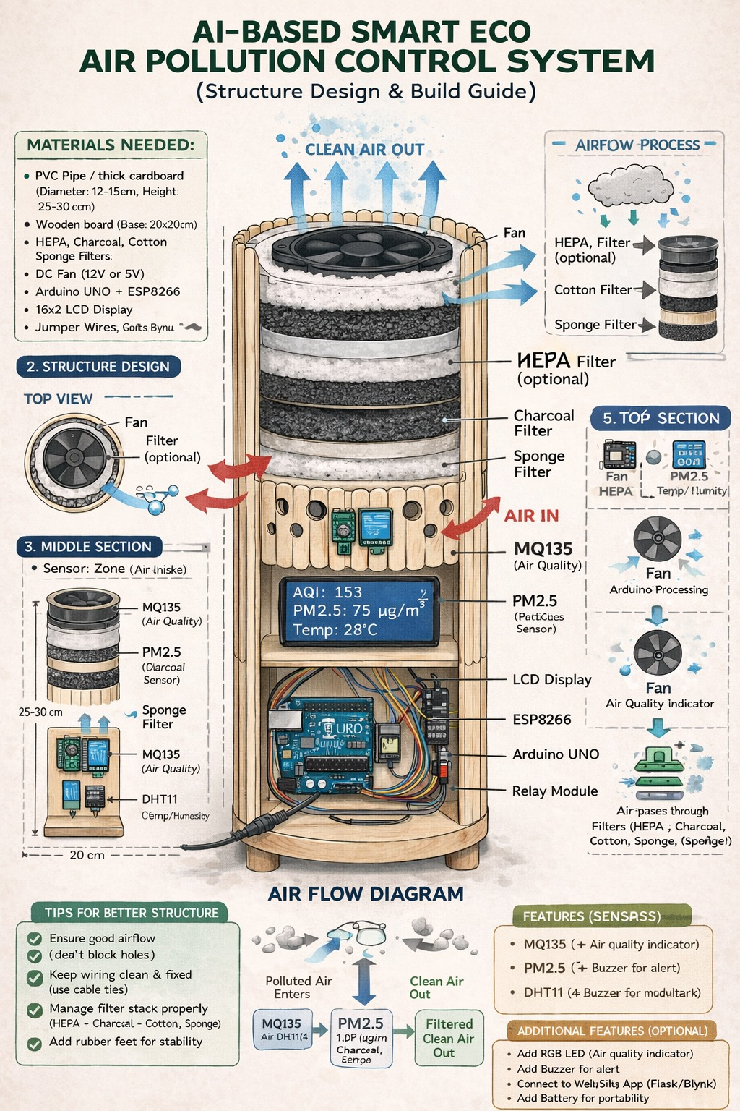
Hardware Design & Physical Build
Build Specifications
Enclosure:
Acrylic — 30cm × 20cm × 15cm
Airflow:
DC Motor (5V, 200mA) draws air inward
Filter Stack:
Pre-mesh → Bamboo Fiber → Charcoal
Sensor Zone:
Inlet: PM2.5 + MQ135 + DHT11
Display:
I2C LCD (16×2) shows AQI + PM2.5
Controller:
Arduino UNO (ATmega328P, 16MHz)
Power:
5V DC regulated supply
Cost:
~₹1,520 total (~USD 18)
DeepThink — K.R. Mangalam University | Major Project 2025–26

Slide 11
Methodology — System Workflow
1
2
3
4
5
Data Collection
Data Processing
AI Decision
Filtration
ML Prediction
PM2.5, MQ135,
DHT11 @ 1s intervals
Arduino ADC →
Calibrated values
Threshold logic
+ adaptive fan speed
Bamboo → Charcoal
multi-layer purification
LR + DT models
AQI class forecast
// Key AI Decision Logic (Embedded C — Arduino)
if (pm25 > PM25_HIGH) analogWrite(FAN_PIN, 255); // FULL speed
else if (pm25 > PM25_THRESHOLD || (mq135 > MQ135_THRESHOLD && humidity < HUMIDITY_GATE))
analogWrite(FAN_PIN, 180); // BASE speed
else analogWrite(FAN_PIN, 0); // STANDBY
DeepThink — K.R. Mangalam University | Major Project 2025–26

Slide 12
Machine Learning — Model Design & Training
Dataset & Features
Logistic Regression (Primary)
10 controlled trials × ~1,800 records = 18,000 total
3 environments: Lab (incense), Workshop, Classroom
Feature Vector (5 features):
• PM2.5 concentration (µg/m³)
• MQ135 output (ppm)
• Temperature (°C)
• Relative Humidity (%)
• Time-of-day encoding
Target: 4-class AQI label (CPCB standards)
Good ≤50 | Moderate 51–100 | Unhealthy 101–200 | Hazardous >200
One-vs-Rest | Z-score normalization | C tuned via 5-fold CV
Train: 93.1% • Test: 91.3% • Macro F1: 90.9%
Hazardous class accuracy: 95.1%
Decision Tree (Secondary — Interpretable)
CART algorithm | Gini impurity | Max depth: 6 (pruned)
Train: 94.5% • Test: 88.7% • Macro F1: 87.8%
Top feature: PM2.5 (importance: 0.61), MQ135 (0.27)
Highly interpretable — suitable for embedded edge deployment
80:20 Train/Test split • SMOTE for class imbalance • scikit-learn 1.3
DeepThink — K.R. Mangalam University | Major Project 2025–26

Slide 13
Results — Filtration Performance (10 Trials)
73.8%
71.9%
2.4s
0/10
PM2.5 Reduction
(340→89 µg/m³)
MQ135 Reduction
(420→118 ppm)
Mean Response Time
(vs 30–60s HEPA)
False Activations
(after humidity gating)
DeepThink — K.R. Mangalam University | Major Project 2025–26

Slide 14
Results — ML Model Performance
Key Insights
• LR recommended as primary model
• DT best for edge/embedded (interpretable)
• PM2.5 + MQ135 = 88% predictive power
DeepThink — K.R. Mangalam University | Major Project 2025–26

Slide 15
Comparative Advantages & Cost Analysis
Feature | Proposed System | Conventional HEPA
Filtration Media | Bamboo + Charcoal (biodegradable ✅) | Synthetic HEPA (non-biodegradable ❌)
ML Prediction | Yes — LR (91.3%) + DT (88.7%) ✅ | No ❌
Real-time AQI Classification | Yes (91.3% accuracy) ✅ | No ❌
Response Time | 2.4 seconds ✅ | 30–60 seconds ❌
Estimated Cost | ₹1,520 (~USD 18) ✅ | ₹8,000–₹25,000 ❌
Outdoor Deployment | Yes ✅ | Limited / No ❌
Source-Level Control | Yes ✅ | No — ambient only ❌
DeepThink — K.R. Mangalam University | Major Project 2025–26

Slide 16
Limitations & Future Research Directions
Current Limitations
Future Research Directions
Efficiency drops when PM2.5 > 500 µg/m³ (filter saturation in 2–3 hours)
🤖
Embedded ML on ESP32 via TensorFlow Lite / Edge Impulse
Bamboo-charcoal filter needs replacement every 30–45 days
☁️
ThingSpeak / AWS IoT Core cloud dashboard & alerts
ML trained on 18,000 records from 10 trials — needs broader real-world validation
🧠
LSTM deep learning for multi-step-ahead forecasting
MQ135 cross-sensitivity to humidity >80% RH (mitigated but not eliminated)
🌍
Multi-month field deployment for diverse training data
ML inference currently on companion PC — not yet fully embedded on MCU
☀️
Solar-powered (5W PV panel) for off-grid outdoor use
🗺️
Multi-node sensor network for spatial AQI mapping
DeepThink — K.R. Mangalam University | Major Project 2025–26

Slide 17
Conclusion
✅
PM2.5 reduced by 73.8% (340 → 89 µg/m³) across 10 controlled trials
✅
MQ135 gaseous pollutants reduced by 71.9% (420 → 118 ppm)
✅
System response time: 2.4 seconds — 12× faster than HEPA purifiers
✅
Logistic Regression: 91.3% accuracy | Decision Tree: 88.7% accuracy
✅
Total hardware cost: ₹1,520 (~USD 18) — 5–16× cheaper than HEPA alternatives
✅
First system to unify IoT monitoring + ML prediction + eco-friendly filtration
"Smarter air. Greener planet. Healthier future." — Team DeepThink | K.R. Mangalam University | May 2026

Slide 18
Thank You!
We welcome your questions and feedback.
S
S
B
K
Shubham
Suryansh
Brijesh
Kartik Yadav
2301730100
2301730126
2301730134
2301730099
Supervisor: Mr. Anurag Singh (Asst. Professor, CSE) | K.R. Mangalam University, Gurugram
B.Tech CSE AI & ML (Sec-B) | Project: AI-Based Smart Eco Air Pollution Control System | May 2026
GitHub: github.com/shubham055555/AI-Based-Smart-Eco-Air-Pollution-Control-System | Projexa Team ID: 26E3261
🏆 Shubham Sharma — Certified: 1M1B Green Internship (AICTE + Salesforce, Sep–Oct 2025) | Tableau + Sustainability + Live Project

