Slide 1
Coursera Capstone Project The Battle of Neighborhoods

Slide 2
Introduction
In a city of Helsinki, if someone is looking to open a café
restaurant, the question is, where would you recommend that
they open it? The background of the problem is that in order
for a café to be profitable, there must be enough customers,
and in order to have enough customers, it is not worth setting
up a café in the immediate promixity of existing ones.
Let’s also make sure that audience is explicitly defined to be
the local restaurant entrepreuners in Helsinki and they should
care about this problem because the location of the new café
has a significant impact on the expected returns.

Slide 3
Data
A description of the data: the data used to solve this problem
is geolocation data collected from FourSquare. Adequate
explanation and discussion, with examples, of the data is the
following. Data is a single dataframe, containing at least a
location of the café. Explanation of the location data is a
standard tuple (lat, lng), where lat stands for latitude and lng
for longitude. Some other metadata like name, postal code
and so on is also collected, but let us discuss that they are not
absolutely necessary for the analysis. Example of the data used
in analysis is shown in table 1.
Data will be used in the following way: by knowing the
locations of already existing cafes, it’s possible to apply
unsupervised learning technique like kernel density estimation
(KDE) to determine the area of influence of the existing cafes,
and start up new café which is not in the area of influence.

Slide 4
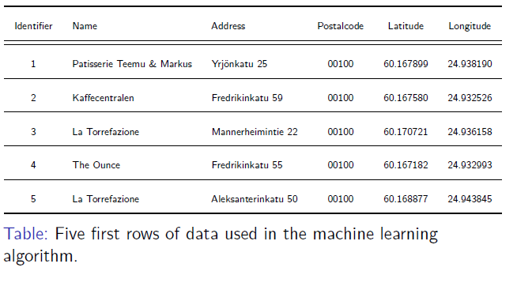

Slide 5
Methodology
Heatmap-based kernel density estimation was used. Heatmat
was already implemented as plugin for Folium, which was used
to visualize data to map. Visualization is shown in figure 1.
Figure: Data visualized to the map of Helsinki, including
heatmap-based kernel density
estimation.

Slide 6
Results
Based on the preliminary results, one possibly good location
for new Cafe would be in crossroad of Aleksanterinkatu and
Mikonkatu, shown in figure 2.
Figure:
Figure: Proposed location for a new café restaurant

Slide 7
Discussion
Before starting a business, some further data analysis of the
optimal location of shop may be require

Slide 8
Conclusions
Optimal location for a new coffee shop in center of Helsinki
was estimated based on data from FourSquare.

