Slide 1
Running the 3-Point Bending Simulation
Matt Schramm

Slide 2
Open 3-Point Cantilever Example
Using the shortcut you previously created, navigate to the tutorial shortcut -> LIGGGHTS_Flexible_Fibers -> examples -> BondPackage -> Tutorials -> Single_Tests -> 3_point_cantilever
Open in.liggghts
File shows the use of if statement block

Slide 3
Running the Example
A input script can be ran by running the following command liggghts –in in.liggghts
LIGGGHTS will now read and interpret your input script

Slide 4
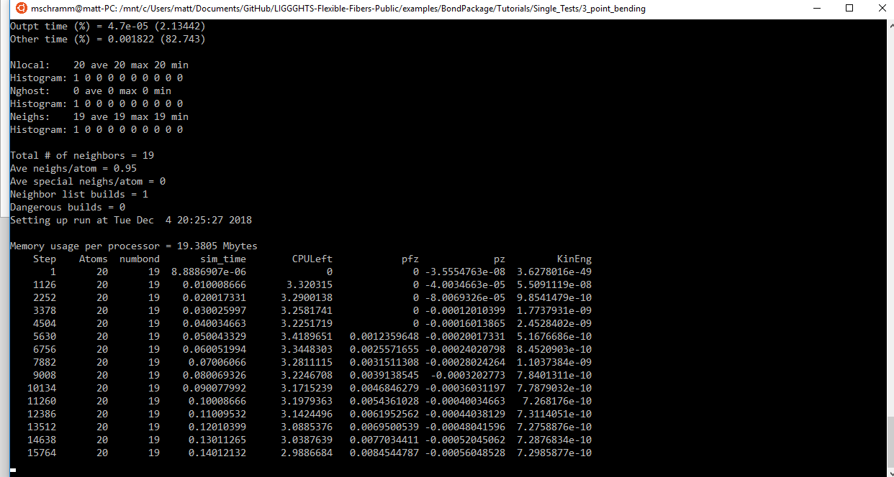
Running the Example

Slide 5
Looking at the Results
Notice that new files have been created in the directory you are in (by typing “ls *” and “ls post/*”
These new files are what we want to look at

Slide 6
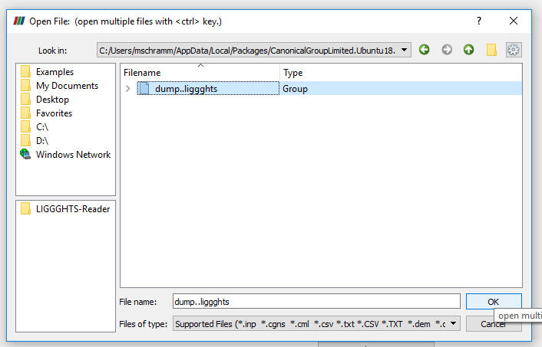
Paraview
Open the dump..liggghts file

Slide 7
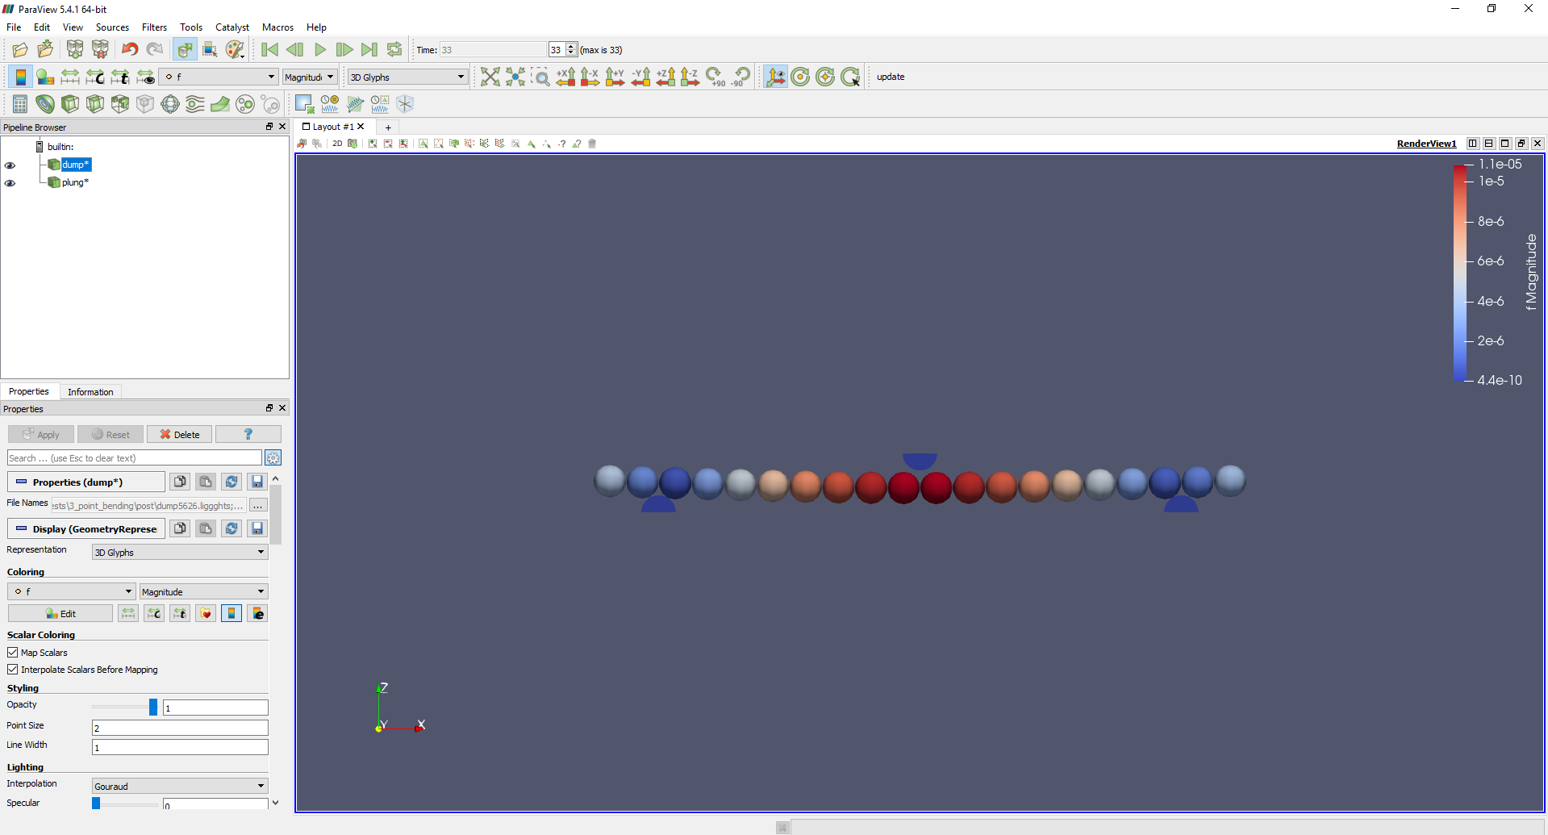
Show Particle Forces
text

