Slide 1
Running the Cantilever Beam Simulation
Matt Schramm

Slide 2
Open Cantilever Beam Example
Using the shortcut you previously created, navigate to the tutorial shortcut -> LIGGGHTS_Flexible_Fibers -> examples -> BondPackage -> Tutorials -> Single_Tests -> cantilever_beam
Open in.liggghts
The actual script starts at the command “atom_style hybrid granular bond/gran …”
All lines before this simply make the file easier to read

Slide 3
Structure of the Input File
Input files are structured as followed
Atom definition
Domain definition
Physics definition
Atom property declaration
Simulation definition
These files can be very powerful but special care is needed

Slide 4
Running the Example
A input script can be ran by running the following command liggghts –in in.liggghts
LIGGGHTS will now read and interpret your input script

Slide 5
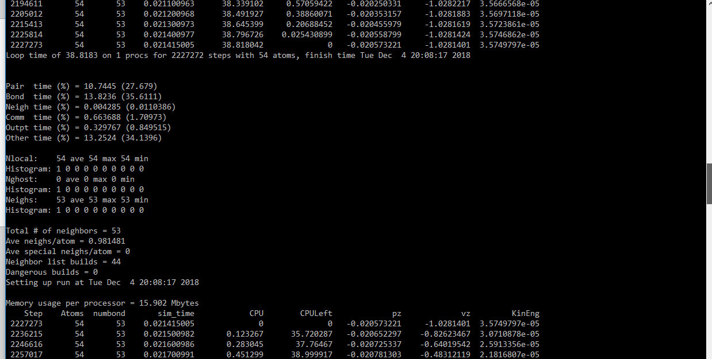
Running the Example

Slide 6
Looking at the Results
Notice that new files have been created in the directory you are in (by typing “ls *” and “ls post/*”
These new files are what we want to look at
Use paraview to view the simulation
Use Matlab to view the “beam.csv” file

Slide 7
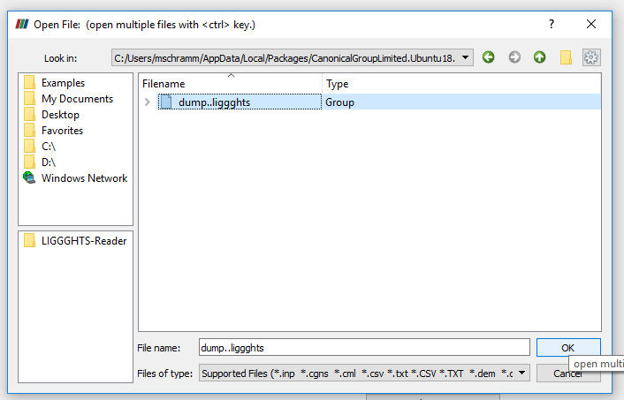
Paraview
Open the dump..liggghts file

Slide 8
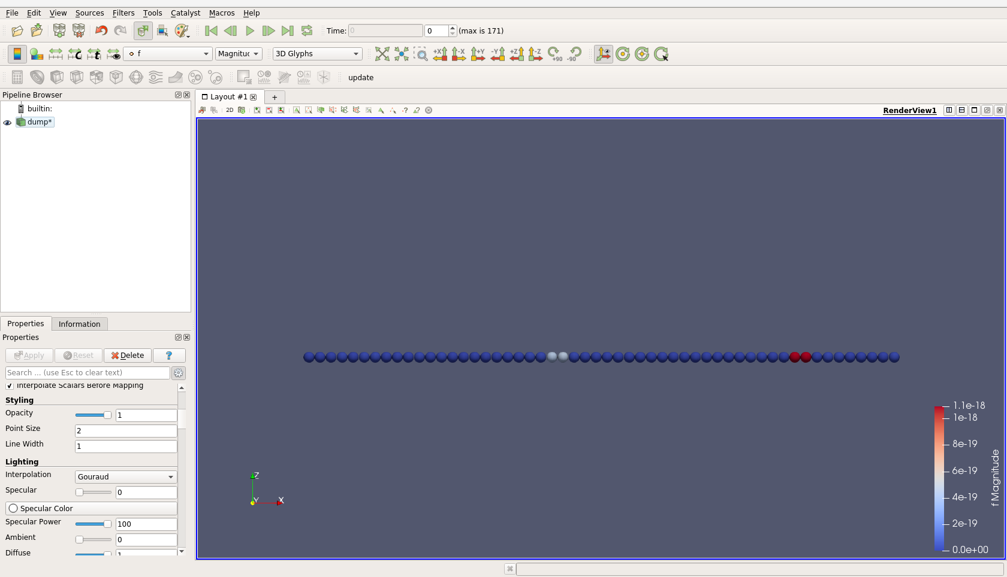
Show Particle Forces
text

Slide 9
Rescale Particle Forces
text

Slide 10
Watch Forces Over Time
text

