Slide 1
Logical Programming & Prolog
Jaskiran Kaur
Nisha Martis
Shubham Deshmukh
Sohini Sarkar

Slide 2
What is Computational Logic?
Computational logic is the use of logic to perform or reason about computation, which can be arithmetic or non- arithmetic. in other words, Computational logic is a term that describes the decision-making progress used in programming and writing algorithms.
It bears a similar relationship to computer science and engineering, as mathematical logic bears to mathematics and as philosophical logic bears to philosophy.
Computational logic is the use of computers to establish facts in a logical formalism.
Formal Logic is the study of reasoning and truth by the way of rule systems. Computational Logic is nothing but formal logic through the lenses of Computer science and mathematics.
Logic though is not strictly tied to computation. To understand and relate with, logic can be seen in everyday lives whenever we make any factual or non-factual claim. Example: “Lakers won today’s match” can be evaluated logically by looking at the scoreboard of today’s match.
A logical formalism is a precisely defined symbolic language that includes logical primitives such as ‘and’ (∧), ‘or’ (∨), ‘not’ (¬), ‘implies’ (→), ‘for all/universal quantifier’ (∀) and ‘there exists/existential quantifier’ (∃).
The above logical connectives are used with multiple propositions (ex: p, q, a, b) to form a formula. We may summarize the truth value of each logical connectives in a truth table.
Notes:
Fghdkalsgkdfjcgj Fghdkalsgkdfjcgj Fghdkalsgkdfjcgj Fghdkalsgkdfjcgj Fghdkalsgkdfjcgj Fghdkalsgkdfjcgj Fghdkalsgkdfjcgj Fghdkalsgkdfjcgj Fghdkalsgkdfjcgj Fghdkalsgkdfjcgj Fghdkalsgkdfjcgj Fghdkalsgkdfjcgj Fghdkalsgkdfjcgj Fghdkalsgkdfjcgj Fghdkalsgkdfjcgj Fghdkalsgkdfjcgj Fghdkalsgkdfjcgj Fghdkalsgkdfjcgj Fghdkalsgkdfjcgj Fghdkalsgkdfjcgj Fghdkalsgkdfjcgj Fghdkalsgkdfjcgj Fghdkalsgkdfjcgj Fghdkalsgkdfjcgj Fghdkalsgkdfjcgj Fghdkalsgkdfjcgj Fghdkalsgkdfjcgj Fghdkalsgkdfjcgj Fghdkalsgkdfjcgj vvvvvv Fghdkalsgkdfjcgj Fghdkalsgkdfjcgj Fghdkalsgkdfjcgj vvv Fghdkalsgkdfjcgj Fghdkalsgkdfjcgj Fghdkalsgkdfjcgj v

Slide 3
Introduction to Logical Programming
It’s a computer programming paradigm where program statements express facts and rules about problems within a system of formal logic.
Logical programming deals with the types of decisions which the computer takes, on how to proceed without any information, where it gives instructions to the computer so it can make a "logical" decision about how best to respond to a certain situation.
Any program written in a logic programming language is a set of sentences in logical form, expressing facts and rules about some problem domain. Rules are written in the form of clauses and are read declaratively as logical implications, for instance:
"H is true if B1, B2, and B3 are true." Facts are expressed similar to rules, but without a body; for instance, "H is true.“
Computation using logic programming is done by making logical inferences based on all available data. In order for computer programs to make use of logic programming, there must be a base of existing logic, called predicates.
Predicates are used to build atomic formulas or atoms, which state true facts. Predicates and atoms are used to create formulas and perform queries. Logic languages most often rely on queries in order to display relevant data. These queries can exist as part of machine learning, which can be run without the need for manual intervention.
Some popular logical programming languages are Prolog, Datalog, Absys, Alice, ASP, PROGOL, etc.

Slide 4
Functional vs Logical Programming
Functional
Logical
In our academic and professional setup, we usually use Functional or Object-Oriented Programming. To give an analogy here are some of the difference between Functional and Logical programming.
Based on Functions.
Constructed by applying and composing functions.
Designed to manage and handle list processing applications.
It reduces code redundancy, improves modularity, solves complex problems, increases maintainability, etc.
It simply uses functions and which may return values.
Based on formal logic.
Program statements represent facts and rules related to problems within a system of formal logic.
Designed for fault diagnosis, natural language processing, planning, and AI.
It is data-driven, array-oriented, used to express knowledge, etc.
It simply uses predicates and doesn’t return values.

Slide 5
Introduction to Prolog
Prolog as the name itself suggests, is the short form of LOGical PROgramming. It is a logical and declarative programming language.
It is particularly suitable for programs that involve symbolic or non-numeric computation. This is the main reason to use Prolog as the programming language in Artificial Intelligence, where symbol manipulation and inference manipulation are the fundamental tasks.
In Prolog, we need not mention the way how one problem can be solved, we just need to mention what the problem is, so that Prolog automatically solves it. However, in Prolog we are supposed to give clues as the solution method.
There are 3 basic elements in Prolog:
Facts − The fact is predicate that is true, for example, if we say, “Tom is the son of Jack”, then this is a fact.
Rules − Rules are extinctions of facts that contain conditional clauses. To satisfy a rule these conditions should be
met. For example, if we define a rule as:
This implies that for X to be the grandfather of Y, Z should be a parent of Y and X should be father of Z.
Questions − And to run a prolog program, we need some questions, and those questions can be answered by the
given facts and rules.
grandfather(X, Y) :- father(X, Z), parent(Z, Y)

Slide 6
Introduction to Prolog Contd..
In Prolog, Any Formulation or Computation is carried out by running a question/query over these relations.
Prolog features are 'Logical variable', which means that they behave like uniform data structure, a backtracking strategy to search for proofs, a pattern-matching facility, mathematical variable, and input and out are interchangeable.
To deduce the answer, there will be more than one way. In such case, the run time system will be asked to find another solution. To generate another solution, prolog uses the backtracking strategy. Prolog is a weakly typed language with static scope rules and dynamic type checking.
Prolog is used in some areas like database, natural language processing, artificial intelligence, but it is pretty useless in some areas like a numerical algorithm or instance graphics.
The artificial intelligence applications can be automated reasoning systems, natural language interfaces, and expert systems. The expert system consists of an interface engine and a database of facts. The prolog's run time system provides the service of an interface engine.
Some application of Prologs are Specification Language, Robot Planning, Natural language understanding, Machine Learning, Problem Solving, Intelligent Database retrieval, Expert System, Automated Reasoning.

Slide 7
History of Prolog
The heritage of prolog includes the research on theorem provers and some other automated deduction system that were developed in 1960s and 1970s.
The Inference mechanism of the Prolog is based on Robinson’s Resolution Principle (1965), and Answer extracting mechanism by Green (1968). These ideas came together forcefully with the advent of linear resolution procedures which gave impetus to the development of a general-purpose logic programming system.
The first Prolog was the Marseille Prolog based on the work by Alian Colmerauer in the year 1970. The manual of this Marseille Prolog interpreter (Roussel, 1975) was the first detailed description of the Prolog language.
Prolog is also considered as a 4th gen programming lang. supporting the declarative programming paradigm. The well-known Japanese 5th-Gen Computer Project, announced in 1981, adopted Prolog as a development language, and thereby grabbed considerable attention on the language and its capabilities.
Now there is even an ISO Prolog standardization (1995) where all of its individual parts have been defined to ensure that the core of the language remains fixed.

Slide 8
Syntax and Semantics
Notes:
Prolog falls under the paradigm of logic, and it's a declarative programming language and it itself uses something known as predicate logic or predicate syntax, which makes it pretty similar to that of the natural language. Having said that it was developed to more easily convey ideas in the programming world.

Slide 9
Understanding the Basics
FACTS
RULES
Unconditionally true in nature.
Tom is a cat
Kunal loves to eat Pasta
Hair is black
Nawaz loves to play games
Pratyusha is lazy.
Conditionally true in nature.
Lili is happy if she dances.
Tom is hungry if he is searching for food.
Jack and Bili are friends if both of them love to play cricket.
Will go to play if school is closed, and he is free.
Notes:
So let us now understand the basics, the building blocks of this language. The program logic is expressed in terms of relations, which are represented as facts and rules. A computation is initiated by running a query over these relations.
What are facts?
If I say, Canada is the second largest country in the world by total area.
If you eat too many carrots, you may turn orange
But if a statement is conditionally true in nature then it is called as rules.
By this explanation I think we all got the point of prolog language being similar to the natural language.
So lets move ahead and get a better understanding of the terminologies.

Slide 10
FACTS
Facts are statements about what is true about a problem, instead of instructions how to accomplish the solution.
The Prolog system uses the facts to work out how to accomplish the solution by searching through the space of possible solutions.
It is defined by an identifier followed by an n-tuple of constants.
A relation identifier is referred to as a predicate.
Guidelines for fact declaration
Names of relationships and objects must begin with a lower case letter.
The relationship name appears as the first term (typically the predicate of the sentence).
Objects appear as comma-separated arguments and are enclosed by a pair of parentheses.
A period "." must end a fact.
Objects also begin with lower case letters. They also can begin with digits (like 1234), and can be strings of characters enclosed in quotes e.g. color(penink, ‘red’).

Slide 11
Examples
Syntax: relation(object1, object2,..)
01
singer(pheobe)
Pheobe is a singer.
02
friends(chandler, joey)
Chandler and Joey are friends.
03
gives(monica, sandwich, ross)
Monica gives the sandwich to Ross.
04
lazy(Sohini)
Sohini is lazy.

Slide 12
RULES
Rules are used when you want to say that a fact depends on a group of facts.
It consists of a head and a body connected by the symbol :- (if)
Rules always end with ‘.’
Syntax and example of a rule
<head> :- <body>.
Read ‘:-’ as ‘if’.
likes(shu, X) :- likes(X, soccer)
“Shu likes X if X likes soccer.”
i.e., “Shu likes anyone who likes soccer”.
Notes:
We can define a rule as an implicit relationship between objects.
The structure of a rule looks like a composition of facts which are connected by the symbol :-

Slide 13
Questions/Queries
Queries are some questions on the relationships between objects and object properties. So question can be anything, as given below −
Is tom a cat?
Does Kunal love to eat pasta?
Is Lili happy?
Will Ryan go to play?
Notes:
Queries are computed over the relations between the objects and object properties to find the answers and return them with the help of logic programming language.
So the questions could be basically anything like: ……. Or whatever that we want to deduce with the help of data that we have.

Slide 14
Understanding the Basics
FACTS
RULES
Unconditionally true in nature.
Tom is a cat
Kunal loves to eat Pasta
Hair is black
Nawaz loves to play games
Pratyusha is lazy.
Conditionally true in nature.
Lili is happy if she dances.
Tom is hungry if he is searching for food.
Jack and Bili are friends if both of them love to play cricket.
will go to play if school is closed, and he is free.
Knowledge
Base
Collection of facts and rules.

Slide 15
KNOWLEDGE BASE
There are three main components in logic programming − Facts, Rules and Queries.
Among these three if we collect the facts and rules as a whole then that forms a Knowledge Base. So, we can say that the knowledge base is a collection of facts and rules.
We can query against the Knowledge Base.
We get output as affirmative if our query is already in the knowledge Base or it is implied by Knowledge Base, otherwise we get output as negative. So, Knowledge Base can be considered similar to database, against which we can query.
Notes:
as we have seen that there are three main components in logic programming − Facts, Rules and Queries. Among these three if we collect the facts and rules as a whole then that forms a Knowledge Base.
In prolog, We declare some facts. These facts constitute the Knowledge Base of the system. We can query against the Knowledge Base. We get output as affirmative if our query is already in the knowledge Base or it is implied by Knowledge Base, otherwise we get output as negative. So, Knowledge Base can be considered similar to database, against which we can query.

Slide 16
Example
Domain:
· Entities = {Bart, Lisa, Maggie, Homer, Marge}
· Relationships = {Male, Female, Parent, Father, Mother, Son, Daughter}
A Simpsons Knowledge Base:
male(homer). male(bart). female(marge). female(lisa). female(maggie). parent(homer, bart). parent(homer, lisa). parent(homer, maggie). parent(marge, bart). parent(marge, lisa). parent(marge, maggie).
mother(X, Y) :- parent(X, Y), female(X). father(X, Y) :- parent(X, Y), male(X). son(X, Y) :- parent(Y, X), male(X). daughter(X, Y) :- parent(Y, X), female(X).

Slide 17
DATA OBJECTS
01
02
03
04
Atoms
tom, pat, x100, x_45
Data Objects
Simple Objects
Constants
Structures
Variables
Atoms
Numbers
Numbers
100, 1235, 2000.45
Variables
X, Y, Xval, _X
Structures
day(9, jun, 2017), point(10, 25)

Slide 18
Atoms
Atoms
Atoms are one variation of constants.
They can be any names or objects.
It has to be Strings of letters, digits and the underscore character, ‘_', starting with a lower-case letter.
If we want to have an atom that starts with a capital letter. By enclosing it in quotes, we make it distinguishable from variables −
‘Mark’
‘John_Jacobs’
‘Albert Einstein’
Numbers
In Prolog, the normal range of integers is from -16383 to 16383.
Prolog also supports real numbers, but normally the use-case of floating point number is very less in Prolog programs, because Prolog is for symbolic, non-numeric computation.
The numbers are preceded by + or – sign (optional).
It contains a single decimal point. But this decimal point cannot exist before an optional plus(+) or minus(-) sign.
Notes:
An atom is a general-purpose name with no inherent meaning. Atoms are one variation of constants. They can be any names or objects.
Another variation of constants is the Numbers.
So integer numbers can be represented as 100, 4, -81, 1202. In Prolog, the normal range of integers is from -16383 to 16383.

Slide 19
Variables
Always begin with an upper-case letter or an underscore character.
Variables can contain the same symbol as atoms.
The same variable name used in 2 different questions represents 2 completely different variables.
An uninstantiated variable can be used to search for any match.
Examples: X, Sum, Memer_name, Student_list, Shoppinglist, _a50, _15.
Anonymous Variables
Anonymous variables have no names.
The anonymous variables in prolog is written by a single underscore character ‘_’.
Each individual anonymous variable is treated as different.
Suppose in our knowledge base we have some facts — “jim hates tom”, “pat hates bob”. So if tom wants to find out who hates him, then he can use variables. However, if he wants to check whether there is someone who hates him, we can use anonymous variables. So when we want to use the variable, but do not want to reveal the value of the variable, then we can use anonymous variables.
Example: hates(_,tom)

Slide 20
Compound term
A compound term is composed of an atom called a "functor" and a number of "arguments", which are again terms. Compound terms are ordinarily written as a functor followed by a comma-separated list of argument terms, which is contained in parentheses. The number of arguments is called the term's arity. An atom can be regarded as a compound term with arity zero. An example of a compound term is person_friends(zelda,[tom,jim]).
Special cases of compound terms:
A List is an ordered collection of terms. It is denoted by square brackets with the terms separated by commas, or in the case of the empty list, by []. For example, [1,2,3] or [red,green,blue].
Strings: A sequence of characters surrounded by quotes is equivalent to either a list of (numeric) character codes, a list of characters (atoms of length 1), or an atom depending on the value of the Prolog flag double_quotes. For example, "to be, or not to be".

Slide 21
Operators
01
02
Comparison Operators
Arithmetic Operators
X > Y | X is greater than Y
X < Y | X is less than Y
X >= Y | X is greater than or equal to Y
X =< Y | X is less than or equal to Y
X =:= Y | the X and Y values are equal
X =\= Y | the X and Y values are not equal
+ | Addition
- | Subtraction
* | Multiplication
/ | Division
** | Power
// | Integer Division
mod | Modulus
Notes:
Comparison operators are used to compare two equations or states. You can see that the ‘=<’ operator, ‘=:=’ operator and ‘=\=’ operators are syntactically different from other languages.
Arithmetic operators are used to perform arithmetic operations.

Slide 22
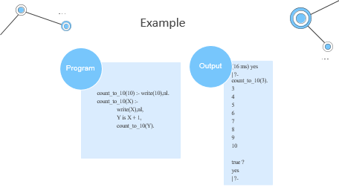
Loops
Loop statements are used to execute the code block multiple times.
Code block is executed multiple times using recursive predicate logic.
There are no direct loops in some other languages, but we can simulate loops with few different techniques.
Notes:
Direct loops are not available in every language but it can be simulated with few different techniques.

Slide 23
Example
Program
count_to_10(10) :- write(10),nl.
count_to_10(X) :-
write(X),nl,
Y is X + 1,
count_to_10(Y).
Output
(16 ms) yes
| ?- count_to_10(3).
3
4
5
6
7
8
9
10
true ?
yes
| ?-

Slide 24
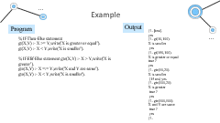
Decision Making
The decision statements are If-Then-Else statements. So when we try to match some condition, and perform some task, then we use the decision making statements. The basic usage is as follows −
If <condition> is true, Then <do this>, Else
In some different programming languages, there are If-Else statements, but in Prolog we have to define our statements in some other manner. Following is an example of decision making in Prolog.

Slide 25
Example
Program
Output
| ?- [test].
yes
| ?- gt(10,100).
X is smaller
yes
| ?- gt(150,100).
X is greater or equal
true ?
yes
| ?- gte(10,20).
X is smaller
(15 ms) yes
| ?- gte(100,20).
X is greater
true ?
yes
| ?- gte(100,100).
X and Y are same
true ?
yes
| ?-
% If-Then-Else statement
gt(X,Y) :- X >= Y,write('X is greater or equal’).
gt(X,Y) :- X < Y,write('X is smaller’).
% If-Elif-Else statement gte(X,Y) :- X > Y,write('X is greater’).
gte(X,Y) :- X =:= Y,write('X and Y are same’).
gte(X,Y) :- X < Y,write('X is smaller').

Slide 26
Detailed Description

Slide 27
Conjunctions & Disjunctions
Conjunction
Disjunction
Conjunction (AND logic) can be implemented using the comma (,) operator.
Two predicates separated by comma are joined with AND statement.
Disjunction (OR logic) can be implemented using the semi-colon (;) operator.
Two predicates separated by semi-colon are joined with OR statement.
Program
parent(jhon,bob). parent(lili,bob). male(jhon). female(lili). % Conjunction Logic father(X,Y) :- parent(X,Y),male(X). mother(X,Y) :- parent(X,Y),female(X). % Disjunction Logic child_of(X,Y) :- father(X,Y);mother(X,Y).
Output:
| ?- [conj_disj]. yes | ?- father(jhon,bob). yes | ?- child_of(jhon,bob). true ? yes | ?- child_of(lili,bob). yes | ?-
Notes:
We will discuss Conjunction and Disjunction properties. These properties are used in other programming languages using AND and OR logics. Prolog also uses the same logic in its syntax..
Suppose we have a predicate, parent(jhon, bob), which means “Jhon is parent of Bob,” and another predicate, male(jhon), which means “Jhon is male”. So, we can make another predicate that father(jhon,bob), which means “Jhon is father of Bob”. We can define predicate father when he is parent AND he is male.
Suppose we have a predicate, father(jhon, bob). This tells that “Jhon is father of Bob”, and another predicate, mother (Lili, bob), this tells that “Lili is mother of bob”. If we create another predicate as child (), this will be true when father(john, bob) is true OR mother (Lili, bob) is true.

Slide 28
Lists in Prolog
Lists
Basic Operations on Lists
Set operations
Lists are used to store the atoms as a collection.
The first element of a list is called its head and the remaining list is called the tail
Membership Checking
list_member(X,L).
Length Calculation
list_length(L,N)
Concatenation
list_concat([],L,L).
Delete Items
list_delete(X, [X], []).
Append Items
list_append(A,T,[A|T]).
Insert Items
list_insert(X, L, R).
list_subset(L, X)
Union Operation
list_union(L1,L2,L3)
Intersection Operation
list_intersection(L1,L2,L3)
Representation of Lists
Repositioning operations
The list of elements will be square brackets.
L = [a, b, c]
A list can be either empty or non-empty.
a-head b,c-tail
Permutation
list_perm(L1,L2)
Reverse Items
list_reverse(List, ReversedList)
Shift Items
list_shift(L1, L2).
Order Items
list_order(L)
Notes:
We will discuss one of the important concepts in Prolog, The Lists. It is a data structure that can be used in different cases for non-numeric programming. Lists are used to store the atoms as a collection..
Membership Operation
During this operation, we can check whether a member X is present in list L or not? So how to check this? Well, we have to define one predicate to do so. Suppose the predicate name is list_member(X,L). The goal of this predicate is to check whether X is present in L or not.
Length Calculation
This is used to find the length of list L. We will define one predicate to do this task. Suppose the predicate name is list_length(L,N). This takes L and N as input argument. This will count the elements in a list L and instantiate N to their number.
Concatenation
Concatenation of two lists means adding the list items of the second list after the first one. So if two lists are [a,b,c] and [1,2], then the final list will be [a,b,c,1,2]. So to do this task we will create one predicate called list_concat(), that will take first list L1, second list L2, and the L3 as resultant list.
Delete from List
Suppose we have a list L and an element X, we have to delete X from L. So there are three cases −
If X is the only element, then after deleting it, it will return empty list.
If X is head of L, the resultant list will be the Tail part.
If X is present in the Tail part, then delete from there recursively.
Append into List
Appending two lists means adding two lists together, or adding one list as an item. Now if the item is present in the list, then the append function will not work. So we will create one predicate namely, list_append(L1, L2, L3).
Insert into List
This method is used to insert an item X into list L, and the resultant list will be R. So the predicate will be in this form list_insert(X, L, R). So this can insert X into L in all possible positions.
Repositioning operations of list items
Following are repositioning operations −
Permutation Operation
This operation will change the list item positions and generate all possible outcomes. So we will create one predicate as list_perm(L1,L2), This will generate all permutation of L1, and store them into L2. To do this we need list_delete() clause to help.
Reverse Operation
Suppose we have a list L = [a,b,c,d,e], and we want to reverse the elements, so the output will be [e,d,c,b,a]. To do this, we will create a clause, list_reverse(List, ReversedList).
Shift Operation
Using Shift operation, we can shift one element of a list to the left rotationally. So if the list items are [a,b,c,d], then after shifting, it will be [b,c,d,a]. So we will make a clause list_shift(L1, L2).
Order Operation
Here we will define a predicate list_order(L) which checks whether L is ordered or not. So if L = [1,2,3,4,5,6], then the result will be true.
Set operations on lists
We will try to write a clause that will get all possible subsets of a given set. So if the set is [a,b], then the result will be [], [a], [b], [a,b]. To do so, we will create one clause, list_subset(L, X). It will take L and return each subsets into X
Union Operation
Let us define a clause called list_union(L1,L2,L3), So this will take L1 and L2, and perform Union on them, and store the result into L3. As you know if two lists have the same element twice, then after union, there will be only one.
Intersection Operation
Let us define a clause called list_intersection(L1,L2,L3), So this will take L1 and L2, and perform Intersection operation, and store the result into L3. Intersection will return those elements that are present in both lists. So L1 = [a,b,c,d,e], L2 = [a,e,i,o,u], then L3 = [a,e].

Slide 29
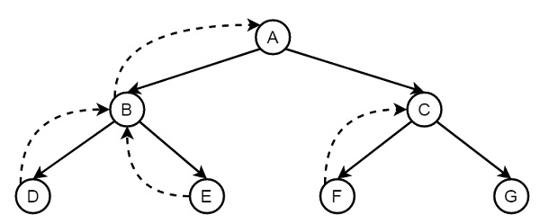
Backtracking
Backtracking is a procedure, in which prolog searches the truth value of different predicates by checking whether they are correct or not.
Press semicolon (;) to get next answers one by one, that helps to backtrack. Otherwise, when we get one result, it will stop.
It sets a marker at the branching spot.
selects the first subgoal to pursue.
If that subgoal fails , it will backtrack to the back-tracking point.
Try an alternate subgoal.
Notes:
Backtracking
Often, when solving real problems, you must pursue a path to its logical conclusion. If this conclusion does not give the answer you were looking for, you must choose an alternate path.
Visual Prolog uses this same backing-up-and-trying-again method, called backtracking, to find a solution to a given problem. As Visual Prolog begins to look for a solution to a problem (or goal), it might have to decide between two possible cases. Prolog uses brute force to check all possibilities • Facts and rules are processed from top to bottom • Clauses within a rule are satisfied from left to right. It sets a marker at the branching spot (known as a backtracking point) and selects the first subgoal to pursue. If that subgoal fails (equivalent to reaching a dead end), Visual Prolog will backtrack to the back-tracking point and try an alternate subgoal.
When Prolog begins an attempt to satisfy a goal, it starts at the top of the program in search of a match
Suppose A to G are some rules and facts. We start from A and want to reach G. The proper path will be A-C-G, but at first, it will go from A to B, then B to D. When it finds that D is not the destination, it backtracks to B, then go to E, and backtracks again to B, as there is no other child of B, then it backtracks to A, thus it searches for G, and finally found G in the path A-C-G. (Dashed lines are indicating the backtracking.) So when it finds G, it stops.

Slide 30
Problem with Backtracking
Write the same predicates more than once when our program demands.
Uncontrolled backtracking may cause inefficiency in a program.
Branches of the tree will be visited.
Duplicate head will remain in the list.
Program
remove_duplicates([], []).
remove_duplicates([Head | Tail], Result) :-
member(Head, Tail),
remove_duplicates(Tail, Result).
remove_duplicates([Head | Tail], [Head | Result]) :-
remove_duplicates(Tail, Result).
Output
?- remove_duplicates([a, b, b, c, a], List).
List = [b, c, a] ;
List = [b, b, c, a] ;
List = [a, b, c, a] ;
List = [a, b, b, c, a] ;
No
Notes:
So far we have seen some concepts of backtracking. Now let us see some drawbacks of backtracking. Sometimes we write the same predicates more than once when our program demands, for example to write recursive rules or to make some decision making systems. In such cases uncontrolled backtracking may cause inefficiency in a program. During backtracking, however, also all other branches of the search tree will be visited. Even if the first rule would match, sometimes the second one will be picked instead and the duplicate head will remain in the list. The (semantically wrong) output can be seen in the following example:
That is, Prolog not only generates the correct solution, but also all other lists we get by keeping some of the elements that should have been deleted.

Slide 31
Preventing Backtracking
Use cut to resolve this.
The cut can be expressed using Exclamation symbol.
The main uses of the cut:
No meaningful solutions (green cut).
To prevent using of subgoals (red cut).
Program
remove_duplicates([], []).
remove_duplicates([Head | Tail], Result) :-
member(Head, Tail), !,
remove_duplicates(Tail, Result).
remove_duplicates([Head | Tail], [Head | Result]) :-
remove_duplicates(Tail, Result).
Output
?- remove_duplicates([a, b, b, c, a], List).
List = [b, c, a] ;
No
Notes:
To resolve this, we will use the Cut in Prolog. which is used to prevent backtracking; it's written as an exclamation mark (!). The effect of the cut is simple: It is impossible to backtrack across a cut.
You place the cut in your program the same way you place a subgoal in the body of a rule.
There are two main uses of the cut:
When you know in advance that certain possibilities will never give rise to meaningful solutions, it's a waste of time and storage space to look for alternate solutions. If you use a cut in this situation, your resulting program will run quicker and use less memory. This is called a green cut.
When the logic of a program demands the cut, to prevent consideration of alternate subgoals. This is a red cut.
Let’s first look at our example about removing duplicate elements from a list again. We change the previously proposed program by inserting a cut after the first subgoal inside the body of the first rule; the rest remains exactly the same as before. Once Prolog went past the cut, this isn’t possible anymore: alternative matchings for the parent goal1 will not be tried. Using this new version of the predicate remove_duplicates/2, we get the desired behaviour. When asking for alternative solutions by pressing ; we immediately get the right answer, namely No

Slide 32
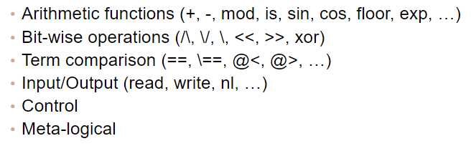
Built-in Predicates
In Prolog, there are some built-in-predicates. There are three types of built-in predicates as given below −
Identifying terms
Decomposing structures
Collecting all solutions
Notes:
BUILT in predicates:
In Prolog, we have seen the user defined predicates in most of the cases, but there are some built-in predicates. There are three types of built-in predicates as given below −
Identifying terms
Decomposing structures
Collecting all solutions

Slide 33
Higher-order programming
A higher-order predicate is a predicate that takes one or more other predicates as arguments.
It does not allow quantification over predicates.
ISO Prolog now has some built-in higher-order predicates such as call/1, call/2, call/3, findall/3, setof/3, and bagof/3.
Prolog goals can be constructed and evaluated at run-time, it is easy to write higher-order predicates like maplist/2, which applies an arbitrary predicate to each member of a given list, and sublist/3, which filters elements that satisfy a given predicate, also allowing for currying.
To convert solutions from temporal representation to spatial representation .
Various all-solutions predicates that collect all answer substitutions of a given query in a list ( list comprehension).
Notes:
A higher-order predicate is a predicate that takes one or more other predicates as arguments. Although support for higher-order programming takes Prolog outside the domain of first-order logic, which does not allow quantification over predicate. ISO Prolog now has some built-in higher-order predicates such as call/1, call/2, call/3, findall/3, setof/3, and bagof/3.[26] Furthermore, since arbitrary Prolog goals can be constructed and evaluated at run-time, it is easy to write higher-order predicates like maplist/2, which applies an arbitrary predicate to each member of a given list, and sublist/3, which filters elements that satisfy a given predicate, also allowing for currying
To convert solutions from temporal representation (answer substitutions on backtracking) to spatial representation (terms), Prolog has various all-solutions predicates that collect all answer substitutions of a given query in a list. This can be used for list comprehension.

Slide 34
Implementation and Examples

Slide 35
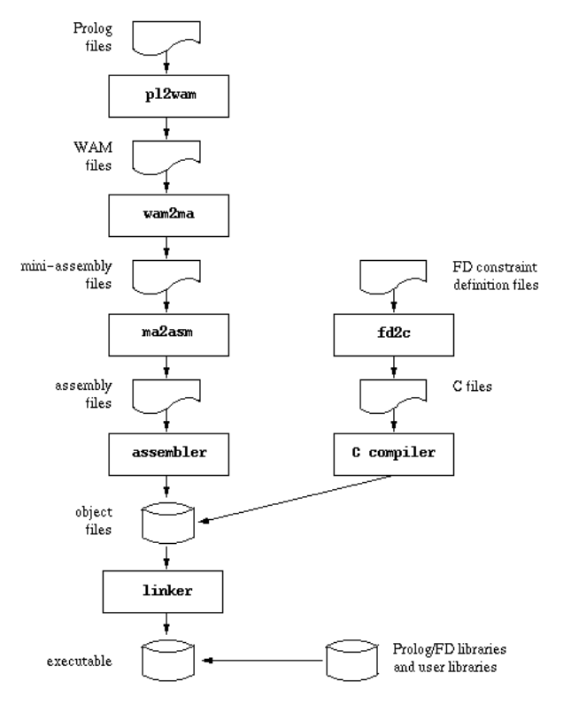
Compilation
Native Compilation scheme can be explained as,
Prolog source is compiled to obtain a WAM file
WAM file is translated to mini assembly files
mini-assembly file is then mapped to the assembly language of the target machine
Assembly file is assembled to give rise to an object file
Compiler also takes into account Finite Domain constraint definition files
translates them to C and invoke the C compiler to obtain object files

Slide 36
Recursion
Recursion: Recursion in any language is a function that can call itself until a goal has been succeeded
Recursion in Prolog: In prolog, recursion appears when a predicate contains a goal that refers to itself
There are two types of recursions:
Tail Recursion : The predicate which causes recursion will be at the tail
Example: head:-p1,p2,p3,head
Non-tail recursion (Stack recursion) : The predicate will be in the middle of the rule
Example: head:-p1,p2,head,p3

Slide 37
Term Indexing
Terms are nothing but data types
Each term is either a variable, atomic term or a compound term
Indexing a term is to speed up the search
"Indexed Terms" are compound prolog terms
Starting index of iterm:
| 1 if a > 0 i = < | 0 if a = 0

Slide 38
Hashing and Tabling
Hash tables are one of the many key-value representations
Hash tables allow for any Prolog data types as keys or values
Variable as a key should be wrapped in a compound
Example: k(var)
Hash table can be created using the below syntax:
ht_new(--HT)
Tabling is used to enhance the performance
It has the drawbacks like
- the memoized answers are not automatically updated or invalidated
- the answer tables must be stored

Slide 39
Installation of prolog on Windows
Visit swi-prolog.org website using any web browser
Click on Download which is adjacent to Home, dropdown list will appear then click on SWI-Prolog
From Stable release, choose the executable file for your system configuration and operating system
Download the file to be installed on your system
To install the executable, follow the steps as we follow for other application installations
Once the installation completes, run the SWI-Prolog application to see the interface

Slide 40
Example: To check if friendship holds
The prolog programs will comprise of multiple clauses (rules/facts)
In the given example, the program has four clauses
Out of which, three are facts and one is rule
Facts are given below:
likes(mike, erica).
likes(erica, mike).
likes(josh, shane).
The facts can be read as "mike likes erica", "erica likes mike" and "josh likes shane"
Rule is as follows:
friendship(X, Y):- likes(X, Y), likes(Y,X).
The rule can be read as "friendship will hold if and only if "X likes Y" and "Y likes X"

Slide 41
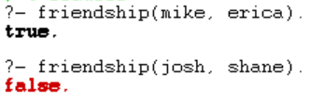
Example: To check if friendship holds
Prolog Code:
likes(mike, erica).
likes(erica, mike).
likes(josh, shane).
friendship(X, Y):-
likes(X, Y),
likes(Y,X).
Output:

Slide 42
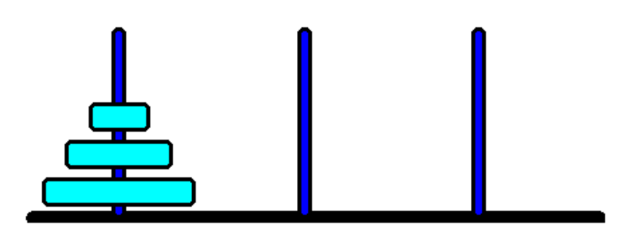
Example: Tower of Hanoi
Require to move N disks from the left peg to the right peg using the center peg as an auxiliary holding peg
Condition : At no time can a larger disk be placed upon a smaller disk
Starting setup for N=3 disks:

Slide 43
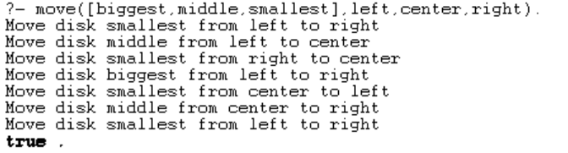
Example: Tower of Hanoi
Prolog Code:
move([Disc],X,_,Y) :- format("Move disk ~w from ~w to ~w\n", [Disc, X, Y]). move([Bottom|Rest],Start,Swap,Goal) :- move(Rest,Start,Goal,Swap), move([Bottom],Start,_,Goal), move(Rest,Swap,Start,Goal).
Output:

Slide 44
References
https://www.cs.auckland.ac.nz/references/gnu/gprolog/manual007.html#:~:text=Compilation%20scheme,a%20WAM%20%5B%208%20%5D%20file.
https://www.youtube.com/watch?v=zkQ4yz50VVo&t=597s
https://www.swi-prolog.org/pack/list?p=indexed_terms
https://www.swi-prolog.org/pldoc/doc/_SWI_/library/hashtable.pl
https://semanticweb.cs.vu.nl/verrijktkoninkrijk/swish/pldoc/man?section=tabling
https://www.geeksforgeeks.org/how-to-install-swi-prolog-on-windows/
Prolog Tutorial - javatpoint
Prolog Tutorial (tutorialspoint.com)
Prolog - Wikipedia

Slide 45
Thank You

