Slide 1
ADVANCED SECURITY SYSTEM
PRESENTED BY-
SUBHAM DIVAKAR

Slide 2
CONTENTS
Problem Statement
Introduction
Block Diagram
Working Principle
Conclusion
References

Slide 3
PROBLEM STATEMENT
Security monitoring system requires data transmission system ,fast receiving data and accurate at a certain distance, so that users can place devices freely at important locations for the monitoring system.
Security Systems of present day are very outdated.

Slide 4
INTRODUCTION
All home security systems are equipped with sensors and motion detectors. When an uninvited visitor arrives at your home and tampers with your door knobs, windows, or garage door, the sensors will trigger an alarm. Some systems include an outdoor and indoor siren that will alert the homeowner and neighbours of an intruder.
If the system is monitored through a home security company, an alert will be sent to the command centre, so the representative can immediately begin to investigate the alarm.

Slide 5
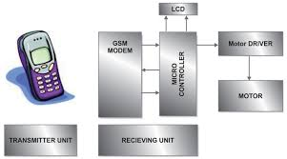
BLOCK DIAGRAM

Slide 6
WORKING PRINCIPLE
All home security systems work on the same basic principle of securing entry points, like doors and windows, as well as interior space containing valuables like art, computers, guns, and coin collections.
Regardless of the size of your home, or the number of doors and windows or interior rooms a homeowner decides to protect, the only real difference is in the number of security components deployed throughout the home and monitored by the control panel.

Slide 7
LAYERS OF SECURITY
KEYPAD BASED LOCK.
FINGERPRINT LOCK(BIOMETRICS).
GSM MODULE ALERTING USING FINGERPRINT MODULE.
PIR MOTION SENSOR WITH BUZZER.
MOTION SENSOR CAMERAS THAT TAKE SNAPSHOTS AND STORE IN MEMORY.
UNLOCKING THE DOOR FROM ANYWHERE

Slide 8
KEYPAD SECURITY
Using keypad you have to enter password of 4 digits to unlock the door.
You will be denied access if you enter wrong password and that too for more than 3 times.

Slide 9
FINGERPRINT RECOGNITION
We have implemented fingerprint security system.
If someone whose fingerprint is not on the module places it on the module then the members of the house get alert SMS messages.
Also if door is unlocked then also you will get notification that the door has been opened.

Slide 10
PIR MOTION SENSORS WITH BUZZER
PIR motion sensors sense the presence of incoming humans and activate the buzzers

Slide 11
ADVANCED MOTION DETECTOR CAMERAS
These cameras not only detect the intruders who have broken through your doors and windows but can also take and store snapshots of them.

Slide 12
UNLOCK THE DOOR FROM ANYWHERE
If a friend or distant relative comes to your house and your are in your office then all you need to do is to send the password to the relative
Using our SMART SECURITY APP he/she can easily unlock the door that is also connected with Bluetooth module.

Slide 13
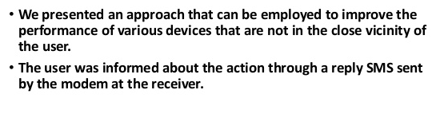
CONCLUSION

