Slide 1

CSE343
CSE 343
SUMMER TRAINING
JAVA PROGRAMMING
SUBMITTED TO-LPU,PUNJAB
SUBMITTED BY-SHUBHAM KUMAR
REG.NO-11804686

Slide 2
CONTENTS
INTRODUCTION OF JAVA
CLASSES AND OBJECTS
COLLECTIONS
INHERITANCE
ABSTRACT AND INTERFACE
STRINGS
EXCEPTION HANDLING
JDBC
MULTITHREADING
STREAMS AND WRITERS

Slide 3
WHAT IS JAVA
Java is a popular programming language, created in 1995.It is owned by Oracle, and more than 3 billion devices run Java.
It is used for:
Mobile applications (specially Android apps)
Desktop applications
Web applications
Web servers and application servers
Games
Database connection
And much, much more

Slide 4
MAIN FEATURES OF JAVA
Platform independent language
Object oriented
Robust
Simple
Secure
Interpreted
High performance
Multithreading
Dynamic

Slide 5
CLASSES IN JAVA
A class is a group of objects which have common properties.
A class is the template or blueprint from which objects are made.
A class in java can contains:
Fields
Methods
Constructors
Blocks
Nested class and interface
A class can be created by using class keyword.
e.g- class myclass{
}

Slide 6
OBJECTS IN JAVA
Entity which has state and behaviour is an object.
An object has three characteristics:
State- means value
Behaviour- means functionality (method)
Identity- ID
Example- Pen
Id-Reynold, State-Color(white), Behaviour- used to write
An object is an instance of a class.

Slide 7
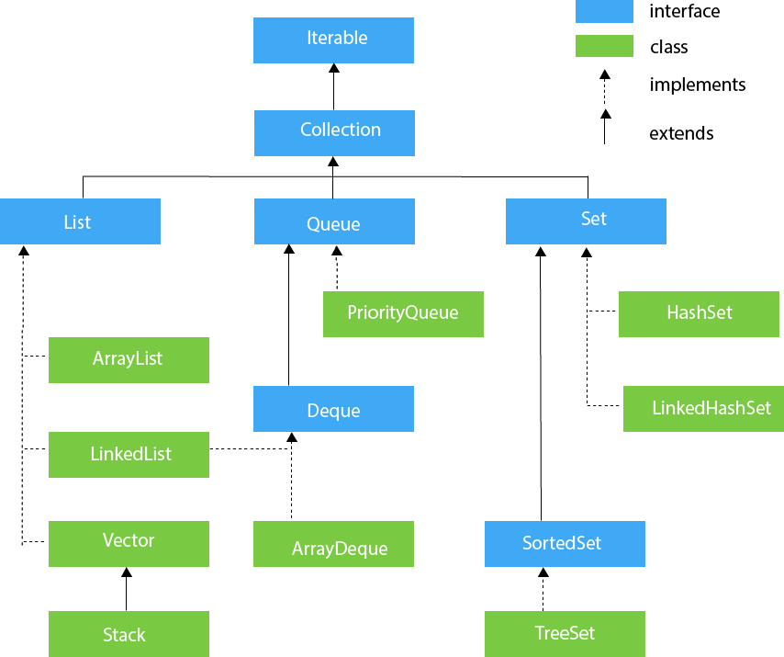
COLLECTIONS IN JAVA
The Collection in Java is a framework that provides an architecture to store and manipulate the group of objects.
A Collection represents a single unit of objects, i.e., a group.
Java Collections can achieve all the operations that you perform on a data such as searching, sorting, insertion, manipulation, and deletion.
Hierarchy of Collection framework:

Slide 8
INHERITANCE IN JAVA
Inheritance in Java is a mechanism in which one object acquires all the properties and behaviours of a parent object. It is an important part of OOPs (Object Oriented programming system).
The idea behind inheritance in Java is that you can create new classes that are built upon existing classes. When you inherit from an existing class, you can reuse methods and fields of the parent class. Moreover, you can add new methods and fields in your current class also.
Syntax of java inheritance
class subclass-name extends superclass-name{
}
extends keyword indicates that you are making new class from the existing class.

Slide 9
ABSTRACT AND INTERFACE IN JAVA
Abstraction is a process of hiding the implementation details and showing only functionality to the user.
A class which is declared as abstract is known as an abstract class. It can have abstract and non-abstract methods. It needs to be extended and its method implemented. It cannot be instantiated.
An interface in Java is a blueprint of a class. It has static constants and abstract methods.
The interface in Java is a mechanism to achieve abstraction. There can be only abstract methods in the Java interface, not method body. It is used to achieve abstraction and multiple inheritance in Java.

Slide 10
STRINGS IN JAVA
Strings, which are widely used in Java programming, are a sequence of characters. In Java programming language, strings are treated as objects.
The Java platform provides the String class to create and manipulate strings.
CREATING STRINGS
String greeting= “hello vertos!”;

Slide 11
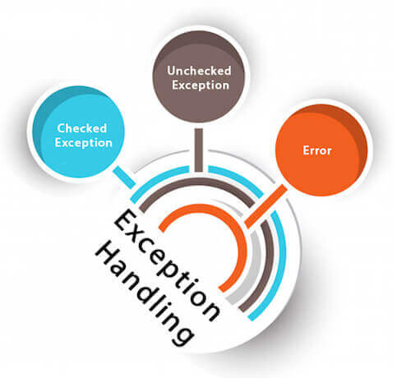
EXCEPTION HANDLING IN JAVA
Exception Handling is a mechanism to handle runtime errors such as ClassNotFoundException, IOException, SQLException, RemoteException, etc.
The core advantage of exception handling is to maintain the normal flow of the application. An exception normally disrupts the normal flow of the application that is why we use exception handling.
Types of exceptions in java:

Slide 12
JDBC
JDBC stands for Java Database Connectivity. JDBC is a Java API to connect and execute the query with the database. It is a part of JavaSE (Java Standard Edition). JDBC API uses JDBC drivers to connect with the database. There are four types of JDBC drivers:
JDBC-ODBC Bridge Driver,
Native Driver,
Network Protocol Driver, and
Thin Driver
Before JDBC, ODBC API was the database API to connect and execute the query with the database. But, ODBC API uses ODBC driver which is written in C language (i.e. platform dependent and unsecured). That is why Java has defined its own API (JDBC API) that uses JDBC drivers (written in Java language).

Slide 13
MULTITHREADING IN JAVA
Multithreading in Java is a process of executing multiple threads simultaneously.
A thread is a lightweight sub-process, the smallest unit of processing. Multiprocessing and multithreading, both are used to achieve multitasking
we use multithreading than multiprocessing because threads use a shared memory area. They don't allocate separate memory area so saves memory, and context-switching between the threads.takes less time than process.
ADVANTAGES OF MULTITHREADING:
1) It doesn't block the user because threads are independent and you can perform multiple operations at the same time.
2) You can perform many operations together, so it saves time.
3) Threads are independent, so it doesn't affect other threads if an exception occurs in a single thread.

Slide 14
STREAMS AND WRITERS
A stream is a sequence of data. In Java, a stream is composed of bytes. It's called a stream because it is like a stream of water that continues to flow.
In Java, 3 streams are created for us automatically. All these streams are attached with the console.
1) System.out: standard output stream
2) System.in: standard input stream
3) System.err: standard error stream
WRITERS:
It is an abstract class for writing to character streams. The methods that a subclass must implement are write(char[], int, int), flush(), and close(). Most subclasses will override some of the methods defined here to provide higher efficiency, functionality or both.

Slide 15
THANK YOU

