Slide 1
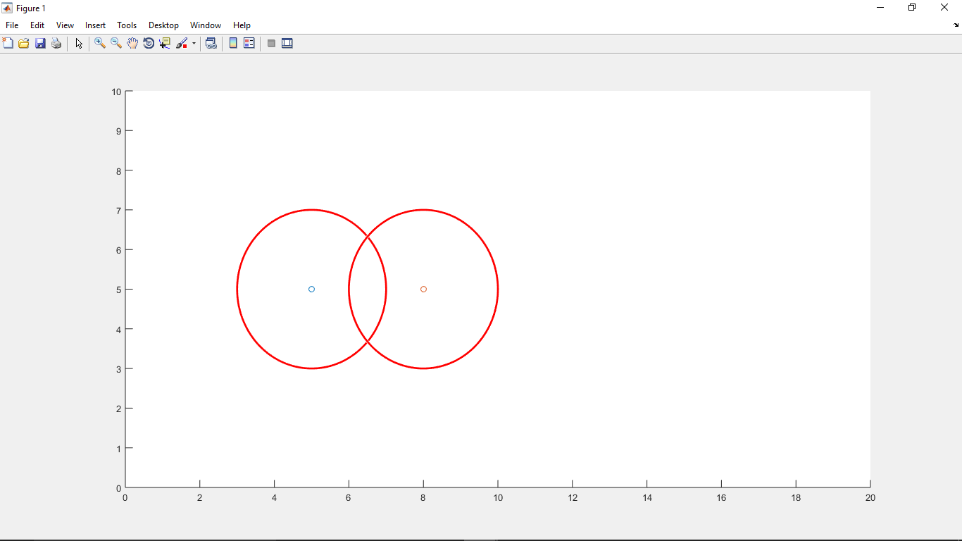

Slide 2

Points J and K
J
K

Slide 3
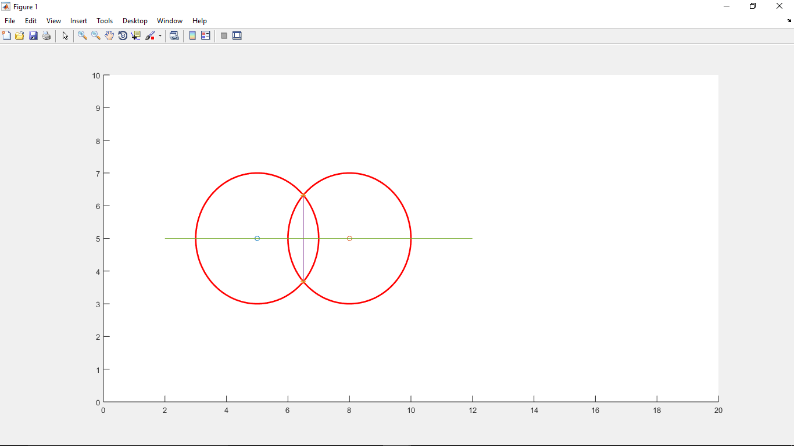
Line joining points J and K

Slide 4

Point of intersection of lines joining points J and K and points B and C
P

Slide 5

Point of intersection of line joining points B and C and the circle with the center B
I

Slide 6

Mid point of P and I
Z

Slide 7
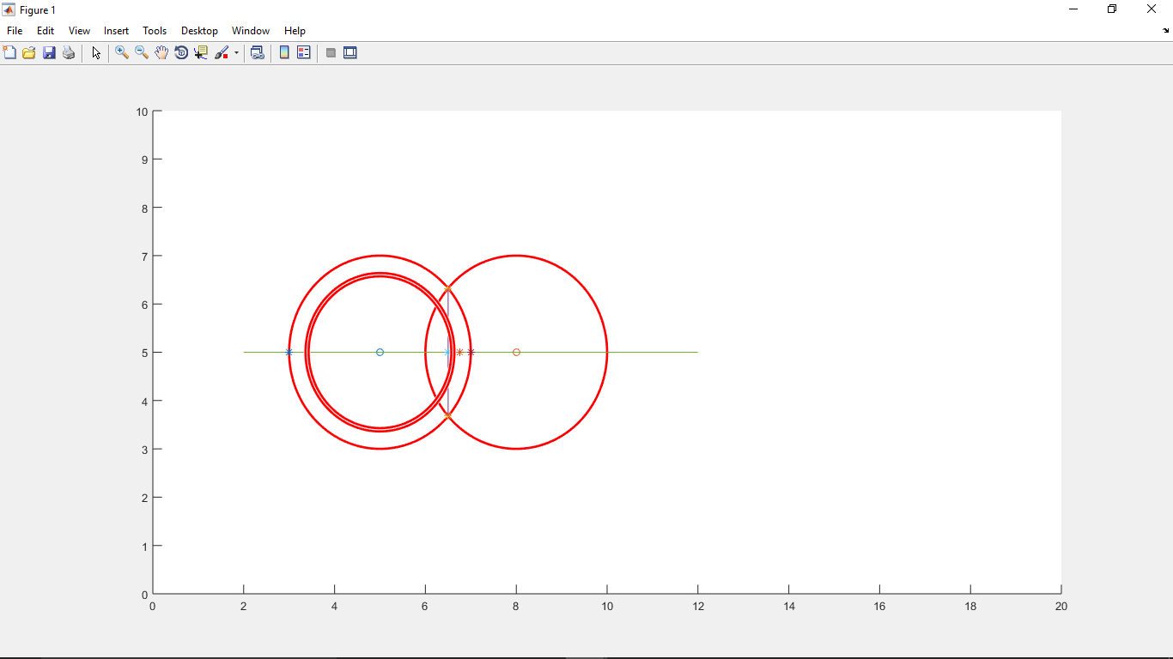
Random circles generated

Slide 8

Points(F) of intersection of the circles and line joining points J and K
Points(Q) of intersection of the circles and the line joining the points B and C
Point T, mid point of the chord

Slide 9
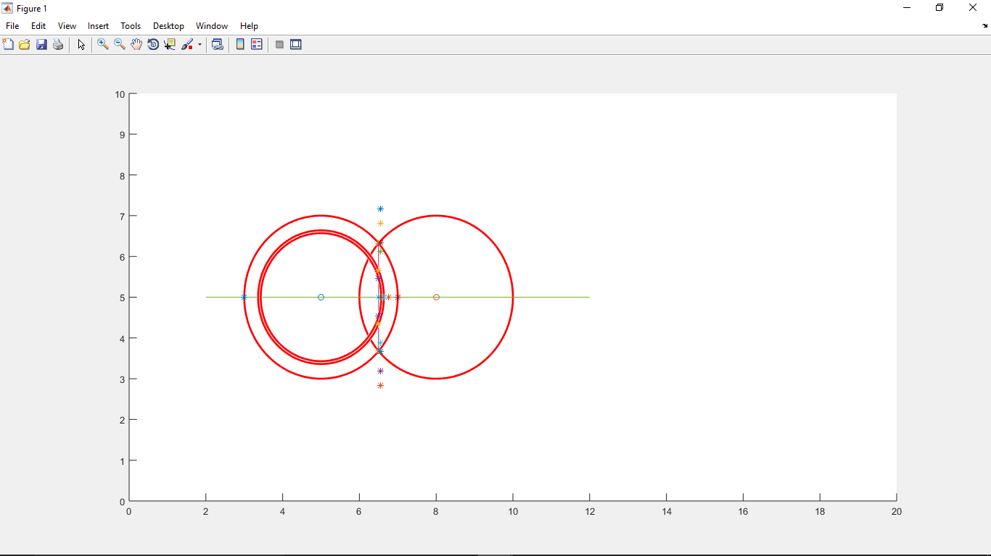
H1
H2
H3
H4
-H4
-H3
-H2
-H1

Slide 10
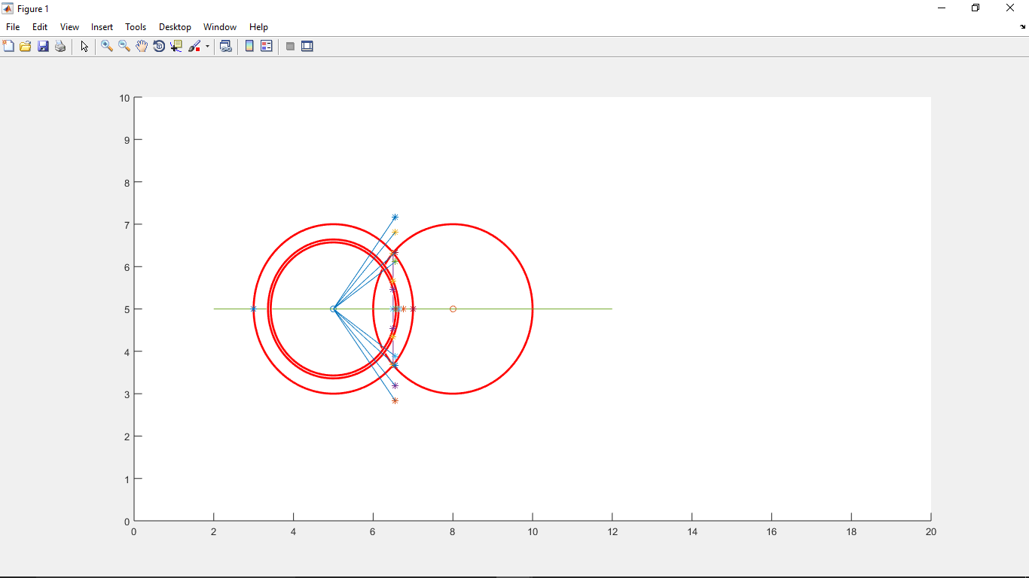

Slide 11
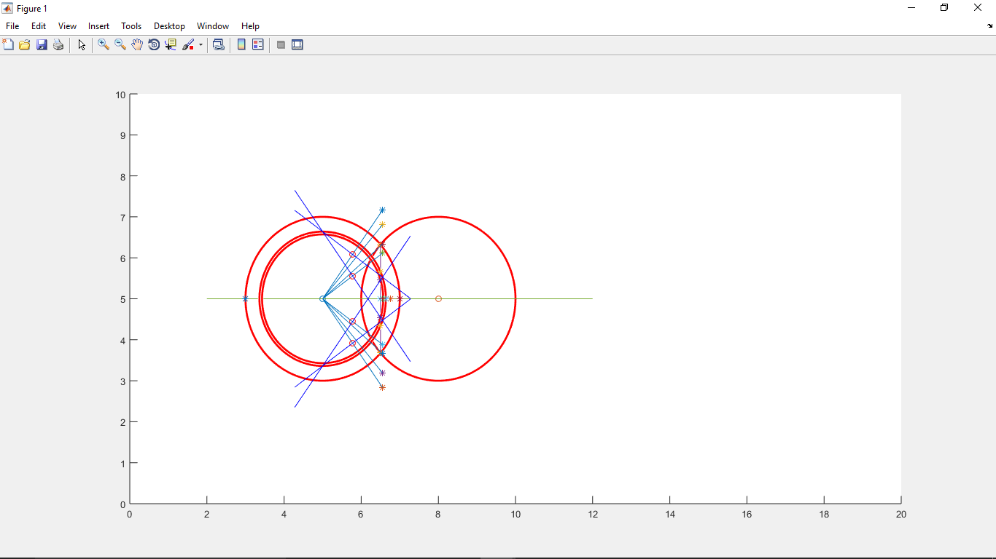
P1
P2
P3
P4

Slide 12


Slide 13
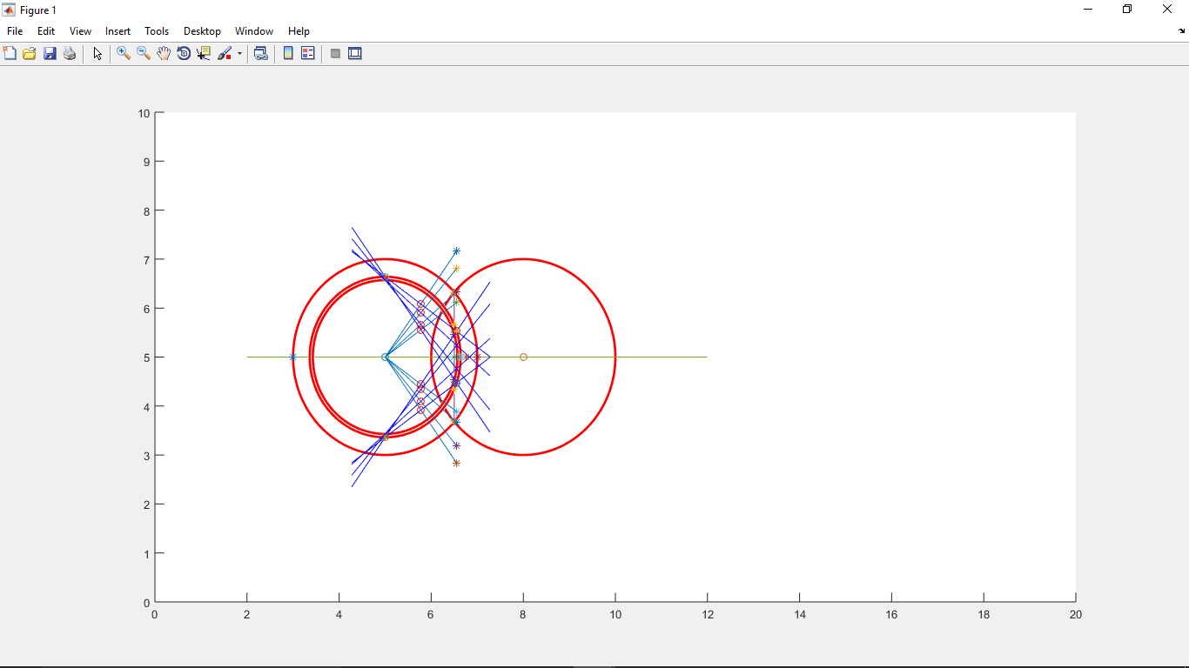
P1
P2
P3
P4

Slide 14
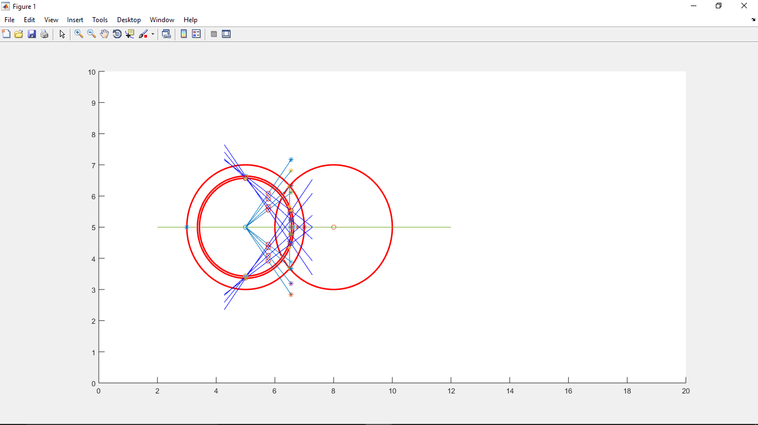
Out of the four points P1, P2, P3 and P4 two points are selected. Further depending upon the RSSI value one point is selected.

