Slide 1

Expanding UCP Product: Analysis and Attendance Prediction for 2022/23 Season

Slide 2
Agenda
Introduction
Insights
Predictive Model for Attendance
Business Recommendations
Conclusion

Slide 3
Introduction:
Brief overview of the UCP product
Passes cover 35 games of the 41 total games
Pass cost $350
Goals of the analysis
Whether we should expand UCP product to all 41 games
Our goal is to predict attendance based on a variety of features

Slide 4
Insight 1-Homestand Vs Other Games
UCP Members
Single Game Buyers
 | Homestand | Other | Overall
Reservations | 4839 | 2135 | 6974
Attendance | 3307 | 1514 | 4821
Difference | 1532 | 621 | 2153
Attendance rate | 68% | 71% | 69.13%
 | Homestand | Other | Overall
Purchased | 59079 | 24448 | 83527
Attendance | 56091 | 23614 | 79705
Difference | 2988 | 834 | 3822
Attendance rate | 95% | 97% | 95%
While the difference is higher for Single Game, 3822, assuming, tickets cannot be refunded, that is realised revenue, giving us a revenue of $ 164,346, taking an average ticket size of $43 for the single game.

Slide 5
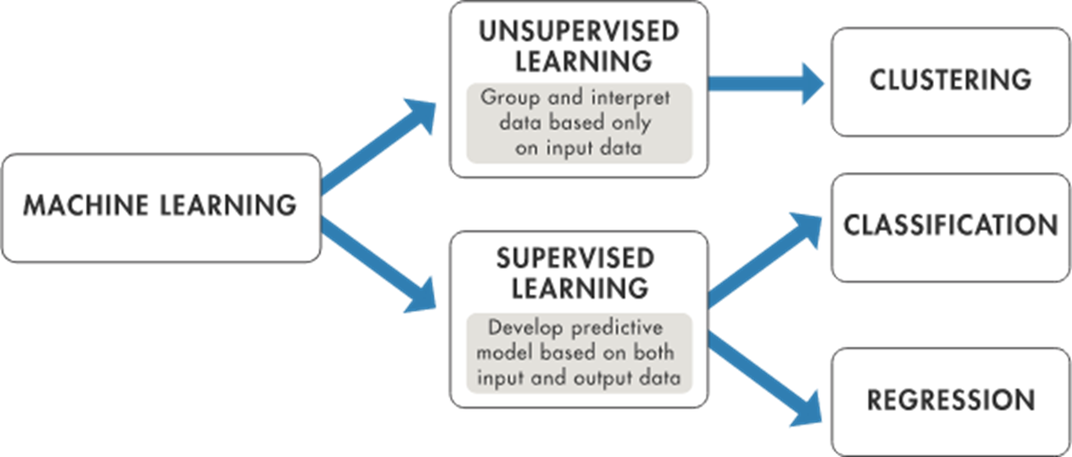
Predict attendance based on a variety of features

Slide 6
Predictive Model - Data Sources
List of data sources
https://www.basketball-reference.com/teams/LAC/2023_games.html
https://www.nba.com/stats/teams/advanced?CF=MIN*GE*15&SeasonType=Regular%20Season&dir=A&sort=NET_RATING
https://weather.visualcrossing.com/VisualCrossingWebServices/rest/services/timeline/{}/2022-10-01/2023-04-20?unitGroup=metric&key={}&contentType=json
Explanation of data collection
Wanted to include game statistics data for all 40 games
Wanted to add Net rating as a feature in the model
Wanted to add weather data as features

Slide 7
Predictive Model - Approach
Chosen approach and rationale
We used a variety of machine learning models to predict attendance, including Linear Regression, Ridge, Lasso, Decision Tree, Random Forest, Support Vector Machines, K-Nearest Neighbors, and XGBoost.
Methodology for model development:
Preprocessing the data
Exploratory Data Analysis
Feature Selection
Model Selection
Hyperparameter Tuning
Model Evaluation
Best Model selection

Slide 8
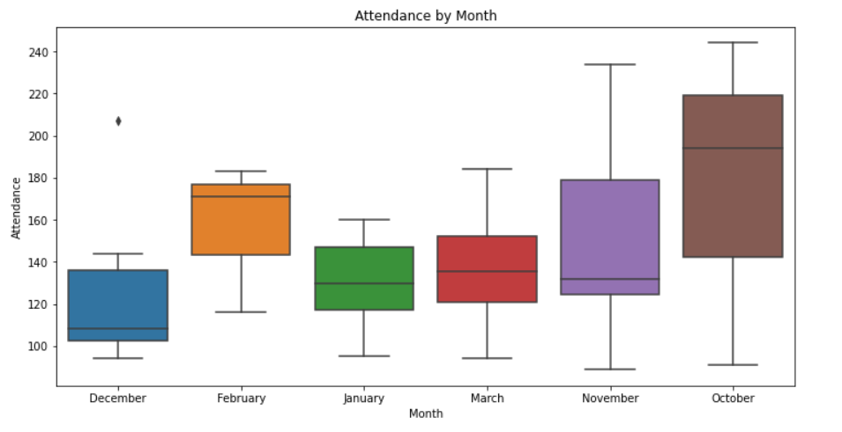
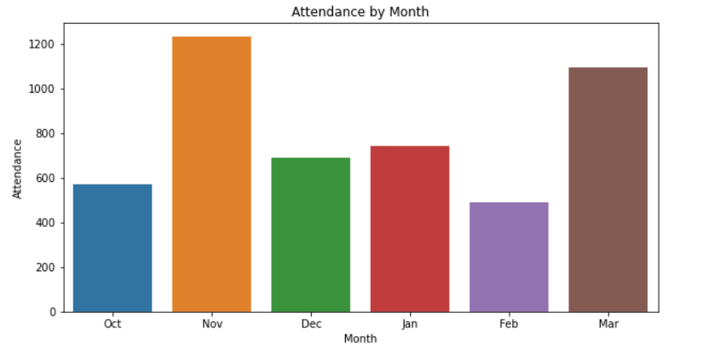
Exploratory Data Analysis
Attendance by Month

Slide 9
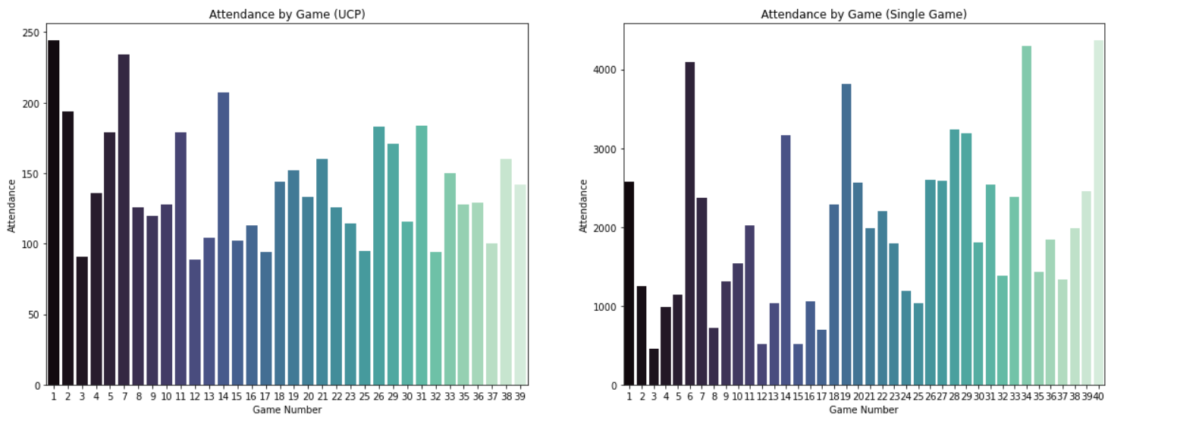
Comparison of Attendance in Game(USP vs Single)

Slide 10
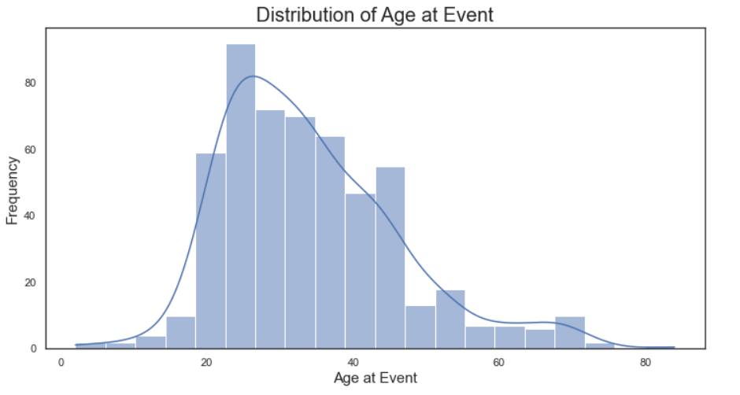
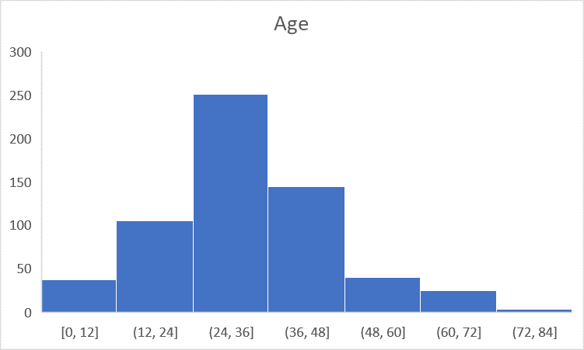
Age Distribution

Slide 11
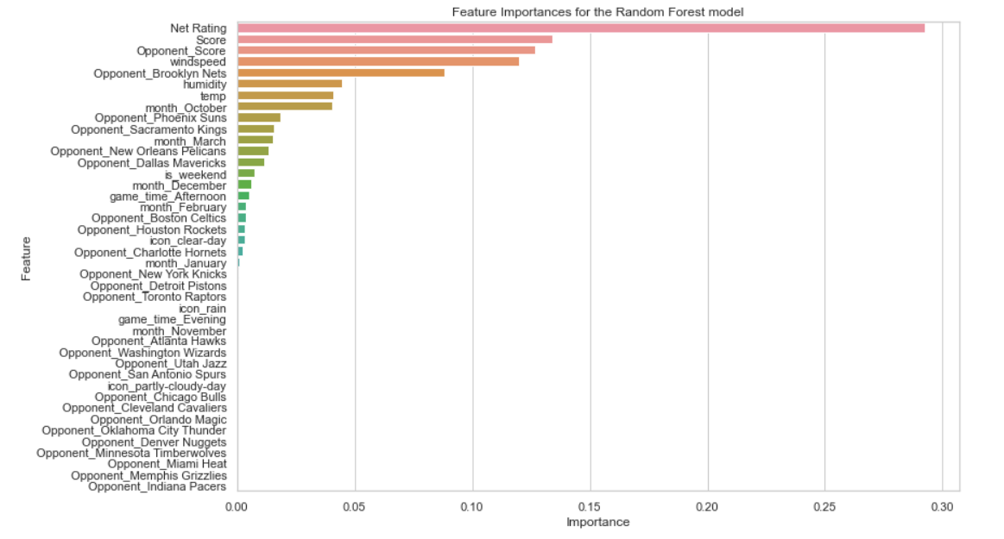
Predictive Model - Features
Feature selection:
Net rating: I wanted to add a metric for evaluation of team’s overall performance

Slide 12
Predictive Model Performance Metrics
The Random Forest model has the lowest RMSE (28.55) and the highest R2 score (0.3019), making it the best-performing model among the tested models.
The K-Nearest Neighbors model comes in second place, with an RMSE of 31.15 and an R2 score of 0.1688.
Other models, such as Lasso, Support Vector Machines, XGBoost, Ridge, and Decision Tree, have comparatively higher RMSE values and lower R2 scores, indicating less accurate predictions
Model | MSE | RMSE | R2
Random Forest | 815.14 | 28.55 | 0.30
K-Nearest Neighbors | 970.60 | 31.15 | 0.17
Lasso | 1012.18 | 31.81 | 0.13
Support Vector Machines | 1066.46 | 32.66 | 0.09
XGBoost | 1372.68 | 37.05 | -0.18
Ridge | 1374.42 | 37.07 | -0.18
Decision Tree | 1484.39 | 38.53 | -0.27
Linear Regression | 13531.57 | 116.33 | -10.59

Slide 13
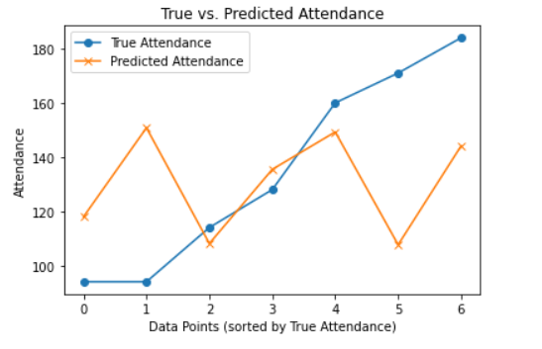
Model Key Findings
The Random Forest model is the best model for predicting attendance based on the given features, as it has the lowest RMSE and the highest R2 score.
Among the tested models, Linear Regression has the worst performance, with an RMSE of 116.32 and a negative R2 score (-10.5881).
For some models, such as Ridge, Lasso, and Support Vector Machines, regularization (controlled by the alpha or C parameter) improves their performance.

Slide 14
Interpretation of Results
The best model (Random Forest) explains approximately 30.19% of the variance in the attendance data, as indicated by the R2 score.
The RMSE value of 28.55 for the best model (Random Forest) indicates that, on average, the model's predictions are off by 28.55 units from the actual attendance values.
Assuming Score and opponent score for the match as average scores of all UCP member games.
We get a predicted value of 140 UCP Members.

Slide 15
Business Recommendations
Recommendations based on insights and predictive model
Basis the current data and evaluation, it would be recommended not to expand the product, a cost-benefit analysis can be done if we have the numbers for those 6 games where the seats were not taken by single game buyers.
Actionable steps to expand UCP product
Depending upon the above numbers, a cost analysis can be done to see if the number of empty seats, which could be filled by our UCP members, and we could increase the price of the pass, since these 4 teams have the highest average ticket size.
Potential benefits and risks
Earned revenue through UCP pass, more people likely to buy at a higher cost(assumption), if matches against those 4 teams are included, while risk of losing ticket sale revenue from single buyers persists who are more likely to attend since we have a 95% attendance rate.

Slide 16
Thank You

