Slide 1


EFFECT OF COVID ON SALES AND E-COMMERCE

Slide 2
Introduction
This pandemic affected and changed the whole world. It affected most things in life. One of the main things covid affected was sales.
To see the effect of covid on sales we chose this topic
We are using E-commerce sales datasets of two different domains (Cosmetics, Jewelry) to check if covid has impacted the sales negatively or positively.

Slide 3

Business questions
Cosmetics
Does increase in covid cases affect cosmetic sales ?
jewelry
Does increase in covid cases affect jewelry sales ?
Brands
What are the most affected brands ?
Jewelry Price
Does increase in covid cases affect jewelry price ?

Slide 4
Frameworks used :
We used Hadoop + Spark frameworks for our project.
JUPYTER NOTEBOOK
DATA PROCESSING
APACHE SPARK
RESOURCE MANAGEMENT
HADOOP YARN
DATA STORAGE
HADOOP HDFS
SQOOP
FLUME
FILE SYSTEM
Data Source (.csv)

Slide 5
Why this framework?
Jupyter notebook on spark is a well balanced combination for Big Data processing and Data Analytics.
Provides good User Interface and combines multiple works into a single file.
It could perform everything from Data Processing and Analysis to Data Visualization.

Slide 6

DATASETS
E-Commerce in Cosmetics
https://www.kaggle.com/datasets/mkechinov/ecommerce-events-history-in-cosmetics-shop
E-Commerce in Jewelry
https://www.kaggle.com/datasets/mkechinov/ecommerce-purchase-history-from-jewelry-store
covid
https://www.kaggle.com/datasets/gauravduttakiit/covid-19

Slide 7

Data Structure
Total size of the datasets is around ~2.5 GB.
E-Commerce (Cosmetic) dataset consists of data from Oct 2019 – Feb 2020.
E-Commerce (Jewellry) dataset consists of data from Dec 2018 – Dec 2021.
The covid dataset consists of data from Jan 2020 – Apr 2022.

Slide 8
DATA STRUCTURE
E-Commerce Cosmetic Dataset:
PROPERTY | DESCRIPTION
event_time | Time when event happened at (in UTC).
event_type | Only one kind of event: purchase.
product_id | ID of a product
category_id | Product's category ID
category_code | Product's category taxonomy (code name) if it was possible to make it.
brand | Downcased string of brand name
price | Float price of a product.
user_id | Permanent user ID.
user_session | Temporary user's session ID. Same for each user's session.

Slide 9
DATA STRUCTURE
E-Commerce Jewellery Dataset:
PROPERTY | DESCRIPTION
OrderDate | The date when the order is placed
Order_ID | ID of the order
Product_ID | ID of a product
Quantity | The number of items purchased
Category_ID | ID of a category
Category_Alias | Name of the category
Brand_ID | ID of brand
Price | Price of the product
User_ID | ID of user
Gender | Gender of the person
Color | Color of the product
Metal | Type of metal in the product
Gem | Type of gem in the product

Slide 10
DATA STRUCTURE
Covid Dataset:
PROPERTY | DESCRIPTION
Date | Date when the case was reported
Country | Contry from where the case was reported
Confirmed | Total number of cases reported
Recovered | Total number patients recovered
Deaths | Total number of deaths reported

Slide 11

Data Preparation & Cleaning
Loaded the e-com dataset as a spark data frame in Jupyter notebook
Converted the datatype of the variables as desired.
Combined five datasets (500MB each) into single data frame. This is our e-Commerce Cosmetic dataset.
Loaded covid dataset as a spark data frame in Jupyter notebook.
Converted the datatype of the variables as desired.
We processed the covid dataset to get covid cases on each day
Finally, we are also using E-Commerce – Jewelry dataset to find effect of covid on gold sale
Now we have three data frames:
1. E-Commerce for Cosmetic
2. Covid dataset
3. E-Commerce for Jewelry

Slide 12
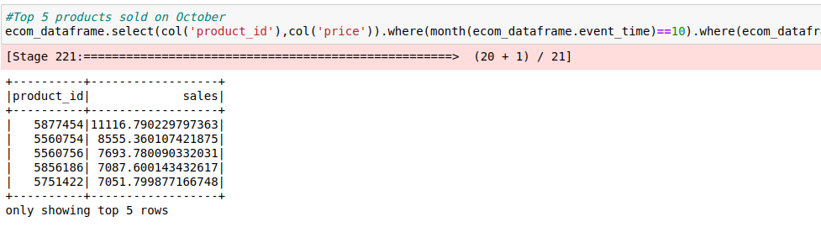
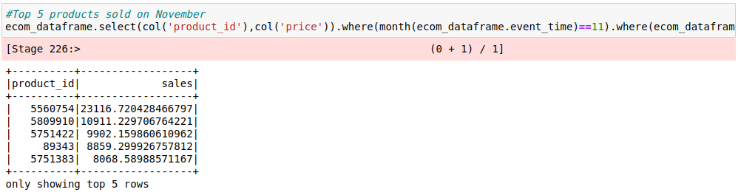
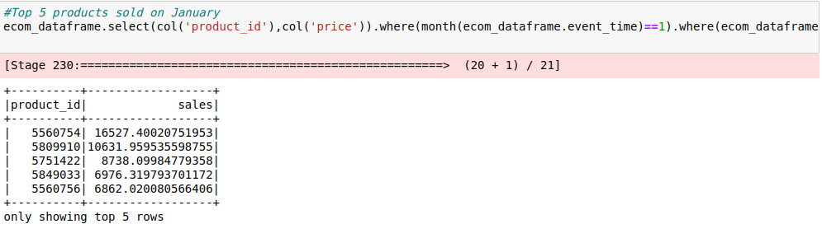
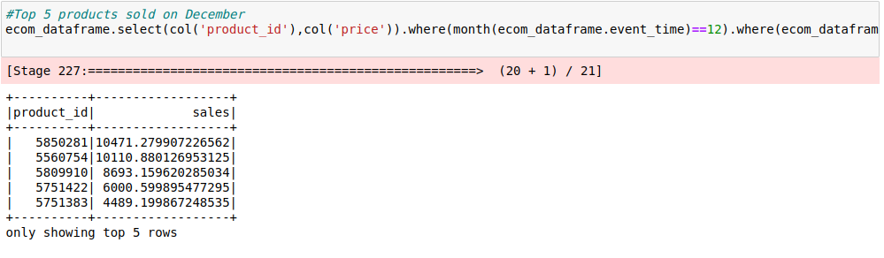
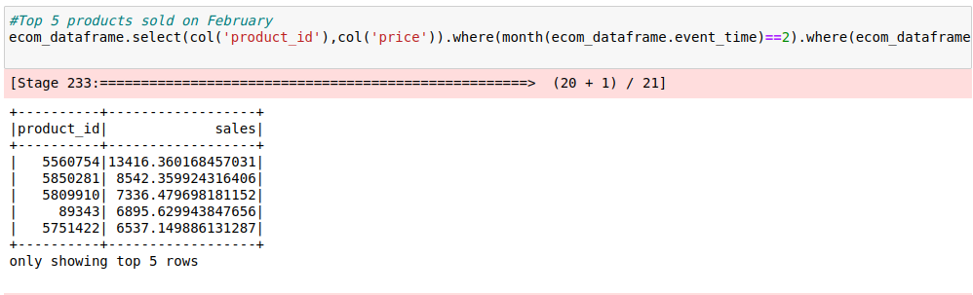
Queries & results
1. What are the top 5 products sold each month?
From the results obtained, we could see that the products ‘5560754’, ‘5751422’, ‘5809910’ are one among the top 5 each month. The performance of these products is consistent throughout the five months. From this pattern, we couldn’t find much difference on sales before and during covid.
October
November
January
December
February

Slide 13
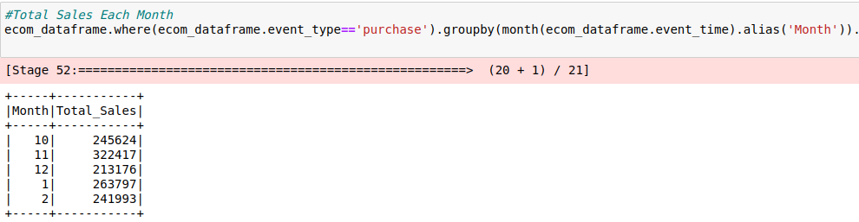
Queries & results
2. What are the total sales each month?
From the results obtained, We could see that the sales are more in November and less in December. From this, we don’t find the effect of covid on sales.

Slide 14
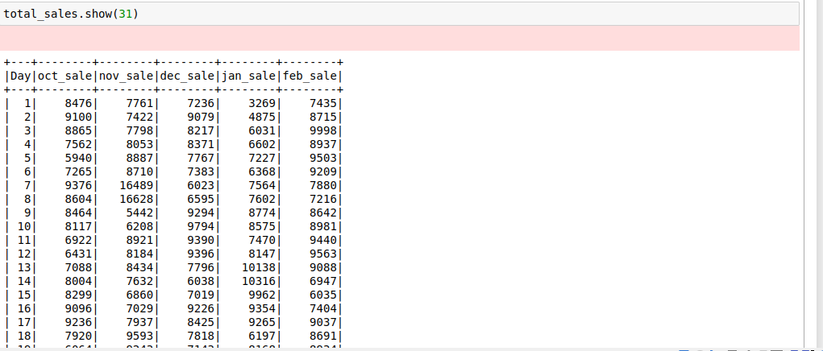
Queries & results
3. What are the sales on each day of the month?
From analysing each day sales, we could observe spikes of sales on each month, except February. Also, we observe declining sales in February, which will be clearer in visualization. These declining sales may be the effect of Covid.

Slide 15
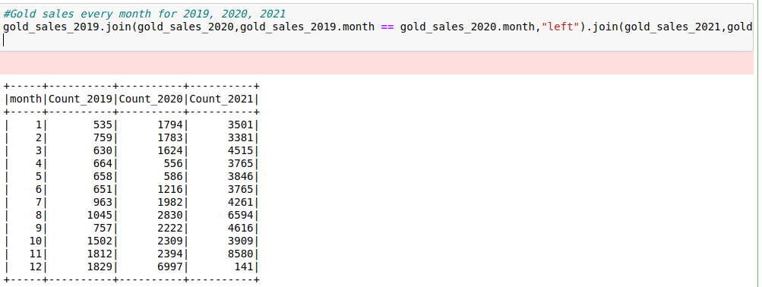
Queries & results
4. What are the gold sales each month of 2019, 2020, 2021?
From the above table, we could observe that the gold sales keep increasing from 2019 to 2021. It is not just a slight change but could see a drastic increase of sales during covid which is unbelievable. Because of this increase in gold sales, we thought of analyzing the gold price during these periods, that might be the influencing factor.

Slide 16
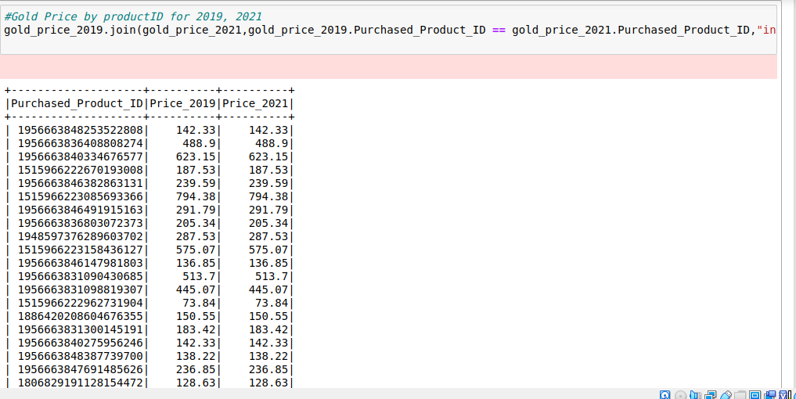
Queries & results
5. How does price of gold products change each year from 2019 to 2021?
From the above table, we could observe that price of the product remaining the same for each product from 2019 to 2021.

Slide 17
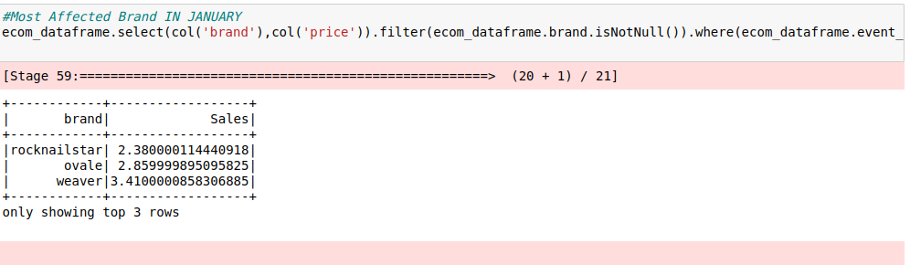
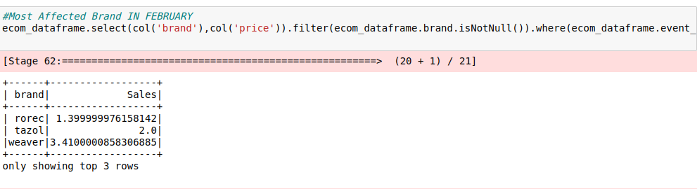
Queries & results
6. WHAT ARE THE MOST AFFECTED BRANDS IN JANUARY AND FEBRUARY?
The brands in the mentioned images are the most affected brands in the months of January and February

Slide 18
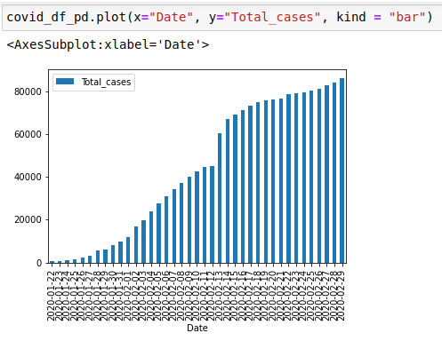
Visualization
1. How covid increases everyday?

Slide 19
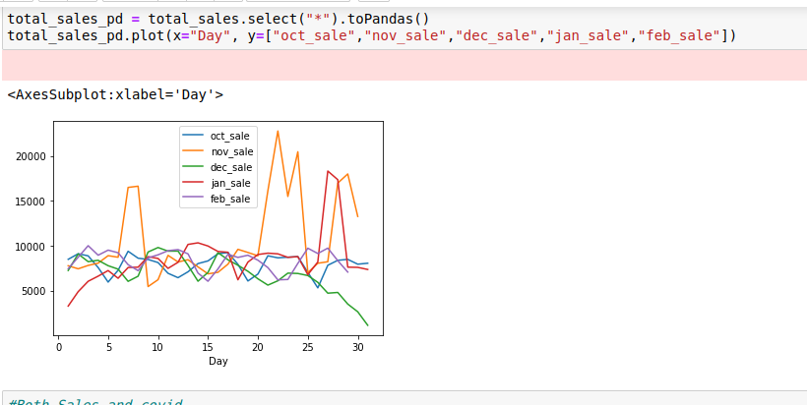
Visualization
2. What are the cosmetics sales each month?

Slide 20
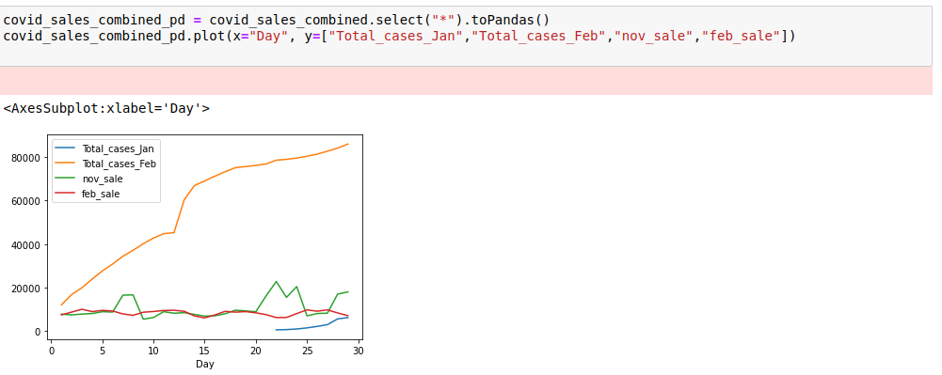
Visualization
3. How covid affect sales in February?

Slide 21
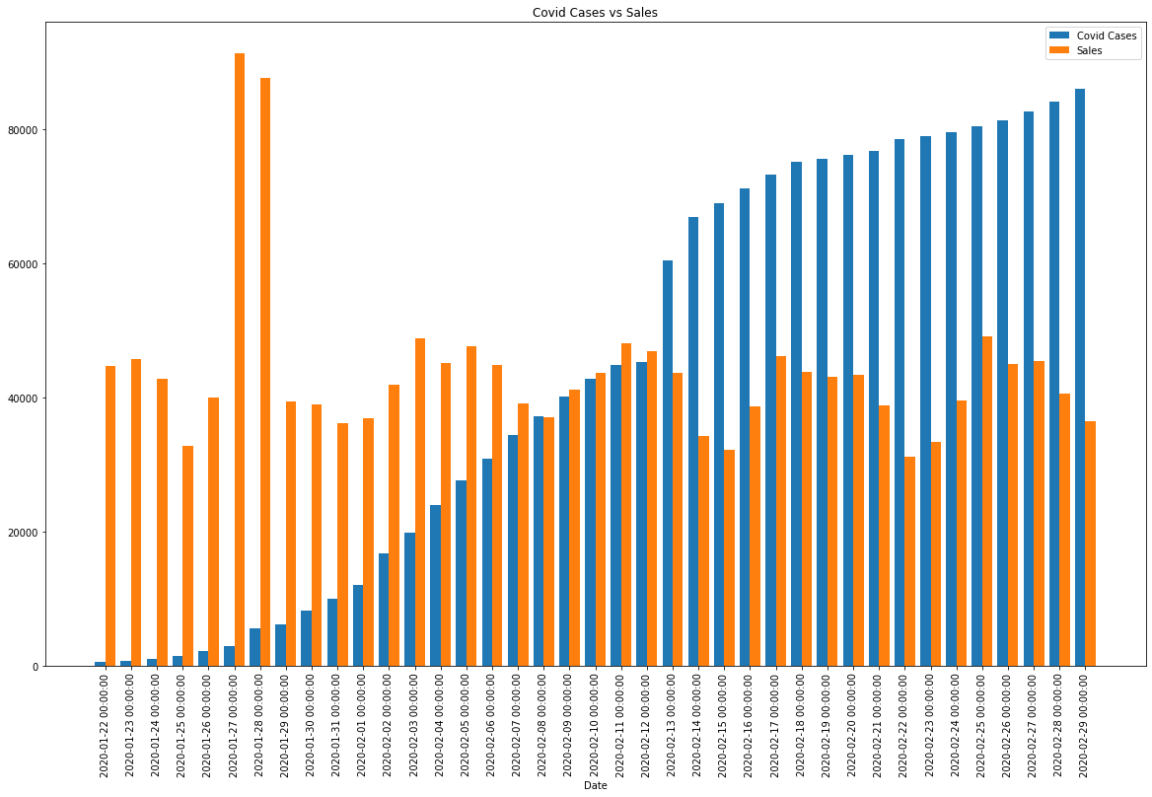
Visualization
4. Covid Vs Sales

Slide 22
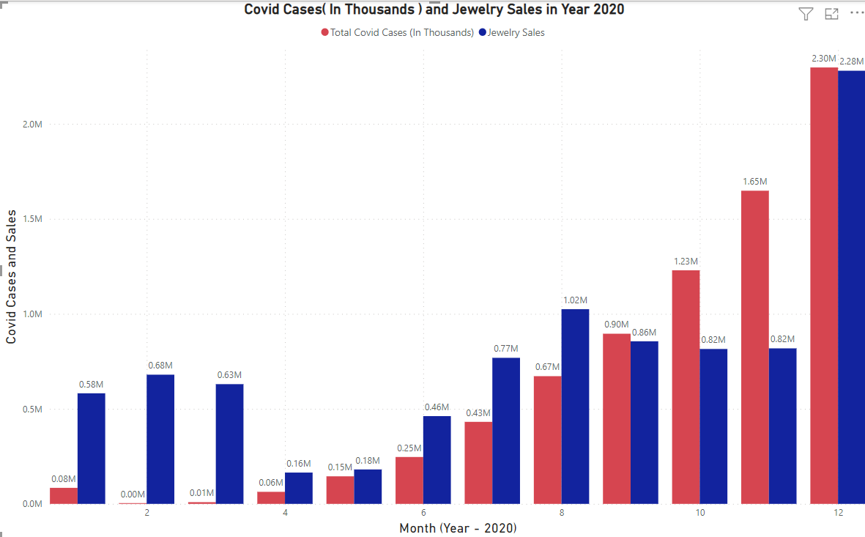
Visualization
5. Covid Vs Jewellery Sales

Slide 23

findings
As shown in the graph from previous slides, The trends for sales is similar from October to January. We see no spike in the sales for the month Feb. Which indicates a decrease in sales due to Covid.
In case of Cosmetic Data, by comparing sales of each month, the sales in November are high this might be because of external factors like Thanks-giving or pre-covid stock up. We didn’t find any Covid cases data affecting the Cosmetic Sales.
For the Jewelry dataset, we could obtain that sale of gold is increasing instantly after covid, this is very unusual, with the price of gold remaining constant every year.

Slide 24

Challenges Faced & Process Attempted
Kafka Implementation
AWS EMR + Spark + Jupyter
Hadoop + Spark + Jupyter

Slide 25
Limitations
!
Dataset :
The main limitation is that we were unable to find the e-commerce dataset for Jan 2019.
our dataset contains records starting from Oct 2019 to Feb 2020. To accurately find the sales and covid relationship, we needed the dataset for Jan 2019.
In that case, we would have been clearly able to compare and correlate the sales in Jan 2019 and Jan 2020.

Slide 26

Future plans
We want to implement the same model using AWS Cloud and Kafka streaming.
Find dataset related to 2019 E-commerce data in order to find better correlation between the Sales and Covid cases.

Slide 27
Business Recommendations
Since there was a clear increase in the buying of gold assets during COVID, the cosmetics industry should focus on sourcing and producing more gold and precious metal jewelry during the next economic downturn(recession) to generate more revenue.
During the month of November, e-commerce business models should spend more on advertising to increase their exposure to the market, since there is a large spike in sales (almost 50 percent) as well as increase their inventory to meet that demand. This could potentially offset loses from reduced sales incurred later during the slightly decreased sales of January-February.
A final business recommendation could be to increase the production of goods that see consistently high sales throughout the year. While obvious, it is important because in this case excess inventory is not an actual worry. Any excess inventory will be cleared indue time given that demand for the product is sustained.

Slide 28

conclusion
From the insights we have obtained, Covid had a negative affect in the month of February on sales. We would be more precise on this with more data on hand

Slide 29
Thank you
GROUP 4:
Ram Smaran Pandiri
Shubham
Aravindhan Keerthana
Chourey Manas
Lankipalli Abhiram
rxp210024
sxx210007
kxa210051
mxc200000
arl170230

