Slide 1

Predicting Soccer Players Value with FIFA Ratings
Christian, Firdhous, Jason, Joyal, Shubham

Slide 2
Project Flow
Project Summary
Data
Visualization
Data Cleaning
Models
Conclusion
Feature Engineering

Slide 3
Project Summary
FIFA is a popular soccer video game that is played by over a million people
FIFA rates players on different attributes and these ratings give them the final rating
Soccer players all over the world have different values
What if we could predict what a soccer player value is based on their FIFA rating?

Slide 4
Data
https://www.kaggle.com/datasets/stefanoleone992/fifa-20-complete-player-dataset
FIFA 20 video game
Some attributes : Name, nation_position, nation_jersey_number, paceshooting
16980 rows and 78 attributes
But do all attributes help predict value for each player?

Slide 5
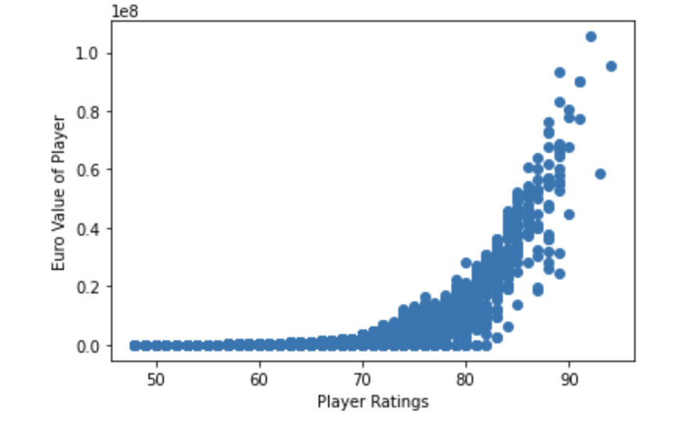
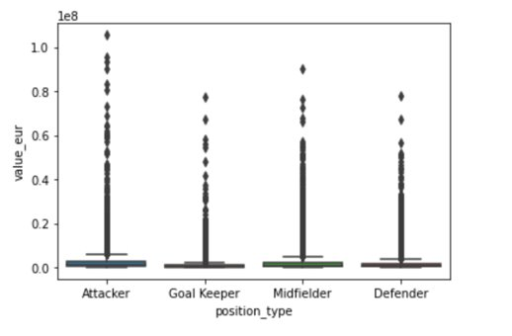
Visualization

Slide 6
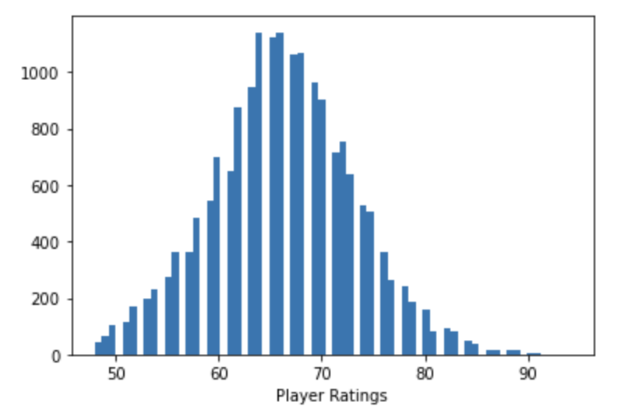
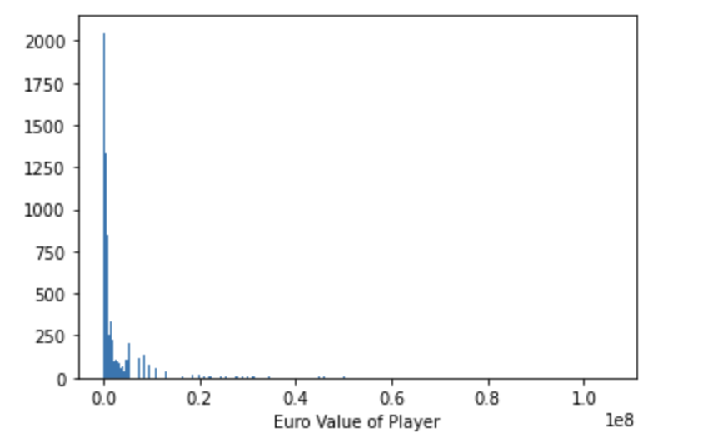
Visualization

Slide 7
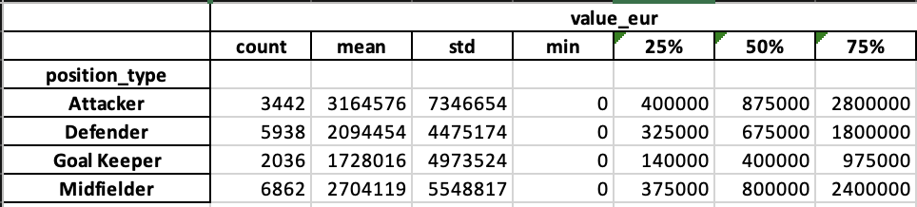
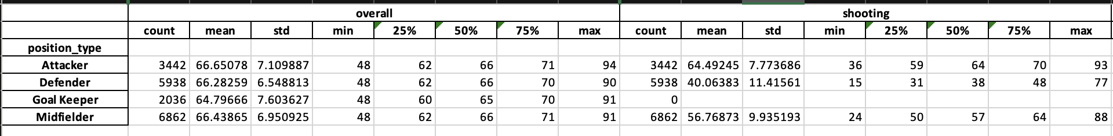
Are All Position Categories the Same?

Slide 8
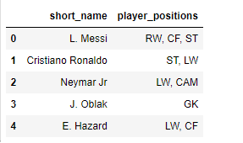
Data Cleaning
Players play for different positions should use different attributes to determine their values.
EX : Middlefield player who has better passing skills may be worth more value
We only focus on attackers
Attackers : CF, ST, LW, RW

Slide 9
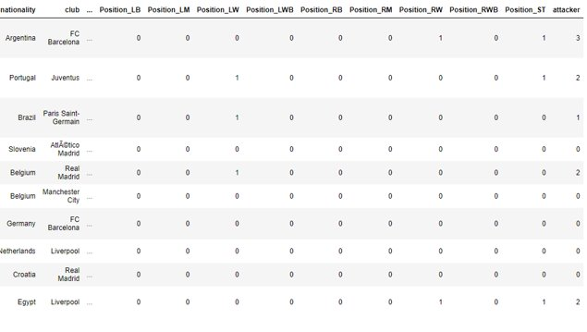
Data Cleaning
We separate the player_position column by comma and set up dummy variables to distinguish those four positions as attackers(CF, ST, LW, RW)
Replaced NA value with median value

Slide 10
Feature Engineering
We added a new variable named 'attacker', comprising of different players positions such as Center Forward, Left Winger, Right Winger, Striker

Slide 11
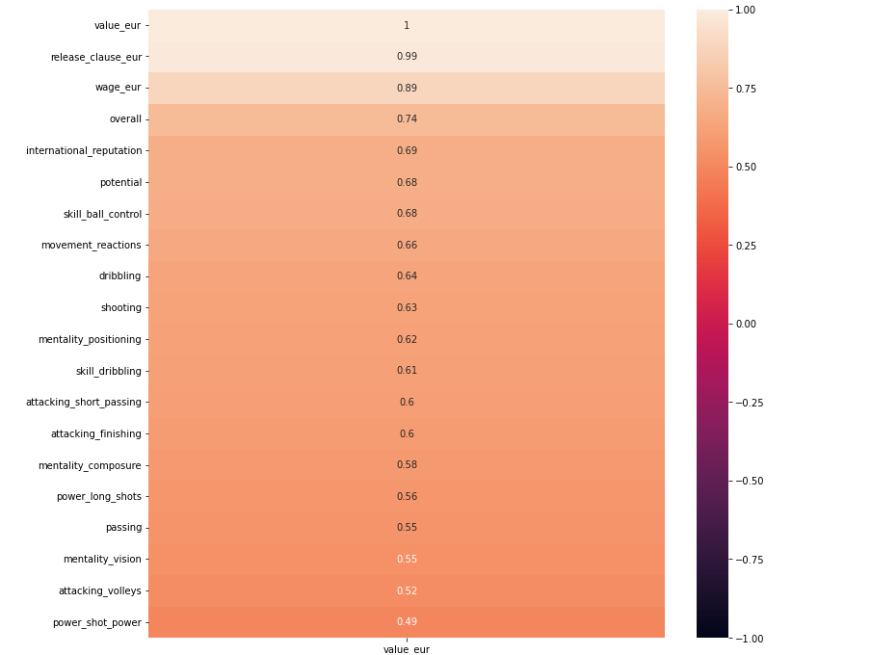
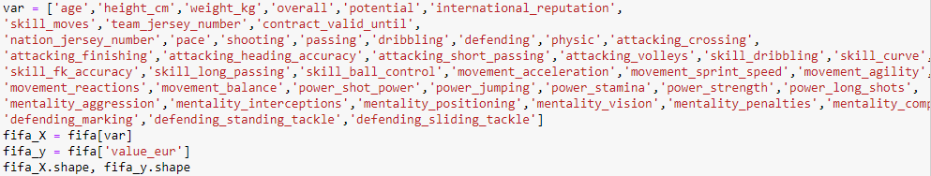
Data Cleaning - Correlation

Slide 12
Models

Slide 13
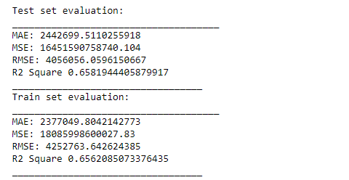
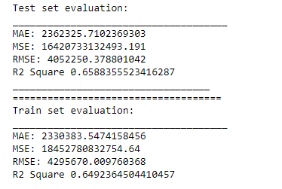
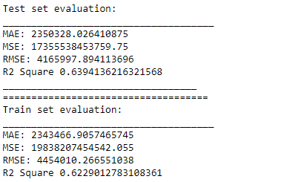
Regression
Split data (70-30)
Linear Regression R^2 = 0.6581
Ridge Regression R^2 = 0.6588
Lasso Regression R^2 = 0.6394

Slide 14
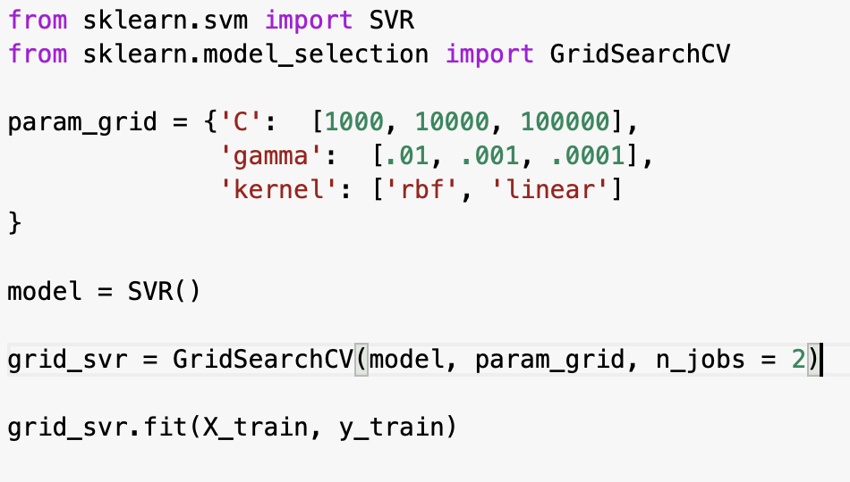
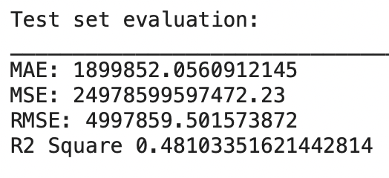
Kernel SVM
SVR Model with GridSearch for hyperparameter tuning
Limited parameter options due to high computational nature of SVR
Performance was generally lower
Likely due to smaller dataset with high amount of variables

Slide 15
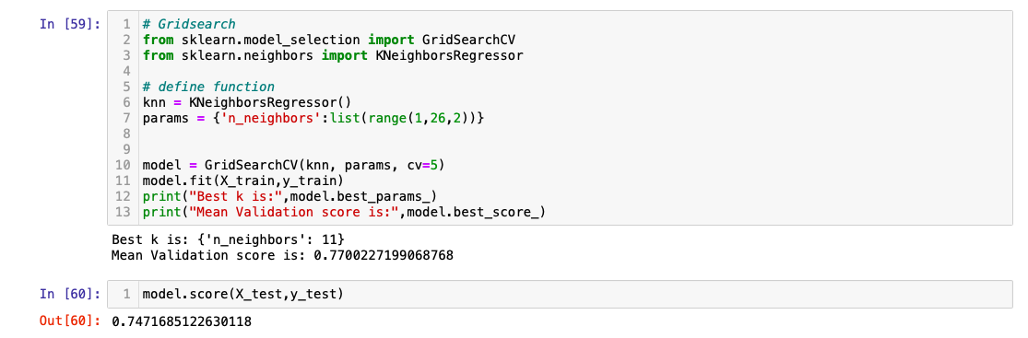
Knn with hyperparameter
Number of neighbors was set as 11 after tuning
Test accuracy: 0.74, MAE: 6012, MSE: 189841478, RMSE: 13778

Slide 16
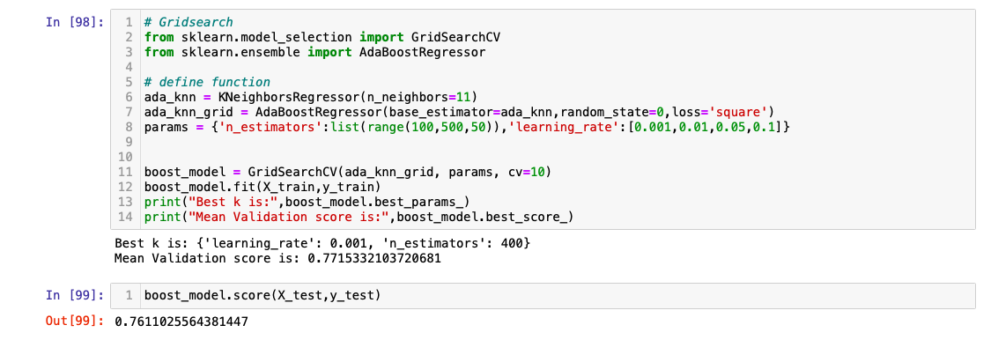
adaboost
n_estimators = 400
learning_rate is set as 0.001
Test accuracy: 0.76, MAE: 5903, MSE: 179378938, RMSE: 13393

Slide 17
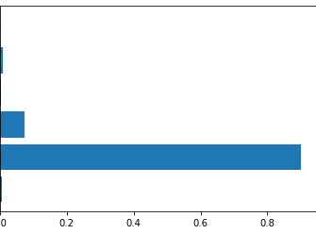
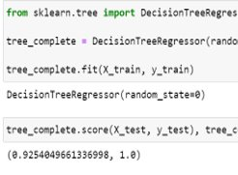
Decision tree
The decision tree gave accuracy of 0.925 on test set and 1 on train set, indicating overfitting\
We see feature importance showing few feature, with 'overall' being the most important feature

Slide 18
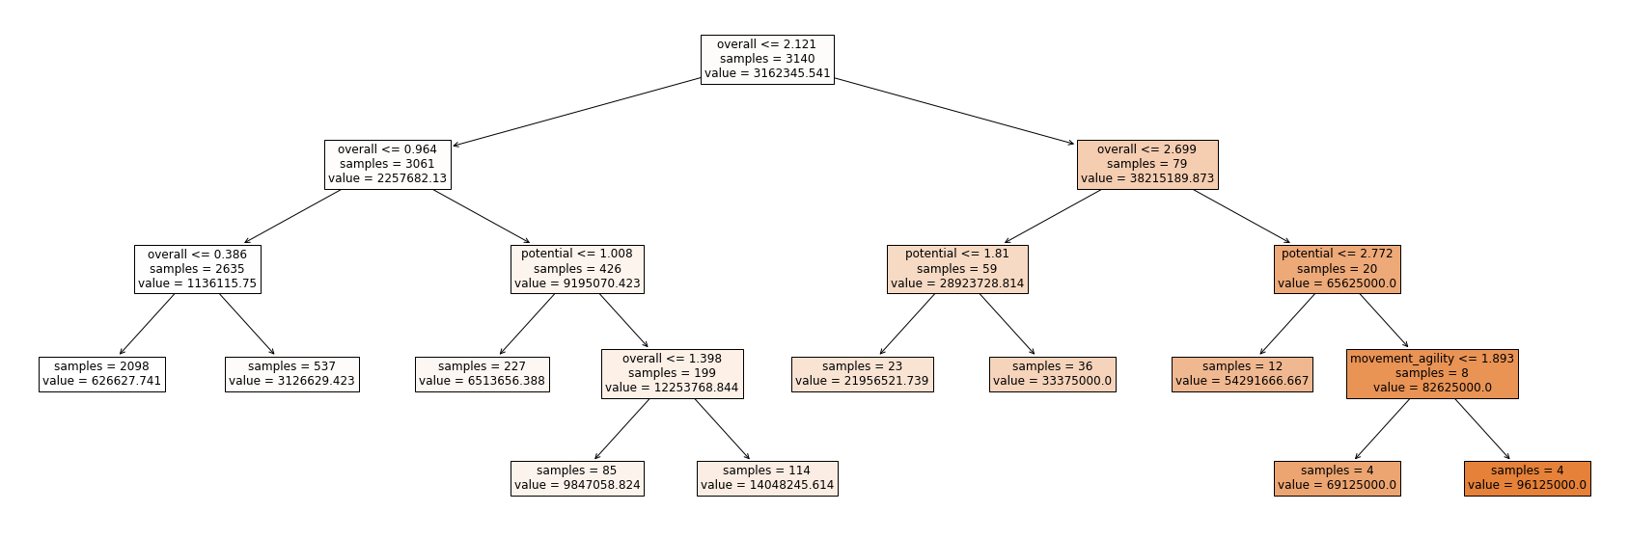
Decision tree

Slide 19
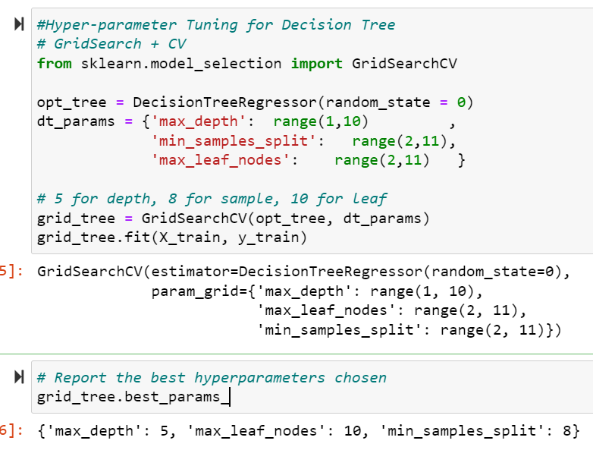
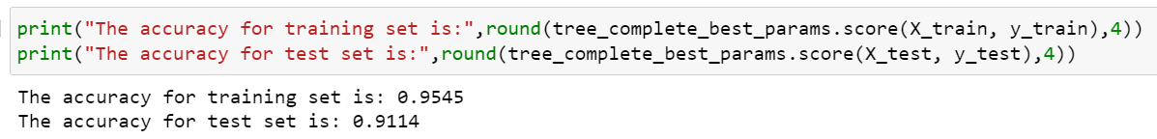
Decision tree with Hyperparameter Tuning
We observed an accuracy of 0.95 on train set and 0.91 on test set indicating we have reduced the overfitting

Slide 20
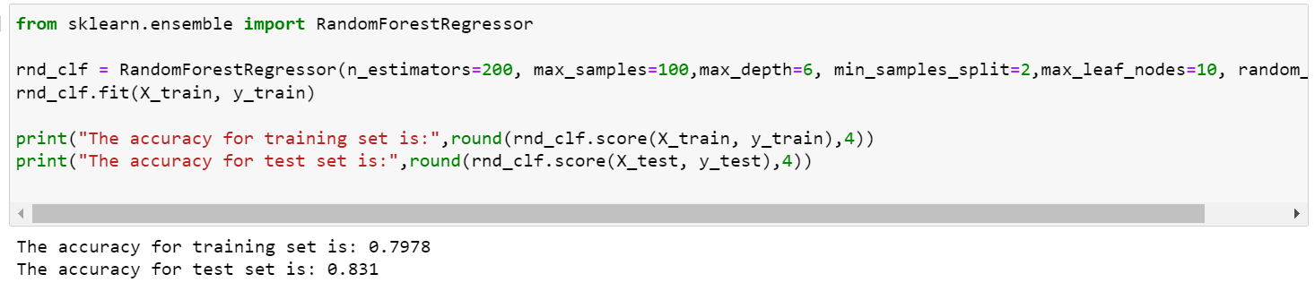
Random Forest
We observed best parameters after hypertuning as:
Max Depth as 6
Max leaf node as 10
Min samples split as 6
We observed an accuracy of 0.797 for train set and 0.831 for test set

Slide 21
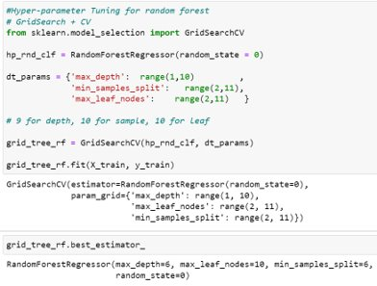

Random Forest with Hyperparamter Tuning
Max depth:6
Max leaf nodes: 10
Min samples split: 6
Accuracy for train set: 0.9652
Accuracy for test set: 0.9438

Slide 22
Model Comparison
Model | Test Score
Random Forest | 94.4%
Decision Tree | 91.1%
KNN with Adaboost | 76.1%
KNN | 74.7%
Ridge Regression | 65.9%
Linear Regression | 65.8%
Lasso Regression | 63.9%
SVM | 48.1%

Slide 23
Conclusion
Overall, we were able to predict players value using their FIFA rating.
Decision Tree and Random Forest were the most effective models with Test Scores over 91% and 94%.
Potentially look at other positions
Combine other FIFA datasets

Slide 24
Questions?

