Slide 1
AI-Powered Snake
Species Identification
for Antivenom Selection
Engineering a deep learning pipeline to
solve the 60-minute survival window.
PRESENTED BY
Shubham Sharma

Slide 2
The Critical Bottleneck in
Emergency Healthcare
The Scale
The Time Constraint
58,000
60 min
Deaths Per Year in India alone.
Snakebites claim more lives in this region
than any other natural emergency.
The 'Golden Hour' Criterion:
Antivenom selection within one hour dramatically
improves survival rates. Manual species
identification by remote healthcare workers is
currently unreliable and far too slow.

Slide 3
Engineering a Clinical-Grade
Solution
⊕
🛡
01. High-Precision Classification
02. Maximising Recall
Develop deep learning models capable of
classifying snake species directly from raw,
field-captured images.
Ensure zero misses for venomous species;
treating false negatives as a life-threatening
failure condition.
📊
◉
03. Model Evolution
04. Clinical Explainability
Systematically compare baseline algorithms,
custom CNNs, and transfer learning to identify the
optimal deployment architecture.
Provide visual, medical-grade validation using
Grad-CAM to prove the model's reasoning to
healthcare professionals.

Slide 4
The Data Funnel: Distilling the Kaggle Snake
Species Dataset
RAW DATASET
23,816
training images
135 species · 6 families
36.5% venomous · 63.5% non
512 × 512 px originals
FILTER
Top 10
most-represented species
selected to build a clean,
class-balanced training set
WORKING SUBSET
2,006
curated images
a focused, high-quality base
ready for preprocessing
WHY DISTILL? Most of the 135 species have too few images to learn from, so we focus on the 10 best-represented — a clean subset of 2,006 images that trains reliably under limited compute.
CLASS BALANCE 5 venomous / 5 non-venomous species (~50 / 50 split).

Slide 5
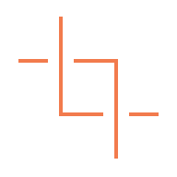

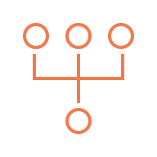

Preprocessing & Augmentation:
Preparing Images for Training
1
Resize
Every image is scaled to 224 × 224 px (RGB) — the native input size of the CNN backbone.
2
Normalise
Pixel values are rescaled from 0–255 down to the [0, 1] range so the network trains stably.
3
Stratified Split
An 80 / 20 train–validation split preserves each species' proportion across both sets.
4
Augment
Training set only: random flip, rotation and zoom add variety and curb overfitting.
224 × 224
INPUT SIZE · RGB
1,604
TRAINING IMAGES · 80%
402
VALIDATION IMAGES · 20%

Slide 6
Architectural Evolution: From Baseline to
State-of-the-Art
Baseline
(Random Forest)
Model 1
(Custom CNN)
Model 2
(Transfer Learning)
Approach
Approach
Approach
Classic Machine Learning
Deep Learning from Scratch
State-of-the-art Feature Extraction
Mechanism
Mechanism
Mechanism
GridSearchCV optimisation
3 custom-trained conv blocks
MobileNetV2 backbone (frozen)
Features
Features
Features
150K+ flattened features
Acts as a baseline for feature extraction
Paired with a custom classification head

Slide 7
Baseline Report: Random Forest + GridSearchCV
Species | Precision | Recall | F1-score | Support
⚠️ Agkistrodon piscivorus | 0.17 | 0.17 | 0.17 | 40
Ahaetulla nasuta | 0.23 | 0.12 | 0.16 | 40
Ahaetulla prasina | 0.35 | 0.17 | 0.23 | 40
⚠️ Austrelaps superbus | 0.22 | 0.25 | 0.24 | 40
Boiga kraepelini | 0.35 | 0.33 | 0.34 | 40
⚠️ Bothriechis schlegelii | 0.27 | 0.31 | 0.29 | 42
⚠️ Bothrops asper | 0.17 | 0.10 | 0.12 | 41
Carphophis vermis | 0.27 | 0.49 | 0.35 | 39
⚠️ Crotalus tigris | 0.32 | 0.42 | 0.37 | 40
Imantodes cenchoa | 0.30 | 0.33 | 0.31 | 40
Macro avg | 0.27 | 0.27 | 0.26 | 402
Weighted avg | 0.27 | 0.27 | 0.26 | 402
VALIDATION ACCURACY
26.9%
402 validation images · 10 classes
THE TAKEAWAY
A classical Random Forest tops out at ~27% — well above the 10% random-chance floor for 10 classes, but far short of clinical reliability. This gap is exactly what deep transfer learning is built to close.

Slide 8
CNN Report: Custom Convolutional Network
Species | Precision | Recall | F1-score | Support
⚠️ Agkistrodon piscivorus | 0.28 | 0.33 | 0.30 | 40
Ahaetulla nasuta | 0.55 | 0.40 | 0.46 | 40
Ahaetulla prasina | 0.47 | 0.45 | 0.46 | 40
⚠️ Austrelaps superbus | 0.39 | 0.45 | 0.42 | 40
Boiga kraepelini | 0.43 | 0.38 | 0.40 | 40
⚠️ Bothriechis schlegelii | 0.56 | 0.64 | 0.60 | 42
⚠️ Bothrops asper | 0.39 | 0.34 | 0.36 | 41
Carphophis vermis | 0.76 | 0.67 | 0.71 | 39
⚠️ Crotalus tigris | 0.45 | 0.70 | 0.55 | 40
Imantodes cenchoa | 0.46 | 0.33 | 0.38 | 40
Macro avg | 0.48 | 0.47 | 0.47 | 402
Weighted avg | 0.48 | 0.47 | 0.47 | 402
VALIDATION ACCURACY
46.8%
402 validation images · 10 classes
THE TAKEAWAY
A purpose-built CNN nearly doubles the baseline — 26.9% → 46.8% (+19.9 pts). Learned visual features clearly help, yet accuracy still falls short of clinical reliability. Transfer learning takes the next leap.

Slide 9
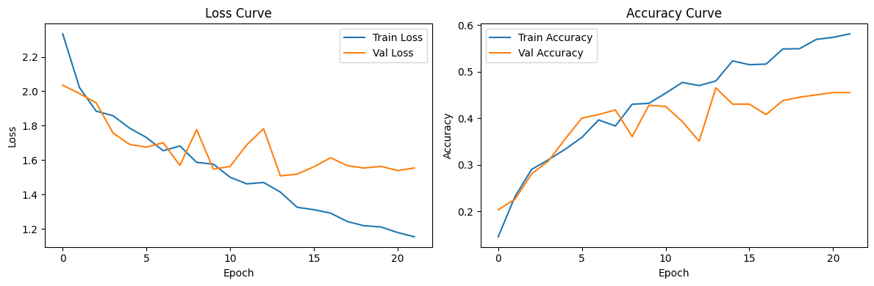
CNN Training Dynamics
Train accuracy keeps climbing while validation accuracy plateaus near 47% and validation loss begins to rise after ~epoch 13 — classic signs of overfitting in the from-scratch CNN, motivating the shift to transfer learning.

Slide 10
Transfer Learning Report: MobileNetV2 (Champion)
Species | Precision | Recall | F1-score | Support
⚠️ Agkistrodon piscivorus | 0.64 | 0.57 | 0.61 | 40
Ahaetulla nasuta | 0.58 | 0.65 | 0.61 | 40
Ahaetulla prasina | 0.56 | 0.47 | 0.51 | 40
⚠️ Austrelaps superbus | 0.73 | 0.88 | 0.80 | 40
Boiga kraepelini | 0.56 | 0.70 | 0.62 | 40
⚠️ Bothriechis schlegelii | 0.77 | 0.71 | 0.74 | 42
⚠️ Bothrops asper | 0.84 | 0.63 | 0.72 | 41
Carphophis vermis | 0.90 | 0.97 | 0.94 | 39
⚠️ Crotalus tigris | 0.87 | 0.97 | 0.92 | 40
Imantodes cenchoa | 0.69 | 0.55 | 0.61 | 40
Macro avg | 0.71 | 0.71 | 0.71 | 402
Weighted avg | 0.71 | 0.71 | 0.71 | 402
VALIDATION ACCURACY
71.1%
402 validation images · 10 classes
THE TAKEAWAY
Transfer learning delivers the leap — 46.8% → 71.1% (+24.4 pts over the from-scratch CNN, +44.3 pts over baseline). Pre-trained ImageNet features generalise far better on a small dataset. This is the champion model.

Slide 11
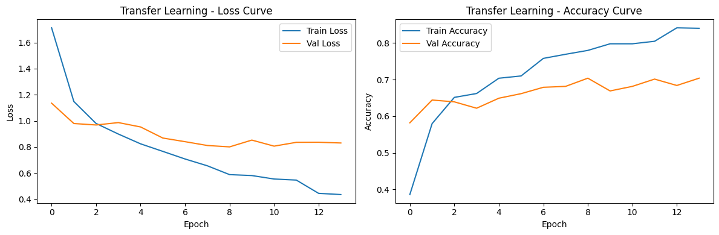
Transfer Learning Dynamics
Validation accuracy climbs steadily to ~70% while validation loss stays low and flat — the pretrained ImageNet features generalise well, with only a modest train/validation gap and no runaway overfitting.

Slide 12
Performance Benchmark:
The Transfer Learning Advantage
A +44.3 pt absolute gain
over the baseline.
Pre-trained ImageNet
weights successfully
capture the complex,
nuanced visual patterns
of snake scales that
custom models struggle
to learn from scratch.

Slide 13
The Champion Architecture: Efficient by Design
Input
224 × 224 × 3
MobileNetV2
frozen backbone · 7×7×1280
Global Avg Pool
→ 1280
Dense 128
ReLU + Dropout
Dense 10
Softmax → 10 classes
MODEL SIZE
9.24 MB
2,423,242 total parameters
TRAINABLE
165 K
just 6.8% — the classifier head
FROZEN BACKBONE
8.61 MB
2.26M pretrained ImageNet params
WHY IT'S THE CHAMPION Freezing the pretrained backbone and training only a 165K-parameter head keeps the model ~9 MB and quick to train —
accurate yet light enough for on-device, offline deployment in the field.

Slide 14
Safety First: Per-Class Recall and Venomous
Profiling
Per-Class Recall Score
■ Venomous
■ Non-venomous
Crucial Safety Metric: The model achieves peak
recall (97%) on the highly venomous Crotalus
tigris, ensuring life-threatening cases are rarely
missed, even while harmless species like
Ahaetulla prasina remain challenging.

Slide 15
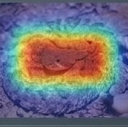
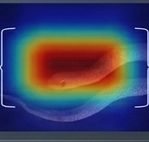
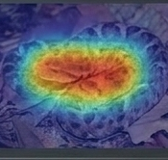
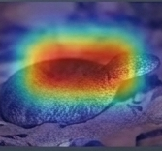
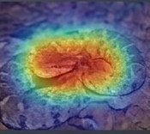
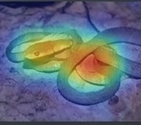
Clinical Explainability: Unlocking the 'Black Box'
with Grad-CAM
Crotalus tigris (93%)
Carphophis vermis (92%)
Bothrops asper (76%)
Austrelaps superbus (82%)
Bothriechis schlegelii (81%)
Boiga kraepelini (68%)
Attention maps confirm the model's clinical viability. Predictions are driven by relevant anatomical features (cranial
shapes, specific scale patterns, body morphology) rather than spurious background artifacts like leaves or rocks.

Slide 16
Real-World Impact: From Algorithm to
Emergency Response
⚡
〜
🌐
Emergency Response
Life-Saving Decisions
Scalable Reach
Reduces species
identification in rural
clinics from hours of
manual searching to mere
minutes.
Enables immediate,
accurate antivenom
selection, dramatically
improving the odds of
survival within the
Golden Hour.
Optimised for mobile apps,
telemedicine platforms,
and offline field-based
wildlife management tools
in remote regions.

Slide 17
Current Limitations and Clinical Boundaries
Subset Dependency
Image Quality
The model was trained on 2,006 images (top 10
species) out of the full 23,816. Expanding to all 135
species requires exponentially more compute.
Field photos suffer from poor lighting, motion blur,
and occlusion. Real-world robustness is highly
dependent on input quality.
Class Imbalance
Pre-Clinical Status
Certain morphological overlaps cause severe
misclassification risks for specific species (e.g.,
Ahaetulla prasina).
The algorithm requires rigorous, formal testing with
medical professionals and toxicologists before live
clinical deployment.

Slide 18
Key Takeaways
Accuracy
(71.1%)
Venomous
Recall (97%)
Grad-CAM
Validation
Transfer learning
decisively turns a
notoriously difficult
135-species problem
into a tractable
mathematical
classifier.
The system inherently
protects patients by
heavily indexing on
the highest-risk
species like
Crotalus
tigris.
Anatomical feature
mapping proves the
model acts as an
explainable medical
assistant, not a
blind algorithm.
Conclusion: By pairing MobileNetV2 with explainable AI, we have engineered a system that is effective, transparent,
and structurally sound. It provides a definitive foundation for clinical tools capable of saving thousands of lives.

Slide 19
Future Work & Roadmap
1
Mobile & Edge Deployment
Convert to TensorFlow Lite for fast, offline on-device inference in disconnected rural settings.
2
Fine-Tune & Ensemble Models
Unfreeze MobileNetV2's top layers and explore ViT / EfficientNet ensembles for further accuracy.
3
Broader, Region-Specific Data
Scale to 10,000+ images across 50+ species and train region-specific models for local accuracy.
4
Multi-Modal & GPS Context
Add audio, thermal and location signals to narrow likely species and raise confidence.
5
Antivenom Inventory Integration
Link predictions to hospital antivenom stock for end-to-end emergency response.

Slide 20
References
[1] Project source code. GitHub. github.com/shubham1697/snake-species-antivenom
[2] Goel, Y. 165 Different Snakes Species [Dataset]. Kaggle. kaggle.com/datasets/goelyash/165-different-snakes-species
[3] Sandler, M., Howard, A., Zhu, M., Zhmoginov, A., & Chen, L.-C. (2018). MobileNetV2: Inverted Residuals and Linear Bottlenecks. CVPR.
[4] Selvaraju, R. R., Cogswell, M., Das, A., Vedantam, R., Parikh, D., & Batra, D. (2017). Grad-CAM: Visual Explanations from Deep Networks via Gradient-based Localization. ICCV.
[5] Deng, J., Dong, W., Socher, R., Li, L.-J., Li, K., & Fei-Fei, L. (2009). ImageNet: A Large-Scale Hierarchical Image Database. CVPR.
[6] Frameworks: TensorFlow / Keras (Chollet et al., 2015) and scikit-learn (Pedregosa et al., 2011, JMLR).
[7] World Health Organization. Snakebite Envenoming — Fact Sheet. who.int

Slide 21
Questions & Discussion
Thank you for your attention.

