Slide 1
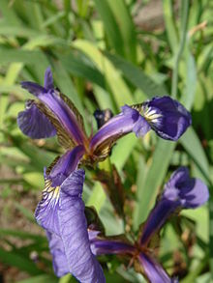
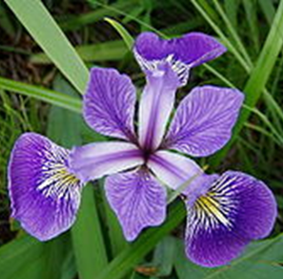
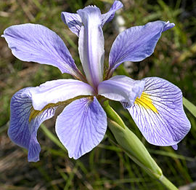
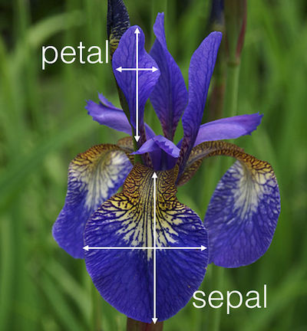
Iris setosa
Iris versicolor
Iris virginica
Sepal /Petal

Slide 2
What is Python
Python is a programming language created by Guido van Rossum in 1989.
Python is an interpreted, object-oriented, dynamic data type of high-level programming languages.(Python Software Foundation 2013). The programming language style is simple, clear and it also contains powerful different kinds of classes.

Slide 3
Feature of Python
Simple and Easy to learn
Open Source
Scalability
Extensive library
Object oriented

Slide 4
Why Python is used in Machine Learning
It is simple and easy to learn
Easy to code .syntax is so simple
Mostly all framework and library is implemented in python(huge amount of inbuilt library
Its easy to implement new ideas
Python is very easy to understand and write a code, not only for machine leaning but also for analytics, programming, web development, statistical analysis..

Slide 5
Most useful library
Numpy,Scipy,Matplotlib
Pandas
Scikit-learn
Tenserflow

Slide 6
Scikit-learn
Scikit–learn is an open source machine learning library for the Python programming language.
It features various classification, regression, and clustering algorithms and is designed to interoperate with the Python numerical libraries NumPy and SciPy (Pedregosa et al. 2011).
SciKit-learn contains the Kmeans algorithm based on Python and it helps to figure out how to implement this algorithm in programming

Slide 7
Steps to build model
Load the Dataset
Summarize ,analyse the dataset
Cleaning of dataset
Split dataset to train and test dataset
Evaluating machine learning algorithim
Make prediction

Slide 8
Practical implementation of ML
Iris Dataset-This is one of the most famous datasets used to illustrate the classification problem. From four characteristics of the flower (the length of the sepal, the width of the sepal, the length of the petal and the width of the petal), the objective is to classify a sample of 150 irises into three species: versicolor, virginica and setosa.

Slide 9
Iris setosa
Iris versicolor
Iris virginica
Sepal /Petal

