Slide 1
KIIT UNIVERSITY
mozilla hackathon 3.0
(Hostel learning environment)

Slide 2

Overview
Introduction
Tutorials on C
Practice section

Slide 3
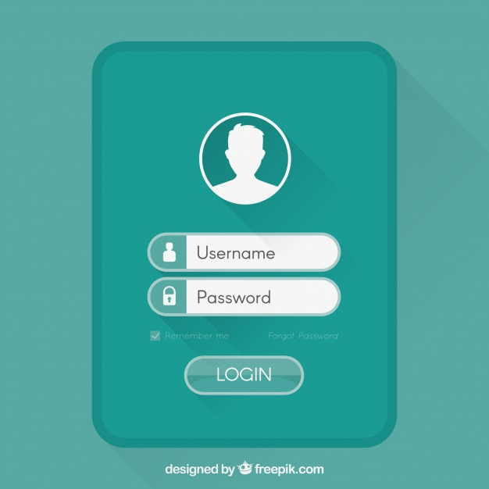
INTRODUCTION
In the introduction of an app first our login app will be executed in which any student can easily login with this app.one can easily go through this app for the basic learning of C.

Slide 4
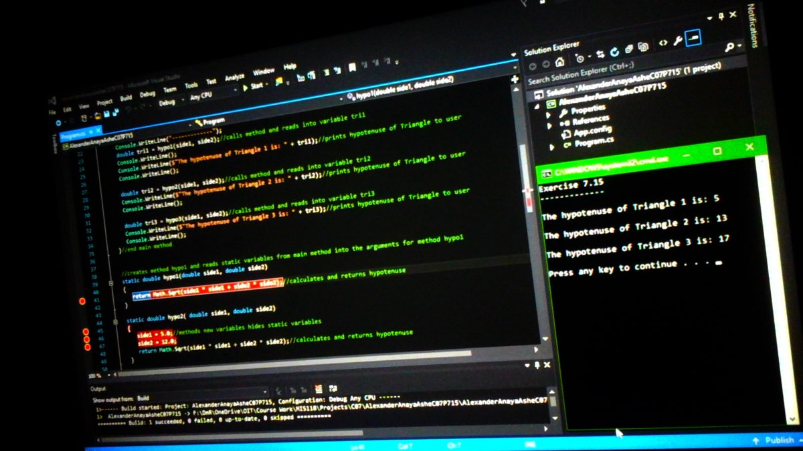
TUTORIALS ON C
After the user will login through this app there will be a Tutorial on 'C' and Practice section will be there for students available on screen.The tutorial screen is intent with 'SYNTAX OF C' and some 'BASIC PROGRAMMINGS',so that each and every student will learn the basics of C,by going through online app.

Slide 5
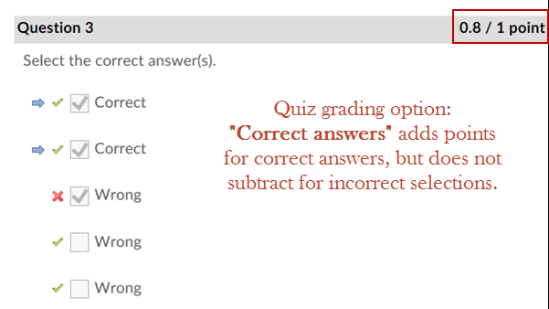
PRACTICE SECTION
After the tutorial section of C,we have another section which is 'PRACTICE SECTION' in which some basic quiz type questions are given on C programmings,so that students can build there knowledge well.This section is basically consist with some basic questions of C.

Slide 6
CONCLUSION
At last we have build up an app which can go through some basic learnings of the language 'C'.This app is beneficial especially for non coders who have no idea about any language.They can go through it and learn some basics of programming language.

