Slide 1
IBM University Engagement Project Submission
“Exploring the Power of Machine Learning with IBM Cloud”

Slide 2

Project Tile – Predictive Maintenance of Industrial Machinery
Domain of Project – Industry
Student Name | Recent Passport Photo | Email ID | Mobile number [WhatsApp]
Shubhamkumar Patil |  | shubham20387@gmail.com | 9860697631

Slide 3
Problem Statement -
Predictive Maintenance of Industrial Machinery
Develop a predictive maintenance model for a fleet of industrial machines to anticipate failures before they occur. This project will involve analyzing sensor data from machinery to identify patterns that precede a failure. The goal is to create a classification model that can predict the type of failure (e.g., tool wear, heat dissipation, power failure) based on real-time operational data. This will enable proactive maintenance, reducing downtime and operational costs.

Slide 4
Proposed Solution -
The proposed solution leverages Machine Learning (ML) to implement a proactive, data-driven approach for predicting industrial machinery failure before it occurs. By continuously monitoring critical operational parameters—such as air temperature, process temperature, rotational speed, torque, and tool wear—the system effectively captures the complex, non-linear relationships that precede equipment breakdown. Built and deployed within the scalable framework of IBM Watson Studio on the IBM Cloud, this solution utilizes advanced classification algorithms to analyze real-time and historical sensor telemetry. By mapping these specific data points against known failure modes, the ML model successfully detects anomalies, estimates structural degradation, and forecasts potential faults. This automated predictive capability transforms traditional maintenance workflows from a reactive or rigidly scheduled routine into an optimized, condition-based strategy, thereby significantly minimizing unplanned downtime, reducing operational costs, and extending the lifespan of vital industrial assets.

Slide 5
Technology Used
IBM Cloud – It provides the infrastructure to build, deploy, and scale the Nutrition Agent efficiently. IBM Cloud enables a reliable, secure, and scalable environment for deploying the Nutrion agent
ML Algorithm/ Model Used: Batched tree Ensemble classifier
Accuracy Obtained: 0.979
Enhancements and Hyperparameter tuning: HPO-1, FE, HPO-2, BATCH
IBM BOB : To create front end, back end and used API keys for deployment

Slide 6
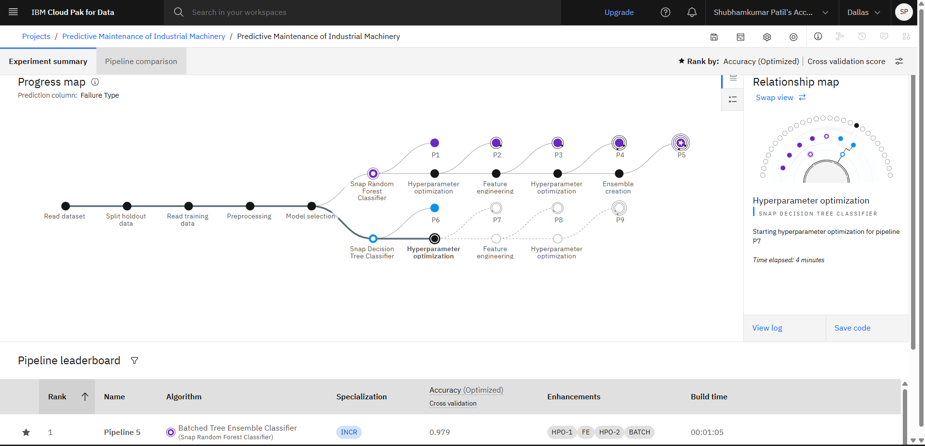
Training Screenshots-

Slide 7
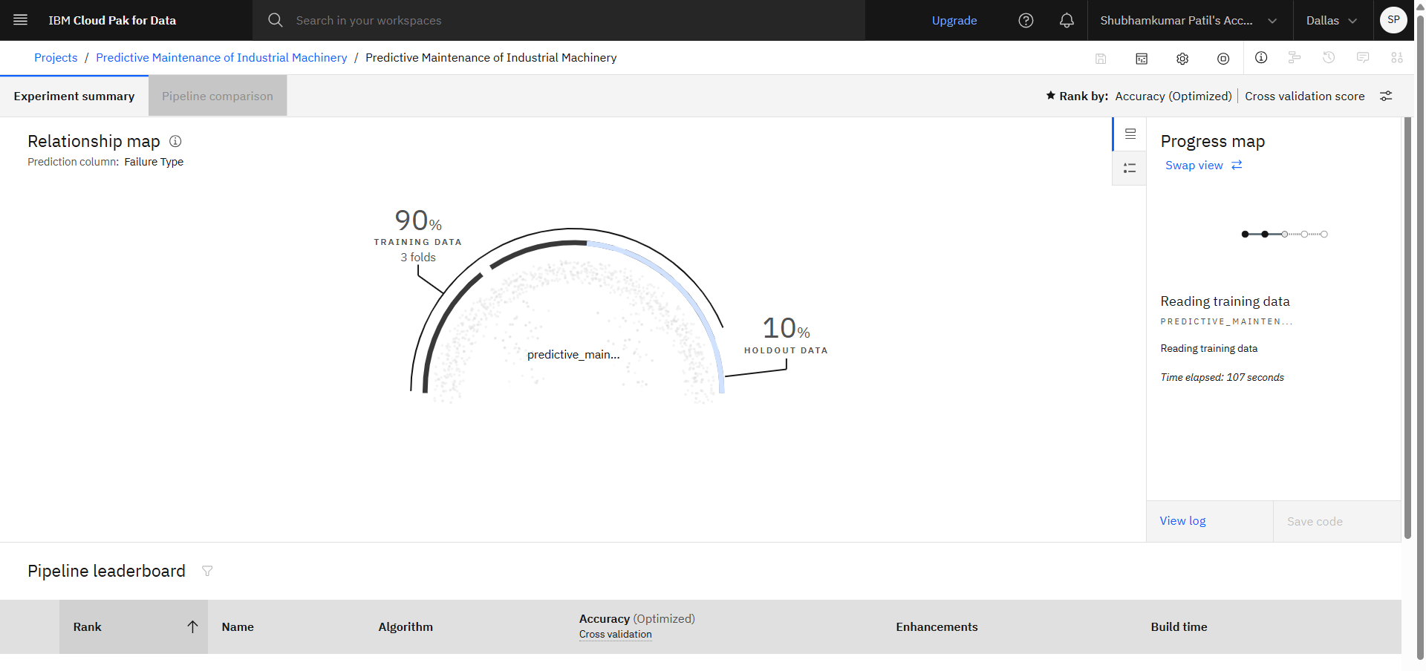
Training Screenshots-

Slide 8
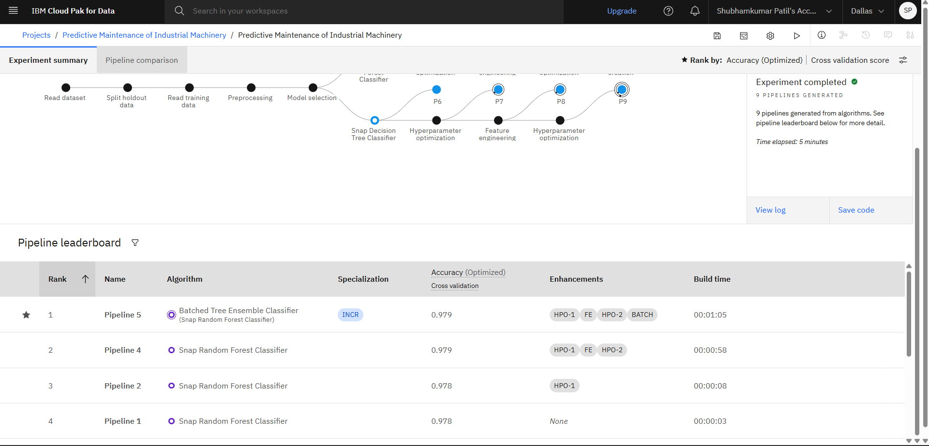
Best Model Screenshot:

Slide 9
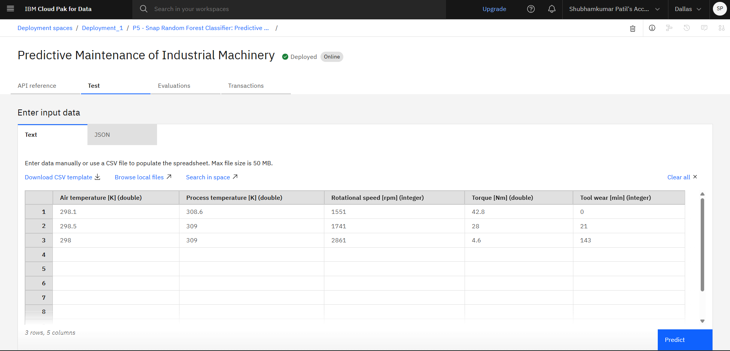
Testing Screenshot:

Slide 10
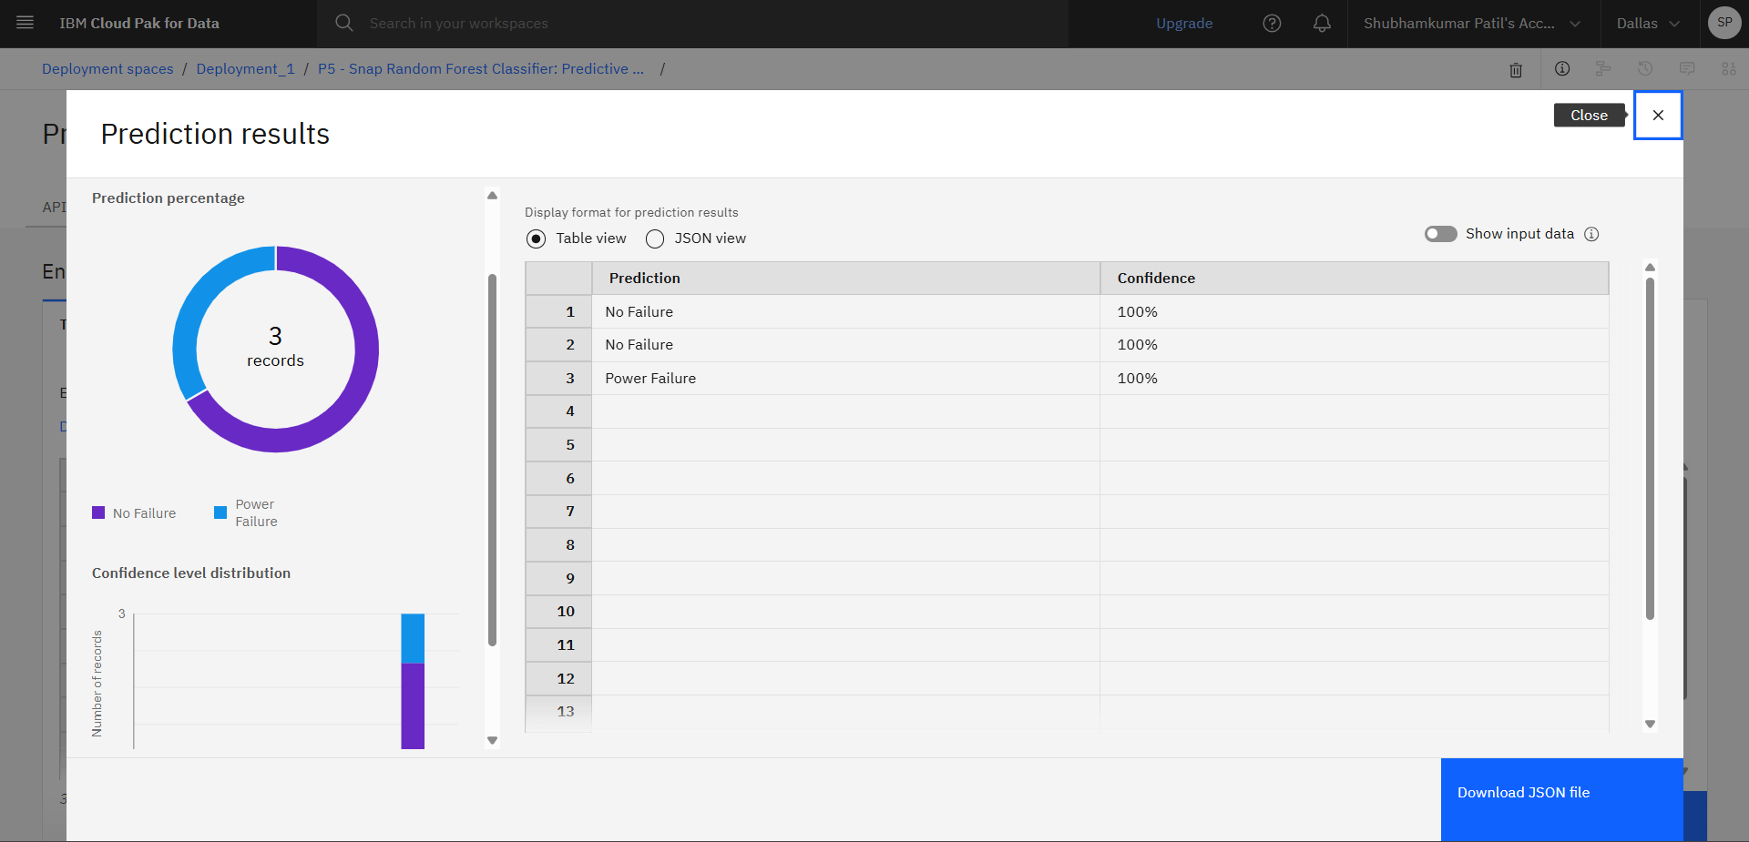
Testing Screenshot:

Slide 11
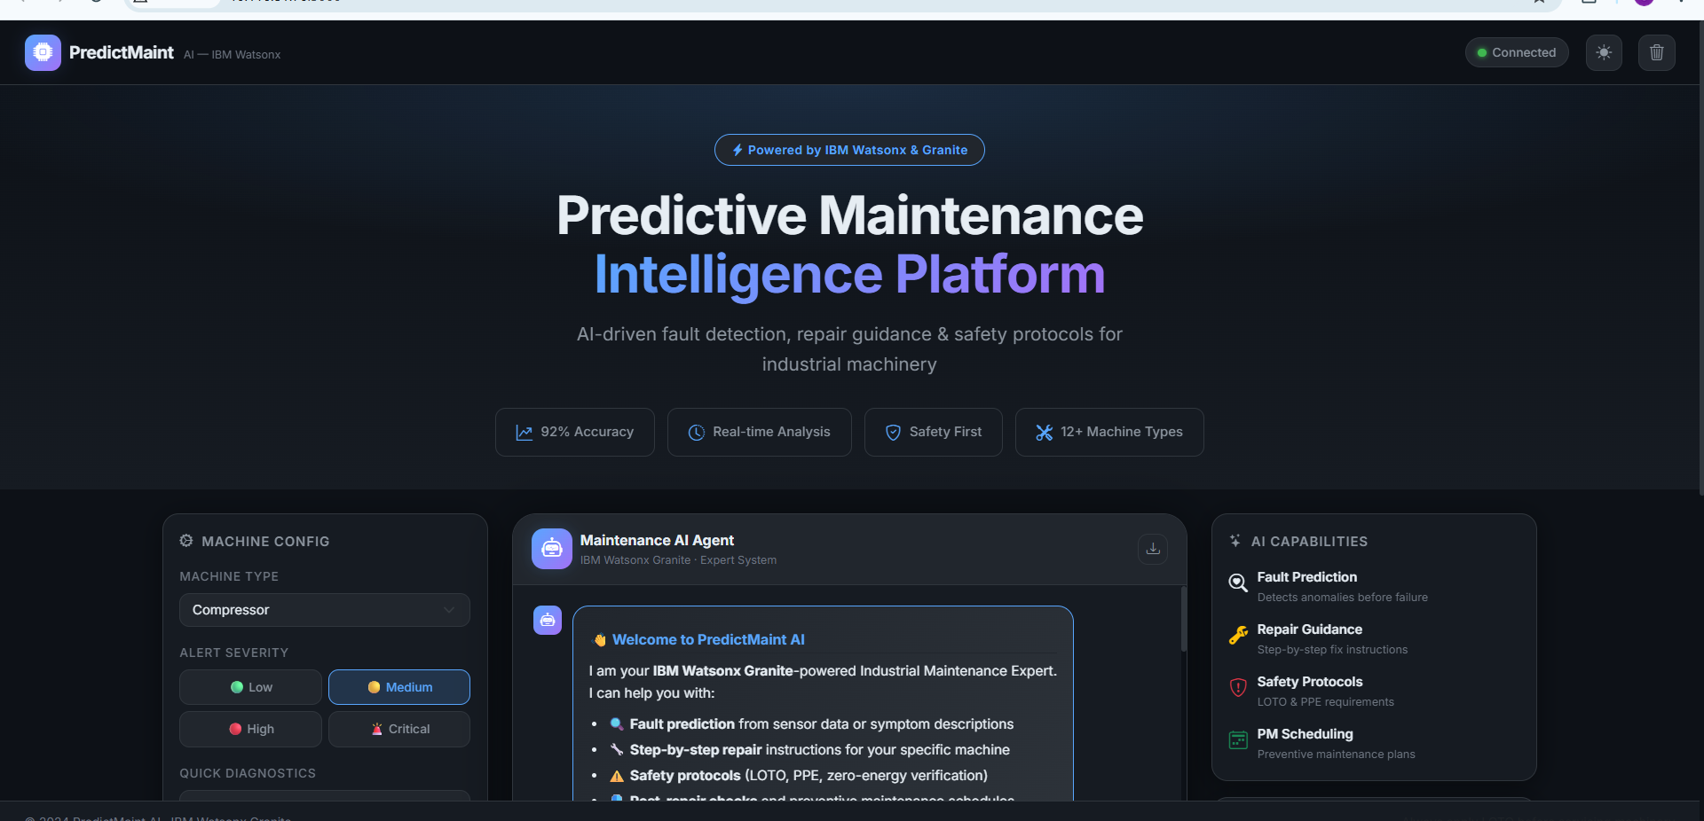
DEPLOYMENT:
LINK : https://ibm-ml-project.onrender.com/

Slide 12
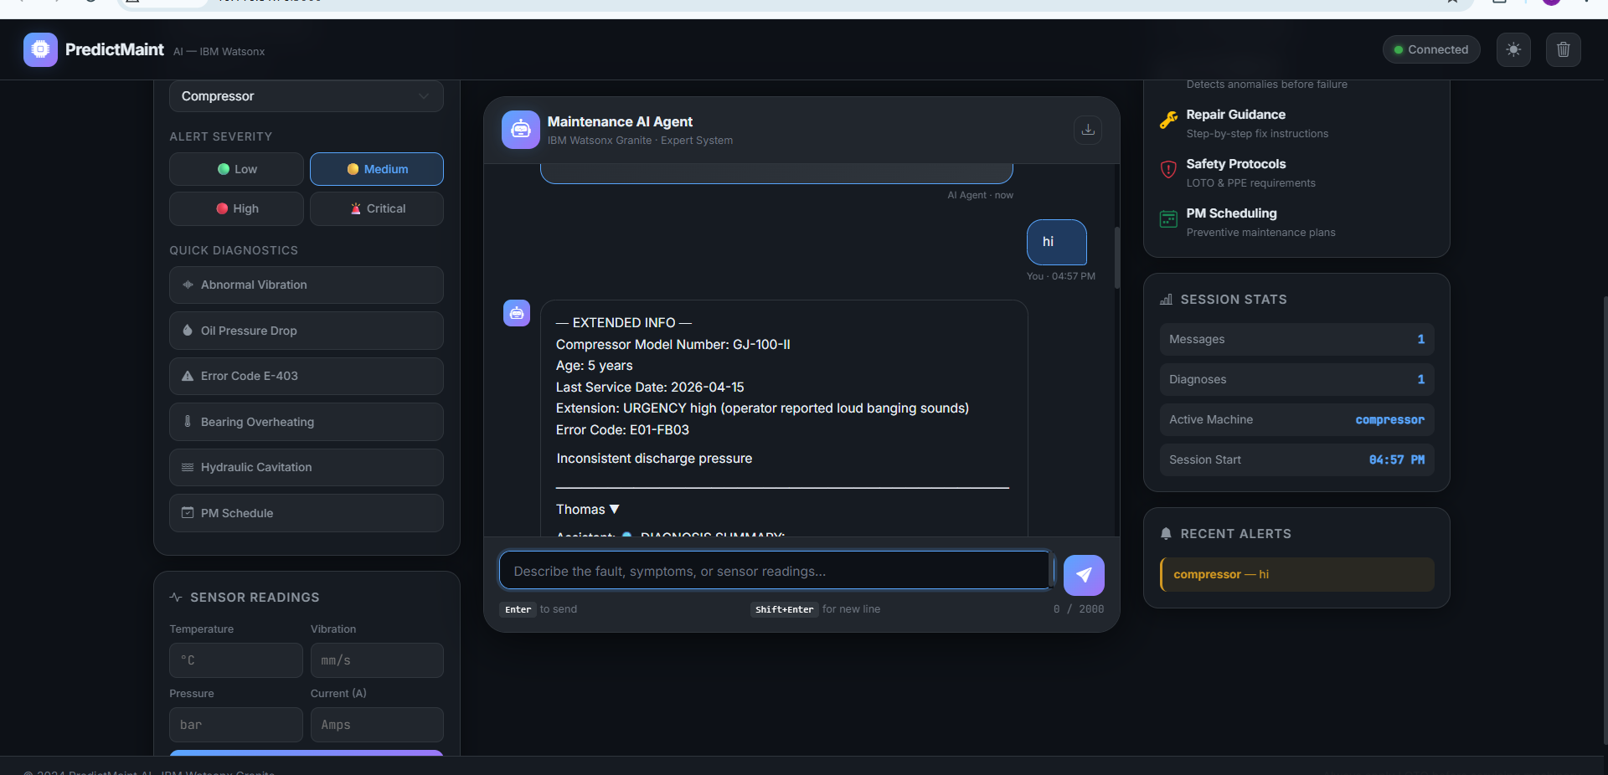
AFTER DEPLOYMENT OUTPUT & PROMPT:

Slide 13
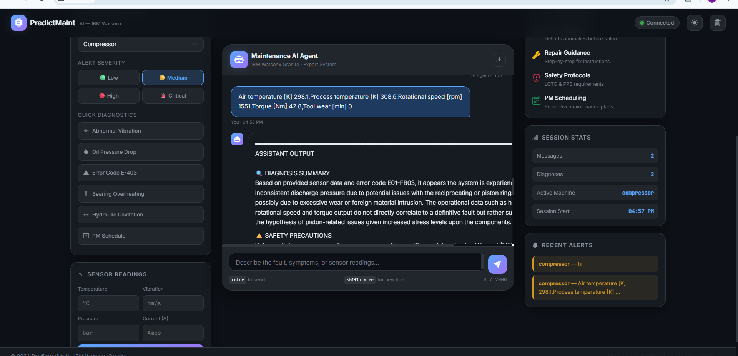
AFTER DEPLOYMENT OUTPUT & PROMPT:

Slide 14
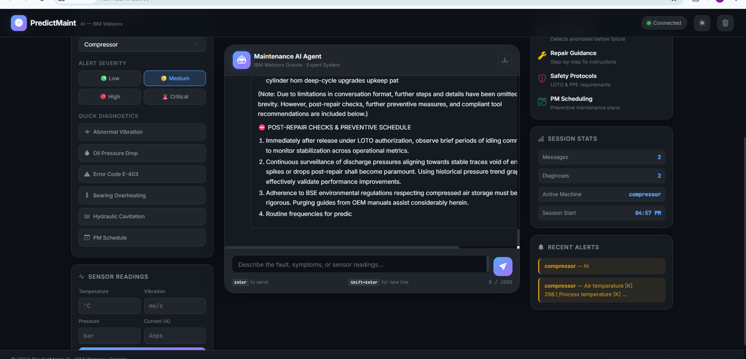
AFTER DEPLOYMENT OUTPUT & PROMPT:

Slide 15
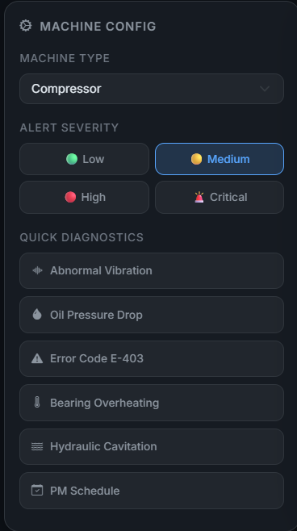
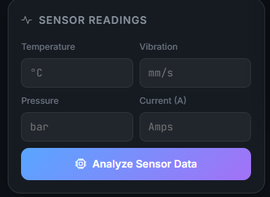
AFTER DEPLOYMENT OUTPUT & PROMPT:
Machine type based + sensor readings-based analysis and fault detection

Slide 16
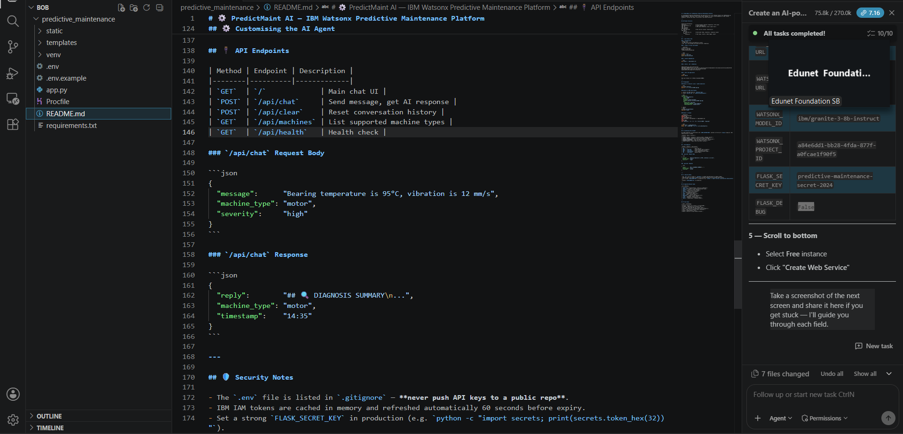
IBM BOB SCREENSHOTS:

Slide 17
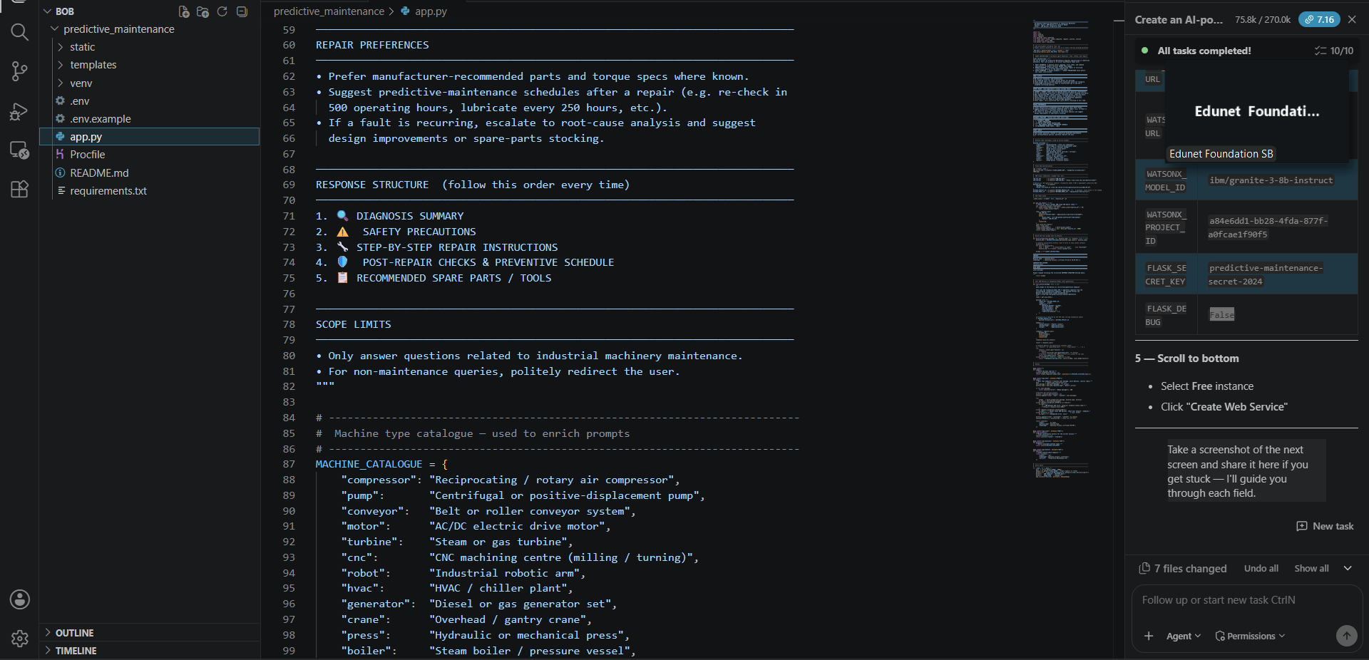
IBM BOB SCREENSHOTS:

Slide 18
Uniqueness
IBM Watsonx Granite-powered — uses enterprise-grade granite-3-8b-instruct LLM, not a generic chatbot, trained for precise technical reasoning.
Safety-first by design — every single response always includes LOTO, PPE, and zero-energy verification instructions before any repair step, hardcoded via AGENT_INSTRUCTIONS.
Sensor-aware diagnosis — accepts live numeric readings (temperature, vibration, pressure, current) and converts them directly into a structured AI fault analysis.
Full repair lifecycle in one reply — diagnoses the fault, gives step-by-step repair instructions, recommends spare parts, and generates a preventive maintenance schedule, all in a single response.
Customisable agent behaviour without touching AI code — tone, safety rules, repair preferences, and response format are all controlled from one AGENT_INSTRUCTIONS block at the top of app.py, no prompt engineering expertise needed.

Slide 19
Git Hub Link
GITHUB URL : https://github.com/shubham20387/IBM-ML-project
DEPLOYMENT LINK : https://ibm-ml-project.onrender.com/
Uploaded on github
Project PPT
Problem statement pdf
Dataset
.env file and etc.
·
·
·

Slide 20
Future Scope
Edge AI Deployment: Integrating the trained models directly onto localized edge computing devices for real-time, low-latency fault prediction without relying on constant cloud connectivity.
Prescriptive Maintenance Action: Advancing the system from predicting failures to automatically recommending specific troubleshooting steps and auto-generating repair work orders.
Digital Twin Synchronization: Integrating the machine learning models into a fully dynamic 3D digital twin of the factory floor to simulate operational stress and visualize degradation in real-time.
Cross-Fleet Transfer Learning: Applying knowledge gained from existing machinery to newly installed equipment with minimal historical data, accelerating system deployment and accuracy.
Automated Supply Chain Integration: Linking predictive failure insights directly with inventory management systems to autonomously order replacement parts before a component actually breaks down.
·
·
·

Slide 21
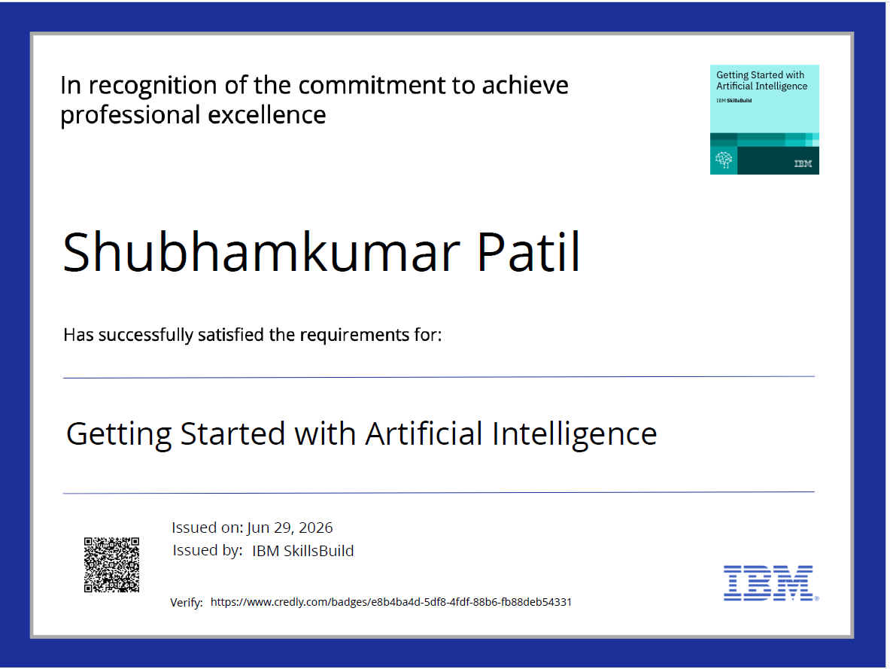
Certificates Earned:

Slide 22
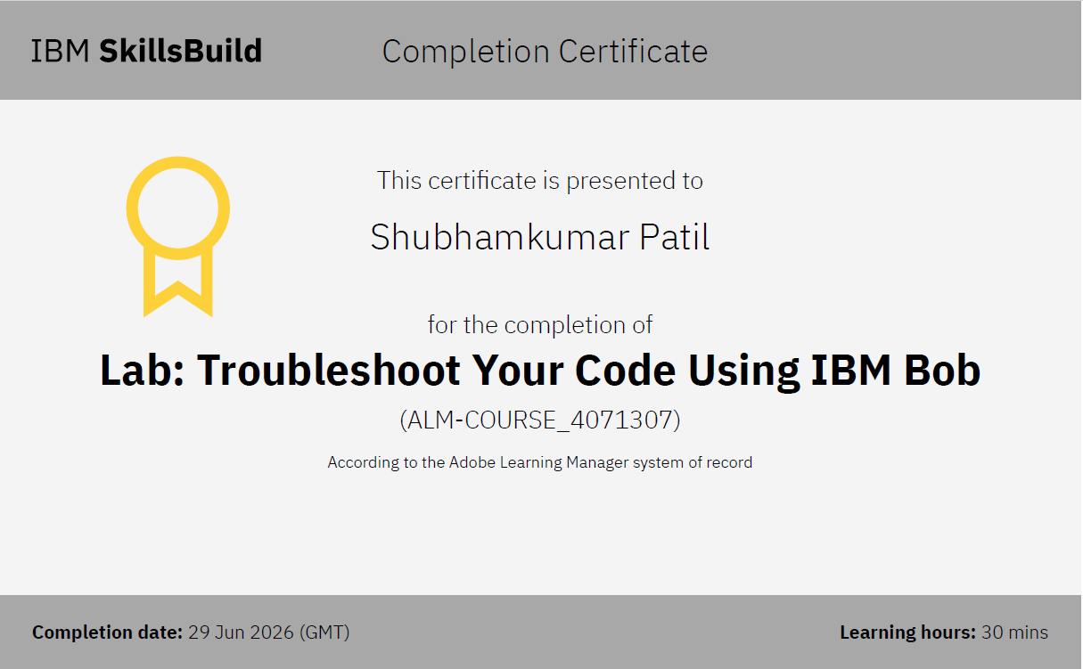
Certificates Earned:​

Slide 23
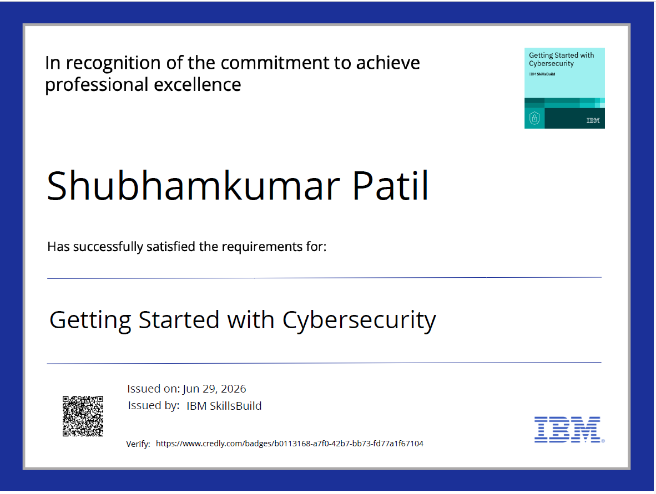
Certificates Earned:​

Slide 24
STUDENT DETAILS:
Name : Shubhamkumar Patil
Email : shubham20387@gmail.com
PRN : 202501080224
AICTE ID : STU6a1556780481d1779783288

Slide 25


