Slide 1
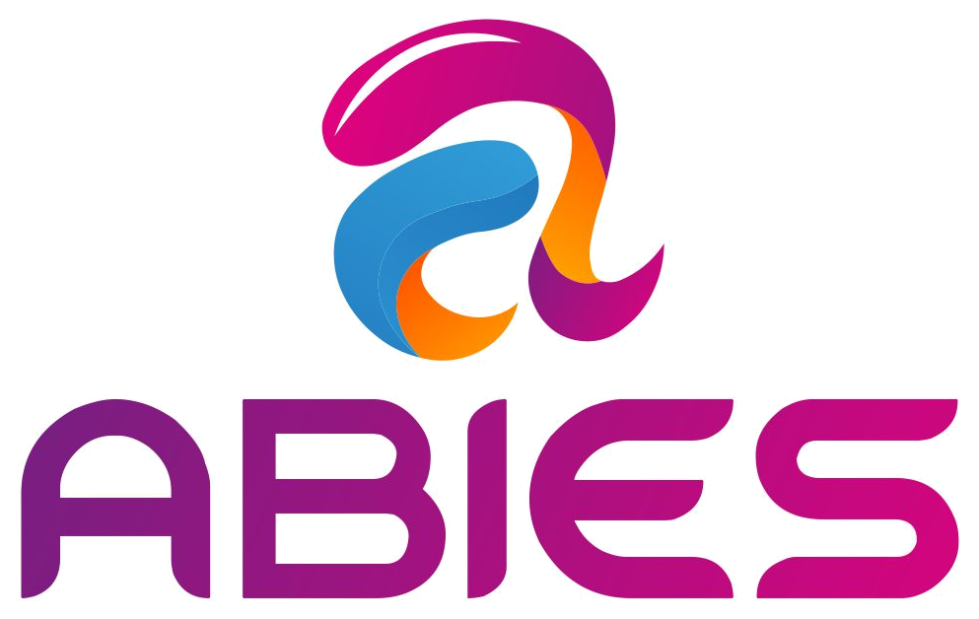
IT Stack & Platform
Architecture
Ayurveda Integrated Care Platform
Prepared for ABIES
Objective
Define the recommended technology stack, deployment model, integrations, security controls, DevOps pipeline and development sprint plan for the ABIES Ayurveda care platform.
Confidential technology planning deck | September 2026

Slide 2
Stack design principles
The platform should be modular, secure, scalable and MVP-friendly.
Start lean
Build a reliable PWA + portals before investing in heavy native mobile apps.
Design for healthcare trust
Identity, consent, audit logs, encryption and access controls from day one.
Integrate, do not reinvent
Use payment, logistics, video, WhatsApp, SMS and lab integrations where possible.
Modular growth path
MVP can start on containers and scale into Kubernetes/OpenShift when demand matures.
Operational visibility
Every order, booking, ticket, partner SLA and incident should be traceable.
ABIES | Ayurveda Integrated Care Platform | IT Stack

Slide 3
Application landscape
A single platform with multiple role-specific experiences.
Patient PWA/App
Registration, health profile, discovery, booking, Care Plan, orders, reports, support
Doctor Portal
Verification, availability, consultation, assessment, prescription, follow-up
Partner Portals
Pharmacy, lab and Panchakarma operations with SLA and settlements
Admin Console
Master data, pricing, user management, quality, audits, dashboards
Support CRM
Customer 360, sales pipeline, tickets, escalations, refunds and TechOps
Common services: Identity • RBAC • Consent • Notifications • Payments • Audit • Analytics
ABIES | Ayurveda Integrated Care Platform | IT Stack

Slide 4
Target architecture overview
Recommended logical architecture for the ABIES platform.
Experience Layer
Patient PWA
Doctor Portal
Partner Portals
Support/Admin
External Systems
Razorpay, logistics, WhatsApp, SMS, video, labs, ABDM-ready
API Gateway
Auth, rate limits, routing, versioning, request audit
Core Services
Appointments, consultation, Care Plan, orders, tickets, settlements
Data Platform
PostgreSQL, Redis, object storage, search, backups, analytics warehouse
Cloud / Container Platform
Docker, Kubernetes/OpenShift path, CI/CD, monitoring, logs, WAF and secrets
ABIES | Ayurveda Integrated Care Platform | IT Stack

Slide 5
Frontend stack
Build fast web/PWA experiences first, then add native mobile when usage proves it.
Recommended MVP
Next.js + React + TypeScript
Progressive Web App
Responsive UI for mobile and desktop
UI system
ABIES design system
Reusable components
Accessibility basics
Multi-language ready
Future mobile
React Native or Flutter
Patient app first
Doctor app only after portal usage is validated
Why PWA first
• Lower development cost
• Works across Android/iOS/desktop
• Easy pilot iteration
• No app-store dependency during MVP
ABIES | Ayurveda Integrated Care Platform | IT Stack

Slide 6
Backend and API stack
Use a structured backend framework to handle healthcare workflows safely.
Recommended backend
Node.js + NestJS + TypeScript
REST APIs first
OpenAPI/Swagger documentation
Background workers for async tasks
Core domains
Users & RBAC
Appointments
Consultations
Care Plans
Orders
Tickets
Settlements
API discipline
Versioned APIs
Idempotency for payments/orders
Structured logging
Validation layer
Audit events
Alternative option
Python FastAPI can also work well for AI-heavy or data-heavy services, but NestJS is cleaner for the main transactional platform.
ABIES | Ayurveda Integrated Care Platform | IT Stack

Slide 7
Data and storage stack
Separate transactional, document, cache and analytics needs.
PostgreSQL
Core relational database for users, bookings, orders, tickets and Care Plans
Redis
Cache, sessions, rate limits, queues and temporary OTP state
Object Storage
Reports, prescriptions, invoices, images and consent artefacts
Search Index
Doctor, medicine, city, service and support-ticket search
Analytics Store
Funnels, KPIs, partner SLA, cohort, revenue and support analytics
Important: health data needs strict access control, retention policy, audit and encryption
ABIES | Ayurveda Integrated Care Platform | IT Stack

Slide 8
Integration stack
Integrations should be wrapped through internal adapter services to avoid vendor lock-in.
Payments
Razorpay / UPI / refunds
Logistics
Shiprocket or courier APIs
Messaging
WhatsApp, SMS, email
Video
Consultation video provider
Labs
Lab booking + report upload
ABDM-ready
ABHA/consent/FHIR path
Maps
Distance and centre discovery
Analytics
Events, attribution, cohorts
Integration pattern
Use internal adapters: ABIES APIs should call payment/logistics/video/lab adapters, not vendor APIs directly from the product code. This keeps the platform replaceable and easier to test.
ABIES | Ayurveda Integrated Care Platform | IT Stack

Slide 9
Identity, security and consent
Security must be designed into the product, not added after launch.
Identity
OTP login
Optional password
Family profiles
Doctor/partner verification
Admin MFA
Access control
Role-based access
Least privilege
Tenant/partner boundaries
Break-glass admin process
Consent & audit
Consent records
Data-access audit trail
Prescription change history
Ticket and order timeline
Protection
TLS everywhere
Encryption at rest
Secrets manager
WAF/rate limits
Backup restore tests
Support and AI must never override practitioner decisions or change prescriptions.
ABIES | Ayurveda Integrated Care Platform | IT Stack

Slide 10
Infrastructure and deployment model
Keep MVP cost manageable while preserving a clear scale path.
Phase 1: MVP
Single cloud account
Dockerized services
Managed PostgreSQL
Object storage
CDN + WAF
Automated backup
Phase 2: Pilot scale
Container orchestration
Separate staging/prod
Central logs
Background workers
Queue processing
Autoscaling-ready
Phase 3: Growth
Kubernetes/OpenShift
Service mesh optional
Multi-AZ database
DR runbooks
Advanced observability
Recommendation
Do not start with over-complex microservices. Start as a modular monolith with clear module boundaries, then split services only when scale or teams require it.
ABIES | Ayurveda Integrated Care Platform | IT Stack

Slide 11
DevOps and CI/CD stack
Automate build, test, security checks and controlled releases.
Code
GitHub / GitLab
Build
Docker image
Test
Unit + API + UI
Scan
SAST + dependency
Deploy
Staging → Prod
Monitor
Logs + alerts
Required pipeline controls
• PR review and branch protection
• Automated migrations with rollback plan
• Environment-specific secrets
• Smoke tests after deployment
• Release notes and change approval for production
Recommended tools
• GitHub/GitLab CI
• Docker
• Terraform optional
• Helm/Kustomize for Kubernetes phase
• SonarQube/Snyk or equivalent scanning
ABIES | Ayurveda Integrated Care Platform | IT Stack

Slide 12
Observability and TechOps
Support teams need product visibility, not just server metrics.
Application monitoring
API latency
Error rate
Login failures
Payment failures
Video session issues
Business monitoring
Booking funnel
Order SLA
Lab report delay
Refund volume
Partner breach
Support monitoring
Ticket backlog
First response time
Escalation count
CSAT
Repeat complaints
Tooling recommendation
OpenTelemetry + Prometheus/Grafana + Loki/ELK + alert routing. Use dashboards for both TechOps and business operations.
ABIES | Ayurveda Integrated Care Platform | IT Stack

Slide 13
Support, sales and CRM stack
Customer-support technology should be connected to the care journey.
Support CRM
Customer 360
Ticketing
SLA queues
Call notes
Refund workflows
Escalations
Sales CRM
Doctor leads
Partner onboarding
Follow-ups
Corporate leads
Campaign attribution
Conversion tracking
TechOps console
Incident queue
System status
Deployment history
Data reconciliation
Audit review
Access approvals
Build vs buy
For MVP, use an integrated admin/support console inside ABIES. If support volume grows, integrate Freshdesk/Zendesk/Zoho while keeping the patient timeline in ABIES.
ABIES | Ayurveda Integrated Care Platform | IT Stack

Slide 14
AI and automation stack
Use AI as an assistant, not as an independent medical decision-maker.
Safe AI use cases
Intake summarisation
Consultation notes
Medicine reminders
Support triage
Document extraction
Translation
Human-in-loop controls
Doctor approves clinical notes
No autonomous diagnosis
No prescription changes
Support scripts reviewed
Audit all AI outputs
Implementation approach
Start with rule-based workflows
Add LLM features later
Use prompt templates
Store source references
Monitor hallucination risk
Principle: AI may prepare, summarise and remind. A verified practitioner decides.
ABIES | Ayurveda Integrated Care Platform | IT Stack

Slide 15
Non-functional requirements
Define quality targets before the build starts.
Availability
99.5% MVP target; higher after paid scale
Performance
Core pages < 3 sec on 4G-like networks
Security
MFA for admins, encryption, audit and secure SDLC
Privacy
Consent, retention, access logs and deletion workflows
Scalability
Modular monolith now; service split later
Recoverability
Daily backup; restore test before launch
ABIES | Ayurveda Integrated Care Platform | IT Stack

Slide 16
Environment strategy
Separate development, testing and production early to reduce operational risk.
DEV
Feature branches
Developer testing
Mock integrations
Seed data
UAT/STAGING
Business testing
Real-like data
Sandbox payments
Partner training
PRODUCTION
Approved releases
Monitoring
Backups
Incident process
Governance
No direct production database changes without approved runbook. Every release needs migration plan, rollback plan, smoke test and release note.
ABIES | Ayurveda Integrated Care Platform | IT Stack

Slide 17
Delivery team and toolchain
A focused team can build the MVP without excessive overhead.
Core team
Product Owner
Solution Architect
UI/UX Designer
Frontend Engineer
Backend Engineer
QA Engineer
DevOps/Cloud Engineer
Clinical/ops advisors
Ayurveda doctor advisor
Panchakarma operations advisor
Support lead
Privacy/legal advisor
Partner onboarding lead
Working tools
Jira/Linear
Figma
GitHub/GitLab
Postman
Notion/Confluence
Grafana
Support CRM
One owner for product backlog, one owner for architecture, one owner for clinical safety.
ABIES | Ayurveda Integrated Care Platform | IT Stack

Slide 18
Development sprint plan: foundation to first care journey
2-week sprints; scope should stay focused on the first reliable journey.
S0 — Discovery & PRD
User stories, workflows, data model, architecture runway
S1 — Platform foundation
Repo, CI/CD, design system, auth, RBAC skeleton
S2 — Patient PWA
Registration, profile, intake, doctor discovery
S3 — Doctor Portal
Verification, profile, slots, patient list
S4 — Booking & Payment
Appointments, reminders, Razorpay, video setup
S5 — Consult & Care Plan
Notes, prescription, care tasks, follow-up
ABIES | Ayurveda Integrated Care Platform | IT Stack

Slide 19
Development sprint plan: operations and partner network
Add fulfilment, support, diagnostics, Panchakarma and launch hardening.
S6 — Medicine fulfilment
Pharmacy portal, prescription order, delivery tracking
S7 — Support & CRM
Customer 360, tickets, SLA, sales pipeline
S8 — Admin/Ops
Pricing, users, partner config, refunds, dashboards
S9 — Diagnostics
Test orders, collection slots, report upload, alerts
S10 — Panchakarma
Centre onboarding, referrals, sessions, notes
S11 — Security & Observability
Audit, monitoring, backup, incident runbooks
S12 — Beta Launch
UAT fixes, training, smoke tests, go-live dashboard
ABIES | Ayurveda Integrated Care Platform | IT Stack

Slide 20
Technical roadmap by release
Each release should create business capability, not only technical components.
MVP 1
MVP 2
MVP 3
Consultation engine
Patient PWA + Doctor Portal + booking + payment + Care Plan + medicines
Operations engine
Support CRM + Admin + dashboards + TechOps + ticket escalations
Network engine
Diagnostics + Panchakarma + partner settlements + quality monitoring
Scale release
Native mobile apps, AI-assisted notes, ABDM integrations, corporate programs, multi-city rollout and advanced analytics.
ABIES | Ayurveda Integrated Care Platform | IT Stack

Slide 21
Technical decisions for ABIES
Decisions to close before detailed PRD and vendor estimation.
Immediate decisions
• PWA-first or native app-first
• Cloud/VPS provider
• Build custom support CRM or integrate external CRM
• Payment/logistics/video vendors
• Pilot city and partner onboarding volume
Architecture decisions
• Modular monolith vs microservices
• ABDM integration phase
• Data retention policy
• Security baseline and audit requirements
• Cloud backup and DR objective
Recommended next step
Convert this IT stack into a detailed technical PRD: screens, APIs, entities, role matrix, integration contracts, event model, test cases, deployment topology and sprint backlog.
ABIES | IT Stack and Architecture Deck

