Slide 1
Heart Disease Prediction using Machine Learning
Group 9 - Bias Variance Dilemma
Submitted to Prof. Mehul Raval
Shubham Patel - AU1940155
Shrey Patel - AU1940110
Keyur Nagar - AU1940207

Slide 2
Introduction
Heart Disease is a leading cause of death globally.
At present, the key factor responsible for mortality is Heart Disease.
More than ⅓ death occur due to heart disease problem.
Smoking habits, unhealthy diet, and physical inactivity are the factor causing heart disease. [1]
Machine learning is proven to be an efficient approach to predict the risk of heart disease using the large amount of data collected from the HealthCare Industry.
Who.int. 2022. Cardiovascular diseases (CVDs). [online] Available at:https://www.who.int/news-room/fact-sheets/detail/cardiovasculardiseases-(cvds).

Slide 3
Problem Statement
To predict the risk of heart disease in a patient given a few sets of parameters that incorporate the disease using machine learning algorithms and finding the best model with the highest accuracy that can solve the problem countering the risk of false-positive detection.

Slide 4
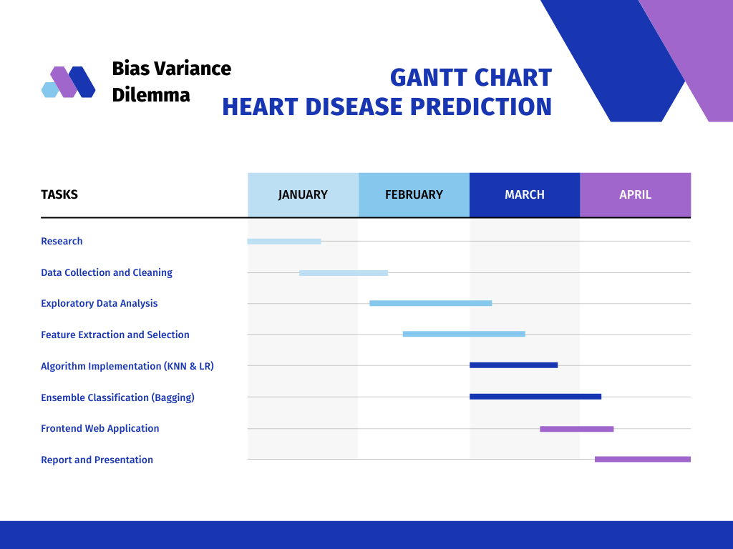
Gantt Chart

Slide 5
Existing Body of Work
The paper named “Improved Study of Heart Disease Prediction System using Data Mining Classification Techniques” uses Naive Bayes, Decision Trees, and Neural Networks approaches. For improvising the model, they introduced two more attributes namely smoking and obesity. This resulted in increase in prediction accuracy. [3]
The paper named “Improving the accuracy of prediction of heart disease risk based on ensemble classification techniques” uses technique of ensemble classification. The ensemble classification technique used to improve the accuracy of model by considering the decision of multiple classifiers. This resulted in an increase of prediction accuracy by 7%. [4]
3. C.S. Dangare, S.S. Apte, “Improved Study of Heart Disease Prediction System using Data Mining Classification Techniques”, International Journal of Computer Applications vol.47, issue.10, pp. 44-48, 2012.
4. C.B.C. Latha, S.C. Jeeva, “Improving the accuracy of prediction of heart disease risk based on ensemble classification techniques”, Informatics in Medicine, Unlocked 16, pp.100203, 2019.

Slide 6
Conclusions from Existing Body of Work
[3] Paper helped to understand that the techniques such as feature extraction and feature selection can increase the model performance. The author added 2 new features to improve the accuracy of the model.
[4] Paper helped to understand that the technique of prediction using ensemble classifiers in which authors try to combine several weak classification algorithms to produce improved results.
3. C.S. Dangare, S.S. Apte, “Improved Study of Heart Disease Prediction System using Data Mining Classification Techniques”, International Journal of Computer Applications vol.47, issue.10, pp. 44-48, 2012.
4. C.B.C. Latha, S.C. Jeeva, “Improving the accuracy of prediction of heart disease risk based on ensemble classification techniques”, Informatics in Medicine, Unlocked 16, pp.100203, 2019.

Slide 7
Our Approach
Cardiovascular Disease Dataset published by Ryerson University. [4]
Dataset contains 12 columns (11 attributes and 1 output) and 70,000 rows.
Step 1: Data Pre-processing
Removing null values.
Removing instances having outlier values of the ap_hi (Systolic Blood Pressure values > 250 and < 0) and ap_lo (Diastolic Blood Pressure values > 200 and < 0).
Age given in days was converted to years for ease in computation.
Step 2: Exploratory Data Analysis (Results can be found in the upcoming slides)
Correlation of the target variable with the data was found with the help of correlation matrix. Maximum correlation with the target variable observed was 0.41. Hence our dataset is moderately correlated.
Getting more insights of the data.
2. Ryerson University, “Cardiovascular Disease dataset,” 2019. [Online] Available: www.kaggle.com.

Slide 8
Step 3: Feature Extraction and Selection:
Applied CFS (Correlation-based Feature Selection) algorithm for finding the best set of features for predicting the heart disease.
Step 4: Disease Prediction
Divided the data set into training and testing sets i.e 80% train data set and 20% test data set.
This problem is a typical example of classification problem, so we tried to use different classification methods on our data set.
Applied KNN algorithm on training and testing data and measured its accuracy by confusion matrix.
Applied Logistic Regression on training and testing data and measured its accuracy by confusion matrix.

Slide 9
Step 5: Ensemble Classification:
Implemented Bagging using Logistic Regression as a base classifier for further increasing the accuracy and reducing overfitting.
Step 6: Model selection and deployment:
Pick the model having high accuracy and deployed the Web Application on the Cloud Platform.

Slide 10
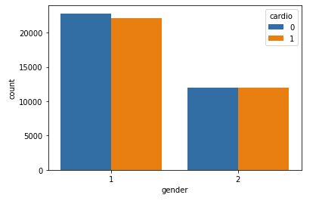
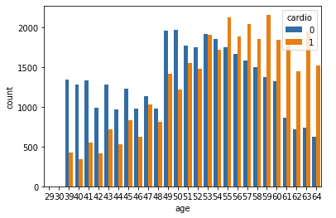
Results of EDA
Gender
Age

Slide 11
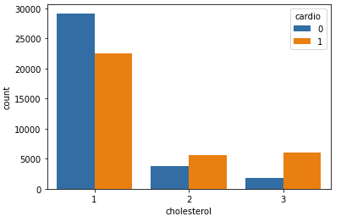
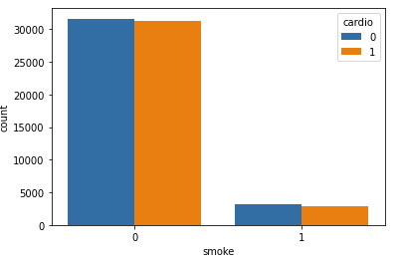
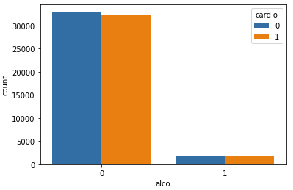
Cholesterol
Smoke
Alcohol

Slide 12
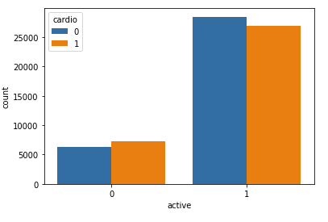
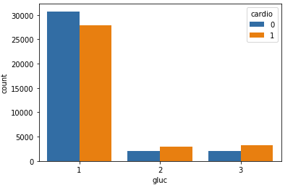
Physical Activity
Glucose

Slide 13


Feature Extraction and Selection
Introduced the new risk feature named BMI (Body mass Index) using the height and weight feature.
CFS is a filter based algorithm that ranks feature subsets according to a correlation-based merit evaluation function. The bias of the evaluation function is towards subsets that contain features that are highly correlated with the class and uncorrelated with each other.[6]
6. M. A. Hall, Correlation-based Feature Selection for Machine Learning- University of Waikato. [Online]. Available: https://www.cs.waikato.ac.nz/ mhall/thesis.pdf. [Accessed: 22-Apr2022].

Slide 14
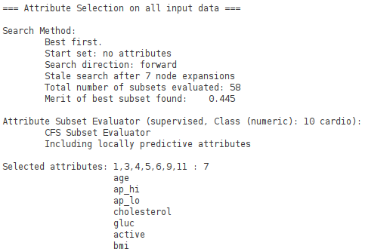
Selected features:
CFS Results:
Features Selected: Age, Systolic blood pressure(ap_hi), Diastolic blood pressure(ap_lo), Cholesterol, Glucose, Physical activity, BMI

Slide 15
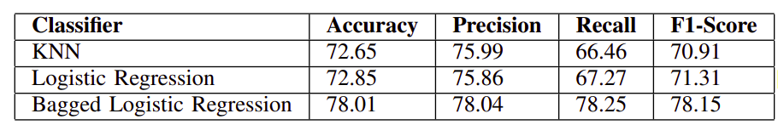
Ensemble classification:
Bagging:
Done using Logistic Regression as a Base Classifier.
Widely used to deal with the problem of bias-variance trade-off.

Slide 16
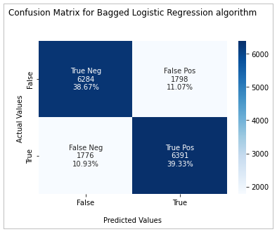
Confusion Matrix:
Bagged Logistic Regression
ACCURACY = 78.01%

Slide 17
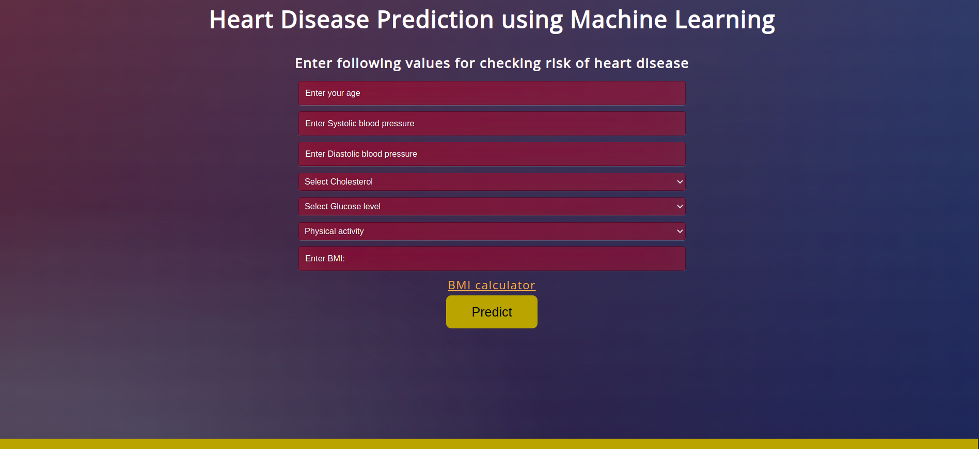
Deployment:
Link to Website: https://hdp-biasvariancedillema.herokuapp.com/

Slide 18
Conclusion
The KNN classifier resulted in 72.65% accuracy whereas the Logistic Regression algorithm resulted in 72.85% accuracy.
Adding one risk feature - BMI and performing Feature Selection using the Correlation-based Feature Selection (CFS) algorithm increased the model accuracy.
The Bagged Logistic Regression model increased the accuracy by 5%, increasing the model accuracy to 78.01%.
Our model can help in the early detection of the Heart Disease.

Slide 19
Role of Each Member
Shubham Patel: Literature Review, Weekly Progress Reports, Coding (EDA, Bagging, Logistic Regression, Feature Extraction & Selection, Website Improvements), End Term Report and Presentation preparation
Shrey Patel: Literature Review, Weekly Progress Reports, Coding(EDA, KNN implementation, Website deployment ), End term report review and presentation preparation.
Keyur Nagar: Literature Review, Weekly Progress Reports, Coding (KNN ,Logistic Regression implementation, Bagging, Website deployment) , End term report review End term Presentation preparation

Slide 20
References
[1] Who.int. 2022. Cardiovascular diseases (CVDs). [online] Available at:https://www.who.int/news-room/fact-sheets/detail/cardiovasculardiseases-(cvds).
[2] Ryerson University, “Cardiovascular Disease dataset,” 2019. [Online] Available: www.kaggle.com.
[3] K, Vanisree Jyothi, Singaraju. (2011). Decision Support System for Congenital Heart Disease Diagnosis based on Signs and Symptoms using Neural Networks. International Journal of Computer Applications. 19. 10.5120/2368-3115.
[4] Chaitrali S Dangare and Sulabha S Apte. Article: Improved Study of Heart Disease Prediction System using Data Mining Classification Techniques. International Journal of Computer Applications 47(10): pp.44-48, June 2012.
[5] C.B.C. Latha, S.C. Jeeva, Improving the accuracy of prediction of heart disease risk based on ensemble classification techniques, Informatics in Medicine, Unlocked 16, pp.100203, 2019.
[6] M. A. Hall, Correlation-based Feature Selection for Machine Learning- University of Waikato. [Online]. Available: https://www.cs.waikato.ac.nz/ mhall/thesis.pdf. [Accessed: 22-Apr2022].

Slide 21
Thank You

