Slide 1
Heart Disease Prediction using Machine Learning
Group 9: bias_variance_dilemma
Shubham Patel- AU1940155
Shrey Patel- AU1940110
Keyur Nagar- AU1940207

Slide 2
Introduction
Heart Disease is a leading cause of death globally.
At present, the key factor responsible for mortality is Heart Disease.
More than ⅓ death occur due to heart disease problem.
Smoking habits, unhealthy diet, and physical inactivity are the factor causing heart disease. [1]
Machine learning is proven to be an efficient approach to predict the risk of heart disease using the large amount of data collected from the HealthCare Industry.
K. Vanisree, S. Jyothi, “Decision Support System for Congenital Heart Disease Diagnosis based on Signs and Symptoms using Neural Networks”, International Journal of Computer Applications vol.19, issue.6, pp.6 – 12, 2011.

Slide 3
Problem Statement
To predict the risk of heart disease in a patient given few set of parameters that incorporate for the disease using machine learning algorithms and finding the best model with highest accuracy that can solve the problem countering the risk of false positive detection as well.

Slide 4
Existing Body of Work
The paper named “Improved Study of Heart Disease Prediction System using Data Mining Classification Techniques” uses Naive Bayes, Decision Trees, and Neural Networks approaches. For improvising the model, they introduced two more attributes namely smoking and obesity. This resulted in increase in prediction accuracy. [1]
The paper named “Improving the accuracy of prediction of heart disease risk based on ensemble classification techniques” uses technique of ensemble classification. The ensemble classification technique used to improve the accuracy of model by considering the decision of multiple classifiers. This resulted in an increase of prediction accuracy by 7%. [2]
C.S. Dangare, S.S. Apte, “Improved Study of Heart Disease Prediction System using Data Mining Classification Techniques”, International Journal of Computer Applications vol.47, issue.10, pp. 44-48, 2012.
C.B.C. Latha, S.C. Jeeva, “Improving the accuracy of prediction of heart disease risk based on ensemble classification techniques”, Informatics in Medicine, Unlocked 16, pp.100203, 2019.

Slide 5
Conclusions from Existing Body of Work
[1] Paper helped to understand that the techniques such as feature extraction and feature selection can increase the model performance. The author added 2 new features to improve the accuracy of the model.
[2] Paper helped to understand that the technique of prediction using ensemble classifiers in which authors try to combine several weak classification algorithms to produce improved results.
C.S. Dangare, S.S. Apte, “Improved Study of Heart Disease Prediction System using Data Mining Classification Techniques”, International Journal of Computer Applications vol.47, issue.10, pp. 44-48, 2012.
C.B.C. Latha, S.C. Jeeva, “Improving the accuracy of prediction of heart disease risk based on ensemble classification techniques”, Informatics in Medicine, Unlocked 16, pp.100203, 2019.

Slide 6
Approach
Cardiovascular Disease Dataset published by Ryerson University. [4]
Dataset contains 12 columns (11 attributes and 1 output) and 70,000 rows.
Step 1: Data Pre-processing
Null values were removed from the dataset. Also some instances having outlier values of the ap_hi (Systolic Blood Pressure values > 250 and < 0) and ap_lo (Diastolic Blood Pressure values > 200 and < 0) were removed. Age was given in days so we normalized it to years. The final dataset size reduced to 68,975.
Step 2: Exploratory Data Analysis
To get more insights of the dataset. Also the correlation of the attributes with the output attribute was found with the help of correlation matrix. (Results can be found in the upcoming slides). The maximum correlation observed was 0.41 hence we conclude that our dataset is moderately correlated.
4. Ryerson University, “Cardiovascular Disease dataset,” 2019. [Online] Available: www.kaggle.com.

Slide 7
Step 3: Disease Prediction
Divided the data set into training and testing sets i.e 80% train data set and 20% test data set.
This problem is a typical example of classification problem, so we tried to use different classification methods on our data set.
Applied KNN algorithm on training and testing data and measured its accuracy by confusion matrix.
Applied Logistic Regression on training and testing data and measured its accuracy by confusion matrix.

Slide 8
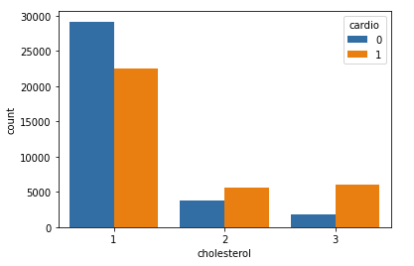
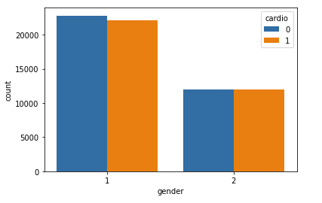
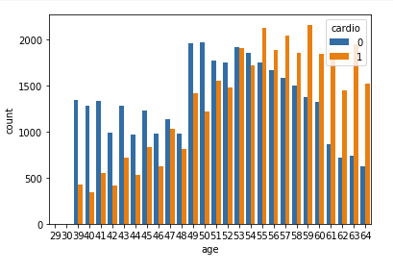
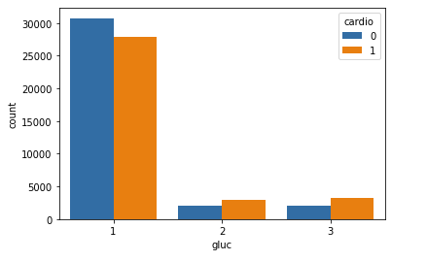
Results of EDA (cont’d.)
Cholesterol level variable
Gender
Age
Glucose

Slide 9
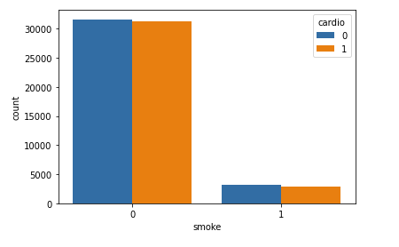
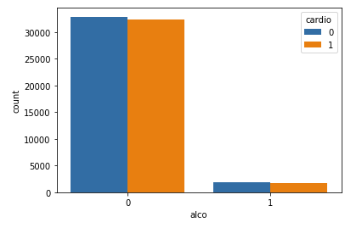
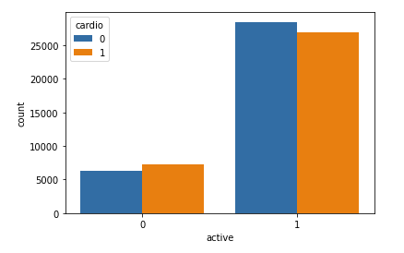
Smoke
Alcohol intake
Physical activity

Slide 10
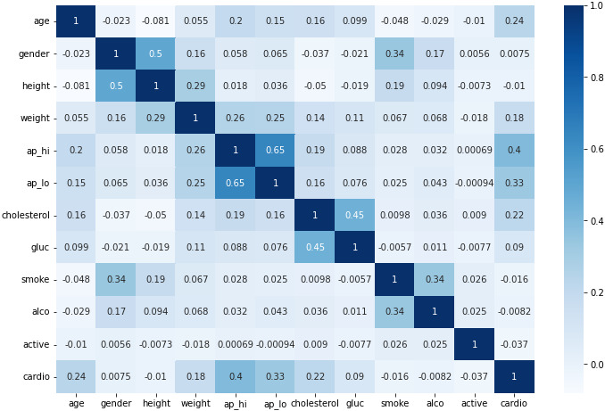
Correlation matrix

Slide 11
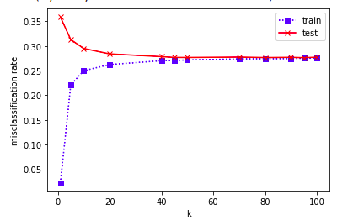
Initial Results
K- Nearest Neighbours (KNN)
Training and Testing Error was observed low at k = 80. Hence, it is the best fit for our dataset.

Slide 12
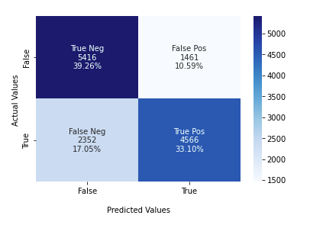
Confusion Matrix for KNN algorithm
ACCURACY = 72.36%

Slide 13
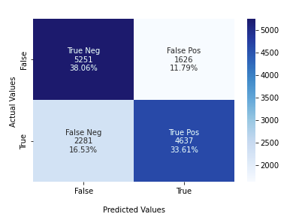
Confusion Matrix for Logistic Regression
ACCURACY = 71.68%

Slide 14
Conclusions from EDA and Disease Prediction Model
The age attribute has a significant effect on heart disease cases. As the age increases the risk of heart disease also increases.
Although the level-1 cholesterol has more people without heart disease, however it can be inferred that as the level of cholesterol increases the heart disease cases also increases.
The rise in glucose level leads to rise in heart disease.
There are more people with heart disease in physically inactive class compared to the physically active class.
The accuracy of the KNN classifier is high compared to that of Logistic regression. Hence, it can be said that the KNN classifier is the best fit for our dataset.

Slide 15
Role of each group member
Shubham Patel: Literature Review, Weekly Progress Reports, Coding (EDA and Logistic Regression), Mid Term Report and Presentation preparation.
Shrey Patel: Literature Review, Weekly Progress Reports, Coding(EDA and KNN implementation), Mid term report review and presentation preparation.
Keyur Nagar: Literature Review, Weekly Progress Reports, Coding (KNN implementation and related results) and Mid term Presentation preparation.

Slide 16
Future Work
We will try to apply Feature Selection and Feature Extraction approaches to reduce our attributes and increase our prediction accuracy.
We will try to apply technique of ensemble classification to improve the model accuracy.
We are planning to deploy our model on the frontend website where the user can enter his/her values for the respective parameters and the model will detect the disease and show relevant results.

Slide 17
References
K. Vanisree, S. Jyothi, “Decision Support System for Congenital Heart Disease Diagnosis based on Signs and Symptoms using Neural Networks”, International Journal of Computer Applications vol.19, issue.6, pp.6 – 12, 2011.
C.S. Dangare, S.S. Apte, “Improved Study of Heart Disease Prediction System using Data Mining Classification Techniques”, International Journal of Computer Applications vol.47, issue.10, pp. 44-48, 2012.
C.B.C. Latha, S.C. Jeeva, “Improving the accuracy of prediction of heart disease risk based on ensemble classification techniques”, Informatics in Medicine, Unlocked 16, pp.100203, 2019.
Ryerson University, “Cardiovascular Disease dataset,” 2019. [Online] Available: www.kaggle.com.

