Slide 1
IMAGE COMPRESSION OF JPG/JPEG/PNG/BMP FORMAT USING SINGULAR VALUE DECOMPOSITION(SVD)
Shrey Patel AU1940110
Vraj Kavathiya AU1940129
Shubham Patel AU1940155
Vedant Thakore AU1940122
Group-21

Slide 2
Introduction:
Main aim: Compressing image(using it’s pixels) by using SVD(Singular value Decomposition) for lossy image compression.
Input image: Compress any format of image e.g. jpeg, jpg, bmp etc.
Fundamental concept: SVD-based image compression scheme using a smaller number of rank to approximate the original matrix.
Main method used: Power method - The pixels of the image are represented in the form of mxn matrix and SVD is performed on it.

Slide 3
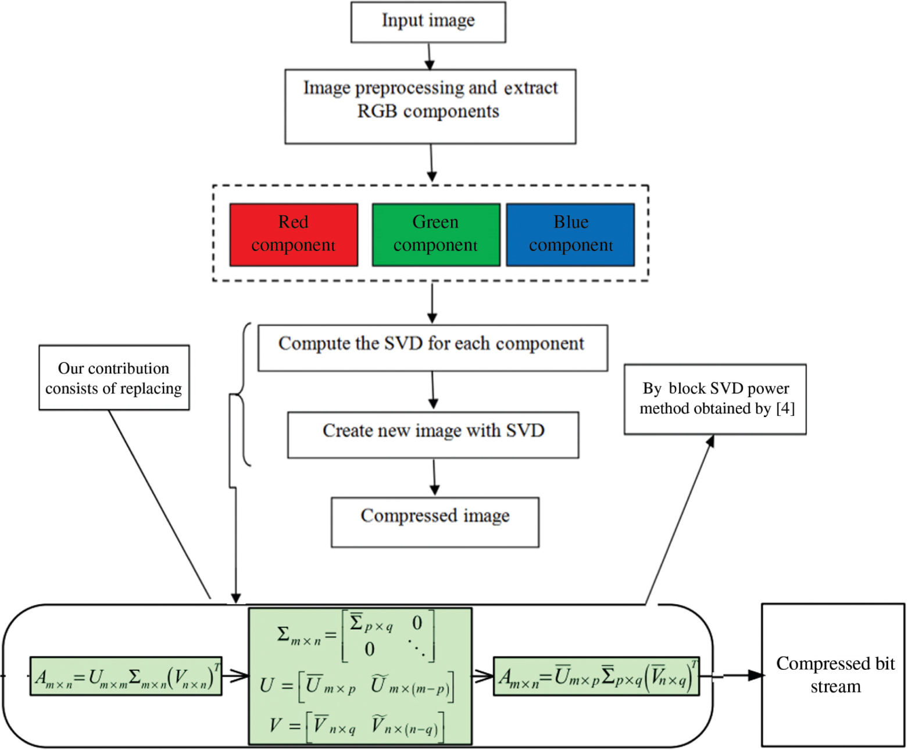
Approach:
The red, blue and green colour component of the Input Image is to be separated.
The SVD is to be performed for red, blue and green colors.
We can calculate how many bytes are needed to store the pieces of the rank approximation compared to size of original image.
The program output shows size of the original and compressed image in bytes, pixels of original image and the compression ratio(ratio of size of compressed to original image).

Slide 4
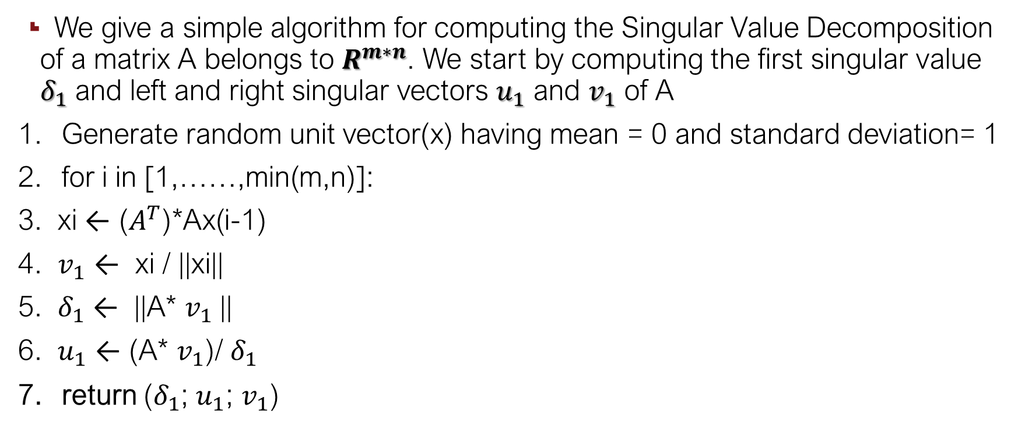
Algorithm:
We give a simple algorithm for computing the Singular Value Decomposition of a matrix A belongs to $R^{m∗n}$. We start by computing the first singular value $δ_{1}$ and left and right singular vectors $u_{1}$ and $v_{1}$ of A
Generate random unit vector(x) having mean = 0 and standard deviation= 1
for i in [1,……,min(m,n)]:
3. xi ← ($A^{T}$)*Ax(i-1)
4. $v_{1}$ ← xi / ||xi||
5. $δ_{1}$ ← ||A* $v_{1}$||
6. $u_{1}$ ← (A* $v_{1}$)/ $δ_{1}$
return ($δ_{1}$; $u_{1}$; $v_{1}$)

Slide 5
Key Steps which include Linear Algebra:
Let A be the m x n matrix. Then, A^{T} A = (U ∑ V^{T})^{T} (U ∑ V^{T}) = V ∑ U^{T} U ∑ V^{T} = V ∑² V^{T}
We can eliminate U by performing A^{T}A. Let B = A^{T} A = V ∑² V^{T} and x be the random unit vector.
We can write it in terms of singular vectors x = ∑­­_{i} c_{i} v_{i}. Hence Bx = ∑­­_{i} c_{i} σ_{i}² v_{i} and performing recursively k times it will give B^{k} x = ∑­­_{i} c_{i} σ_{i}² ^{k} v_{i.}
As the first singular value σ₁ is larger than all other singular values, the B^{k} x corresponding to v₁ will be larger than rest others.
Choosing random unit vector would ensure that for all vectors v_{j}, the ratio of σ₁ /σ_{j} would be greater than 1.
The loop computes x_{t +1} = Bx_{t}, and renormalizing at each step. The loop will break when the angle between x_{t} and x_{t +1} is nearly 1. Using v₁, σ₁ and u₁ are calculated.
We want to ensure that the vectors in span of v₁ are ignored and hence we will set A to A = A – σ₁ u₁ v₁^{T} and repeat the whole process again.

Slide 6
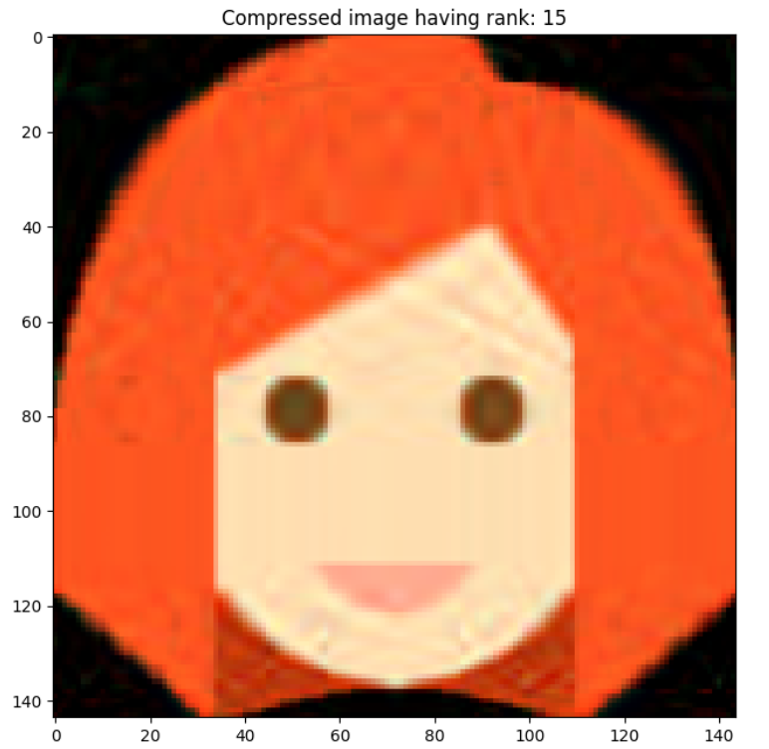

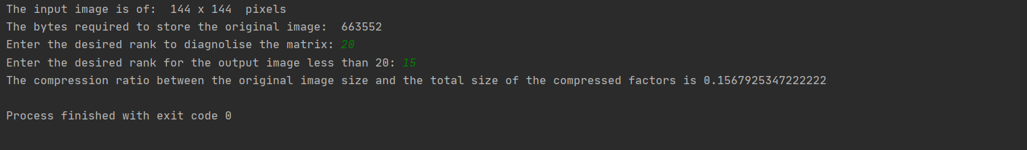

Results:

Slide 7
Drawbacks:
Not a very good block-based transformation technique, and using SVD on the whole image requires lots of memory.
Main issue: Takes a lot of time to compress. So, Time complexity is very large.
To actually save data, we need k > (m*n / (m+n+1). That may not be the case with all the images.
Power method is not numerically stable as a small change in matrix could bring larger change in singular value ratio of the two images.

Slide 8
Conclusion:
Our group has finally worked on image compression with the help of Power method which includes the concept of SVD(Singular Value Decomposition).
All types of image formats can be compressed for e.g. .bmp, .jpg , .jpeg etc.
Greater reduction in size is observed in .bmp as compared to other file formats.
Major drawback: As the program requires more time with increase in rank(k) value, so it is not an industrial method for image compression.
The quality of the output image depends on the k value.

Slide 9
Thank You!

