Slide 1

STAT- 542 FINAL PROJECT
AIRBNB NEW USER BOOKINGS PREDICTION
GROUP MEMBERS:
UMESH KARAMCHANDANI (UMESHK2)
SHUBHAM MEHTA (MEHTA45)
ANUSHREE VILAS PIMPALKAR (AVP4)

Slide 2


PROBLEM STATEMENT
Airbnb: New User Bookings
Where will a new guest book their first travel experience?

Slide 3

MOTIVATION
New users on Airbnb can book a place to stay in more than 34,000 cities across 190+ countries
By accurately predicting where a new user will book their first travel experience
Airbnb can share more personalized content with their community
Decrease the average time to first booking
Better forecast demand
In this dataset, with all users from the 'US', we have 12 possible outcomes of the destination country: 'US', 'FR', 'CA', 'GB', 'ES', 'IT', 'PT', 'NL','DE', 'AU', 'NDF' (no destination found), and 'other'.

Slide 4
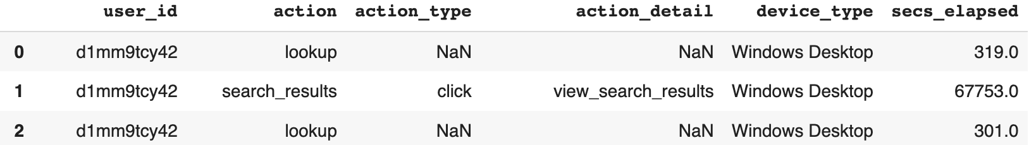
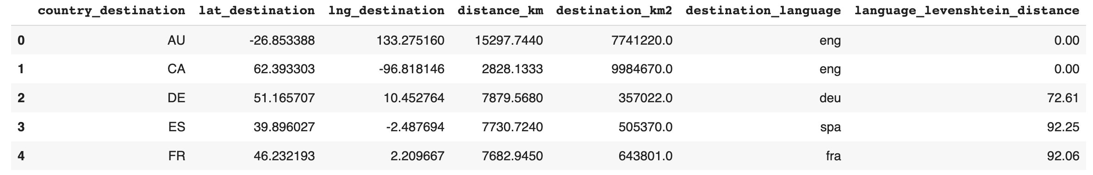
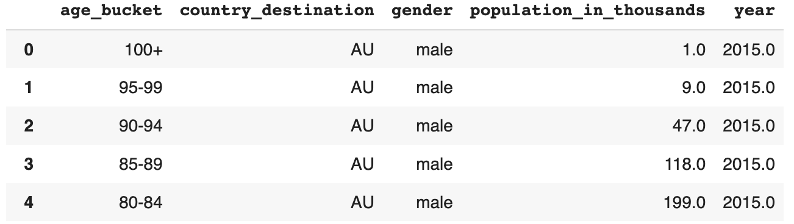
DATA DESCRIPTION & INTUITION
Users along with their demographics
Web sessions log for users
Summary statistics of destination countries in this dataset and their locations
Summary statistics of users' age group, gender, country of destination
INTUITION
People of different ages and gender might have different preferred destinations
Someone who spends more time per session or take more number of sessions is more likely to book a destination
Some particular action, action type or action detail might affect the chances of booking or destination country
The distance between destination and US and destination language might affect the first destination booking

Slide 5
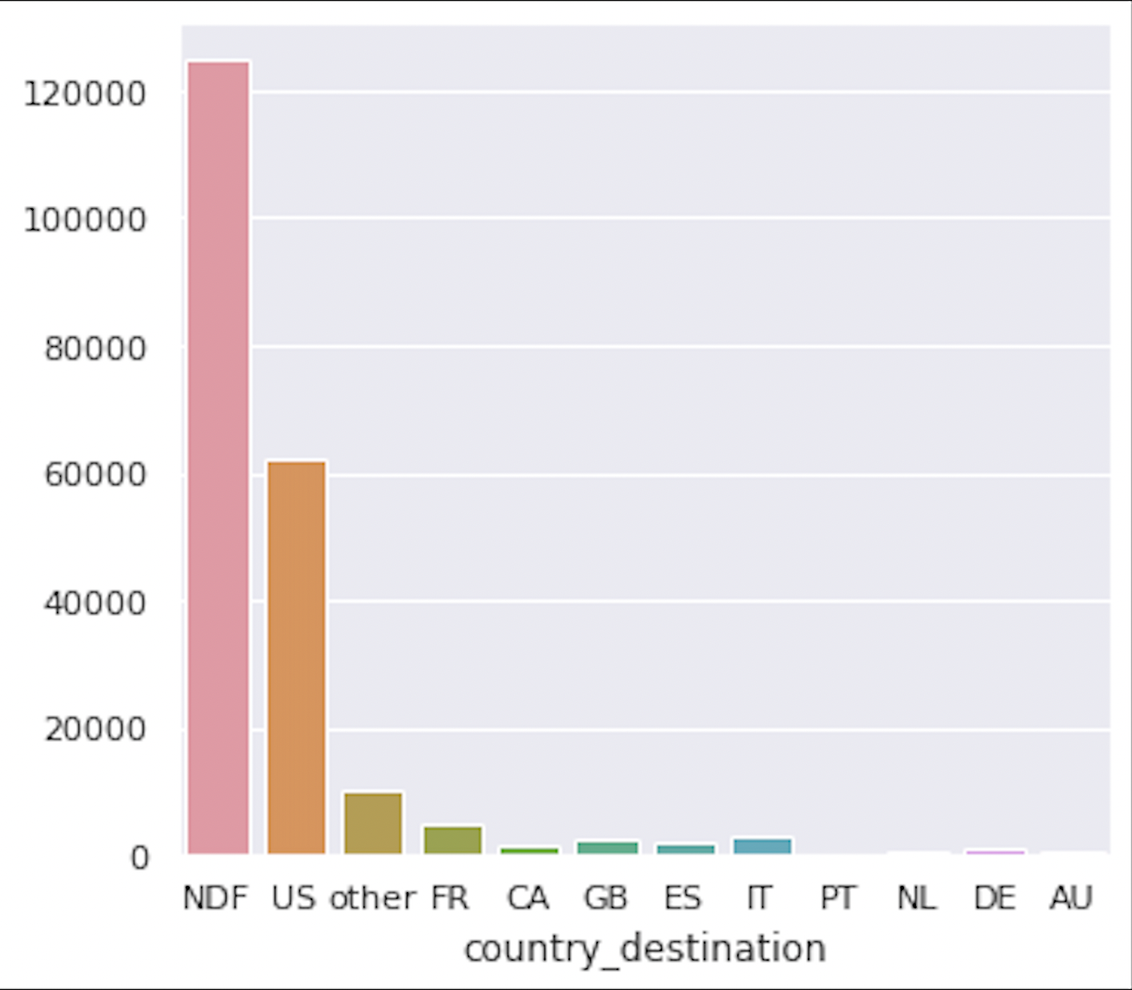
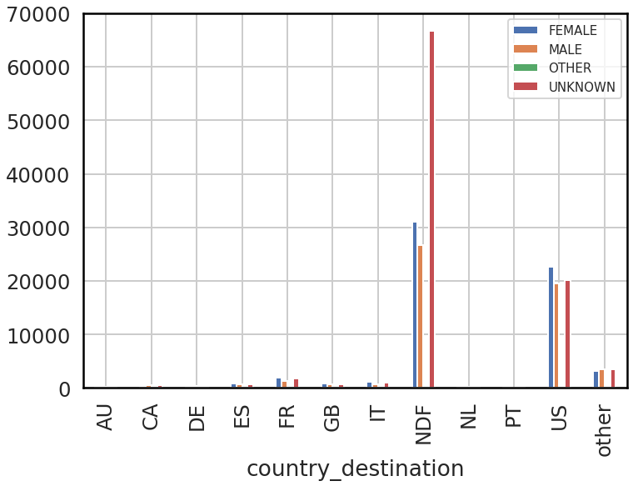
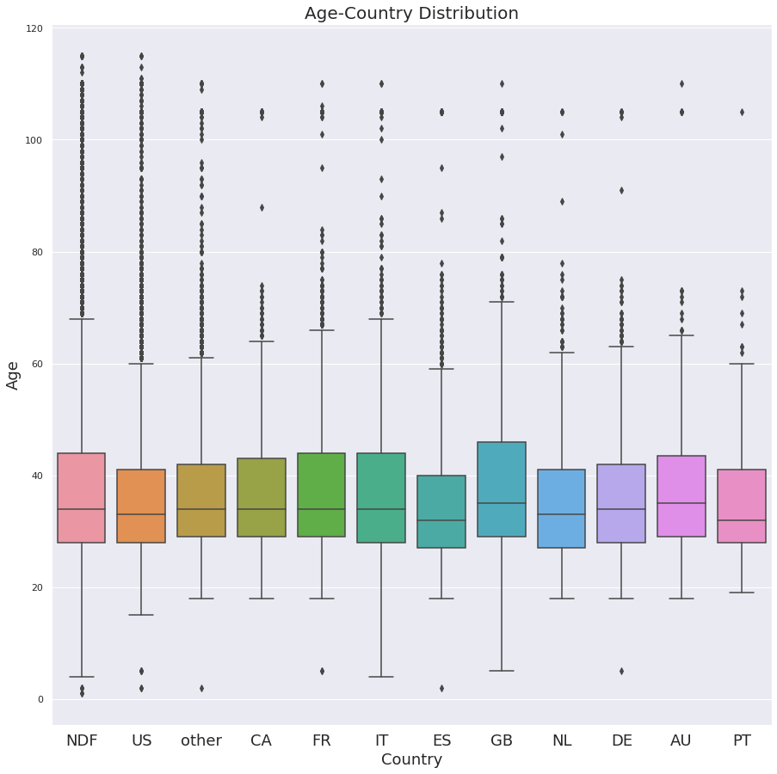
Users without gender information may not make a booking
Maximum number of users did not book any destination followed by US as the first destination
The distribution of age is more or less the same for every country. Great Britain has the highest median age and Spain is more popular amongst younger travelers
Customers who have not given their gender may not be serious about booking (NDF)

Slide 6
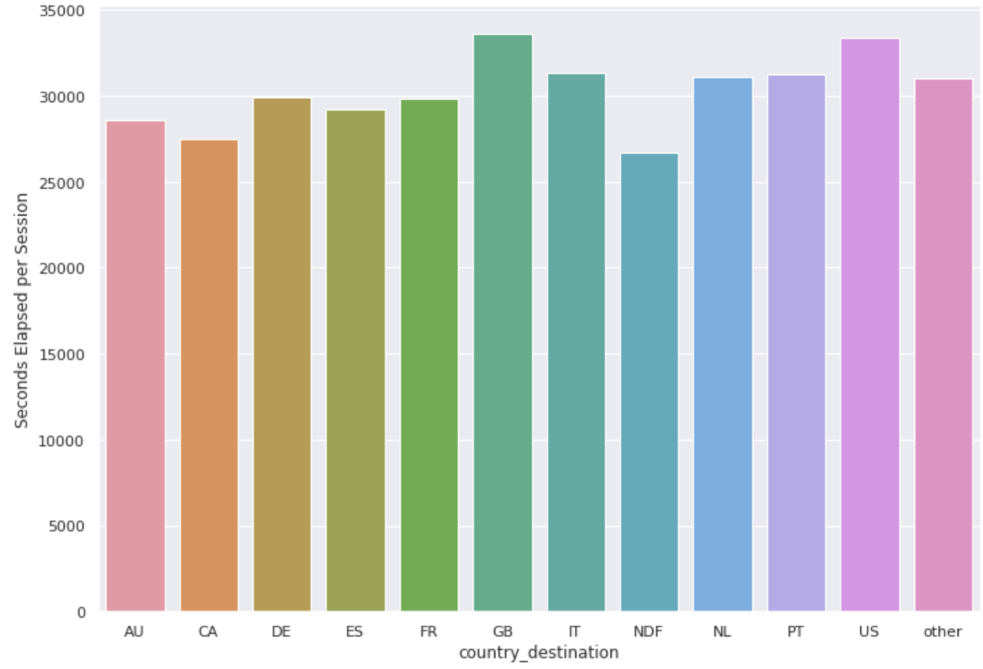
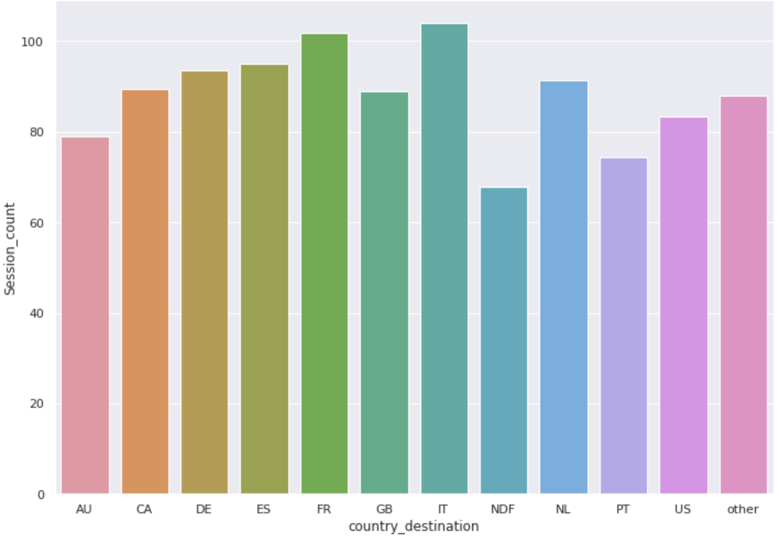
Users' web activity : An important indicator of first destination
Average time per session is highest for users who booked United States, Great Britain as destination
Average time per session is lowest for users who did not book any destination
Average number of sessions is highest for users who booked France, Italy as destination
Average number of sessions is lowest for users who did not book any destination

Slide 7
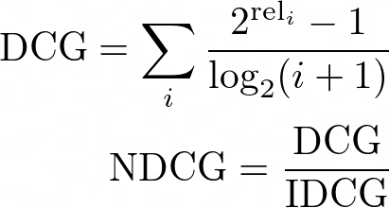
EVALUATION METRIC : NDCG
The goal is to predict top 5 destinations a new user is likely to book. Here, the rank of the relevant destination is an important consideration
For every new user, the ground truth country is marked with relevance = 1, while the rest have relevance = 0
NDCG (Normalized Discounted Cumulative Gain)
rel_i is the relevance of result at position i
IDCG is the maximum possible (ideal) DCG
Predictions ( For Ground Label : FR) | Score
[FR,US,GB,IT,NZ] | 1.0
[US,FR,GB,IT,NZ] | 0.63
[US,GB,FR,IT,NZ] | 0.50
[US,GB,IT,FR,NZ] | 0.43
[US,GB, IT,NZ,FR] | 0.39

Slide 8
FEATURE ENGINEERING
Data Aggregation
(User Data + Sessions Data)
Sessions Data contains information about customer interaction with Airbnb website / app
To capture the interactions with website/app, summary statistics like mean time elapsed, number of unique actions, number of sessions were created
To capture the importance of certain Actions performed w.r.t booking, features like actions, actions type, action details that contain text data were vectorized through Term Frequency – Inverse Document Frequency
Bag of Words (BOW) used for processing device type
Ordinal Encoding performed to encode categorical variables for Tree-Based modeling
One-hot encoding used for Logistic and Naïve-Bias Classifier
Date / Month Extraction
TfIdf Vectorizer
Ordinal Encoding
Count Vectorizer (BOW)
One Hot Encoding

Slide 9
XGBOOST and LightGBM resulted in highest NDCG score
Model | Training: NDCG Score | Testing: NDCG Score
Naive Bayes | 0.447 | 0.444
Logistic Regression | 0.686 | 0.806
Random Forest | 0.741 | 0.734
XGBoost | 0.867 | 0.858
LightGBM | 0.883 | 0.858
ExtraTrees | 0.894 | 0.847
Naïve Bayes gives lowest NDCG score on training and test data. It assumes that features are independent, which is not true in most cases
Logistic regression produces linear decision boundaries resulting in lower accuracy as compared to LightGBM / XGBoost / ExtraTrees
ExtraTrees, XGBoost and LightGBM produces better accuracy among these 6 models.

Slide 10
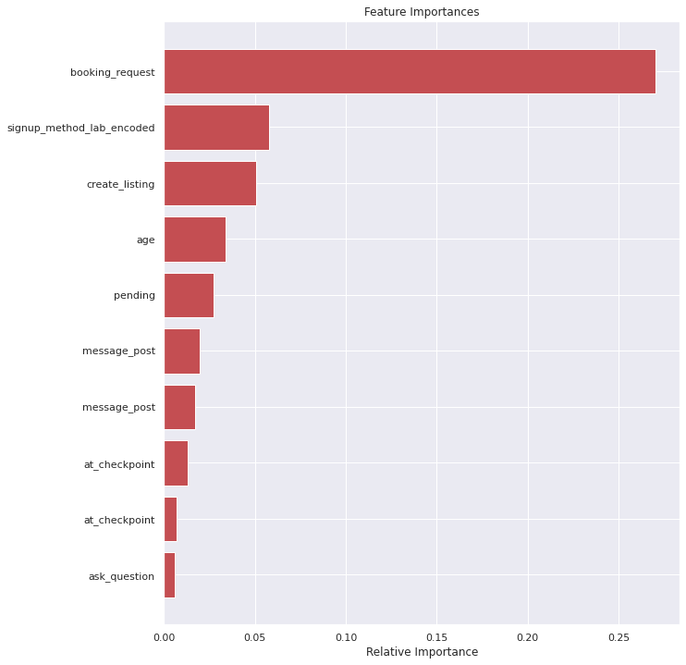
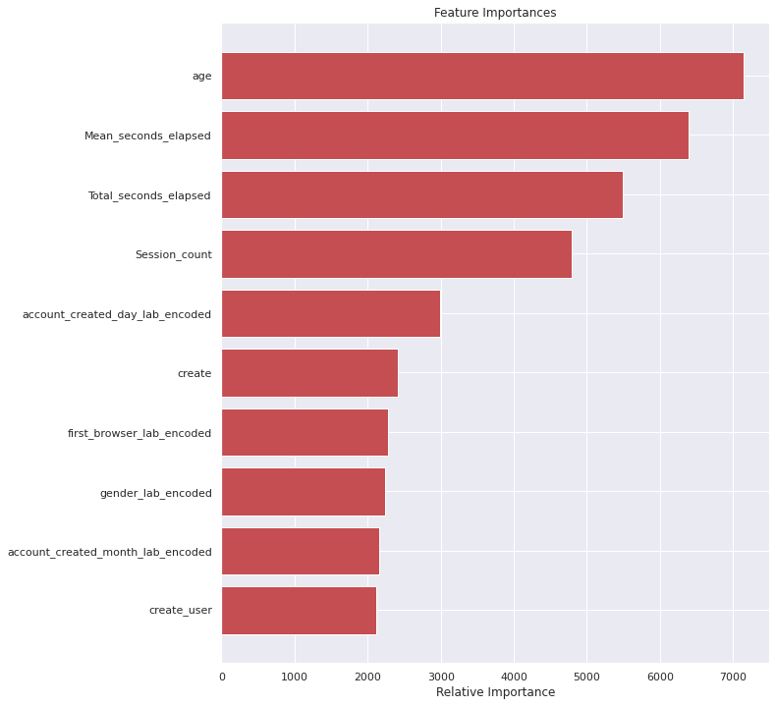
FEATURE IMPORTANCE AND INFERENCE
XGBoost Feature Importance
LightGBM Feature Importance
Age is one of the most important feature which helps in predicting the destination country
Session metrics like average time per session, number of sessions play a significant role in deciding the destination
Users who use certain actions like booking request, create listing are more likely to book for a destination
Some other important factors like signup method, gender of the user helps in identifying the first destination

Slide 11


