Slide 1
Express

Slide 2
Express
Express is a minimal and flexible Node.js web application framework that provides a robust set of features for web and mobile applications.
It is an open source framework developed and maintained by the Node.js foundation.

Slide 3
Install Express.js
Firstly, you have to install the express framework globally to create web application using Node terminal.
Use the following command to install express framework globally.
npm install -g express

Slide 4
Install Express.js
Use the npm init command to create a package.json file for your application.
The package. json file is the heart of any Node project.
It records important metadata about a project and also defines functional attributes of a project that npm uses to install dependencies and run scripts.

Slide 5
Install Express
Use the following command to install express:
npm install express --save
The above command install express in node_module directory and create a directory named express inside the node_module. You should install some other important modules along with express

Slide 6
First program
var express = require('express');
var app = express();
app.get('/', function(req, res){
res.send("Hello world!");
});
app.listen(3000);

Slide 7
First program
If we run our application and go to localhost:3000/hello, the server receives a get request at route "/hello", our Express app executes the callback function attached to this route and sends "Hello World!" as the response.
Notes:
To test this request, open up your terminal and use cURL to execute the following request −
curl -X POST "http://localhost:3000/hello"

Slide 8
Express.js Request Object
Express.js Request and Response objects are the parameters of the callback function which is used in Express applications.
The express.js request object represents the HTTP request and has properties for the request query string, parameters, body, HTTP headers, and so on.

Slide 9
Express.js Response Object
The Response object (res) specifies the HTTP response which is sent by an Express app when it gets an HTTP request.

Slide 10
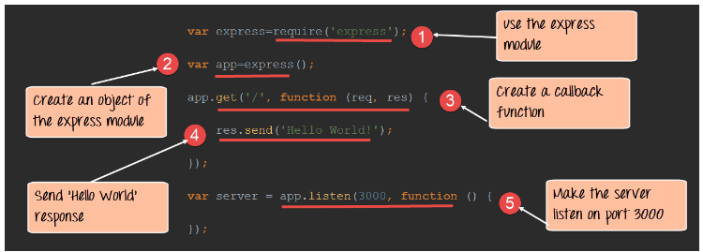

Slide 11
In our first line of code, we are using the require function to include the "express module."
Before we can start using the express module, we need to make an object of it.
Here we are creating a callback function. This function will be called whenever anybody browses to the root of our web application which is http://localhost:3000 . The callback function will be used to send the string 'Hello World' to the web page.

Slide 12
In the callback function, we are sending the string "Hello World" back to the client. The 'res' parameter is used to send content back to the web page. This 'res' parameter is something that is provided by the 'request' module to enable one to send content back to the web page.
We are then using the listen to function to make our server application listen to client requests on port no 3000. You can specify any available port over here.

Slide 13
GET and POST Request
GET requests are used to send only limited amount of data because data is sent into header
POST requests are used to send large amount of data because data is sent in the body and Post method is secure because data is not visible in URL bar

Slide 14
res.sendFile()
The res.sendFile() function basically transfers the file at the given path
res.sendFile(path [, options] [, fn])

Slide 15
res.sendFile()
The __dirname in a node script returns the path of the folder where the current JavaScript file resides. __filename and __dirname are used to get the filename and directory name of the currently executing file.

Slide 16
req.query
The req.query property is an object containing the property for each query string parameter in the route.

Slide 17
body-parser
Parse incoming request bodies in a middleware before your handlers, available under the req.body property.
npm install --save body-parser

Slide 18
Express routing
Routing refers to how an application’s endpoints (URIs) respond to client requests.
You define routing using methods of the Express app object that correspond to HTTP methods; for example, app.get() to handle GET requests and app.post to handle POST requests.

Slide 19
Express routing
These routing methods specify a callback function (sometimes called “handler functions”) called when the application receives a request to the specified route (endpoint) and HTTP method.
In other words, the application “listens” for requests that match the specified route(s) and method(s), and when it detects a match, it calls the specified callback function.

Slide 20
Express routing
In fact, the routing methods can have more than one callback function as arguments.
With multiple callback functions, it is important to provide next as an argument to the callback function and then call next() within the body of the function to hand off control to the next callback.

Slide 21
Express routing
It specifies how an application responds to a client request to a particular route, URI or path and a specific HTTP request method (GET, POST, etc.). It can handle different types of HTTP requests.
Adding routes to the Router object is just like adding routes to the app object
To use the router in our main app file we would then require() the route module, then call use() on the Express application to add the Router to the middleware handling path.

Slide 22
Express routing
app.METHOD(PATH, HANDLER)
Where:
app is an instance of express.
METHOD is an HTTP request method, in lowercase.
PATH is a path on the server.
HANDLER is the function executed when the route is matched.

Slide 23
Route methods
A route method is derived from one of the HTTP methods, and is attached to an instance of the express class.

Slide 24
Middlewares
Middleware functions are functions that have access to the request object (req), the response object (res), and the next function in the application’s request-response cycle.
The next function is a function in the Express router which, when invoked, executes the middleware succeeding the current middleware.
Middleware functions can perform the following tasks:
Execute any code.
Make changes to the request and the response objects.
End the request-response cycle.
Call the next middleware in the stack.

Slide 25
Middleware function myLogger
Here is a simple example of a middleware function called “myLogger”. This function just prints “LOGGED” when a request to the app passes through it. The middleware function is assigned to a variable named myLogger.
var myLogger = function (req, res, next) { console.log('LOGGED')
next()
}

Slide 26
Middleware function myLogger
To load the middleware function, call app.use(), specifying the middleware function. For example, the following code loads the myLogger middleware function before the route to the root path (/).

Slide 27
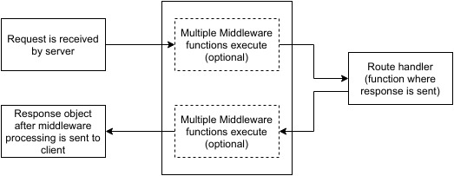
Middleware function myLogger

Slide 28
Middleware function myLogger
var express = require('express')
var app = express()
var myLogger = function (req, res, next) {
console.log('LOGGED')
next()
}
app.use(myLogger)
app.get('/', function (req, res) {
res.send('Hello World!')
})
app.listen(3000)

Slide 29
Middleware function myLogger
Every time the app receives a request, it prints the message “LOGGED” to the terminal.
The order of middleware loading is important: middleware functions that are loaded first are also executed first.
If myLogger is loaded after the route to the root path, the request never reaches it and the app doesn’t print “LOGGED”, because the route handler of the root path terminates the request-response cycle.
The middleware function myLogger simply prints a message, then passes on the request to the next middleware function in the stack by calling the next() function. Every time the app receives a request, it prints the message “LOGGED” to the terminal.

Slide 30
Middleware function myLogger
The order of middleware loading is important: middleware functions that are loaded first are also executed first.
If myLogger is loaded after the route to the root path, the request never reaches it and the app doesn’t print “LOGGED”, because the route handler of the root path terminates the request-response cycle.
The middleware function myLogger simply prints a message, then passes on the request to the next middleware function in the stack by calling the next() function.

Slide 31
Types of middleware
Application-level middleware - This kind of middleware method is bind to the app Object using app.use() method.
Router-level middleware - Router-level middleware can be used by using router.use() method
Error-handling middleware

Slide 32
Types of middleware
Built-in middleware - there is only one built-in middleware is express.static.
app.use(express.static(path.join(__dirname, 'public')));
This middleware function is based on serve-static, and is responsible for loading static assets such as HTML files, images, and so on.

Slide 33
Types of middleware
Third-party middleware - There are a number of third party middleware, such as body-parser.mongoose, morgan and so on. These can be installed by using command:
npm install <module name>

Slide 34
res.download
The res.download() function transfers the file at path as an ‘attachment’.

Slide 35
cookie-parser
Cookies are small piece of information i.e. sent from a website and stored in user's web browser when user browses that website.
Every time the user loads that website back, the browser sends that stored data back to website or server, to recognize user.
Install cookie parser middleware:
npm install cookie-parser

Slide 36
cookie-parser
This middleware will parse the Cookie header on the request and expose the cookie data as the property req.cookies

Slide 37
cookie-session
A user session can be stored in two main ways with cookies: on the server or on the client.
This module stores the session data on the client within a cookie, while a module like express-session stores only a session identifier on the client within a cookie and stores the session data on the server, typically in a database.

Slide 38
cookie-session
The following points can help you choose which to use:
cookie-session does not require any database / resources on the server side, though the total session data cannot exceed the browser’s max cookie size.
cookie-session can simplify certain load-balanced scenarios.
cookie-session can be used to store a “light” session and include an identifier to look up a database-backed secondary store to reduce database lookups.

Slide 39
cookieSession(options)
name
The name of the cookie to set, defaults to session.
keys
The list of keys to use to sign & verify cookie values.
secret
A string which will be used as single key if keys is not provided. The session secret is a key used for signing and/or encrypting cookies set by the application to maintain session state.

Slide 40
cookieSession(options)
maxAge
a number representing the milliseconds from Date.now() for expiry

Slide 41
express-session
Create a session middleware with the given options.
Note: Session data is stored server-side.

Slide 42
express-session(options)
secret
This is the secret used to sign the session ID cookie.
A session secret is a key used for encrypting cookies. Without the string, access to the session would essentially be denied.

Slide 43
express-session(options)
resave
Forces the session to be saved back to the session store, even if the session was never modified during the request.
Depending on your store this may be necessary, but it can also create race conditions where a client makes two parallel requests to your server and changes made to the session in one request may get overwritten when the other request ends, even if it made no changes (this behavior also depends on what store you’re using).

Slide 44
express-session(options)
saveUninitialized
Forces a session that is “uninitialized” to be saved to the store.
A session is uninitialized when it is new but not modified.
Choosing false is useful for implementing login sessions, reducing server storage usage, or complying with laws that require permission before setting a cookie.

Slide 45
Defining dynamic routes
Use the req.params object to access all the parameters you pass in the url

Slide 46
express.Router
Use the express.Router class to create modular, mountable route handlers.
A Router instance is a complete middleware and routing system; for this reason, it is often referred to as a “mini-app”.

Slide 47
app.use()
app.use applies the specified middleware to the main app middleware stack.
When attaching middleware to the main app stack, the order of attachment matters; if you attach middleware A before middleware B, middleware A will always execute first.
You can specify a path for which a particular middleware is applicable.

Slide 48
app.use()
In the below example, “hello world” will always be logged before “happy holidays.”
const express = require('express')
const app = express()
app.use(function(req, res, next) {
console.log('hello world')
next()
})
app.use(function(req, res, next) {
console.log('happy holidays')
next()
})

Slide 49
app.all()
app.all on the other hand will attach to the app’s implicit router.
app.all attaches a particular piece of middleware to all HTTP methods, and if attached in the main config file will globally apply the middleware to all requests made to your app.
Like app.use, it is also possible to specify a path for which the middleware should be applied.

Slide 50
app.all()
const express = require('express')
const app = express()
app.all('/api/*', function(req, res, next) {
console.log('only applied for routes that begin with /api')
next()
})

Slide 51
Express validator
Express Validator is an Express middleware library that you can incorporate in your apps for server-side data validation.
The best way to handle validation on any kind of input coming from outside in Express is by using the express-validator package:
npm install express-validator

Slide 52
Express validator
You require the check and validationResult objects from the package:
const { check, validationResult } = require('express-validator');
We pass an array of check() calls as the second argument of the post() call. Every check() call accepts the parameter name as argument. Then we call validationResult() to verify there were no validation errors. If there are any, we tell them to the client

Slide 53
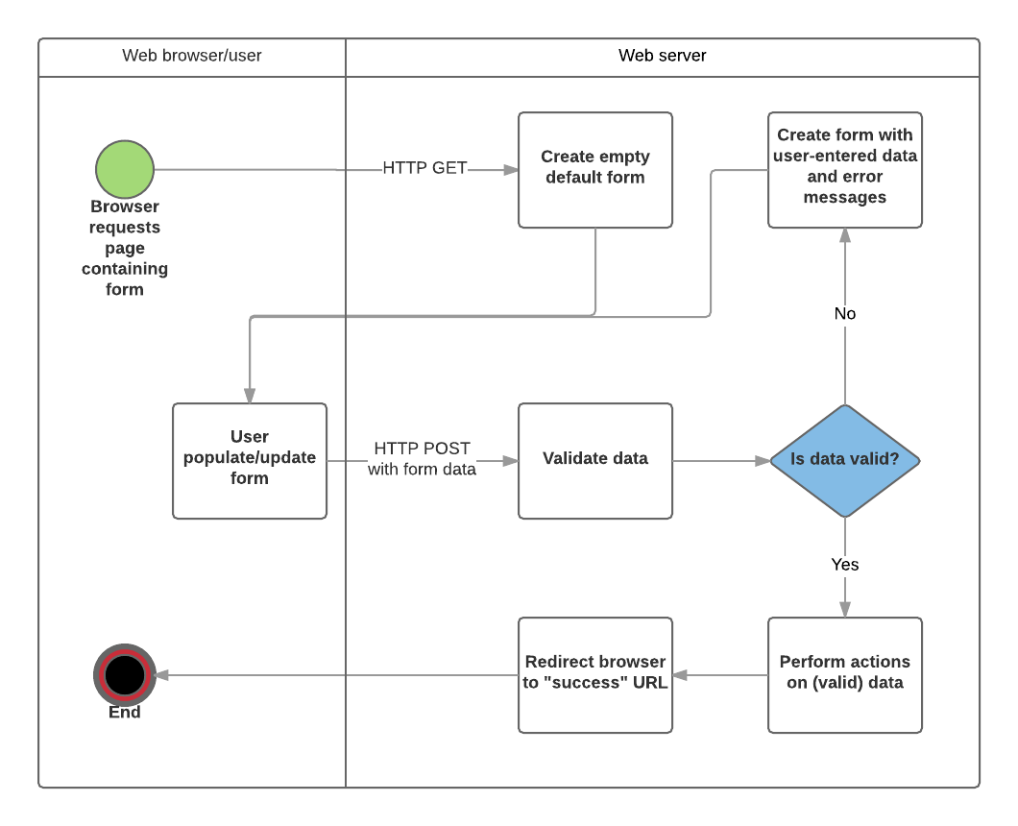
Express validator

Slide 54
formidable
A Node. js module for parsing form data, especially file uploads.

Slide 55
multer
Multer is a node.js middleware for handling multipart/form-data, which is primarily used for uploading files

