Slide 1
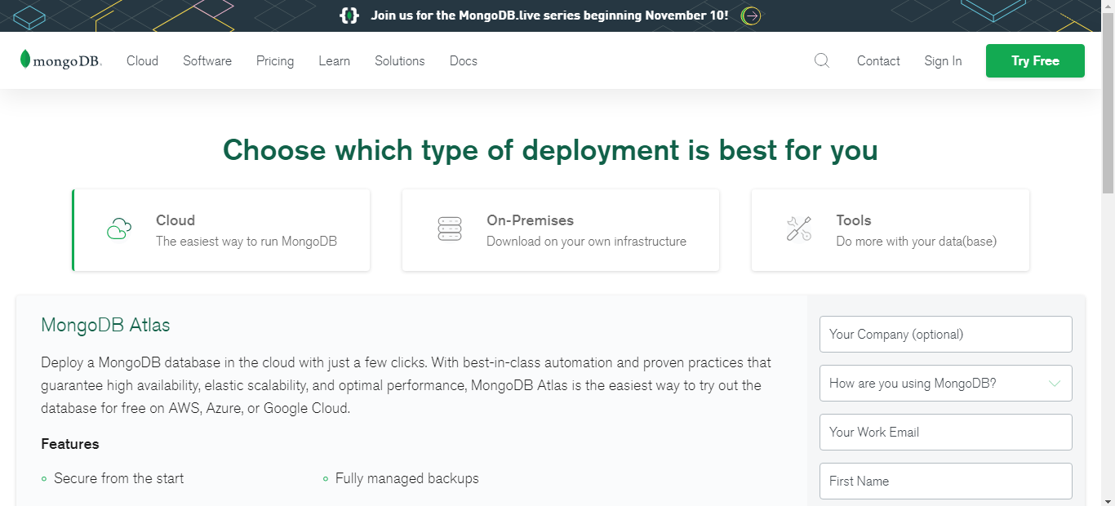
MongoDB Installation
Go to mongodb.com.
Click on “Try free”.
Choose “On-Premises”

Slide 2
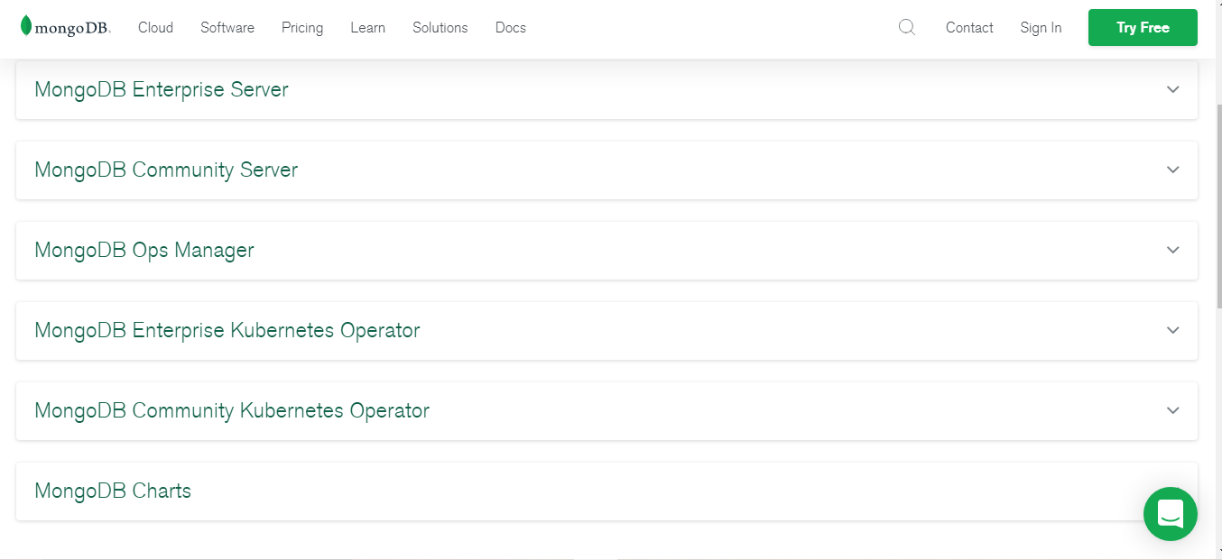
MongoDB Installation
Click on “MongoDB Community Server”

Slide 3
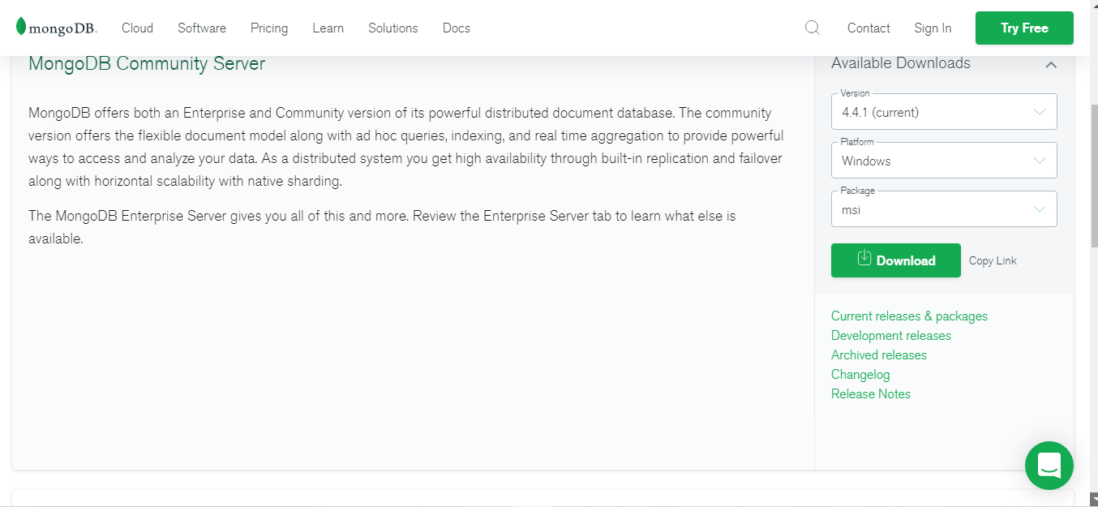
MongoDB Installation
Click on “Download”

Slide 4
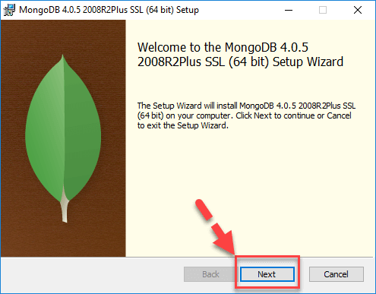
MongoDB Installation
Click on “Next”

Slide 5
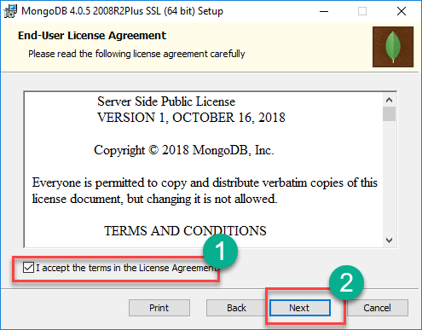
MongoDB Installation
Accept the license agreement and click on NEXT

Slide 6
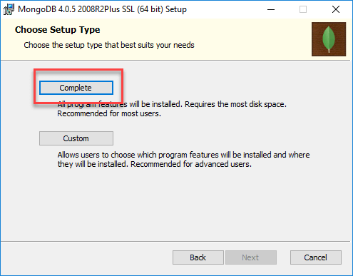
MongoDB Installation
Click on the "complete" button to install all of the components.

Slide 7
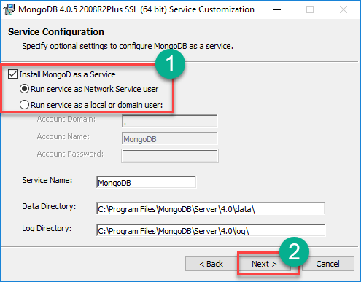
MongoDB Installation
Select “Run service as Network Service user”. make a note of the data directory, we’ll need this later.
Click Next

Slide 8
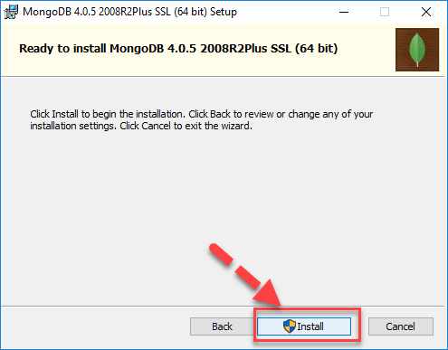
MongoDB Installation
Click on the Install button to start the installation.

Slide 9
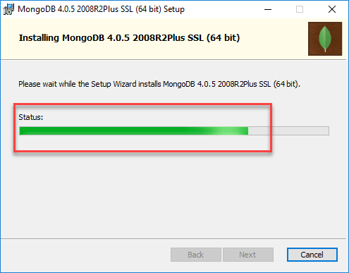
MongoDB Installation
Installation begins. Click Next once completed

Slide 10
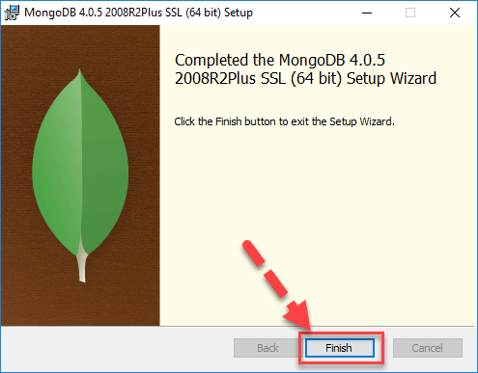
MongoDB Installation
Click on the Finish button to complete the installation

Slide 11
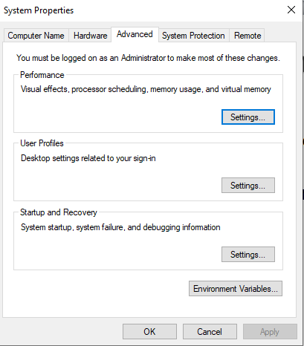
MongoDB Installation
Follow the path and copy it
C:\Program Files\MongoDB\Server\4.4\bin
Set environment variables
Right click on My Computer->Properties-> Advanced system settings-> Advanced-> Environment Variables

Slide 12
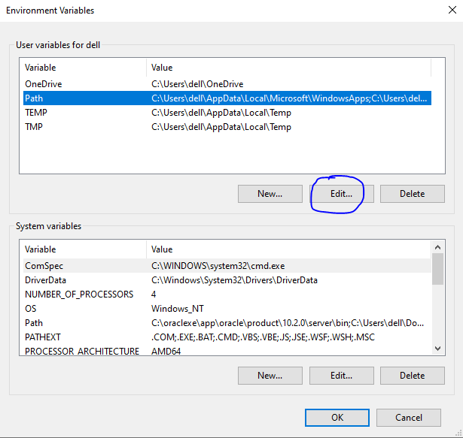
MongoDB Installation
Click on Path and then on New

Slide 13
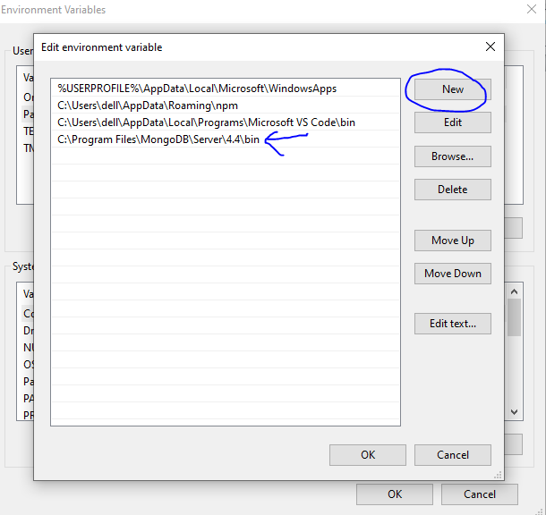
MongoDB Installation
Mention variable name and variable path as follows
Click ok

Slide 14
MongoDB Installation
Launch cmd and write mongo. You will get the version.
For node.js->
Launch node js command prompt and install the package:
npm install mongodb

Slide 15
MongoDB Introduction
Cross-platform document-oriented database program.
open-source document database
Classified as a NoSQL database program
Uses JSON-like documents with optional schemas
Provides, high performance, high availability, and easy scalability.
MongoDB works on concept of collection and document.

Slide 16
Database
Database is a physical container for collections.

Slide 17
Collection
Collection is a group of MongoDB documents.
It is the equivalent of an RDBMS table.
A collection exists within a single database.
Collections do not enforce a schema. Documents within a collection can have different fields.

Slide 18
Document
A document is a set of key-value pairs.
Documents have dynamic schema.
Dynamic schema means that documents in the same collection do not need to have the same set of fields or structure
Common fields in a collection's documents may hold different types of data.

Slide 19
Relationship of RDMS terminology with MongoDB
RDBMS | MongoDB
Database | Database
Table | Collection
Tuple/Row | Document
column | Field

Slide 20
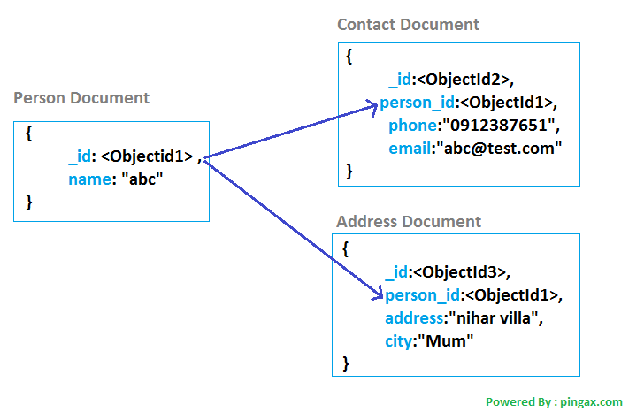
Document structure

Slide 21
Document structure
_id is a 12 bytes hexadecimal number which assures the uniqueness of every document.
_id can be provided while inserting the document.
If you don’t provide then MongoDB provides a unique id for every document.

Slide 22
Advantages
Schema – less
Variation in number of fields, content and size of the document from one to other.
Easy to scale
Easy to use

Slide 23
Data Model Design
MongoDB provides two types of data models:
- Embedded data model
- Normalized data model.

Slide 24
Embedded data model
In this model, you can have (embed) all the related data in a single document.
It is also known as de-normalized data model.

Slide 25
Normalized data model
In this model, you can refer the sub documents in the original document, using references.

Slide 26
Create Database
There is no create database command in MongoDB.
In MongoDB you don't need to create a database manually because MongoDB will create it automatically when you save the value into the defined collection at first time.
You also don't need to mention what you want to create, it will be automatically created at the time you save the value into the defined collection.

Slide 27
use command
Create database:
Syntax -> use DATABASE_NAME
Eg. -> use student
If the database already exists, it will return the existing database.
To check the currently selected database, use the command db:
db
To check the database list, use the command show dbs:
show dbs

Slide 28
Create collection
Syntax -> db.createCollection(name, options)
Eg. -> db.createCollection(“student_details")
To show collections -> show collections

Slide 29
Drop collection
Syntax -> db.COLLECTION_NAME.drop()
Steps to drop with example:
use student
show collections
db.student_details.drop()

Slide 30
Drop database
Syntax -> db.dropDatabase()
Steps:
show dbs
use student
db.dropDatabase()
show dbs

Slide 31
Insert()
Syntax -> db.COLLECTION_NAME.insert(document)
Eg. -> db.student_details.insert({"name" : "Michael"})
Eg ->
db.student_details.insert({
"_id":1,
"name" : "Michael",
"contact_details" : {
"mobile" : 98789999,
"address" : "Noida"
},
"course" : "Node js"
})

Slide 32
find()
To query data from MongoDB collection, you need to use MongoDB's find() method.
Syntax -> db.COLLECTION_NAME.find()
Eg. -> db.student_details.find()
To find particular document:
Eg -> db.student_details.find({"name":"Michael"})

Slide 33
pretty()
To display the results in a formatted way, you can use pretty() method.
Syntax -> db.COLLECTION_NAME.find().pretty()
Eg -> db.student_details.find().pretty()

Slide 34
Insert multiple docs
var allStudents = [
{
"_id":1,
"name" : "Michael",
"contact_details" : {
"mobile" : 98789999,
"address" : "Noida"
},
"course" : "Node js"
},
{
"_id": 2,
"name" : "James",
"contact_details" : {
"mobile" : 98789999,
"address" : "Delhi"
},
"course" : "HTML"
}];

Slide 35
Insert multiple docs
db.student_details.insert(allStudents)

Slide 36
insertOne()
Syntax -> db.COLLECTION_NAME.insertOne(document)
Eg ->
db.student_details.insertOne({
"_id":1,
"name" : "Michael",
"contact_details" : {
"mobile" : 98789999,
"address" : "Noida"
},
"course" : "Node js"
})

Slide 37
insertMany()
Syntax -> db.COLLECTION_NAME.insertMany(document)
Eg ->
db.student_details.insertMany([{
"_id" : 1,
"name" : "Michael",
"contact_details" : {
"mobile" : 98789999,
"address" : "Noida"
},
"course" : "Node js"
},
{
"_id" : 2,
"name" : "James",
"contact_details" : {
"mobile" : 98789999,
"address" : "Delhi"
},
"course" : "HTML"
}])

Slide 38
insertMany()
db.student_details.insertMany([{
"_id" : 1,
"name" : "Michael",
"contact_details" : {
"mobile" : 98789999,
"address" : "Noida"
},
"course" : "Node js",
"marks" : 78
},
{
"_id" : 2,
"name" : "James",
"contact_details" : {
"mobile" : 98789999,
"address" : "Delhi"
},
"course" : "HTML",
"marks" : 56
},
{
"_id" : 3,
"name" : "Manoj",
"contact_details" : {
"mobile" : 657577,
"address" : "Kolkata"
},
"course" : "HTML",
"marks" : 56
}])

Slide 39
insertMany()
db.student_details.insertMany([
{_id:1, name:'Manoj',course:'Node js', marks:78},
{_id:2, name:'Anuj', course: 'HTML', marks:45},
{_id:3, name:'Shalini', course: 'HTML', marks:90},
{_id:4, name:'Ankit', course:'Node js', marks:67},
{_id:5, name: 'Prakash', course: 'CSS', marks:97},
{_id:6, name: 'Rajneesh', course: 'CSS', marks:54},
{_id:7, name: 'Rashi', course: 'React js', marks:82},
{_id:8, name: 'Sameer', course: 'React js', marks:23},
{_id:9, name: 'Rahul', course: 'JavaScript', marks:55},
{_id:10, name: 'Richa', course: 'Vanilla js', marks:73}
])

Slide 40
update()
Syntax -> db.COLLECTION_NAME.update(SELECTION_CRITERIA, UPDATED_DATA)
Steps to update document:
db.student_details.find().pretty()
db.student_details.update({'_id':2},{$set:{'course':'android'}})
Adding new property:
db.student_details.update({'_id':2},{$set:{'marks':'89'}})

Slide 41
update()
db.student_details.update({'_id':2},{$set:{'contact_details.address':'Bangalore'}})

Slide 42
save()
Replaces the existing document with the new document passed in the save() method.
Syntax -> db.COLLECTION_NAME.save({_id:ObjectId(),NEW_DATA})
Steps to replace document:
db.student_details.find().pretty()
db.student_details.save({'_id':2, 'name':'Michael','Marks':76})

Slide 43
Update multiple docs
To update multiple documents, you need to set a parameter 'multi' to true.
Two ways:
db.student_details.update({'course':‘HTML'},{$set:{'course':'CSS'}},{multi:true})
db.student_details.updateMany({'course':'CSS'},{$set:{'course':'android'}})

Slide 44
remove()
Syntax -> db.collection_name.remove (DELETION_CRITERIA)
Remove all docs:
Eg. -> db.student_details.remove({})
Remove all docs that match a condition:
db.student_details.remove( {name : "Michael" } )
Remove a single document that match a condition
db.student_details.remove( { name : "Michael" }, 1 )

Slide 45
limit()
To limit the records in MongoDB
Syntax -> db.COLLECTION_NAME.find().limit(NUMBER)
Eg ->
db.student_details.find({},{"name":1,"_id":0}).limit(2)
The output of above command will be:
{ "name" : "Michael" }
{ "name" : "James" }

Slide 46
limit()
Eg -> db.student_details.find({},{"name":1}).limit(2)
The output of above command will be:
{ "_id" : 1, "name" : "Michael" }
{ "_id" : 2, "name" : "James" }

Slide 47
sort()
To sort documents in MongoDB
Syntax -> db.COLLECTION_NAME.find().sort({KEY:1})
Eg -> db.student_details.find({},{"name":1,_id:0}).sort({"name":-1})
db.student_details.find({},{"name":1,_id:0}).sort({"name":1})

Slide 48
Aggregation
Aggregation operations group values from multiple documents together, and can perform a variety of operations on the grouped data to return a single result.
Syntax -> db.COLLECTION_NAME.aggregate(AGGREGATE_OPERATION)
Eg to find out how many students are learning a particular course
->db.student_details.aggregate({$group : {_id : "$course", num_courses : {$sum : 1}}})

Slide 49
Aggregation
Find minimum marks from every course
db.student_details.aggregate({$group: {_id: "$course", min_marks: {$min: "$marks"}}})
Find average marks of the students
db.student_details.aggregate({$group : {_id : "", average_marks : {$avg : "$marks"}}})

Slide 50
Indexing
Use createIndex() method of MongoDB.
Syntax ->
db.COLLECTION_NAME.createIndex({KEY:1})
Key is the name of the field on which you want to create index
1 is for ascending order.
-1 is for descending order.
Eg-> db.student_details.createIndex({"name":1})

Slide 51
Skip()
To skip the number of documents.
Syntax ->
db.COLLECTION_NAME.find().limit(NUMBER).skip(NUMBER)
Eg ->Skipping two records and limiting upto 4
db.student_details.find({},{"name":1,_id:0}).limit(4).skip(2)

Slide 52
Comparison Operators
MongoDB provides different types of comparison operators.
$gte
$lte
$gt
$lt

Slide 53
Greater than Operator $gt
{field: {$gt: value}}
Eg. Find all students with marks greater than 80 -> db.student_details.find({marks: {$gt: 80}}).pretty()

Slide 54
Greater than equals to Operator $gte
{field: {$gte: value}}
Eg. Find all students with marks greater than or equal to 80 -> db.student_details.find({marks: {$gte: 80}}).pretty()

Slide 55
Less than Operator $lt
{field: {$lt: value}}
Eg. Find all students with marks less than 80 -> db.student_details.find({marks: {$lt: 80}}).pretty()

Slide 56
Less than equals to Operator $lte
{field: {$lte: value}}
Eg. Find all students with marks less than or equal to 80 -> db.student_details.find({marks: {$lte: 80}}).pretty()

Slide 57
Connectivity
MongoClient
npm install mongodb
an instance of mongodb
Mongoose
npm install mongoose

Slide 58
Object Modeling
MongoDB has a flexible schema that allows for variability between different documents in the same collection.
This flexibility can be very powerful, for example, as a database’s uses evolve over time.
But that flexibility doesn’t mean that you need to forgo some safety checks like type and range checking.

Slide 59
Mongoose
Mongoose is an object data modeling (ODM) library that provides a rigorous modeling environment for your data
Enforces structure as needed while still maintaining the flexibility that makes MongoDB powerful.

Slide 60
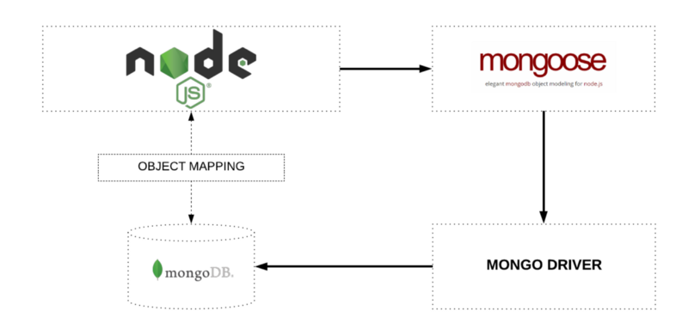
Mongoose

Slide 61
Mongoose
General Terminology:
Schemas - Everything in Mongoose starts with a Schema. Each Schema maps to a MongoDB collection and defines the shape of the documents within that collection. It has information about properties/field types of documents. Schemas can also store information about validation and default values, and whether a particular property is required. In other words, they’re blueprints for documents.

Slide 62
Mongoose
General Terminology:
Model - A model is a class with which we construct documents.
Document - A simple data record.
Collection - A set of documents.

Slide 63
Mongoose
Model a user by specifying its properties in a mongoose schema.
var userSchema = new mongoose.Schema({
name: {
first: String,
last: { type: String, trim: true}
},
age: { type: Number, min: 0 }
});

Slide 64
Mongoose
This is a simple Mongoose schema for a User object.
It has a name composed of a last and first as Strings, and an age that’s limited to be no less than zero.
The last name is trimmed of extraneous leading and trailing whitespace.
These validations are enforced when new objects are created and, if they fail, an error is raised and can be caught by your code.

