Slide 1
Titanic Mini Data Visualization Dashboard
By Shubham Jaiswal

Slide 2
Project Overview
This project explores the Titanic dataset using Python to uncover patterns related to passenger survival. It demonstrates data cleaning, feature engineering, and visualization techniques through a compact dashboard.

Slide 3
Objectives
- Analyze Titanic passenger data to find key survival patterns.
- Create new insightful features from raw data.
- Build visualizations to interpret relationships between variables.
- Summarize takeaways using data-driven insights.

Slide 4
Tools and Libraries
- Python
- Pandas, NumPy
- Matplotlib, Seaborn
- Jupyter Notebook

Slide 5
Data Preparation
Steps performed:
- Loaded CSV dataset.
- Handled missing values: Age (median), Fare (median), dropped Cabin.
- Created features: FamilySize, IsAlone, AgeGroup.
- Added label column SurvivedLabel (Yes/No).

Slide 6
Feature Engineering Highlights
- FamilySize = SibSp + Parch + 1
- IsAlone = 1 if FamilySize == 1 else 0
- AgeGroup = Child, Teen, YoungAdult, Adult, Senior
These new features improve interpretability and visual analysis.

Slide 7
Key Visualizations
1. Age Distribution: Most passengers were young adults.
2. Survival Rate by Sex: Females had much higher survival chances.
3. Survival by Passenger Class: Higher class passengers survived more.
4. Survival vs AgeGroup: Younger passengers tended to survive more.
5. Correlation Heatmap: Showed links between class, fare, and survival.

Slide 8
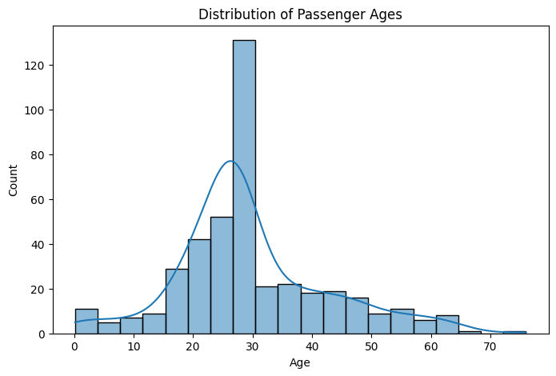
Key Visualizations
1. Age Distribution: Most passengers were young adults.

Slide 9
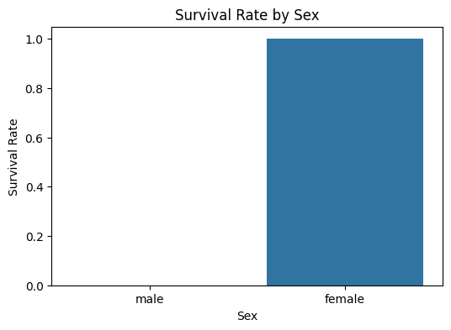
Key Visualizations
2. Survival Rate by Sex: Females had much higher survival chances.

Slide 10
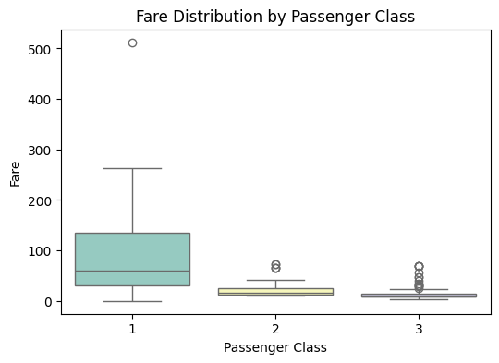
Key Visualizations
3. Survival by Passenger Class: Higher class passengers survived more.

Slide 11
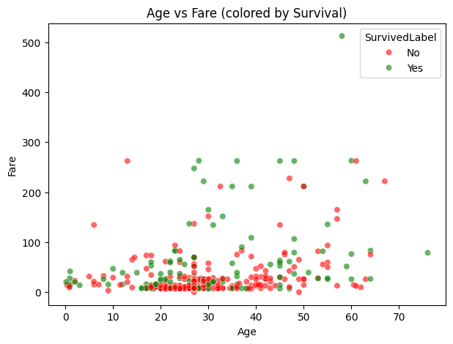
Key Visualizations
4. Survival vs AgeGroup: Younger passengers tended to survive more.

Slide 12
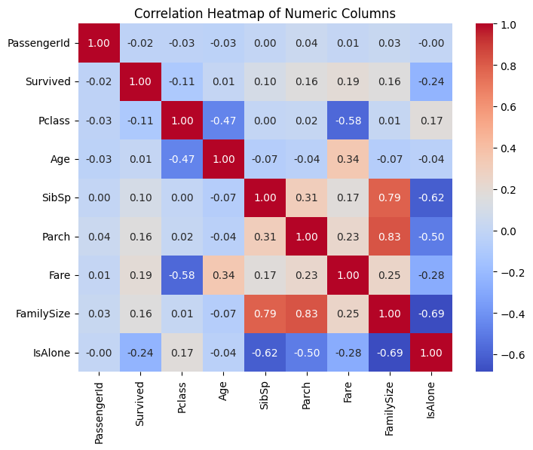
Key Visualizations
5. Correlation Heatmap: Showed links between class, fare, and survival.

Slide 13
Insights and Observations
- Female and higher-class passengers had significantly better survival rates.
- Travelling alone reduced survival probability.
- Fare and class were strong indicators of safety.
- Children and teens had better survival odds than adults.

Slide 14
Conclusion
The Titanic dataset offers valuable lessons in data cleaning, feature creation, and visualization. Through this mini dashboard, we can quickly identify patterns that influenced survival — illustrating how data storytelling helps uncover insights.

Slide 15
Future Improvements
- Add predictive modeling (e.g., Logistic Regression, Random Forest).
- Create interactive dashboards using Plotly or Dash.
- Integrate real-time data insights for better engagement.

