Slide 1
Complete Machine Learning Pipeline
Titanic Dataset Survival Prediction
By :- Shubham Jaiswal

Slide 2
Introduction
Objective: Build a complete ML pipeline for Titanic survival prediction.
Uses Logistic Regression classifier.
Demonstrates end-to-end ML workflow including preprocessing, model training, evaluation, and deployment.

Slide 3
Data Loading & Exploration
Dataset: tested.csv (Titanic passenger data)
Shape: 418 rows × 11 columns
Target: Survived
Key Insights:
- Missing values in Age, Fare, Cabin
- Mix of numerical and categorical features
- PassengerId removed as non-predictive

Slide 4
Data Preprocessing
Feature Types:
Numerical: Pclass, Age, SibSp, Parch, Fare
Categorical: Name, Sex, Ticket, Cabin, Embarked
Steps:
- Imputation (mean/constant)
- OneHotEncoding for categorical
- Train-test split (80/20)
- Final shape: 712 features

Slide 5
Pipeline Architecture
Built using scikit-learn Pipeline + ColumnTransformer
Components:
1. ColumnTransformer
2. Numerical Pipeline (Imputer + Scaler)
3. Categorical Pipeline (Imputer + OneHotEncoder)
4. Classifier: LogisticRegression
Benefits: modular, reproducible, efficient, deployable

Slide 6
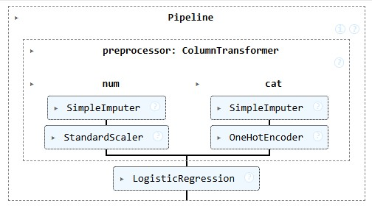

Slide 7
Model Training
Training pipeline with .fit()
Automatically applies preprocessing and trains classifier.
Training Data:
334 × 11 → 334 × 712 after encoding
Ensures no data leakage.

Slide 8
Model Evaluation
Results:
Accuracy: 1.0000
Precision, Recall, F1: 1.0000 for both classes
ROC-AUC: 1.0000
Cross-Validation: All folds scored 1.0
Confusion Matrix:
TN=53, FP=0, FN=0, TP=31

Slide 9
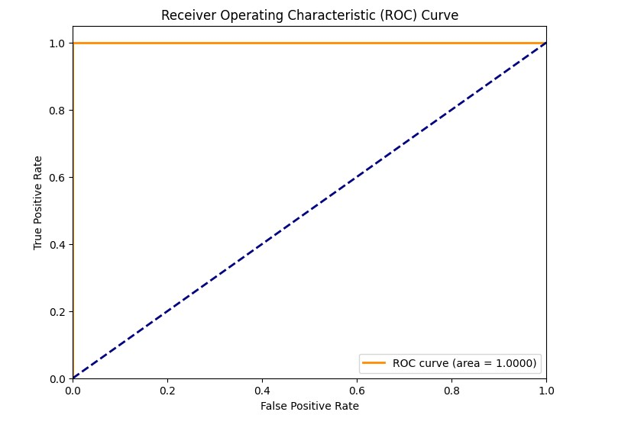

Slide 10
Model Persistence
Saved pipeline using joblib:
dump(model_pipeline, 'titanic_pipeline.joblib')
Advantages:
- Complete workflow stored
- Consistency in transformations
- Production-ready for new predictions

Slide 11
Results & Key Findings
Highlights:
- Perfect model performance (Accuracy 100%)
- Robust preprocessing and evaluation
- Caution: May indicate data leakage or easy dataset
Achievements:
- Automated preprocessing
- Pipeline integration
- Model persistence

Slide 12
Conclusion
Summary:
End-to-end ML pipeline from raw data to deployable model.
Future Enhancements:
- Feature engineering
- Model comparison
- Hyperparameter tuning
- Ensemble methods
Takeaway: Modular, reproducible, and production-ready ML workflow.

