Slide 1

Design and selection of Electric sysem in EV
Project By:-
Sagar Shinde,
Sairaj Deshmukh,
Shubham Suryawanshi,
Akash Waghmare.
Project Guide:-
Prof. S.S. Kadlag.

Slide 2
Contents:-
(HV) High voltage system
(LV) Low system
Traction power calculation
Motor selection
Motor controller selection
Battery and BMS selection and specification
Modifications

Slide 3
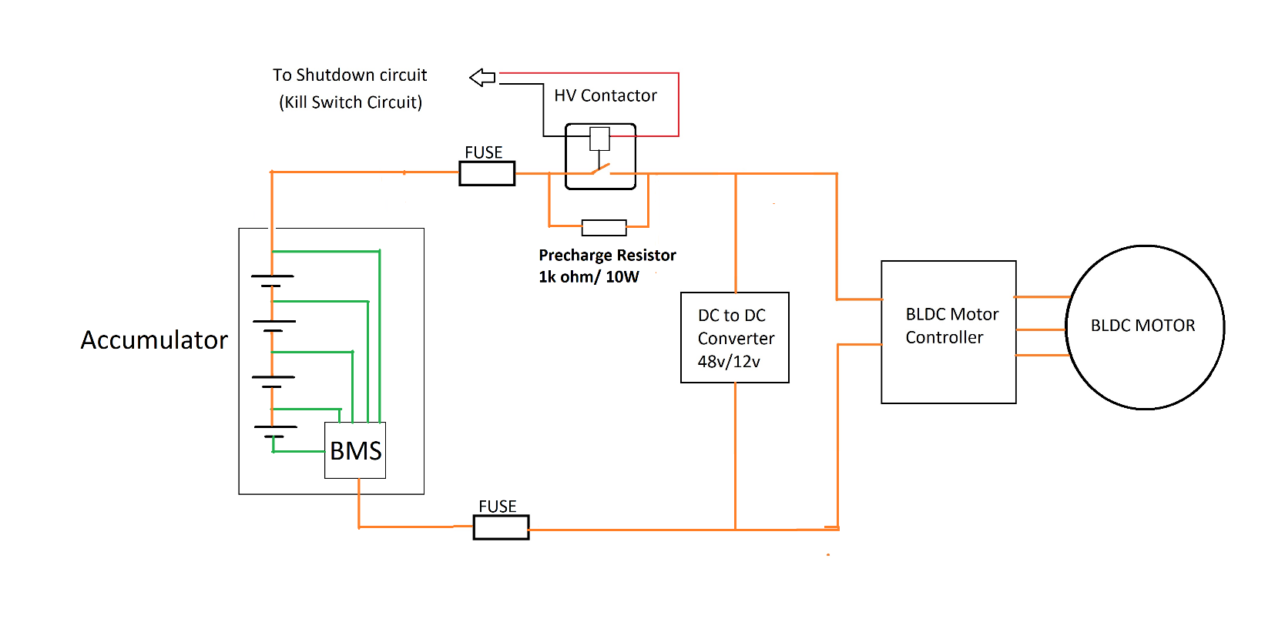
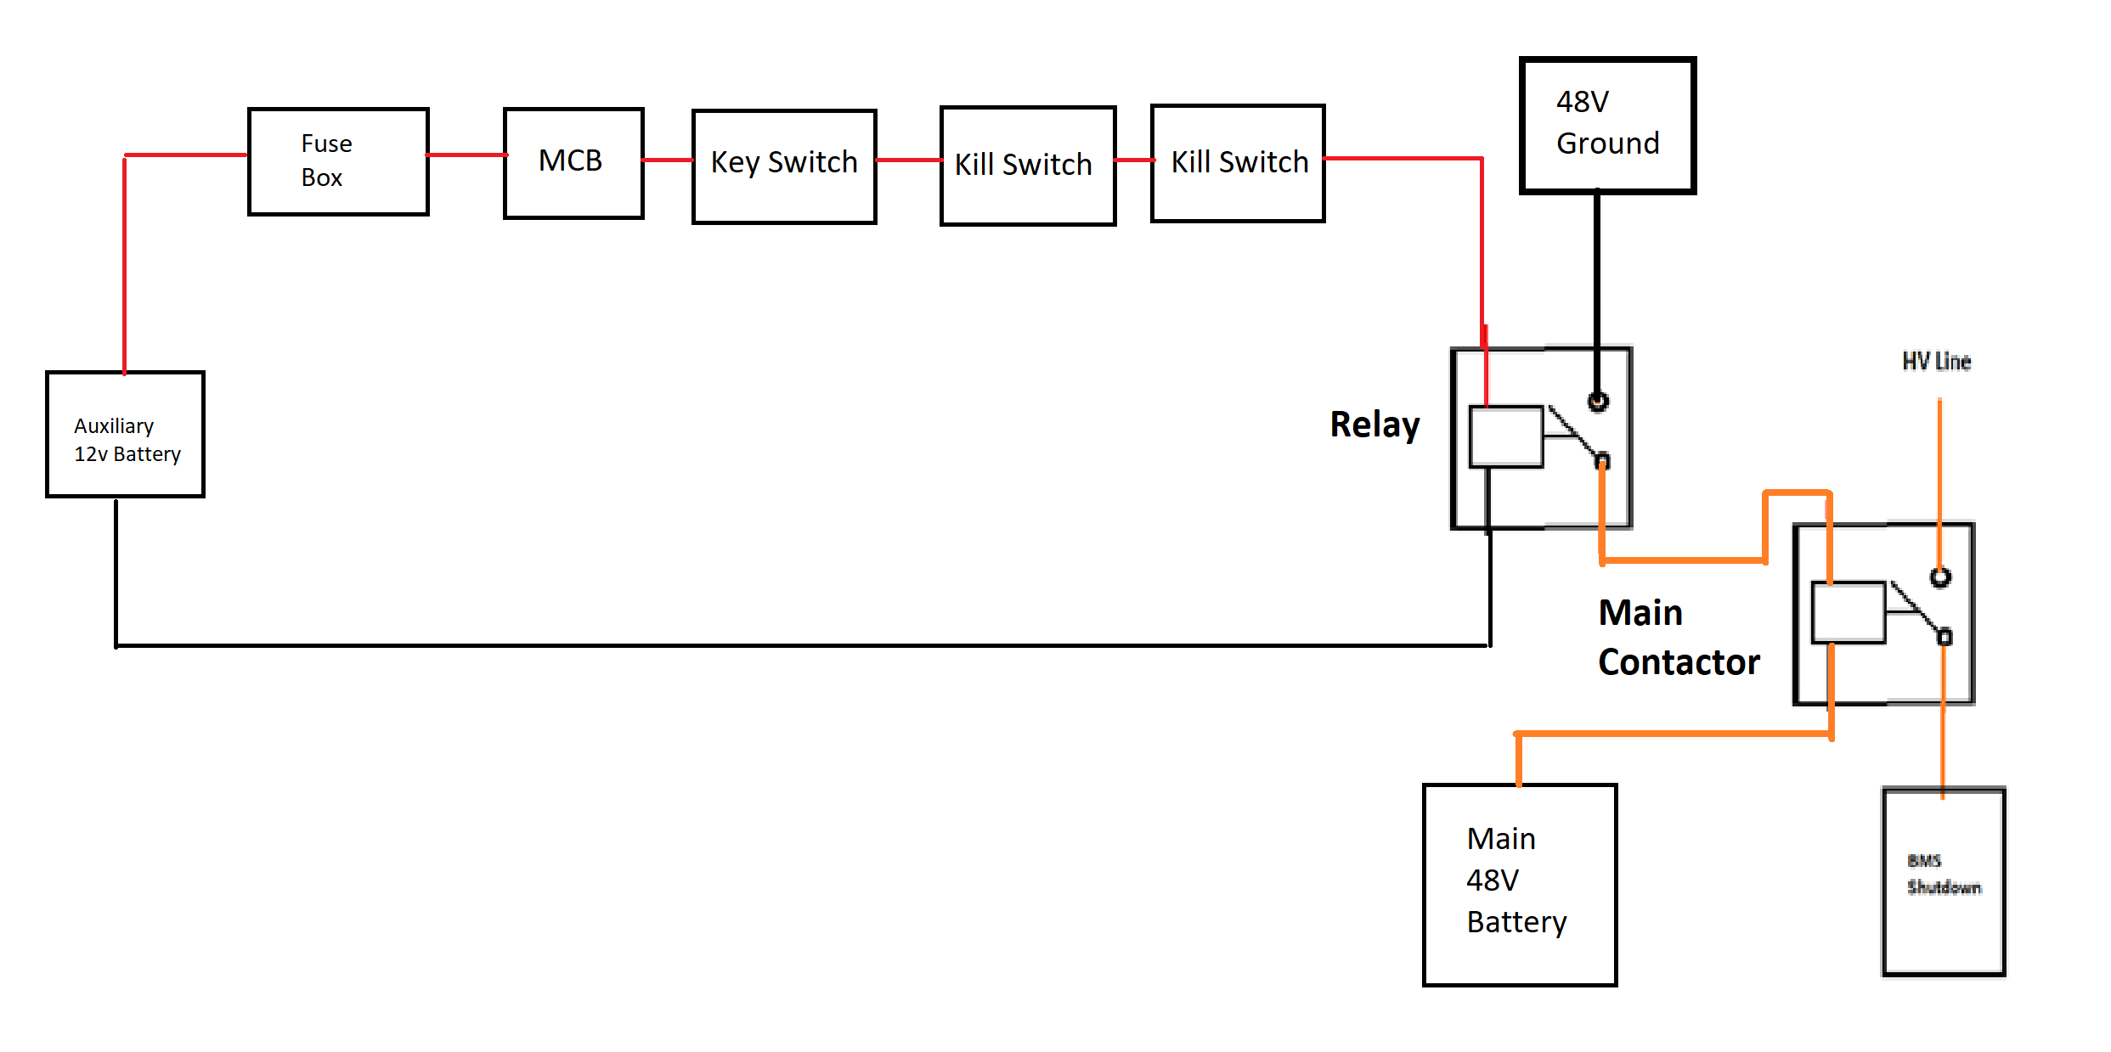
HV High Voltage system
(LV) Low Voltage System

Slide 4
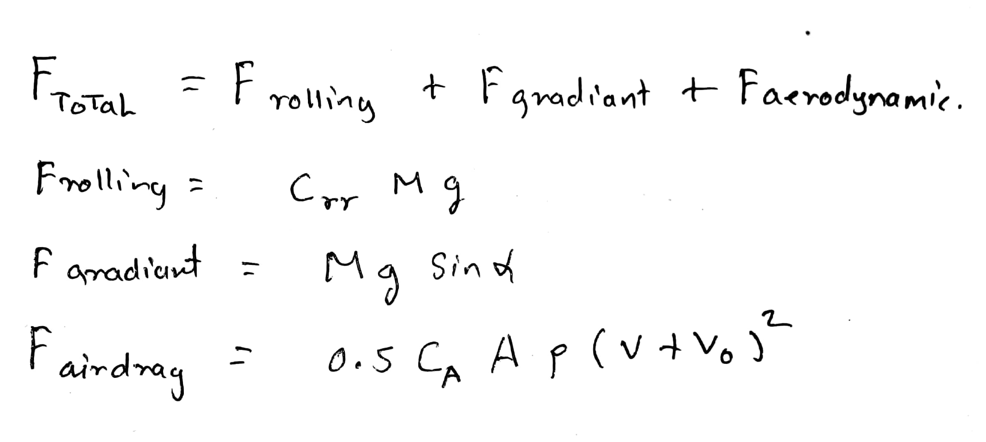
Traction Power Calculation
Required Motor Output power = Gear ration x F total X Radius of tyre

Slide 5
Motor selection
Type of motor (Bldc, Induction motor, etc)
Type of motor controller (Sinusoidal, Trapezoidal)
Max Output Torque and Speed
Driving cycle
Based on Battery capacity
Vehicle configuration (hybrid, pure electric, Wheel Hub drive)

Slide 6
Motor Controller Selection
Type of motor rotor position sensing
Type of motor (BLDC, Induction motor)
Maximum short circuit current
Current and Voltage rating
Type of communication (CAN bus, I2C)

Slide 7
Battery and BMS selection
Battery Selection
Required voltage and current rating
Type of cell chemistry (we used Li-ion cylindrical type 18650-3)
Charging time
Maximum watt hour
Battery cells = 700 cells
Battery Voltage = 14 * 3.7 = 51.8V
Battery Current = 50 * 2.2 = 110 A
BMS selection
Type of cell chemistry
Number of Cell modules in series (we have used 15s connector BMS for 14cell modules.
Max and Min current output.
Charging method (pulse, PWM)
BMS having protection such as max current, overcharging, reverse polarity protection

Slide 8
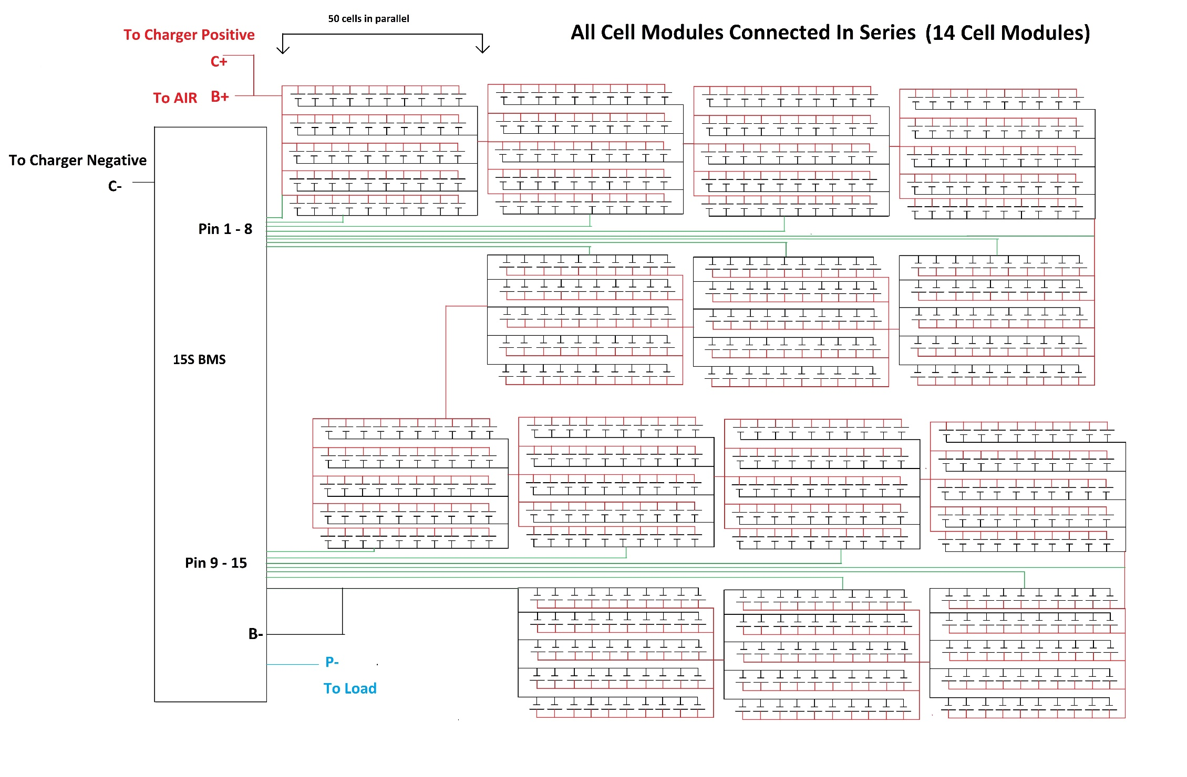
BMS Battery Management System

Slide 9
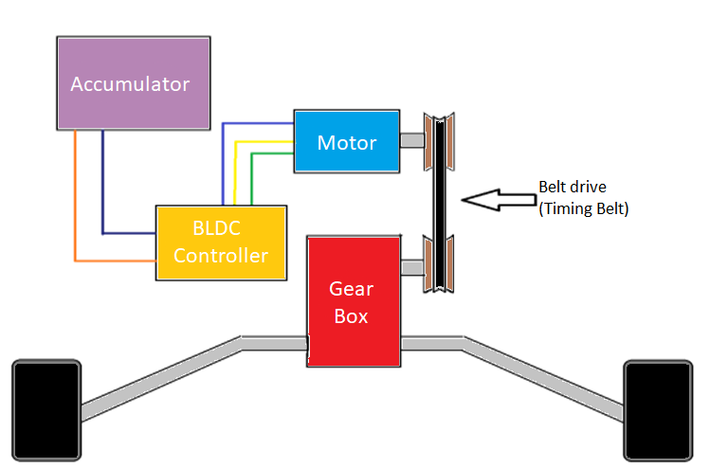
POWER TRAIN
8
BATTERY SPECIFICATIONS
Type | Lithium ion
Voltage (v) | 51.8
Current rating (Ah) | 110
CONTROLLER SPECIFICATIONS
Motor controller | Kelly KLS7245H
Rated Voltage | 24V-72V
Continuous Current | 140 A
Max. Current | 350 A
Operating frequency | 20 kHz
BLDC MOTOR SPECIFICATIONS
Transmission unit | Elec. Controller
Max. Power (kw) | 4.5
Max. rpm | 4500
Rated current (A) | 94

Slide 10
Modifications
Improvement in wire harnessing.
Algorithm for having more control over the system.
Real-time Data monitoring and Data acquisition capability.
Visual representation of fault in the system.

Slide 11
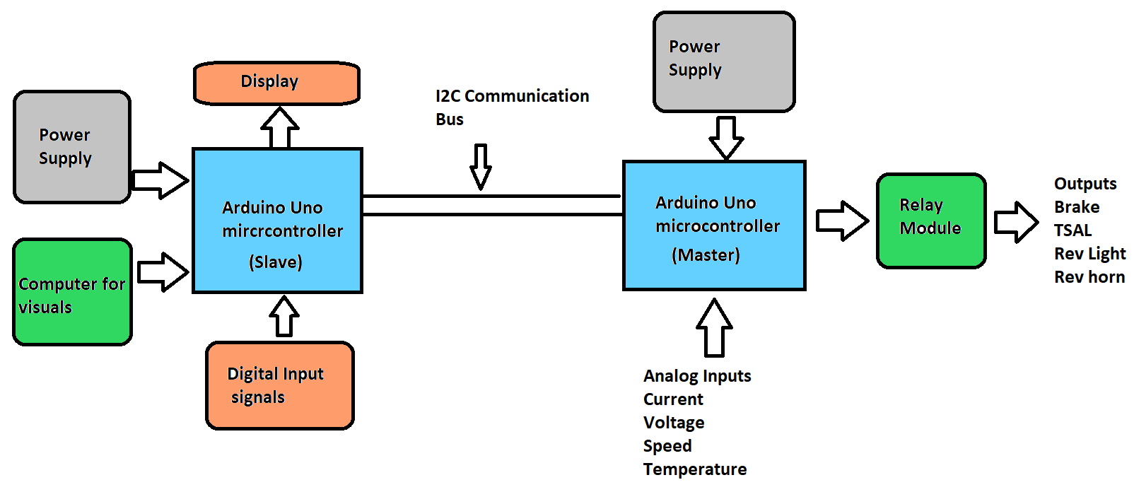
1. Improvement in ware harnessing

Slide 12
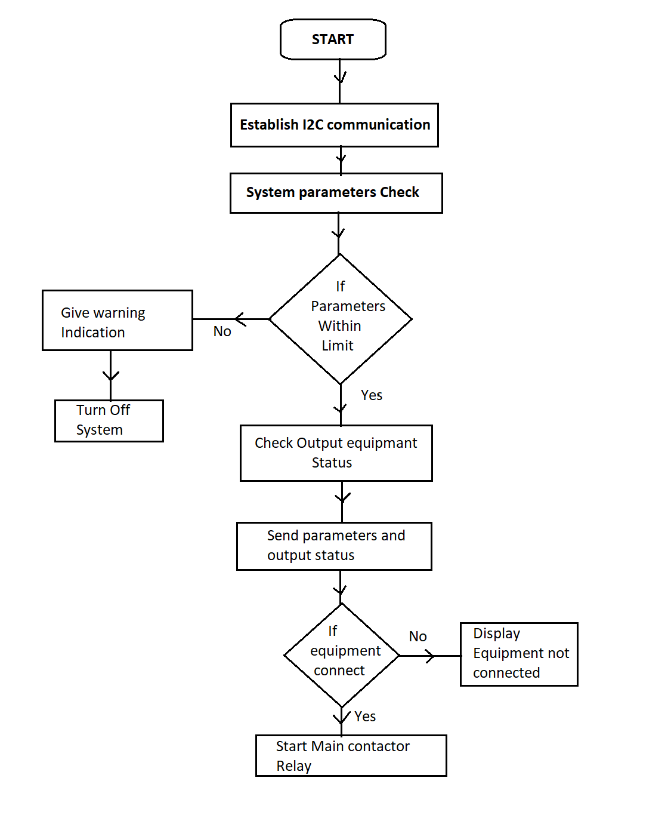
2. Algorithm for having more control over the system.
This will detect connected components
and check for parameters.
If parameters beyond the limit then
Shutdown and don’t allow system to start.
If every thing is fine then start the system.

Slide 13
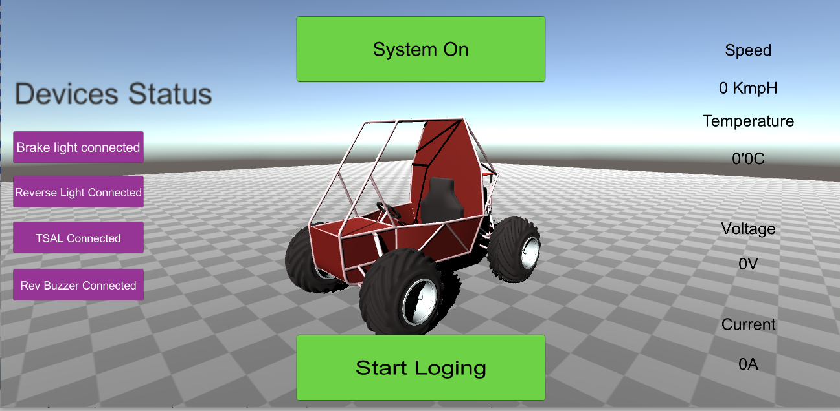
3. Real-time Data monitoring and Data acquisition capability.
4. Visual representation of fault in the system
Achieved by USB Serial communication between system and compute.
Computer has a software developed in Unity 3d.
Logged data can be used for

Slide 14
Conclusion:-
From this we can conclude that
Basic Design of electric vehicle system
Selection of suitable traction equipment
Required protections for BMS and controller
Improvement in Vehicle

