Slide 1
AttnGAN: Fine-Grained Text to Image Generation with Attentional Generative Adversarial Networks
A Review based on https://arxiv.org/abs/1711.10485

Slide 2

Introduction
AttnGAN is a neural network architecture for generating images from textual descriptions.
It uses attentional generative adversarial networks (GANs) to produce images that can match the given description.
The network can be trained on various datasets and produce high-resolution images.
AttnGAN has outperformed previous methods in terms of visual quality and diversity of images.
Photo by Pexels

Slide 3
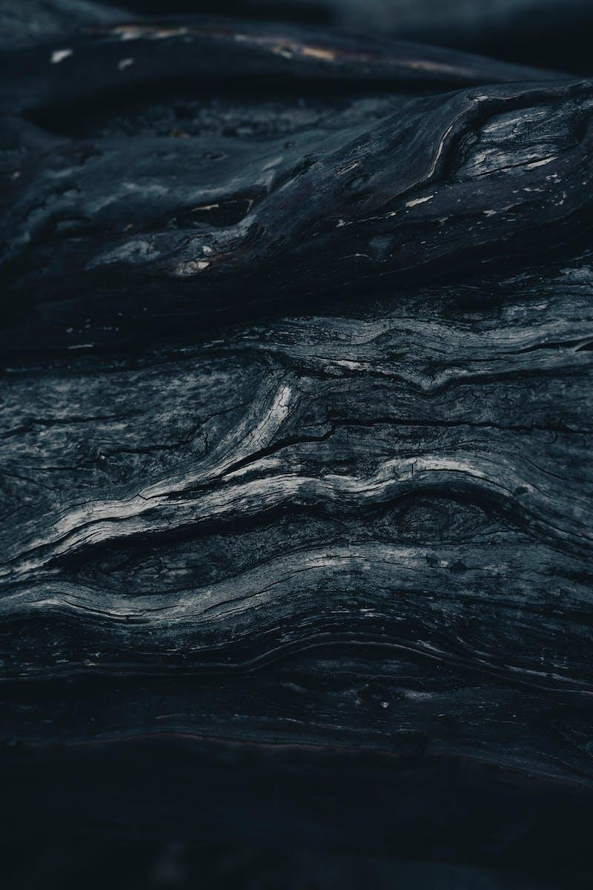
How AttnGAN Works
AttnGAN uses a hierarchical structure to generate images from text.
The image generation is based on a conditional GAN, which is trained to match the given textual description.
The attention mechanism allows the network to focus on specific regions of the image based on the input text.
The network generates images in stages, improving their quality gradually.
Photo by Pexels

Slide 4
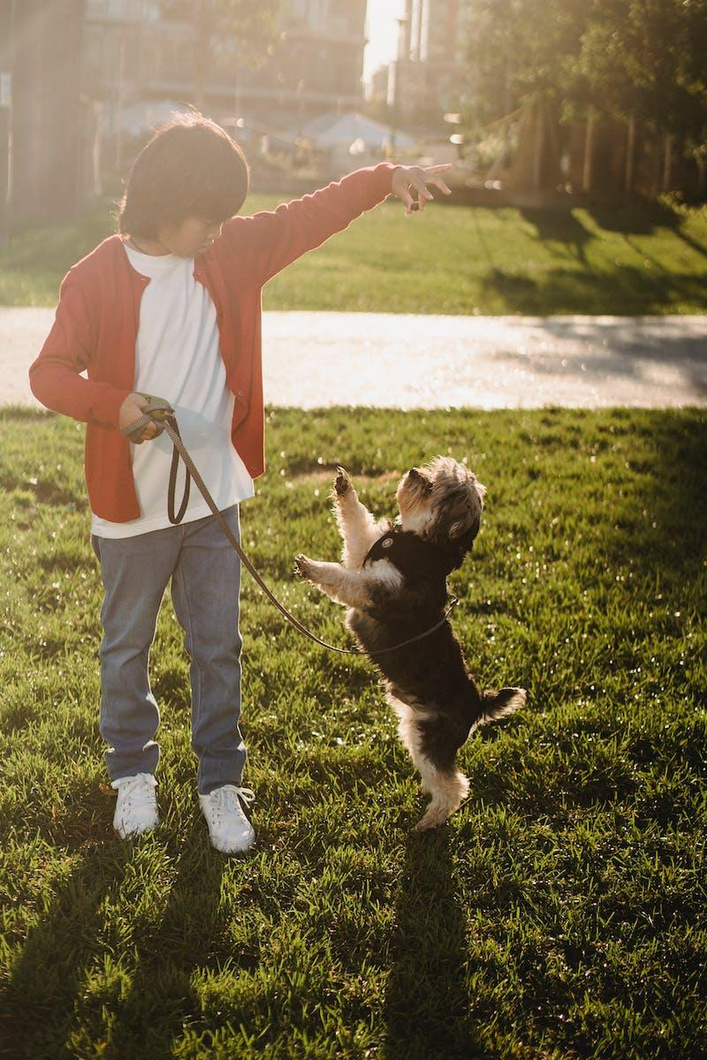
Training AttnGAN
The network is trained on a large dataset of images and corresponding text descriptions.
The training process involves optimizing the generator and discriminator networks to produce high-quality images.
The use of attention mechanism improves the training process by allowing the network to focus on specific image regions.
AttnGAN can be fine-tuned on specific domains to generate more accurate and specific images.
Photo by Pexels

Slide 5

Applications of AttnGAN
AttnGAN can be used for a variety of applications, such as image captioning, fine art generation, and interior design.
The network can also be used to assist in creative tasks, such as creating illustrations for children's books and storyboards for movies.
AttnGAN has been used in research for generating images of rare bird species and archaeological artifacts.
It can also be used for generating realistic images for virtual reality environments.
Photo by Pexels

Slide 6
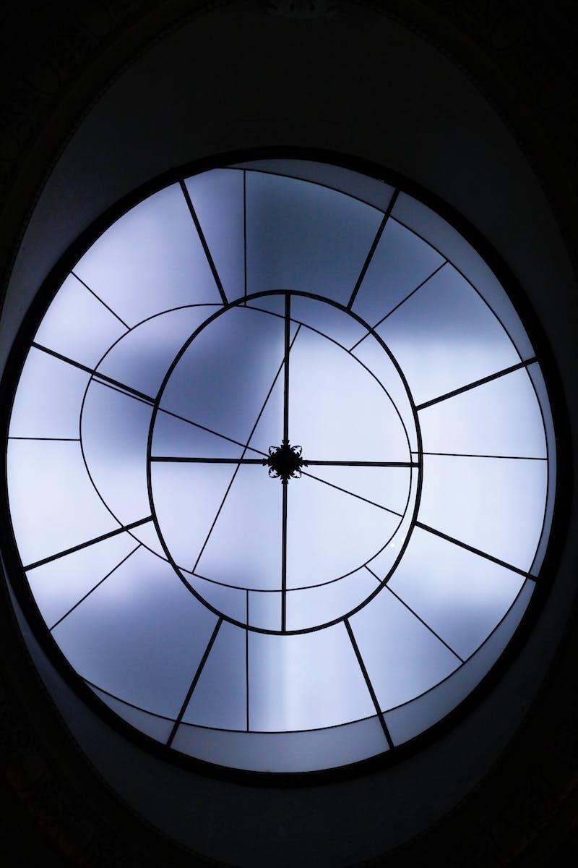
Challenges and Future Work
AttnGAN still faces challenges in generating highly specific images with complex backgrounds and multiple objects.
The network can also generate biased or stereotyped images based on the dataset it is trained on.
Future work includes improving the diversity of generated images and designing better evaluation metrics for GANs.
Exploring the use of reinforcement learning and meta-learning for image generation is another avenue for future research.
Photo by Pexels

Slide 7
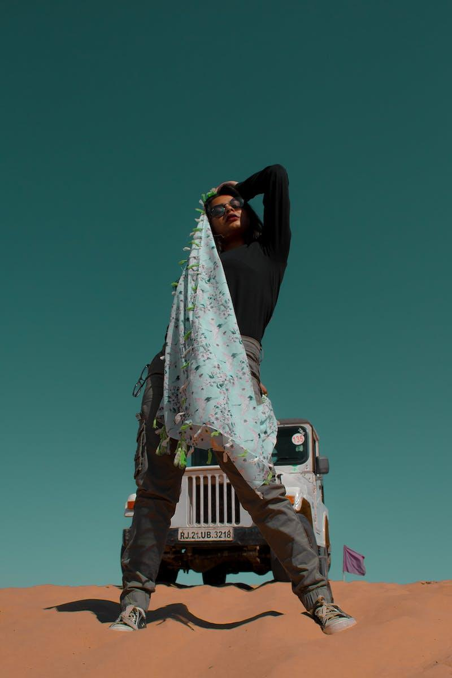
Conclusion
AttnGAN is an impressive architecture for generating images from textual descriptions.
The use of attention mechanism and conditional GANs allow the network to produce high-quality and diverse images.
The network has a vast range of applications and has the potential to revolutionize image generation in various fields.
Further research is needed to address the challenges faced by AttnGAN and improve its capabilities.
Photo by Pexels

