Slide 1
SQL Training
November, 2017
Deloitte AIM

Slide 2
Restricting and Sorting Data

Slide 3
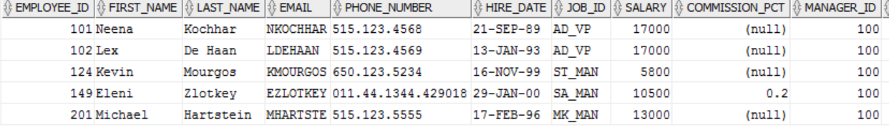
Limiting Rows Selected
SELECT [ DISTINCT ] { * | column [alias], … }
FROM table
[ WHERE condition (s) ] ;
select * from employees where MANAGER_ID=100;

Slide 4
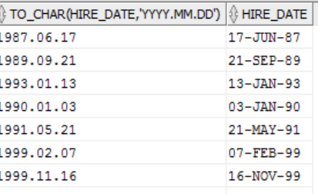
Restricting data
Where clause can compare
Values in columns
Literal values
Arithmetic expressions, or
Functions
SELECT TO_CHAR(HIRE_DATE,'YYYY.MM.DD') FROM EMPLOYEES;
Character Strings and Dates
Enclosed in single quotation marks
Character values are case sensitive
Date values are format sensitive
Default data format is – DD-MON-RR

Slide 5
Comparison Operators
Syntax
-- WHERE expr operator value
General Comparison Operators
Other comparison operators
=
>
>=
<
<=
<>
BETWEEN … AND … → Between two values (inclusive)
IN(list) → Matches any value in list of values
LIKE → Match a character pattern
IS NULL → Is a null value

Slide 6
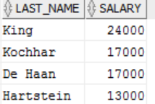
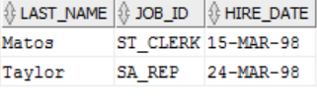
Examples
Display last name and department number
for employees earning more than $12000
SELECT LAST_NAME, SALARY FROM EMPLOYEES
WHERE SALARY > 12000;
Display last name, JOB_ID, and start date of employees hired between Feb 20, 1998 and May 1, 1998. Order the results in ascending order of Start Date
SELECT LAST_NAME, JOB_ID, HIRE_DATE FROM EMPLOYEES WHERE HIRE_DATE BETWEEN '20-FEB-98' AND '01-MAY-98' ORDER BY HIRE_DATE;

Slide 7
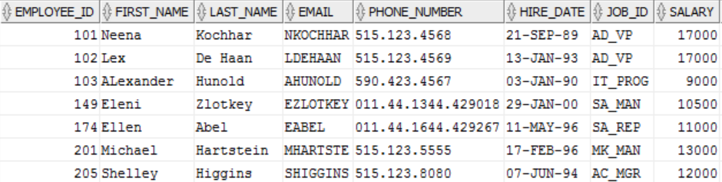
Examples contd…
select * from employees where SALARY BETWEEN 9000 AND 20000;
select * from employees where SALARY IN(9000,20000);

Slide 8
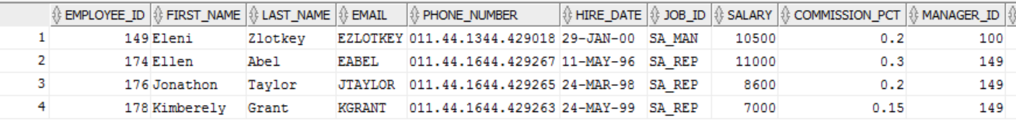
LIKE
Wildcards
% → any sequence of zero or more characters
_ (underscore) → any single character
ESCAPE Option to match wildcard characters
select * from employees where UPPER(FIRST_NAME) LIKE 'N_ENA%';
select * FROM EMPLOYEES where JOB_ID LIKE 'SA\_%' ESCAPE '\';
select * from employees where FIRST_NAME LIKE 'N_e%';

Slide 9
Logical Operators
Operators
Precedence
AND →True if both conditions True
OR → True if either condition True
NOT →
True if condition False
False if condition True
Null if condition Null
Arithmetic Operators
Concatenation Operators
Comparison conditions
IS [NOT] NULL, LIKE, [NOT] IN
[NOT] BETWEEN
NOT logical condition
AND logical condition
OR logical condition
Override precedence with parentheses.

Slide 10
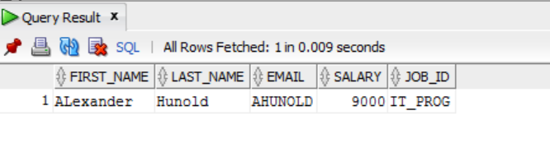
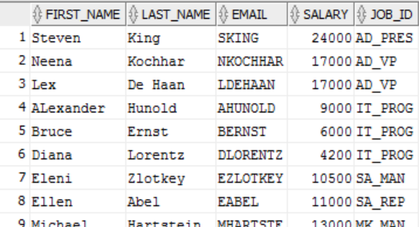
Examples:
select FIRST_NAME,LAST_NAME,EMAIL,SALARY,JOB_ID from employees where JOB_ID='IT_PROG' AND SALARY BETWEEN 9000 AND 24000;
select * from employees where JOB_ID='IT_PROG' OR (SALARY BETWEEN 9000 AND 24000);

Slide 11
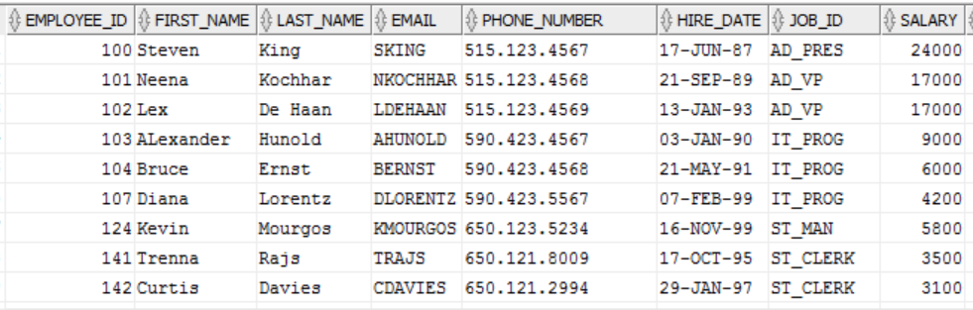
ORDER BY Clause
SELECT expression
FROM table
[WHERE condition(s)]
[ORDER BY {column, expr}|ASC|DESC||;
ASC → ascending order (default)
DESC → descending order
Order by must be last clause in Select statement
select * from employees ORDER BY EMPLOYEE_ID ASC;

Slide 12
Practice Exercise
Display last name and department number for employees earning more than $12000
Display last name and salary for all employees whose salary is not in the range of $5000 and $12000 and are in department 20 or 50
Display last name, JOB_ID, and start date of employees hired between Feb 20, 1998 and May 1, 1998. Order the results in ascending order of Start Date
Display the Last Name and Hire Date of every employee, who was hired in 1994
Display the last name and job title of all employees, who do not have a manager
Display the last name, salary and commission percentage for all employees who earn commissions. Sort data in descending order of salary and commissions
Display the last names of all employees where third letter of the name is an a
Display the last name of all employees who have an a and an e in their last name
Display last name, job and salary for all employees who job is sales representative or stock clerk and whose salary is not equal to $2500, $3500, or $7000
Display last name, salary and commission percentage for all employees whose commission percentage amount is 20%

Slide 13
Single Row Functions

Slide 14
Overview and Types
Single Row Functions operate on single rows only and return one result per row. They can manipulate data items, data types; accept argument(s) and return one value; can be nested
Character – LOWER, UPPER, INITCAP, CONCAT, SUBSTR, LENGTH, INSTR, LPAD, RPAD, TRIM, REPLACE
General – NVL, NVL2, NULLIF, COALESCE, CASE, DECODE, REGEXP_LIKE, REGEXP_REPLACE
Number – ROUND, TRUNC, MOD
Conversion – TO_CHAR, TO_NUMBER, TO_DATE
Date – MONTHS_BETWEEN, ADD_MONTHS, NEXT_DAY, LAST_DAY, ROUND, TRUNC

Slide 15
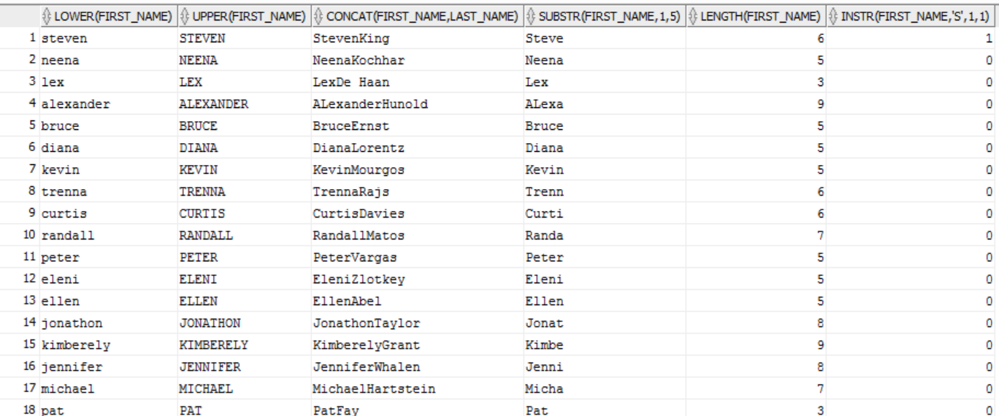
Character functions
INSTR: Searches a string for a substring using characters and returns the position in the string that is the first character of a specified occurrence of the substring. The functions vary in how they determine the position of the substring to return
UPPER: Converts the string to upper case
LOWER: Converts the string to lower case
SUBSTR: Returns the portion of character based on start and length
LENGTH: Returns the length of the string
SELECT LOWER(FIRST_NAME),UPPER(FIRST_NAME),CONCAT(FIRST_NAME,LAST_NAME),SUBSTR(FIRST_NAME,1,5),
LENGTH(FIRST_NAME),INSTR(FIRST_NAME,'S',1,1)
FROM EMPLOYEES;

Slide 16
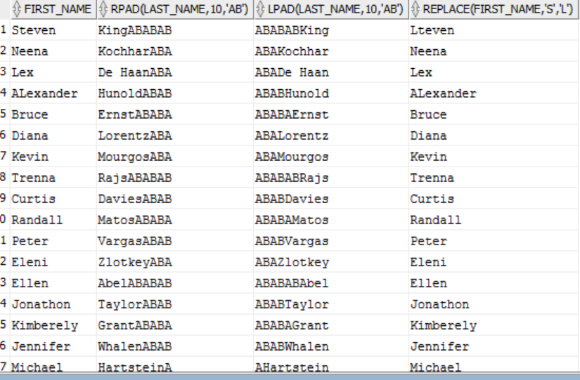
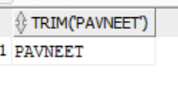
Other Character functions
RPAD/LPAD
TRIM/LTRIM/RTRIM
REPLACE
SELECT FIRST_NAME, RPAD(LAST_NAME,10,'AB'),LPAD(LAST_NAME,10,'AB'),replace(FIRST_NAME,'S','L') FROM EMPLOYEES;
SELECT TRIM(' PAVNEET ') FROM DUAL;

Slide 17
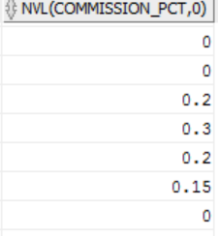
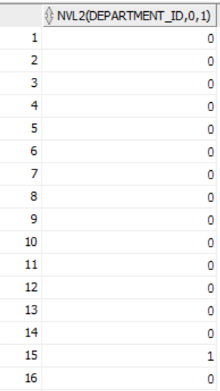
General Functions
NVL: Allows you to replace Null with an expression
NVL2: The NVL2 function accepts three parameters. If the first parameter value is not null it returns the value in the second parameter. If the first parameter value is null, it returns the third parameter.
NULLIF: Compares two arguments and returns null, if the arguments are equal, otherwise the function returns first argument
COALESCE: Returns first not null expression in the argument list
CASE: Chooses from a sequence of conditions, and evaluates a single expression
DECODE: The DECODE function is not specifically for handling null values, but it can be used in a similar way to the NVL function, as shown by the following example
Regular Expressions: Enables to implement complex match logic within database
select nvl(COMMISSION_PCT,0) FROM EMPLOYEES;
select NVL2(DEPARTMENT_ID,0,1) FROM EMPLOYEES;

Slide 18
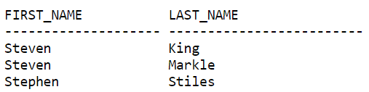
REGEXP_LIKE,REGEXP_REPLACE
REGEXP_LIKE is similar to the LIKE condition, except REGEXP_LIKE performs regular expression matching instead of the simple pattern matching performed by LIKE. This condition evaluates strings using characters as defined by the input character set
REGEXP_REPLACE extends the functionality of the REPLACE function by letting you search a string for a regular expression pattern
SELECT first_name, last_name
FROM emp
WHERE REGEXP_LIKE (first_name, '^Ste(v|ph)en$');
The following example examines country name. Oracle puts a space after each non-null character in the string.
SELECT REGEXP_REPLACE(country_name, '(.)', '\1 ') "REGEXP_REPLACE"
FROM countries;

Slide 19

DECODE and CASE
Select sum(salary),decode(TO_CHAR(HIRE_DATE,'YYYY'),'1999',1,0) as YEA FROM EMPLOYEES
group by (decode(TO_CHAR(HIRE_DATE,'YYYY'),'1999',1,0));
select distinct JOB_ID,
CASE JOB_ID
when 'AD_PRES'
THEN 'A'
WHEN 'IT_PROG'
THEN 'C'
WHEN 'AD_VP'
THEN 'B'
ELSE NULL
END AS GRADE
from employees;
JOB GRADE
AD_PRES A
AD_VP 0
ST_MAN B
IT_PROG C
SA_REP D
ST_CLERK E
…
…

Slide 20
Number Functions
ROUND: Returns n rounded to m places to the right of the decimal point
TRUNC: Returns n truncated to m decimal places, where m and n are numeric arguments
MOD: Returns the remainder of m divided by n. Returns m if n is 0
SLECT ROUND (54.339, 2) FROM DUAL;
Returns the following result.
ROUND(54.339 ------------ 54.34
SELECT TRUNC(15.79,1) "Truncate" FROM DUAL;
Returns the following result.
Truncate --------- 15.7
SELECT MOD (26,11) "ABLOMOV" FROM DUAL;
Returns the following result.
ABLOMOV --------- 4

Slide 21
Conversion Functions
TO_CHAR (number | date [ , ‘fmt’] ) Converts a number or a date value to a VARCHAR2 character string with format model fmt
TO_NUMBER (char [ , ‘fmt’ ] ) Converts a character string containing digits to a number with the optional format model fmt
TO_DATE (char [ , ‘fmt’ ] ) Converts a character string representing a date to a date value according to the fmt specified (If fmt is omitted, format is DD-MON-RR )
SELECT LAST_NAME, HIRE_DATE
FROM empLOYEES
WHERE hire_date = TO_DATE ( 'JUNE 17, 1987', 'Month dd, YYYY');
SELECT LAST_NAME, HIRE_DATE FROM EMPLOYEES WHERE TO_NUMBER(TO_CHAR(HIRE_DATE,'DD')) < 16;

Slide 22
Date Formats
Element | Description
SCC or CC | Century; server prefixes B.C. date with -
Years in dates YYYY or SYYY | Year; server prefixes B.C. date with -
YYY or YY or Y | Last three, two or one digits of the year
SYEAR or YEAR | Year spelled out; server prefixes B.C. date with -
BC or AD | B.C./A.D. indicator
Q | Quarter of year
MM | Month: two-digit value
WW or W | Week of year or Month
J | Julian day
DY | Name of day; three-letter abbreviation

Slide 23
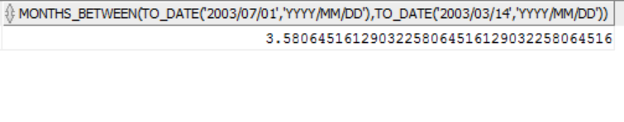
Date Functions
MONTHS_BETWEEN
ADD_MONTHS
NEXT_DAY
LAST_DAY
ROUND
MONTHS_BETWEEN
The Oracle/PLSQL MONTHS_BETWEEN function returns the number of months between date1 and date2.
SELECT MONTHS_BETWEEN (TO_DATE ('2003/07/01', 'yyyy/mm/dd'), TO_DATE ('2003/03/14', 'yyyy/mm/dd') ) FROM DUAL;

Slide 24
ADD_MONTHS, LAST_DAY, NEXT_DATE
ADD_MONTHS: Adds the specified number of months to a date
LAST_DAY: Returns the date of the last day of the month for a given date
NEXT_DATE: Returns the date of the first day after the specified date which falls on the specified day of the week.
ADD_MONTHS ('12-JAN-1995', 3) ==> 12-APR-1995
LAST_DAY ('12-JAN-99') ==> 31-JAN-1999
NEXT_DAY ('01-JAN-1997', 'MONDAY') ==> 06-JAN-1997

Slide 25
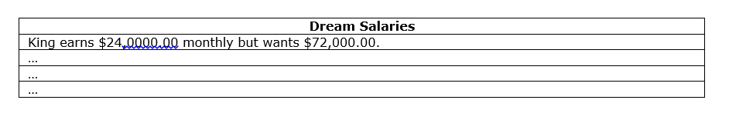
Practice Exercise
For each employee, display employee Id, last name, Salary, and the salary increased by 15% and expressed as a whole number. Label the column as New Salary. Add one more column that subtracts the old salary from New Salary and label the column as increase
Write a query that displays the employees’ last names with first letter capitalized and all other letters lowercase and the length of the names, for all employees whose name start with J, A or M. Sort the results by employees’ last names
Name Length
Abel 4
Matos 5
Mourgos 7
For each employee, display the last name and calculate the number of months worked between today and the date the employee was hired. Label the column MONTHS_WORKED. Order your results by the number of months worked. Round the number of months up to the closest whole number
Write a query that produces the following for each employee
employee <last name> earns <salary> monthly but wants <3 times salary>. Label the column, “Dream Salaries”

Slide 26
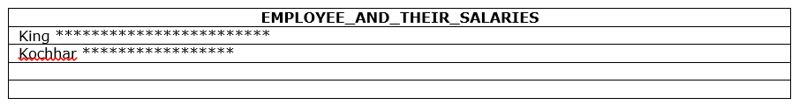
Practice Exercise contd …
Display each employee’s last name, hire date, and salary review date, which is the first Monday after six months of service. Label the column, REVIEW. Format the dates to appear similar to “Monday, the Thirty-First of July, 2000”
Display last name, hire date, and day of week on which employee started. Label the column “DAY”. Order the results by the day of the week starting with Monday
Create a query that displays the employees’ last names and commission percentages. If an employee does not earn commission, put “No Commission.” Label the column COMM
Create a query that displays the employees’ last names and indicates the amounts of their annual salaries with asterisks. Each asterisk signifies a thousand dollars. Sort the data in descending order of salary. Label the column EMPLOYEES_AND_THEIR_SALARIES

Slide 27
Practice Exercise contd …
Using the decode function, write a query that displays the grade of all employees based on the value of the column, JOB_ID, as per below
JOB GRADE
AD_PRES A
ST_MAN B
IT_PROG C
SA_REP D
ST_CLERK E
None of the above 0
Rewrite the preceding SQL with case statement

Slide 28
Joining Multiple Tables

Slide 29
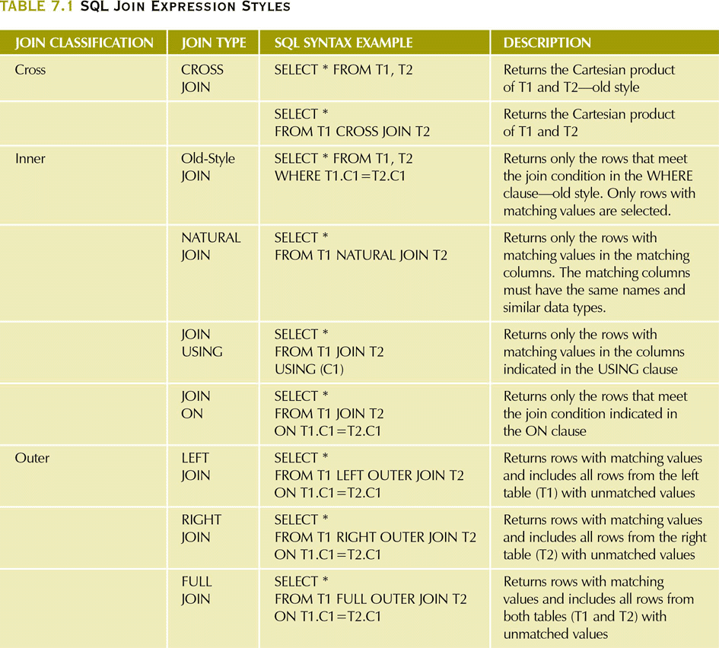
SQL Join Expression Styles

Slide 30
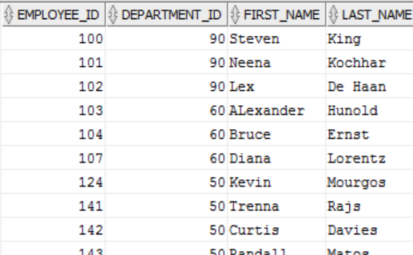
Inner Join
SELECT A.EMPLOYEE_ID,A.DEPARTMENT_ID,FIRST_NAME,LAST_NAME from
EMPLOYEES A
INNER JOIN
DEPARTMENTS B
ON A.DEPARTMENT_ID = B.DEPARTMENT_ID;

Slide 31
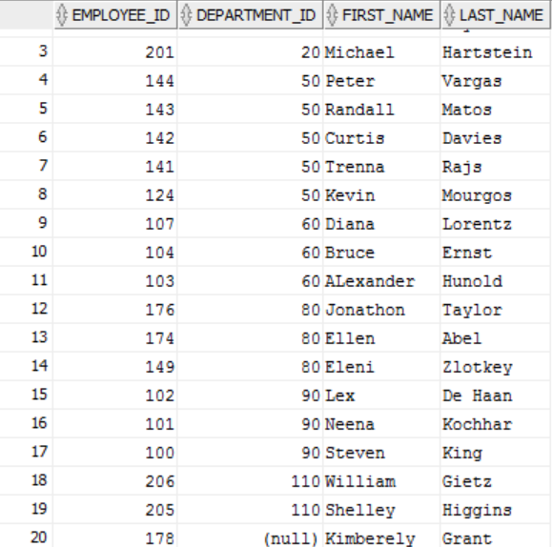
Outer Join
SELECT A.EMPLOYEE_ID,B.DEPARTMENT_ID,FIRST_NAME,LAST_NAME from EMPLOYEES A
LEFT OUTER JOIN
DEPARTMENTS B
ON A.DEPARTMENT_ID = B.DEPARTMENT_ID;

Slide 32
Additional JOIN clauses
JOIN USING – return only the rows with matching vales in the column indicated in the USING clause
This column must exist in both tables
SELECT column-list FROM table1 JOIN table2 USING (common-column)
JOIN ON – when the tables have no common attribute name but the columns have the same attribute type
SELECT column-list FROM table1 JOIN table2 ON join-condition

Slide 33
Practice Exercise
Write a query to display last name, department number, and department name for all employees
Create a unique listing of all jobs that are in department 80. Include Location of department 80 in the output
Write a query to display the employee last name, department name, Location Id, and City of all employees who earn a commission
Write a query to display the last name, job, department number, and department name for all employees, who work in Toronto
Display employee last name, employee number along with their manager’s last name and manager number
Display employee last names, department numbers and all employees who work in the same department as a given employee (Colleague)
Query to display name, job, department name, salary and salary grade for all employees
Query to display name and hire date of any employee, hired after employee Davies
Display names and hire dates for all employees, who were hired before their managers, along with the manager’s name and hire dates

Slide 34
Aggregation

Slide 35
Group Functions
Group functions operate on sets of rows to give one result per group. These sets may be the whole table or the table split into groups. All group functions ignore null values. You can optionally include DISTINCT to make the function consider non-duplicate values. You can group by multiple columns as well.
AVG – Evaluates average of an expression over a set of rows
COUNT – Returns the Count of an expression
MAX – Evaluates maximum of an expression over a set of rows
MIN – Evaluates minimum of an expression over a set of rows
STDDEV – Returns Standard Deviation of expression. It is the square root of the variance
SUM – Sum of an expression over a set of rows
VARIANCE – Square of STDDEV

Slide 36



AVG, SUM, MIN, MAX, COUNT
You can use AVG and SUM for numeric data
You can use MIN, MAX, COUNT for any datatype
SELECT AVG(salary), SUM(salary)
FROM employees;
SELECT min(salary), max(salary)
FROM employees;
SELECT COUNT(*)
FROM employees;

Slide 37
Group By Clause
SELECT column, group_function (column)
FROM table
[WHERE condition]
[GROUP BY group_by_expression]
[ HAVING group_condition ]
[ORDER BY column] ;
Order of evaluation of the clauses:
WHERE Clause
Group By Clause
Having Clause

Slide 38
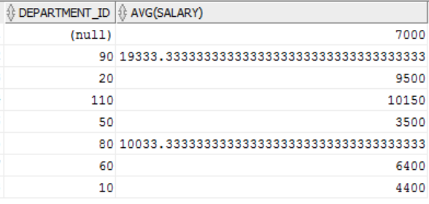
Grouping Data
SELECT DEPARTMENT_ID, AVG(salary)FROM EMPLOYEES GROUP BY DEPARTMENT_ID;

Slide 39
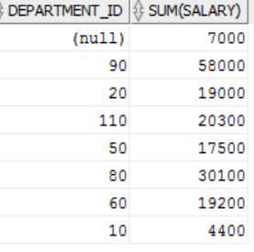
Restricting Groups using HAVING Clause
SELECT DEPARTMENT_ID, sum(salary)FROM EMPLOYEES
GROUP BY DEPARTMENT_ID
having sum(salary)>3500;

Slide 40
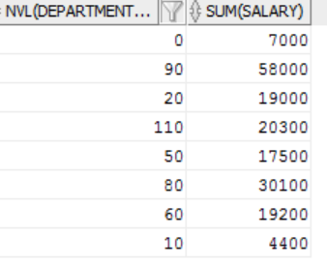
Using the NVL Function with Group Functions
The NVL function forces group functions to include null values
SELECT NVL(DEPARTMENT_ID,0),sum(salary) FROM employees
GROUP BY DEPARTMENT_ID
having sum(salary)>3500;

Slide 41
Practice Exercise
Display highest, lowest, sum and average salary for all employees
Display minimum, maximum, sum and average salary for each job type
Write a query to display the number of people with the same job
Determine the number of managers without listing them. Label the column “Number of Managers”
Write a query to display difference between highest and lowest salaries
Display Manager Number and the salary of the lowest paid employee for that manager. Exclude anyone whose manager is not known. Exclude any groups, where the minimum salary is less than $6,000. Sort the output in descending order of salary
Query to display each department’s name, location, number of employees and average salary for all employees in that department. Round the salary to two decimal places
Create a query that will display the total number of employees and of that total, the number of employees hired in 1995, 1996, 1997, 1998
Display Job, Total salary for that job and total salary for that job against department 20, 50, 90

Slide 42
Analytical Functions

Slide 43
Analytical Functions
Difference between Aggregate and Analytical Function is although analytical function give aggregated result, they do not group by the result set. Analytical functions are computed after all JOINS, WHERE clause, GROUP BY and HAVING clause. They can appear only in the select list and in the main ORDER BY clause of the query.
ROW_NUMBER – Assigns a unique number to each row to which it is applied
RANK – Calculates the rank of a hypothetical row identified by the arguments of the function w.r.t to a given sort specification
DENSE_RANK – Similar to rank, but does not skip ranks in case of tie
FIRST and LAST – Used to return first or last value from an ordered sequence
LAG and LEAD – Read from Previous or next row
LISTAGG – Used for string aggregation

Slide 44
ROW_NUMBER
ROW_NUMBER assigns a unique number to each row to which it is applied (either each row in the partition or each row returned by the query), in the ordered sequence of rows specified in the order by clause, beginning with 1
SELECT department_id, first_name, last_name, salary
FROM
(
SELECT
department_id, first_name, last_name, salary,
ROW_NUMBER() OVER (PARTITION BY department_id ORDER BY salary desc) rn
FROM employees
)
WHERE rn <= 3;

Slide 45
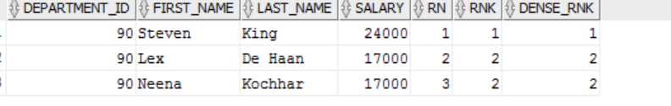
ROW_NUMBER vs RANK vs DENSE_RANK
SELECT
department_id, first_name, last_name, salary,
ROW_NUMBER() OVER (PARTITION BY DEPARTMENT_ID ORDER BY salary desc) rn,
rank() over (PARTITION BY DEPARTMENT_ID order by salary desc) rnk,
dense_rank() over ( PARTITION BY DEPARTMENT_ID order by salary desc) dense_rnk
FROM employees;

Slide 46
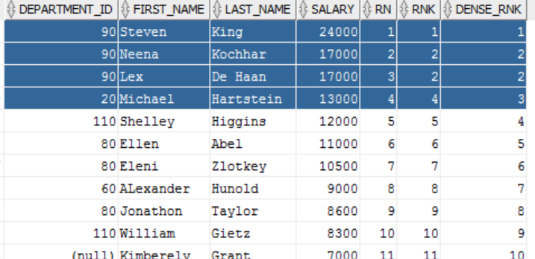
Example Contd..
SELECT
department_id, first_name, last_name, salary,
ROW_NUMBER() OVER (ORDER BY salary desc) rn,
rank() over ( order by salary desc) rnk,
dense_rank() over ( order by salary desc) dense_rnk
FROM employees;

Slide 47
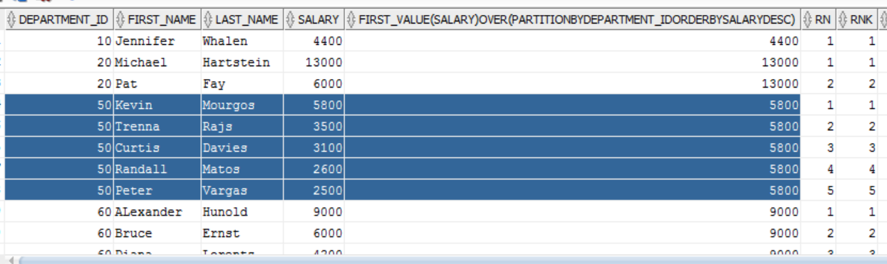
FIRST_VALUE
The FIRST_VALUE analytic function is similar to the FIRST analytic function, allowing you to return the first result from an ordered set
SELECT department_id, first_name, last_name, salary,FIRST_VALUE(SALARY) OVER ( PARTITION BY DEPARTMENT_ID ORDER BY salary desc),ROW_NUMBER() OVER ( PARTITION BY DEPARTMENT_ID ORDER BY salary desc) rn,rank() over ( PARTITION BY DEPARTMENT_ID order by salary desc) rnk,dense_rank() over ( PARTITION BY DEPARTMENT_ID order by salary desc) dense_rnk FROM employees ;

Slide 48
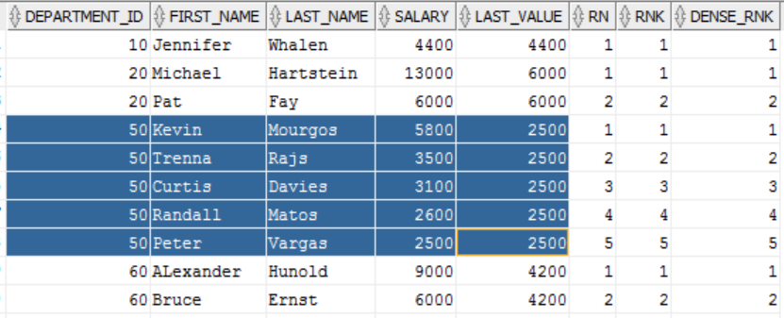
LAST_VALUE
SELECT DEPARTMENT_ID,FIRST_NAME,LAST_NAME, SALARY,LAST_VALUE(SALARY)OVER (PARTITION BY DEPARTMENT_ID ORDER BY SALARY DESC RANGE BETWEEN UNBOUNDED PRECEDING AND UNBOUNDED FOLLOWING) LAST_VALUE,ROW_NUMBER() OVER (PARTITION BY DEPARTMENT_ID ORDER BY salary desc) rn, RANK()over(PARTITION BY DEPARTMENT_ID order by salary desc) rnk, DENSE_rank() over ( PARTITION BY DEPARTMENT_ID order by salary desc) dense_rnk FROM employees;

Slide 49
Practice Exercise
For each employee, display Employee Id, Last Name and also the count of employees in the same department
Display LAST_NAME, DEPARTMENT_ID, SALARY and Previous Highest salary within that department. Order the results by Department Id and in descending order of salary
Display Employee’s Last Name, Salary and their rank in accordance to descending order of their salary. Ensure that no ranks are skipped
For all employees, display the DEPARTMENT_ID, LAST_NAME, SALARY along with LAST_NAME of the employee who earns lowest salary in that department

Slide 50
Subqueries

Slide 51
Subquery Overview
Subquery can return
One single value (one column, one row)
A list of values (one column, multiple rows)
A virtual table (multicolumn, multirow set of values)
NULL
Types of Subqueries
IN subqueries – You want to find all customers who have purchased something from a list of products, not just one product
HAVING subqueries – restrict a GROUP by applying a conditional criteria to the grouped rows
List all products with the total quantity sold greater than the average quantity sold
INLINE subqueries – can appear as a value in a the column list of a SELECT
Must return one value
CORRELATED subqueries – subquery executes once for each row in the outer row (like nested loops)

Slide 52
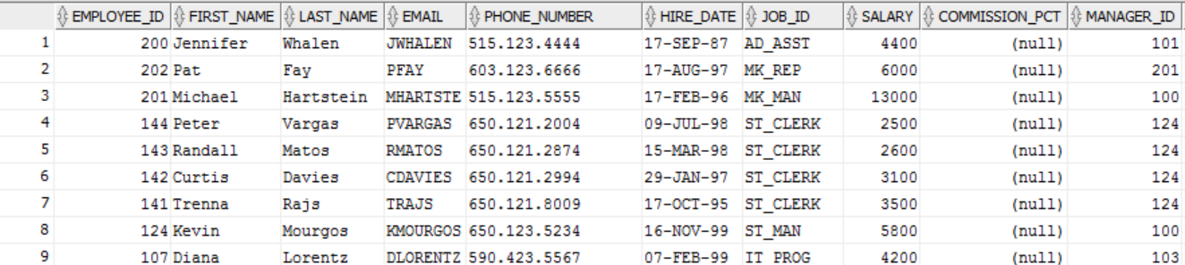
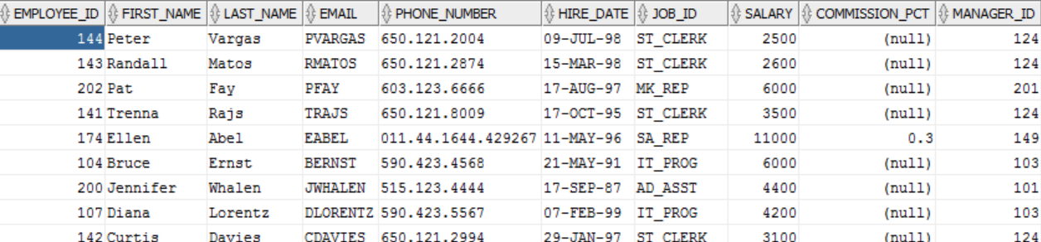
IN Subquery Example
SELECT * FROM EMPLOYEES where DEPARTMENT_ID in (select DEPARTMENT_ID from DEPARTMENTS);
select * from employees where EMPLOYEE_ID not in (select NVL(manager_id,0) from employees);

Slide 53

HAVING Subquery Example
Display the department number and its lowest salary for the department with the highest average salary
SELECT DEPARTMENT_ID,MIN(SALARY) FROM EMPLOYEES GROUP BY DEPARTMENT_ID HAVING AVG(SALARY) = (SELECT MAX(AVG(SALARY)) FROM EMPLOYEES GROUP BY DEPARTMENT_ID);

Slide 54
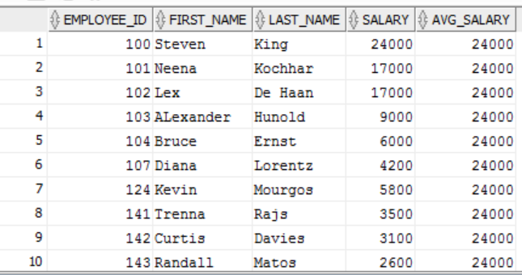
Inline Subquery Example
select EMPLOYEE_ID,FIRST_NAME,LAST_NAME,SALARY, (SELECT MAX(SALARY) FROM EMPLOYEES) AS AVG_SALARY from employees;

Slide 55
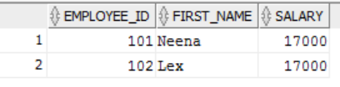
Correlated Subquery Example
SELECT EMPLOYEE_ID,FIRST_NAME ,A.SALARY FROM EMPLOYEES A
WHERE 1=(SELECT COUNT(DISTINCT B.SALARY) FROM EMPLOYEES B WHERE A.SALARY<B.SALARY);

Slide 56
EXISTS and WITH clause
The EXISTS clause
EXISTS operator tests for existence of rows in the result set of the subquery
If a subquery row value is found:
The search does not continue in the inner query
The condition is flagged TRUE
If a subquery row value is not found:
The condition is flagged FALSE
The search continues in the inner query
The WITH Clause
Using WITH clause, you can use the same query block in a SELECT statement, when it occurs more than once within a complex query
The WITH Clause retrieves the results of a query block and stores it in user’s temporary tablespace
The WITH Clause improves performance

Slide 57
Practice Exercise
Write a query to display last name, hire date of any employee in the same department as Zlotkey. Exclude Zlotkey
Display Employee Numbers and last names of all employees who earn more than the average salary
Query to display employee numbers and last names of all employees who work in a department with any employee whose last name contains a u
Display last name, department number, and job id of all employees whose department location Id is 1700
Display last name and salary of every employee who reports to King
Display employee numbers, last names and salaries of all employees who earn more than the average salary and who work with any employee with a u in their name
Write a query to display last name, department number and salary of any employee whose department number and salary both match the department number and salary of any employee who earns a commission
Display last name, department name and salary of any employee whose salary and commission match the salary and commission of any employee located in Location Id 1700
Query to display last name, hire date and salary for all employees who have same salary and commission as Kochhar

Slide 58
Practice Exercise contd …
Query to display employees who earn a salary that is higher than the salary of all of the Sales Manager (JOB_ID = ‘SA_MAN’). Sort the results on salary from highest to lowest
Display Employee Id, last name and department Id of those employees who live in cities whose name begins with T
Query to find all employees who earn more than the average salary in their departments. Display last name, salary, department Id and the average salary for the department. Sort by average salary
Find all employees who are not supervisors. Use NOT EXISTS operator. Can this be done by NOT IN operator? How or why not?
Write a query to display last names of the employees who earn less than the average salary in their departments
Display last names of employees who have one or more co-workers in their department with later hire dates but higher salaries
Write a query to display the department names of those departments whose total salary cost is above one eight (1/8) of the total salary cost of the whole company. Use WITH clause

Slide 59
Set Operators

Slide 60
UNION
Combine two companies customer lists where they have names in common so that the final list has no duplicate names
Column names and their attributes must be the same
Can include more than two tables where applicable
SELECT <COLUMN NAMES> FROM CUSTOMER
UNION
SELECT <COLUMN NAMES> FROM CUSTOMER_2;
SELECT <COLUMN NAMES> FROM T1 UNION
SELECT <COLUMN NAMES> FROM T2 UNION
SELECT <COLUMN NAMES> FROM T3;

Slide 61
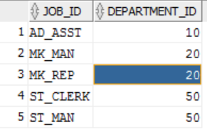
UNION Example
SELECT JOB_ID, DEPARTMENT_ID FROM EMPLOYEES WHERE DEPARTMENT_ID = 10
UNION
SELECT JOB_ID, DEPARTMENT_ID FROM EMPLOYEES WHERE DEPARTMENT_ID = 50
UNION
SELECT JOB_ID, DEPARTMENT_ID FROM EMPLOYEES WHERE DEPARTMENT_ID = 20 ;

Slide 62
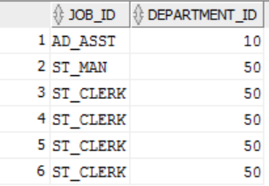
UNION ALL
UNION ALL merges the tables but keeps duplicates in the result table
SELECT JOB_ID, DEPARTMENT_ID FROM EMPLOYEES WHERE DEPARTMENT_ID = 10
UNION ALL
SELECT JOB_ID, DEPARTMENT_ID FROM EMPLOYEES WHERE DEPARTMENT_ID = 50

Slide 63

Intersect
Find records that are common in both tables
SELECT EMPLOYEE_ID, JOB_ID FROM EMPLOYEES INTERSECT SELECT EMPLOYEE_ID, JOB_ID FROM JOB_HISTORY;

Slide 64
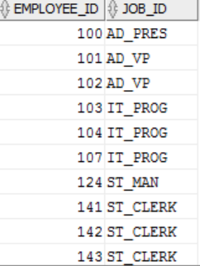
Minus
Combines rows from two queries and returns only those rows that appear in the first set but not the second
SELECT EMPLOYEE_ID, JOB_ID FROM EMPLOYEES MINUS SELECT EMPLOYEE_ID, JOB_ID FROM JOB_HISTORY;

Slide 65
Practice Exercise
List the department Ids for department that do not contain the Job Id ST_CLERK using SET operators
Display the Country Id and names of the countries that have no departments located in them, using SET operators
Produce a list of jobs for departments 10, 50 and 20, in that order. Display JOB Id and Department Id, using SET operators
List the employee Ids and Job Ids of those employees who are currently in the job title that they have held once before during their tenure with the company

Slide 66
Additional Practice

Slide 67
Practice Exercise
Show all data of clerks who have been hired after the year 1997
Show the employees that have no commission with a 10% raise in their salary (Round off the salaries)
Show the last names of all employees together with the number of years and months they have completed
Show those employees that have a name starting with J,K,L, or M
Show all employees, and indicate with ”Yes” or “No” whether they receive commission
Show department names, locations, names, job, titles, and salaries of employees who work in location 1800
How many employees have a name that ends with “n”?
Show the names and locations for all the departments and the number of employees, working in each department. Make sure that departments without employees are included as well
Which jobs are found in department 10 & 20?
Which jobs are found in Administration and Executive departments, and how many employees do these jobs? Show the job with highest frequency first

Slide 68
Practice Exercise contd …
Show all employees, who have managers with a salary higher than $15000. Show the following data: employee name, manager name, manager salary, and salary grade of the manager
Show all employees, who have managers with a salary higher than $15000. Show the following data: employee name, manager name, manager salary, and salary grade of the manager
Display the department number and its lowest salary for the department with the highest average salary
Display Department Number, Department Name, Manager Id and Location Id for departments where no Sales Rep work
Show department number, department name, and number of employees working in each department that
Includes fewer than 3 employees
Has the highest number of employees
Has the lowest number of employees
Show all employees who were hired on the day of week on which the highest number of employees has been hired
Write a query to display top 3 earners in EMPLOYEES table. Display the last names and their salary
Write a query to display Job Ids of those jobs, whose maximum salary is half the maximum salary in the whole company. Use WITH Clause
Display LAST_NAME, HIRE_DATE in descending order of their HIRE_DATE. If two consecutive records have a hire date difference of more than 12 months, then do not display them

Slide 69
Appendix

Slide 70
Reference Materials
S No | Name | Artefact
1 | Table DDLs and DMLs for the practice exercises
2 | Training Supplement

Slide 71

Thank you

Slide 72

About Deloitte Deloitte refers to one or more of Deloitte Touche Tohmatsu Limited, a UK private company limited by guarantee, and its network of member firms, each of which is a legally separate and independent entity. Please see www.deloitte.com/about for a detailed description of the legal structure of Deloitte Touche Tohmatsu Limited and its member firms. Please see www.deloitte.com/us/about for a detailed description of the legal structure of Deloitte LLP and its subsidiaries. Certain services may not be available to attest clients under the rules and regulations of public accounting.
Copyright © 2015 Deloitte Development LLC. All rights reserved.
Member of Deloitte Touche Tohmatsu Limited
This presentation and the related panel discussion contain general information only, and Deloitte is not, by means of this presentation and panel discussion, rendering accounting, business, financial, investment, legal, tax, or other professional advice or services. This presentation and panel discussion are not substitutes for such professional advice or services, nor should they be used as a basis for any decision or action that may affect your business. Before making any decision or taking any action that may affect your business, you should consult a qualified professional advisor. Deloitte shall not be responsible for any loss sustained by any person who relies on this presentation and panel discussion.

