Slide 1


INBOUND MARKETING
Sarvajanik College of Engineering & Technology, Surat.
Master of Computer Application Departments
Academic Year 2024-25
Present By :
SHUBHAM JHA - ET23MTCA020
KHUSHAL SOLANKI - ET23MTCA062

Slide 2
OBJECTIVES
What is Inbound Marketing ?
Inbound Vs Outbound Marketing
What Makes Inbound Different ?
Inbound Methodology
Characteristics of Inbound Marketing
Ways of Inbound Marketing
Advantages of Inbound Marketing
References

Slide 3

What is Inbound Marketing ?
Inbound Marketing is a business methodology that attracts customers by creating valuable content and experiences tailored to them.
A method of building relationships with customers by valuing and empowering their goals.

Slide 4
Inbound Vs Outbound
Inbound Marketing : Inbound is a strategy that focuses on attracting customers via company created contents.
Outbound Marketing : Outbound is when a marketer reaches out to people to see if they are interested in a product.

Slide 5


What Makes Inbound Different?
Traditional (Outbound)
Inbound
Cold Calling E-Mails (SPAM) Interruptive Ads Door-to-door visit
SEO Blogging Attraction

Slide 6
Inbound Methodology
Attract
Contains relevant content and conversations to attrack user to your website
Engage
Presenting ideas and insights that align with users problems and goals as well as that gathering of information in order to establish a deeper bond/connection
Delight
Proving help and support to empower customers to find their purchase and asure their long-term commitment

Slide 7
Characteristics of Inbound Marketing
Attracts, Not Distracts
Content-Driven
Engages and Educates
Builds Trust
Long-Term Relationship
Data Driven

Slide 8
Ways of Inbound Marketing
SEO (Search Engine Optimization) :- Focuses on improving your website’s visibility on search engines through keyword optimization, and enhancing site speed and mobile-friendliness.
Social Media :- Uses platforms like Facebook, Twitter, LinkedIn, and Instagram to share content, engage with followers, and build a community around your brand.

Slide 9
Ways of Inbound Marketing
Podcasting :- Involves hosting or appearing on podcasts to provide valuable content to attracting and engaging listeners.
Content Marketing :- Involves creating and distributing valuable content like blogs, e-books, whitepapers, and case studies to attract and engage your target audience.

Slide 10
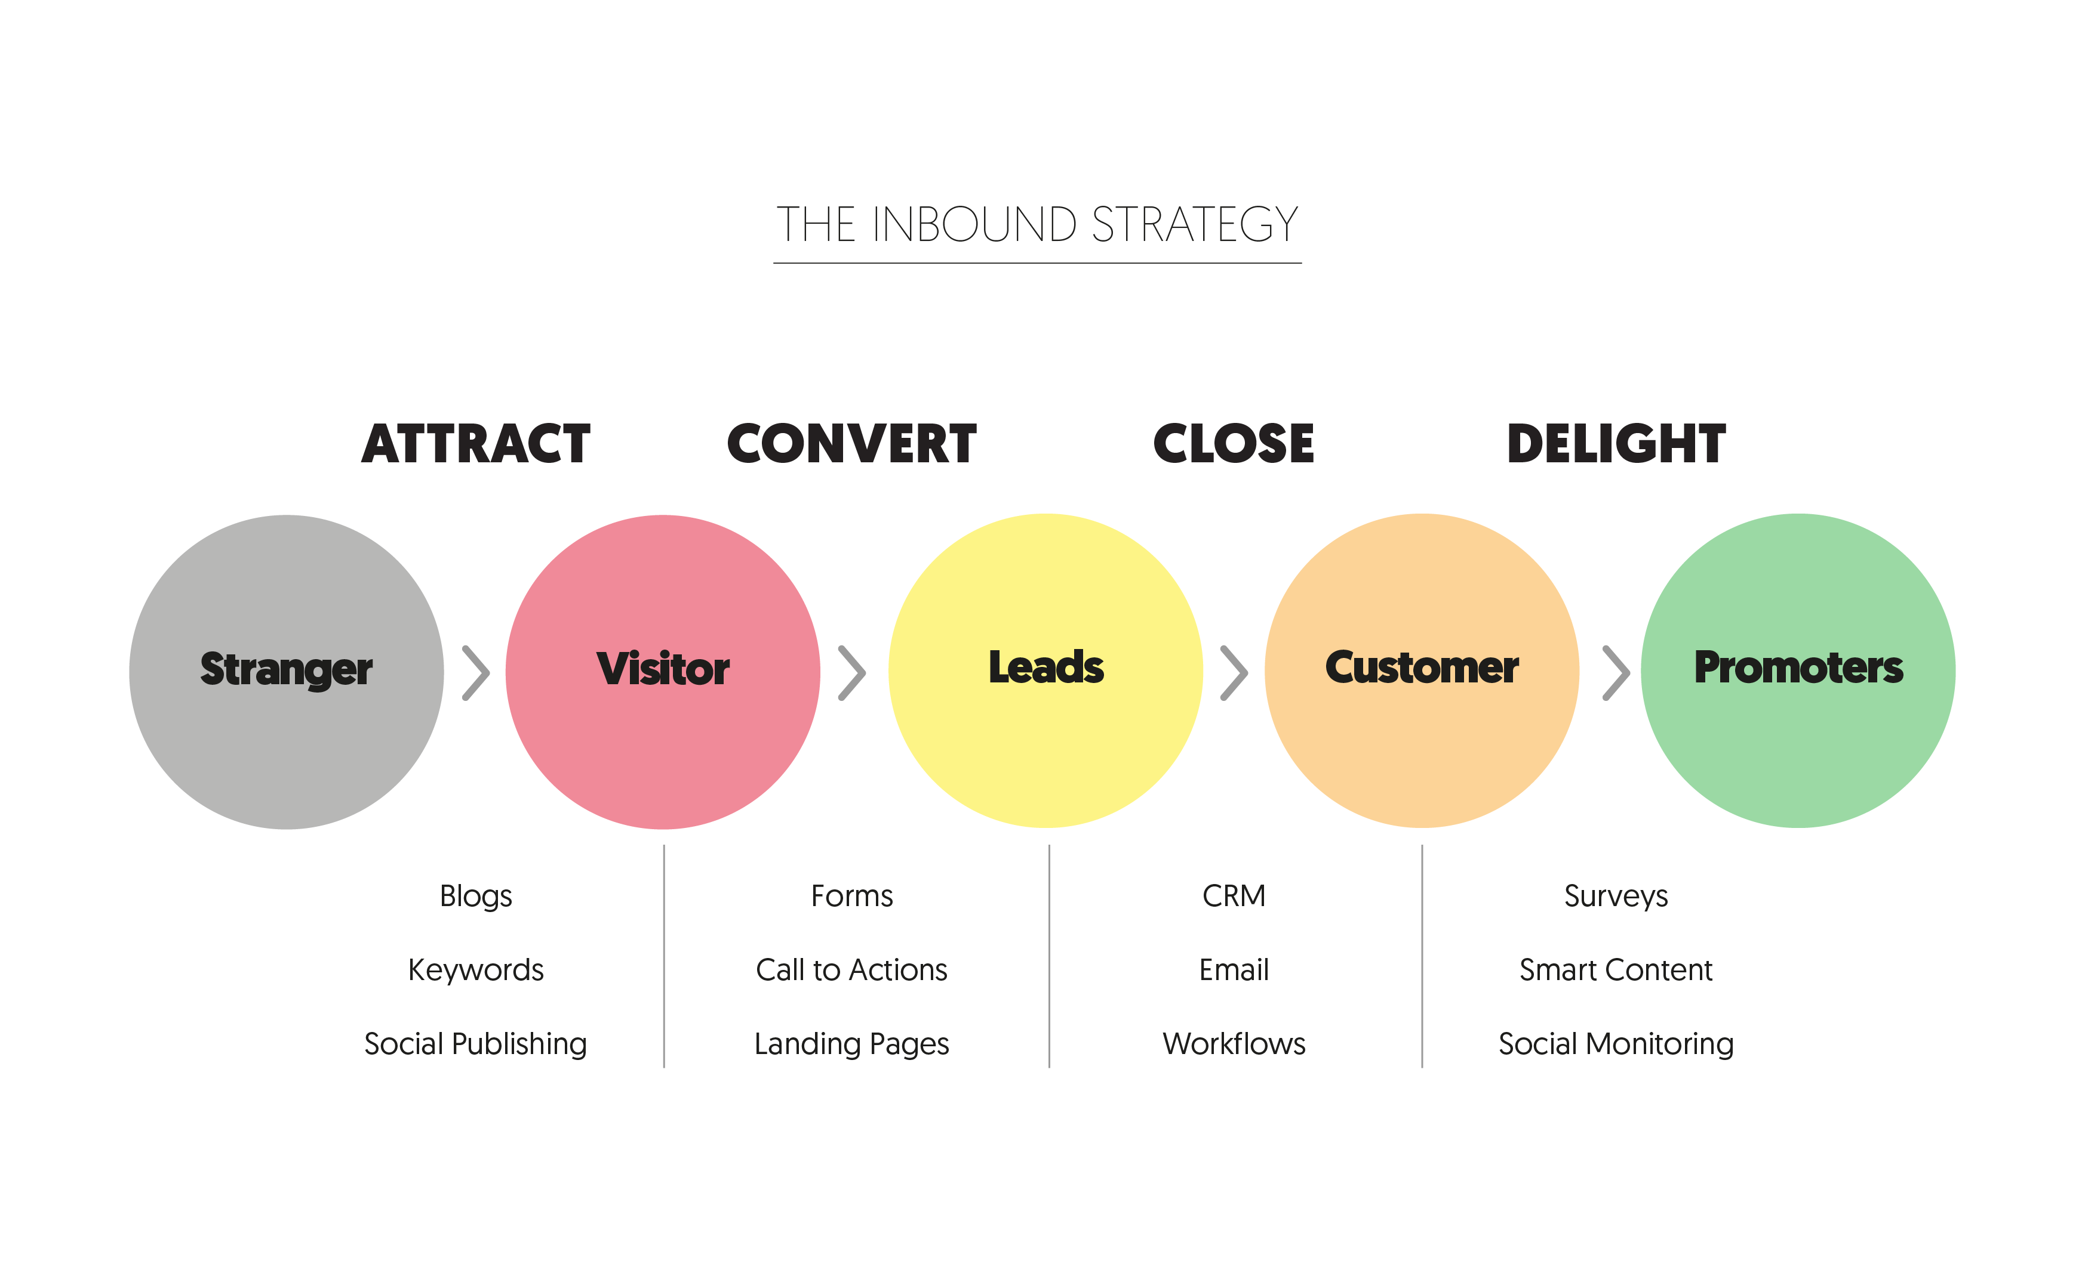

Slide 11
Cooperation vs Collaboration
Cooperation : It is the concept of working with others to achieve your own goal.
Collaboration: Working with others to produce something together and achieve shared goals.

Slide 12
Advantages of Inbound marketing
Cost-Effective :- Inbound marketing is generally more cost-effective than traditional outbound marketing. Creating content, optimizing for search engines, and engaging on social media often require less investment than paid advertising.
Enhances Brand Awareness :- Consistently producing and sharing valuable content across various channels increases your brand’s visibility and recognition. As more people discover your content, your brand becomes more familiar and trusted in the market.

Slide 13


Inbound leads cost 61% less than outbound
OUTBOUND : AVG COST - $346
INBOUND : AVG COST - $135
Source : HubSpot

Slide 14




Inbound Marketing is about …
Blogs
Photos
Videos
Presentation

Slide 15
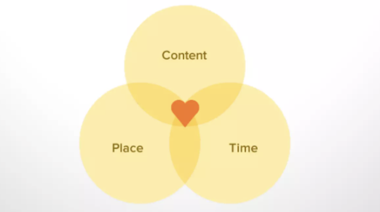
By publishing the right content in the right place at the right time ,your marketing becomes relevant and helpful to your customers ,not irritative.
Now that’s marketing people can love.

Slide 16
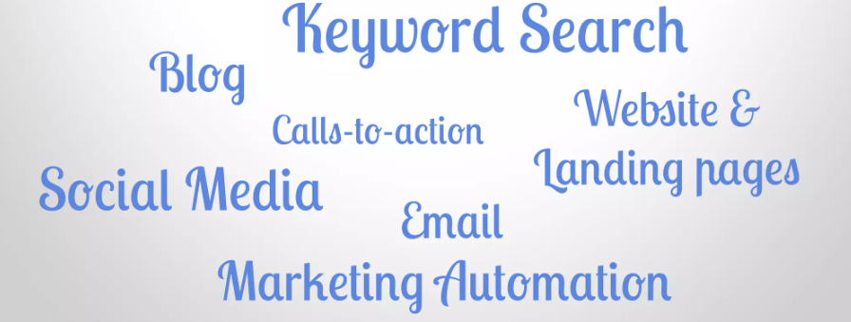
It’s Multi-Channel Marketing
Inbound Marketing is multi-channel by nature because it approaches people where they are, in the channel where they want to interact with you.

Slide 17
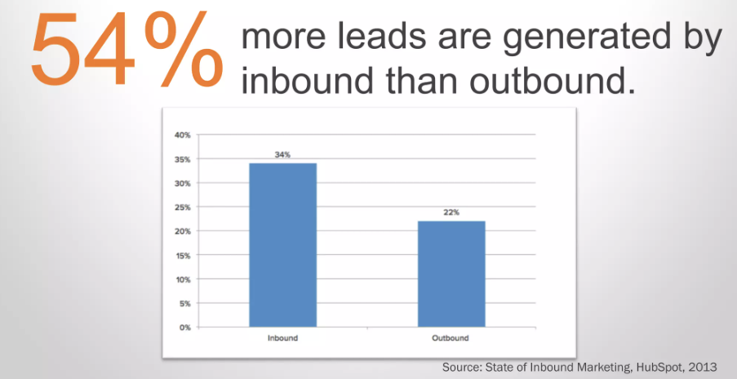
Inbound Creates More Leads

Slide 18
Inbound is the future of Marketing

Slide 19
References https://www.hubspot.com/inbound-marketing https://digitalmarketinginstitute.com/blog/what-is-inbound-marketing https://advertising.amazon.com/library/guides/inbound-marketing

Slide 20
THANK YOU

